Slide 1
ADITYA INSTITUTE OF TECHNOLOGY AND MANAGEMENT
DEPARTMENT OF ELECTRONICS AND COMMUNICATION ENGINEERING
(Approved by AICTE, Permanently Affiliated to JNTUGV, Vizianagaram, Accredited by NBA & NAAC with A+)
(AUTONOMOUS)
K.KOTTURU, TEKKALI - 532201

Slide 2
Fraud Detection in Banking Data by Hybrid Machine Learning Techniques
Under the guidance of:
Dr. M. Jayamanmadha Rao
Professor & Chief Warden
Department of ECE
PRESENTED BY:
K. Yamini 21A51A04A4
B. Dharma Rao 21A51A04D0
K. Rakshitha 21A51A04C7
G. Ashok 22A55A0409

Slide 3
Contents
ABSTRACT
INTRODUCTION
LITERATURE REVIEW
PROBLEM STATEMENT
PROPOSED SYSTEM
EXTENSION
METHODOLOGY
FLOW OF WORK
RESULTS AND DISCUSSION
CONCLUSION

Slide 4
ABSTRACT
As e-commerce grows, credit card usage has increased, leading to more banking transactions and a rise in fraud. Detecting fraudulent activities has become crucial due to the high costs associated with fraud. This study explores tuning class weights to balance legitimate and fraudulent transactions, using Bayesian optimization to adjust hyperparameters while addressing data imbalance. We propose weight-tuning as a preprocessing step and use CatBoost, XGBoost, and LightGBM with a voting mechanism to improve fraud detection. Deep learning further fine-tunes hyperparameters to enhance performance. Experiments on real-world data assess the proposed methods using ROC-AUC and precision-recall metrics. Individual models, including logistic regression, are evaluated with 5-fold cross-validation, and a majority voting ensemble is applied. Results show that the proposed approach outperforms existing methods, significantly improving fraud detection accuracy.

Slide 5
INTRODUCTION
With the rise of financial institutions and e-commerce, online transactions have increased, making fraud detection a major challenge. An effective fraud detection system must accurately identify fraudulent cases to protect both banks and customers. This study explores machine learning techniques such as CatBoost, LightGBM, and XGBoost, along with deep learning and hyperparameter tuning, to enhance fraud detection. We use Bayesian optimization and propose weight-tuning as a preprocessing step to handle unbalanced data. XGBoost is chosen for its fast training and regularization, while CatBoost is used for its effective results without extensive hyperparameter tuning. A majority voting ensemble combining CatBoost, XGBoost, and LightGBM is proposed to improve accuracy. Real-world data is used for testing, with performance evaluated using ROC-AUC, precision-recall, F1-score, and MCC metrics. The results show that our approach outperforms traditional methods, highlighting the importance of publicly available datasets and open-source research.

Slide 6
LITERATURE REVIEW
S NO | AUTHOR | TITLE | METHODOLOGY | CONCLUSION
1. | Mohammed Naif Alatawi | Detection of fraud in IoT based credit card collected dataset using machine learning | They followed a hybrid approach using multiple machine learning models, including deep neural networks, decision trees, support vector machines, random forests, clustering methods. | The approach enhances fraud detection and prevention in IoT ecosystems, offering practical insights for banking institutions and paving the way for future advancements.
2. | Ayushi Patil , Shreya Mahajan , Jinal Menpara , Shivali Wagle , Preksha Pareek , Ketan Kotecha | Enhancing fraud detection in banking by integration of graph databases with machine learning | They followed a graph-based approach by modeling transaction data as a relational graph using Neo4J as the graph database and applying JSON features extracted from the graph to various machine learning models. | Graph-based ML techniques, combined with innovative technologies, play a crucial role in improving fraud detection strategies and enhancing banking security against evolving fraud tactics.

Slide 7
LITERATURE REVIEW
S NO | AUTHOR | TITLE | METHODOLOGY | CONCLUSION
3. | Naga Simhadri Apparao Polireddi | An effective role of artificial intelligence and machine learning in banking sector | They followed a conceptual approach, analyzing the potential of AI and ML in transforming financial services through efficiency gains and innovation. | AI and ML are revolutionizing financial institutions by transforming data utilization, improving internal processes, and creating new business models while addressing emerging challenges.
4. | J Femila Roseline , GBSR Naidu , Dr. V. SamuthiraPandi , S Alamelu , Dr.N. Mageswari | Autonomous credit card fraud detection using machine learning approach | They followed a machine learning approach using an LSTM-RNN model enhanced with an attention mechanism to improve fraud detection accuracy. | The proposed LSTM-RNN model with attention significantly improves fraud detection accuracy and is more effective than traditional classifiers for this task.

Slide 8
LITERATURE REVIEW
S NO | AUTHOR | TITLE | METHODOLOGY | CONCLUSION
5. | Mahdi Seify , Mehran Sepehri , Amin Hosseinian-far , Aryana Darvish | Fraud Detection in Supply Chain with Machine Learning | They followed a supervised machine learning approach using big data and pattern recognition techniques to identify fraud in supply chains. | The study demonstrates the effectiveness of machine learning in identifying fraud in supply chains, with ongoing research to refine the methods.
6. | Naga Simhadri Apparao Polireddi | An effective role of artificial intelligence and machine learning in banking sector | They followed a conceptual approach, analyzing the potential of AI and ML in transforming financial services through efficiency gains and innovation. | AI and ML are revolutionizing financial institutions by transforming data utilization, improving internal processes, and creating new business models while addressing emerging challenges.

Slide 9
PROBLEM STATEMENT
The banking sector faces a persistent challenge in detecting and preventing fraudulent activities, such as unauthorized transactions and identity theft, especially with the increasing use of digital banking services and online transactions. Fraudsters are constantly evolving their tactics, making it difficult to protect against financial losses and safeguard customer assets. The primary goal is to develop effective and adaptive fraud detection methods that can keep pace with evolving fraudulent activities, ensuring the protection of both financial institutions and their customers from financial harm and data breaches. Achieving a robust fraud detection system is crucial for maintaining trust in the banking industry, safeguarding customer assets, and minimizing financial losses due to fraud.

Slide 10
PROPOSED SYSTEM
The project presents an advanced fraud detection system for banking data using machine learning. It employs class weight-tuning and Bayesian optimization to enhance performance, utilizing algorithms like CatBoost, LightGBM, and XGBoost. Deep learning fine-tunes the system, which is evaluated with real-world data using key metrics.For better results and accuracy we are implementing stacking algorithm.
Advantages:
The system significantly enhances fraud detection accuracy compared to traditional methods.
Adapts to evolving fraud tactics, maintaining its effectiveness over time.
The system efficiently manages unbalanced data without compromising accuracy.
Evaluation with multiple performance metrics ensures a robust assessment of its real-world effectiveness.

Slide 11
OBJECTIVE
To develop a fraud detection system for banking data to prevent fraudulent activities. Objective is to efficiently analyze banking data through the application of machine learning algorithms. To enhance dataset analysis by exploring diverse sampling and scaling techniques. To implement hybrid models as an extension to improve fraud detection accuracy. To create an extension of a user-friendly front-end using Flask for user testing and authentication. The main objective of this project is to predict credit card fraud detection by using different types of Machine learning and Deep learning Models like LightGBM, XG Boost, Cat Boost, Neural Network and Hybrid model like LG + XG+ CAT, LG + XG, LG + CAT, XG + CAT.

Slide 12
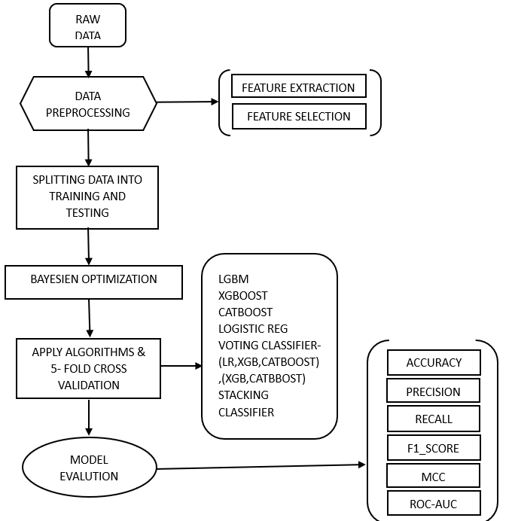
FLOWCHART

Slide 13
CREDIT CARD FRAUD DATASET
We employed the Credit Card Fraud Detection dataset obtained from Kaggle to train machine learning algorithms. Initially, the dataset included a range of transaction-related attributes, including "Amount," "Time," and "V1" through "V28." For privacy and security reasons, specific details about these original features were withheld to protect sensitive information while still allowing for effective fraud detection training. So, these are the top 5 rows of the credit card fraud detection dataset. So, it contains 32 columns, we are displaying few of them here.

Slide 14
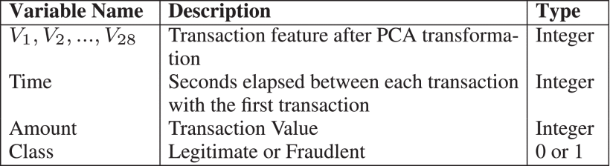
This dataset contains only numerical input variables resulting from a principle component analysis (PCA) transformation. Unfortunately, the original features and background information about the data are not given due to confidentiality and privacy considerations. PCA yielded the following principal components: V1,V2,V28 . The untransformed features with PCA are “time” and “amount.” The “Time” column contains the time (in seconds) elapsed between each transaction and the first transaction in the dataset. The feature “Amount” shows the transaction amount. Feature “Class” is the response variable, and it takes the value 1 in case of fraud and 0 otherwise.

Slide 15
Overview of Legitimate vs Fraudulent Transactions:
Since fraudulent transactions are significantly rarer than legitimate ones, the dataset is highly imbalanced. The table provides a breakdown of transaction types in the dataset used for fraud detection. It shows a total of 284,315 legitimate transactions, accounting for 99.83% of all transactions, while only 492 transactions were identified as fraudulent, representing just 0.17%.
Transaction Type | Count | Percentage
Legitimate Transactions | 284,315 | 99.83%
Fraudulent Transactions | 492 | 0.17%

Slide 16
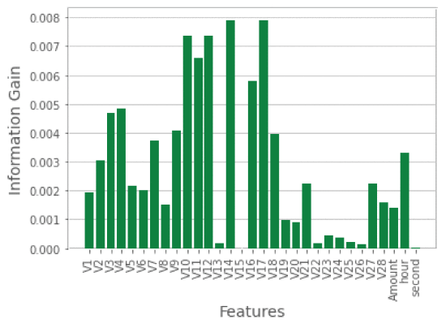
Information Gain:
The information gain (IG) method is used to select the most important features that lead to a dimension reduction of the training data. Information gain functions by extracting similarities between credit card transactions and then awarding the greatest weight to the most significant features based on the class of legitimate and fraudulent credit card transactions.

Slide 17
METHODOLOGY
LIGHT GRADIENT BOOSTING: Light Gradient Boosting Machine (LightGBM) is an efficient gradient boosting framework known for its speed and accuracy. It uses a histogram-based learning method to create decision trees, with a focus on leaf-wise growth for deeper trees. LightGBM optimizes the tree-building process using gradient-based techniques, supports categorical features, and offers customization options through various hyperparameters.
XGBOOST: XGBoost, or Extreme Gradient Boosting, is a high-performance machine learning algorithm known for its efficiency and accuracy. It leverages gradient boosting, building decision trees sequentially to create a robust predictive model. XGBoost's optimization techniques, handling of missing data, and regularization options make it a popular choice for various tasks such as classification and regression. It also supports parallel and distributed computing, making it suitable for large datasets and complex problems.

Slide 18
CATBOOST: CatBoost is a powerful gradient boosting algorithm specifically designed for categorical feature handling. It excels in machine learning tasks like classification and regression, offering automatic feature transformation, robust handling of missing data. CatBoost's self-tuning capabilities and the absence of hyperparameter fine-tuning make it a popular choice for a wide range of applications, particularly in scenarios where categorical data is prevalent.
LOGISTIC REGRESSION: Logistic Regression is a classification algorithm that predicts the probability of an input belonging to a specific category. It employs the sigmoid function to map the input features to a probability score between 0 and 1, and a threshold is applied to classify the input into one of two or more categories based on this probability. The model learns coefficients during training to best fit the data and make accurate classifications.
RANDOM FOREST: Random Forest is an ensemble learning method that builds multiple decision trees and combines their outputs to improve prediction accuracy. It works for both classification and regression tasks by aggregating the results of multiple trees to reduce variance and overfitting.

Slide 19
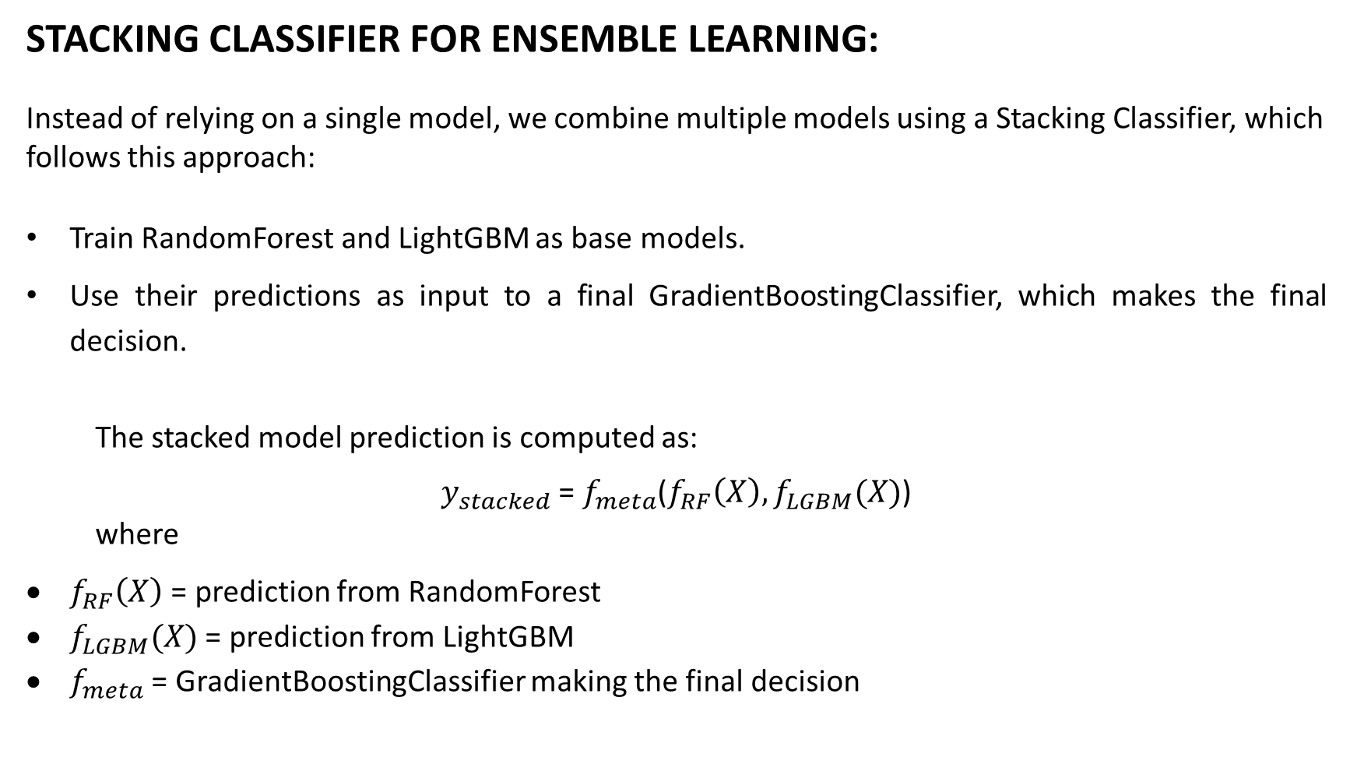
STACKING CLASSIFIER FOR ENSEMBLE LEARNING:
Instead of relying on a single model, we combine multiple models using a Stacking Classifier, which follows this approach:
Train RandomForest and LightGBM as base models.
Use their predictions as input to a final GradientBoostingClassifier, which makes the final decision.
The stacked model prediction is computed as:
$y_{stacked}$ = $f_{meta}$($f_{RF}\left(X\right), f_{LGBM}(X)$)
where
$f_{RF}\left(X\right)$ = prediction from RandomForest
$f_{LGBM}(X)$ = prediction from LightGBM
$f_{meta}$ = GradientBoostingClassifier making the final decision

Slide 20
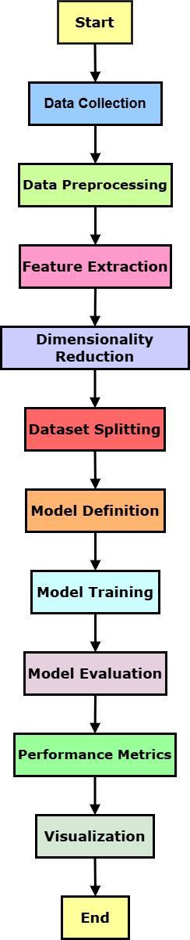
FLOW OF WORK
Figure shows the steps of the process, starting with collecting and preparing data, followed by extracting important features. After reducing the dimensions, the data is split for defining and training the model. Finally, the model's performance is evaluated using metrics, and the results are displayed through visualizations.
Data Collection & Preprocessing:
We gather real-world credit card transaction data, which includes features like transaction amount, time, and anonymized variables. Preprocessing involves cleaning the dataset by handling missing values, encoding categorical features, balancing the class distribution (e.g., using SMOTE or class weights), and normalizing or scaling numerical attributes to prepare the data for effective model training

Slide 21
Model Selection & Feature Extraction:
We select powerful machine learning algorithms such as LightGBM, XGBoost, CatBoost, and Logistic Regression for fraud detection. Feature extraction is performed to create new, meaningful variables from the raw data — like transaction frequency, time gaps between purchases, or behavioral patterns — which improve the model’s ability to distinguish between legitimate and fraudulent transactions.

Slide 22
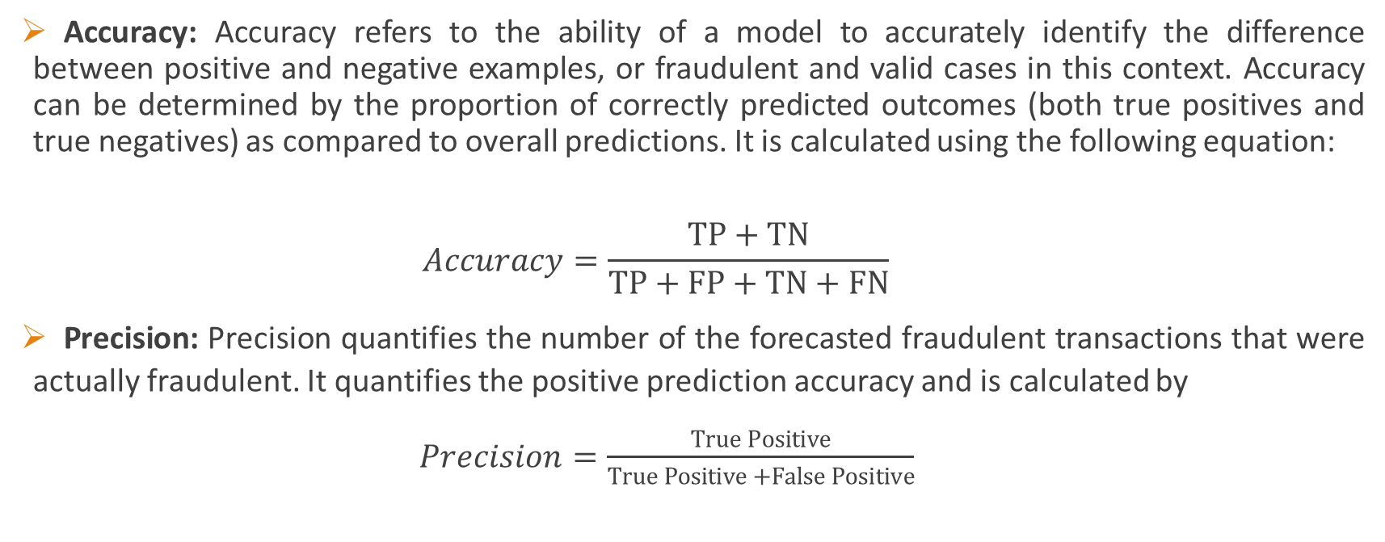
EVALUATION METRICS
Accuracy: Accuracy refers to the ability of a model to accurately identify the difference between positive and negative examples, or fraudulent and valid cases in this context. Accuracy can be determined by the proportion of correctly predicted outcomes (both true positives and true negatives) as compared to overall predictions. It is calculated using the following equation:
$$Accuracy=\frac{TP+TN}{TP+FP+TN+FN}$$
Precision: Precision quantifies the number of the forecasted fraudulent transactions that were actually fraudulent. It quantifies the positive prediction accuracy and is calculated by
$Precision=\frac{True Positive}{True Positive +False Positive}$

Slide 23
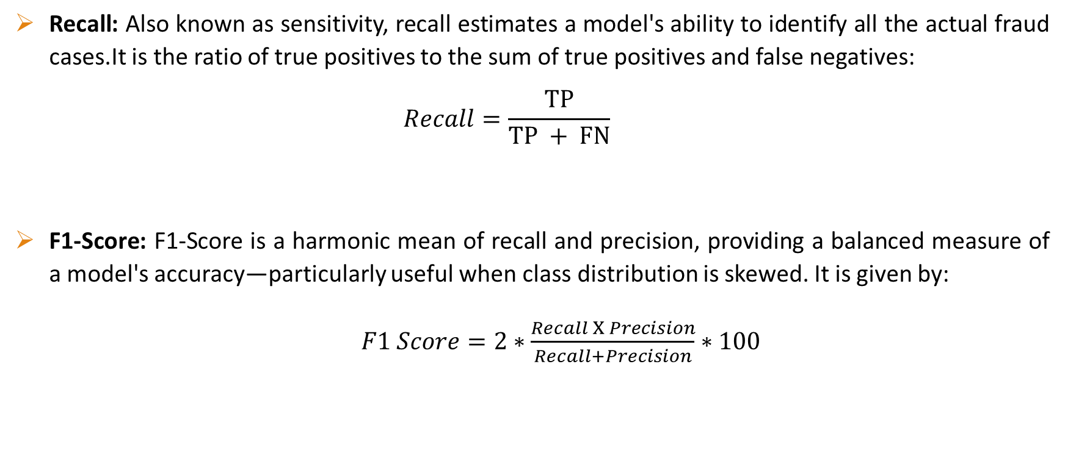
Recall: Also known as sensitivity, recall estimates a model's ability to identify all the actual fraud cases.It is the ratio of true positives to the sum of true positives and false negatives:
$$Recall=\frac{TP}{TP + FN}$$
F1-Score: F1-Score is a harmonic mean of recall and precision, providing a balanced measure of a model's accuracy—particularly useful when class distribution is skewed. It is given by:
$F1 Score=2∗\frac{Recall X Precision}{Recall+Precision}∗100$

Slide 24
RESULTS & DISCUSSION
This table compares the performance of different machine learning models for fraud detection. Models like XGBoost and CatBoost achieved high precision and recall, showing better ability to detect fraudulent transactions. LightGBM had good accuracy but lower precision and recall. Voting classifiers combining different models improved the performance further. Among all, the Stacking model performed the best with the highest accuracy, precision, recall, and F1-score, making it the most effective model for fraud detection in this project.
 | model | accuracy | precision | recall | f1
0 | LGBM | 0.996908 | 0.344762 | 0.413333 | 0.355455
1 | XGB | 0.999122 | 0.883232 | 0.588889 | 0.682707
2 | CatBoost | 0.999262 | 0.848312 | 0.713333 | 0.768263
3 | Vot_Lg,Xg,Ca | 0.996908 | 0.344762 | 0.413333 | 0.355455
4 | Vot_Lg,Xg | 0.999122 | 0.883232 | 0.588889 | 0.682707
5 | Vot_Xg,Ca | 0.999262 | 0.848312 | 0.713333 | 0.768263
6 | Vot_Lg,Ca | 0.999227 | 0.830345 | 0.733333 | 0.764458
7 | Stacking | 0.999332 | 0.85101 | 0.753333 | 0.795105

Slide 25
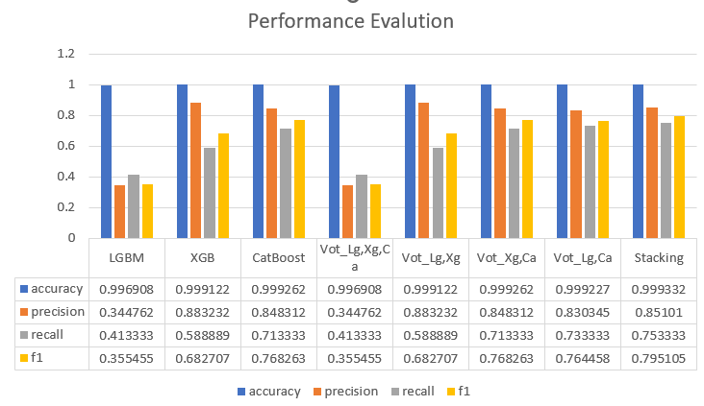
This bar chart visualizes the performance evaluation of different machine learning models. It compares accuracy, precision, recall, and F1-score across models like LightGBM (LGBM), XGBoost (XGB), CatBoost, Voting Classifiers (various combinations), and Stacking. While accuracy is consistently high across models, precision and recall vary significantly. XGBoost and CatBoost show strong precision and recall, while Stacking achieves the best overall performance, with high scores in accuracy, precision, recall, and F1-score, making it the top-performing model for fraud detection in this project.

Slide 26
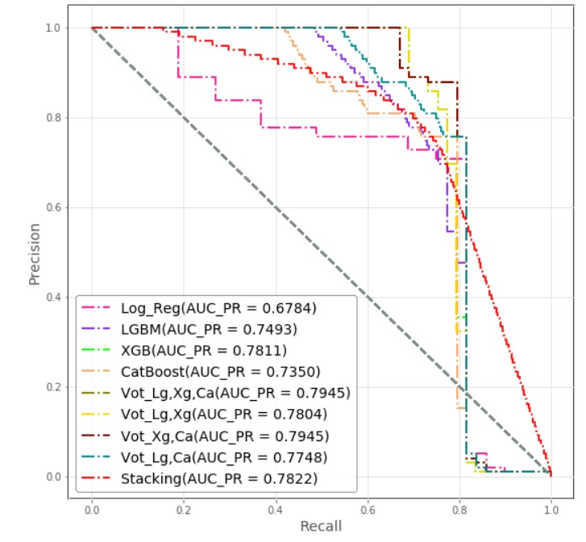
VISUALIZATION OF RESULTS
Precision and Recall Curve: This Precision-Recall curve highlights how well each model handles imbalanced data by focusing on correctly identifying the positive cases without getting confused by the negatives. Models like XGBoost and the ensemble methods (especially Voting_Lg,Xg,Ca and Stacking) achieve higher AUC-PR scores, meaning they strike a better balance between precision and recall. These models are more dependable when it comes to catching the right positives while minimizing false alarms. Logistic Regression lags behind, with the lowest AUC-PR, showing it struggles in more complex classification situations. Overall, ensemble models once again show their strength by delivering the most reliable results.

Slide 27
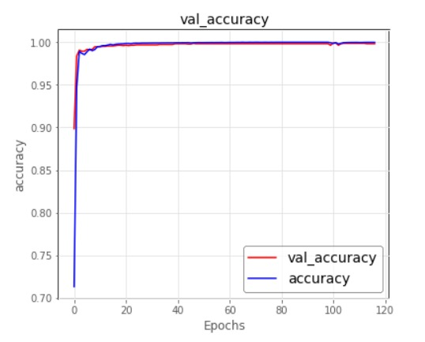
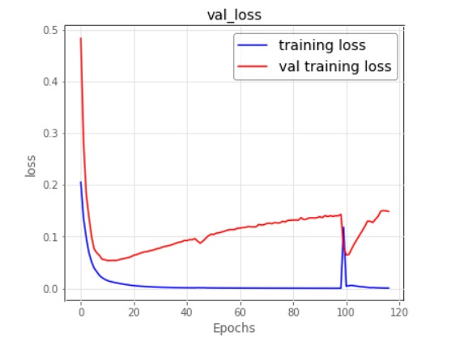
This graph shows how the model’s training accuracy and validation accuracy improved over 120 epochs. Both training and validation accuracy quickly increased and stayed close to 100%, showing that the model learned well without overfitting. The small gap between the two lines means the model performs consistently on both training and new data.
This graph shows how the model’s training loss and validation loss changed over 120 epochs. The training loss (blue line) keeps getting lower, which means the model is learning the training data well. However, the validation loss (red line) decreases at first but then starts to increase, showing that the model begins to overfit after some point. This means it performs well on training data but struggles a bit on new, unseen data.

Slide 28
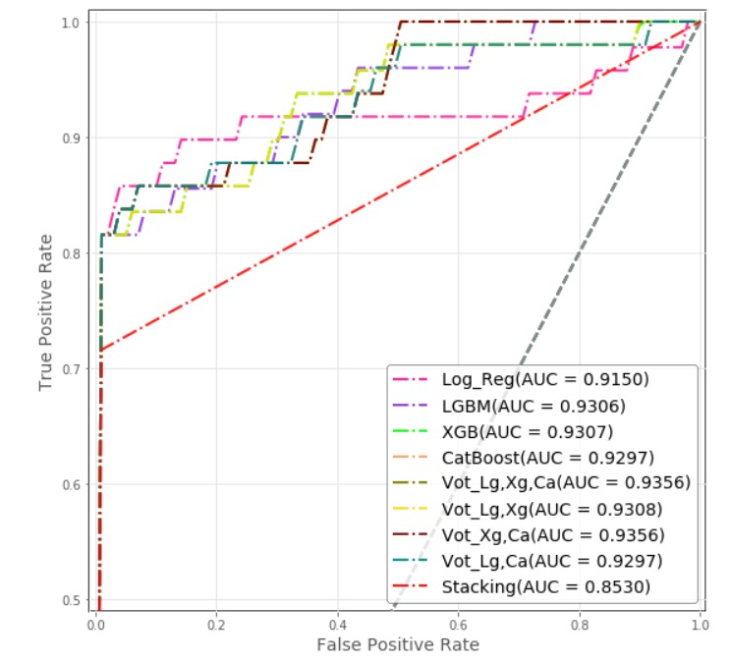
ROC Curve Comparison of Different Models: This ROC curve hows how well different models can distinguish between the positive and negative classes. A higher curve means better performance, and the Area Under the Curve (AUC) score helps us compare them. Here, models like XGBoost, LGBM, CatBoost, and the ensemble Voting models (especially the one combining Logistic Regression, XGBoost, and CatBoost) perform the best, with AUC scores above 0.93. These models are great at correctly identifying true positives while keeping false positives low. On the other hand, while Stacking is usually strong, it performs slightly lower here with an AUC of 0.85. Overall, ensemble models again prove their strength by achieving top-tier performance.

Slide 29
CONCLUSION
Our project achieved strong results across several machine learning models, including LightGBM, XGBoost, CatBoost, and neural networks. Among them, the Stacking Classifier stood out, delivering the highest accuracy. By using different sampling and scaling techniques, we were able to further improve fraud detection performance. We also integrated a user-friendly Flask interface with secure authentication, making it easy to input data and test the system's effectiveness. Overall, the project shows great potential for applying advanced machine learning methods to fraud detection in the banking sector. There's still room to improve by exploring more ensemble techniques and optimizations, but the outcomes already offer valuable benefits, like enhancing fraud detection, reducing financial losses, and ensuring safer transactions.

Slide 30


