Slide 1
LIBRARY MANAGEMENT SYSTEM
MPP Project(Dr Shad) - 2016
Prepared By: Dharma Kshetri
Shankalpa Chaudhary

Slide 2
Features
Add Books
Add Members
Book Copies
Checkout
Overdue
Reports

Slide 3
Tools
Eclipse IDE
Java, JavaFX, ScreenBuilder
Data store in flat file(HashMap)

Slide 4
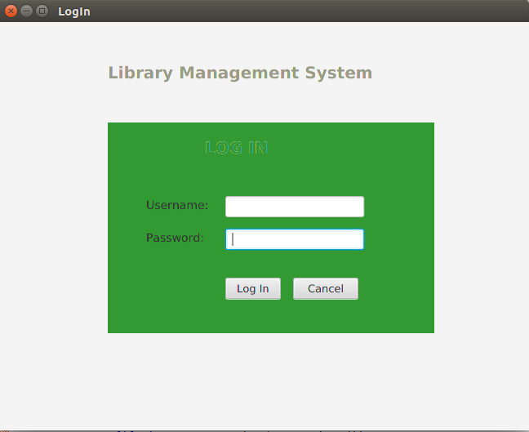
Login
User Login Both Admin and Librarian
Library member Only take Book, no need to login
Using Factory Method Pattern, Based upon assigned role(see code)

Slide 5
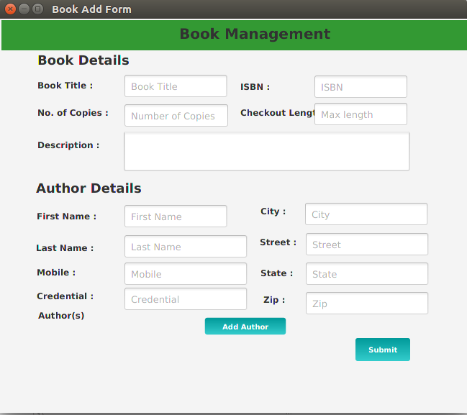
Add Book
Add Book Only Administrator
Composition used(see code)
BookCopy create new object inside the Book constructor
Book has a no of copies

Slide 6
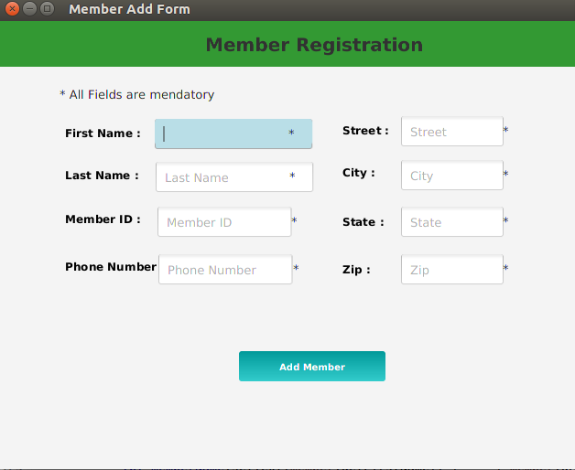
Add Members
Adding members features Only for Admin
Inheritance used(see code) ,
LibraryMember,admin extend from Person
Librarymember is a person

Slide 7
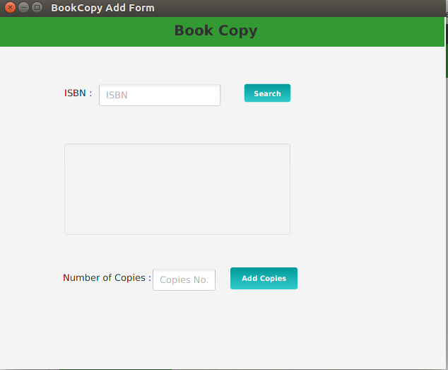
Book Copies
Admin add number of book copies
Cloneable interface is used
Object cloning is a way to create exact copy Book object

Slide 8
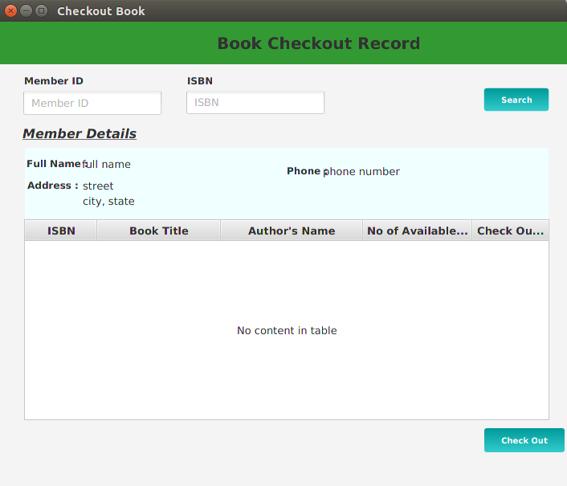
CheckOut
Librarian checkout number of book to member
Inheritance is used
MemberDataAccess and BookDataAccess extends DataAccess

Slide 9
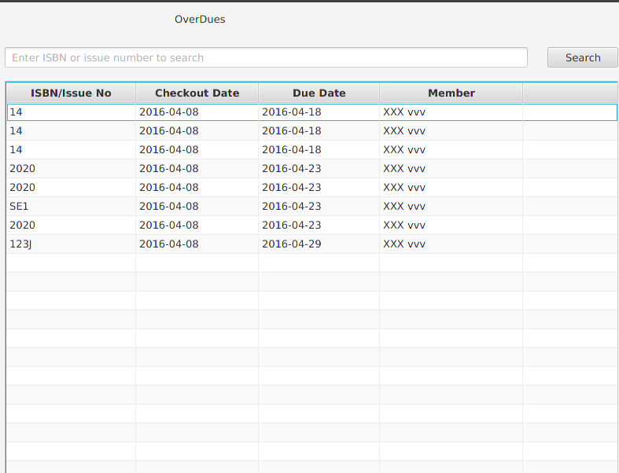
Overdue
Librarian calculate overdue
Encapsulation is used(see code)
Member only know about the overdue not details

Slide 10
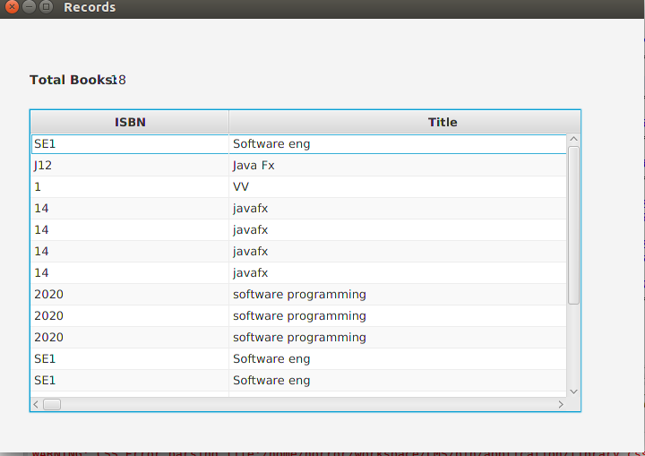
Report
Admin and Librarian generate the reports
Overall summary of library (no of books, names of books, respective isbn numbers)

Slide 11
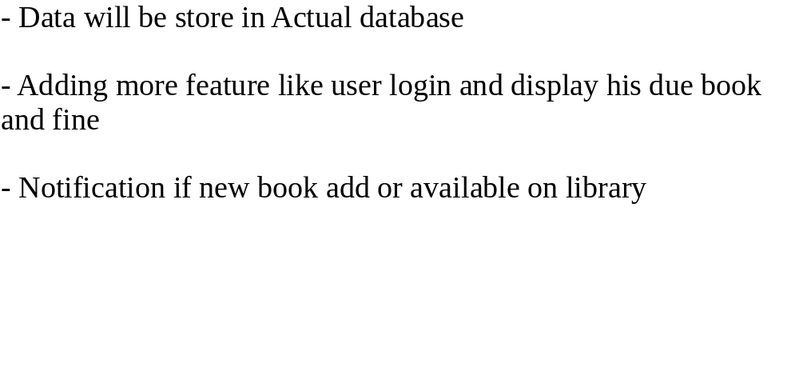
Future enhancement

Slide 12
Overall Summary and User java feature in Project
Login user role(Factory Method)
Login(Interface)
Book(Encapsulation,Compostion)
BookCopy(Colonable)
Checkout(Inheritance)
Overdue(Encapsulation)
- Data store in flat file(Hash map)
- Serialization is the conversion of an object to a series of bytes.

Slide 13
Thank you !!!
Any Question

