Slide 1



Eyesec Cyber Security
private limited, Belagavi
Registered office:
1st Floor, Sairaj Landmark, Savarkar Road, Tilakawadi 590006, Belagavi
https://www.eyesec.in
+91-9008450948

Slide 2

Contents :
Overview of the Organization
Vision and mission
Organization Structure
Roles and responsibilities
Products and market performance
Web penetration tester (OJT-1)
Cyber security Engineer (OJT-2)

Slide 3

Overview of Organization
1. Training & Awareness -
🗯 We help students become future-ready by promoting continuous learning and collaboration.
🗯 Conducted 100+ ( office + online ) workshops, talks, and training programs at international conferences like PyCon India, SciPy India, EuroPython, and many more.
2. Technology Training Programs -
🗯 Covering niche technologies identified by NASSCOM, including :
  Cyber Security
  Data Science
  Web Development
  AI/ML
  NLP & RPA
  Python Web Frameworks.

Slide 4
Vision & Mission
Vision -
Mission -
1. Ensuring Cyber Security for All –
🗯 Eyesec aims to create a safe and secure digital environment for businesses and individuals by providing 24/7 cybersecurity services.
2. Encouraging Knowledge Sharing –
🗯 Our vision includes creating opportunities for professionals to learn, share knowledge, and interact with top industry experts.
1. Providing Continuous Cyber Protection -
🗯 Our mission is to offer round-the-clock cybersecurity solutions to protect businesses and individuals from cyber threats.
2. Creating a Thriving Cybersecurity Community –
🗯 We are committed to building platforms where experts and learners can collaborate and grow together.

Slide 5
🎯 Organization Structure
MD & CEO
CTO
COO
CBO
Team Leader
Employees
Interns

Slide 6
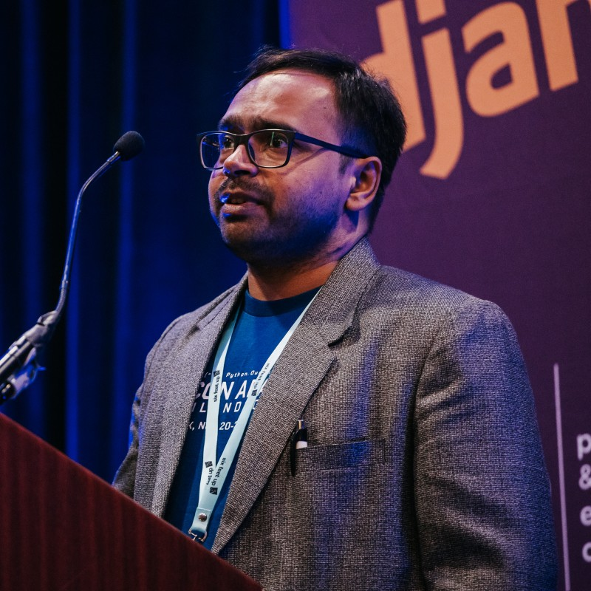
Roles and Responsibilities
Name : Mr. Gajendra Deshpande
Designation : Managing director and CEO, Eyesec Cyber Security Solutions Pvt. Ltd, Belagavi
Email : contact@eyesec.in
A chief executive officer is the highest-ranking position at a company.
CEO manages all operations, resources and corporate decisions for the entire company.
CEO
Mr. Gajendra Deshpande

Slide 7

Roles and Responsibilities
Name : Mr. Vidyadheesh Pandurangi
Designation : Chief Technical Officer (CTO)
Email : vidyadheeshp@gmail.com
The chief technology officer handles a company's information technology department, and even their research and development department.
CTO
Mr. Vidyadheesh Pandurangi

Slide 8
Products and Market Performance
🗯 Eyesec has been actively developing cybersecurity solutions, along with Website Design and Development, App development, Software Development and services.
🗯 The company has shown strong growth in the EdTech sector, successfully training over 1000+ resources and conducting 100+ workshops.
🗯 Eyesec is currently working on real-time projects and innovative products that will enhance cybersecurity and digital solutions.

Slide 9
Web Penetration Tester (OTJ-1)
Overview of Web Penetration Tester -
Web Penetration Testers (Ethical Hackers) find and fix security problems in websites, apps and services.
Key Responsibilities -
  Test Websites : Try to break login systems, forms, and other features to find weak spots.
  Find Security Flaws : Like SQL Injection, XSS, CSRF, and wrong settings.
  Report Issues : Make clear reports showing what’s wrong and how to fix it.
  Stay Updated : Always learning about new hacking tricks and tools.

Slide 10
Web Penetration Tester (OTJ-1)
Required Skills –
  Technical : Python, JavaScript, PHP, Web frameworks.
  Security Tools : Burp Suite, OWASP ZAP, Metasploit, Wireshark.
  Web Technologies : HTTP, APIs, Databases (SQL, NoSQL).
  Problem-Solving : Analyze and fix security flaws.
  Certifications (Preferred) : CEH, OSCP, GIAC.
Career Path & Tools –
Career Path :
  Junior Penetration Tester → Web Security Analyst → Senior Penetration Tester → Security Consultant/Manager.

Slide 11
Web Penetration Tester (OTJ-1)
Popular Tools :
  Burp Suite : Web app security testing.
  OWASP ZAP : Open-source vulnerability scanner.
  SQL-map : SQL injection detection and exploitation.
  Metasploit : Framework for exploiting vulnerabilities.
  Nmap, Nikto : Scanning networks and web servers.
  Hydra, Dirb, Go-buster : Brute-forcing and directory scanning.

Slide 12
Cybersecurity Engineer (OTJ-2)
Overview of Cybersecurity Engineer -
Cybersecurity Engineers protect companies by building and maintaining secure systems.
Key Responsibilities -
  Find Risks : Check systems for weak spots and fix them.
  Design Secure Systems : Build strong protections like encryption and firewalls.
  Handle Incidents : Quickly react to hacking or breaches and fix the damage.
  Check Compliance : Make sure everything follows rules like ISO 27001 and GDPR.
  Simulate Attacks : Try ethical hacking to find vulnerabilities before real hackers do.

Slide 13
Cybersecurity Engineer (OTJ-2)
Required Skills –
  Coding (Python, C, JavaScript).
  Strong networking knowledge (firewalls, VPNs, IDS/IPS).
  Good with encryption and cloud security (AWS, Azure).
  Smart at solving problems and handling cyber attacks.
Career Path, Growth & Certifications –
Career Growth Path:
  Start : Security Analyst, Network Admin, IT Support.
  Mid-Level : Cybersecurity Engineer, SOC Analyst, Penetration Tester.
  Senior-Level : Security Architect, CISO (Chief Info Security Officer), Security Consultant.

Slide 14
Cybersecurity Engineer (OTJ-2)
Important Certifications –
  CEH (Certified Ethical Hacker)
  CISM (Certified Information Security Manager)
  CISSP (Certified Info Systems Security Professional), etc.

Slide 15
Thank You!

