Slide 1
Data Cleaning and Excel Projects: Completed during learning period
Dharma Raghuvanshi
Email address: dharmaraghuvanshi@gmail.com
Phone Number: 9826452822
Gitgub:

Slide 2
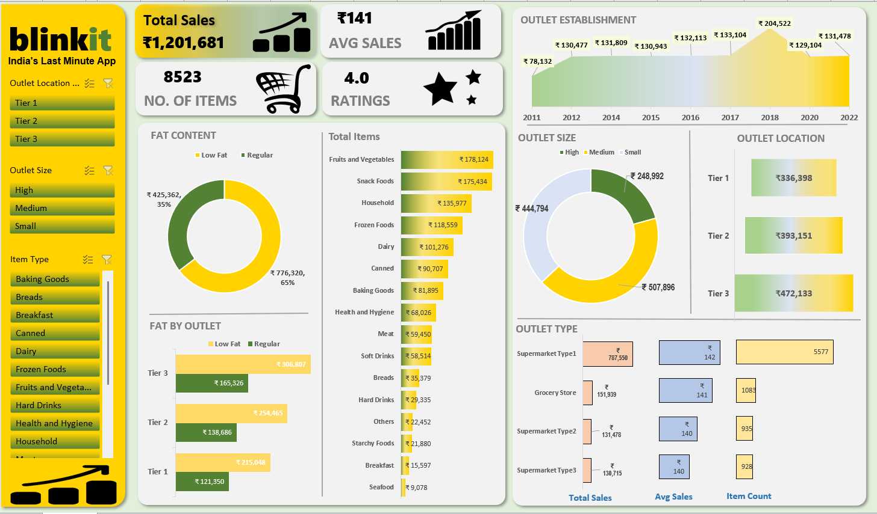
The data provided fat content, establishment year and outlet type with item and other detail.
The data was cleaned and arranged using power query.
Using pivot table the tables were arranged to be displayed on dashboard.
The dashboard gives insight on the business helping decision making: The outlet size could be reduced to medium for high outlets as business generated is similar to a medium size store.

Slide 3
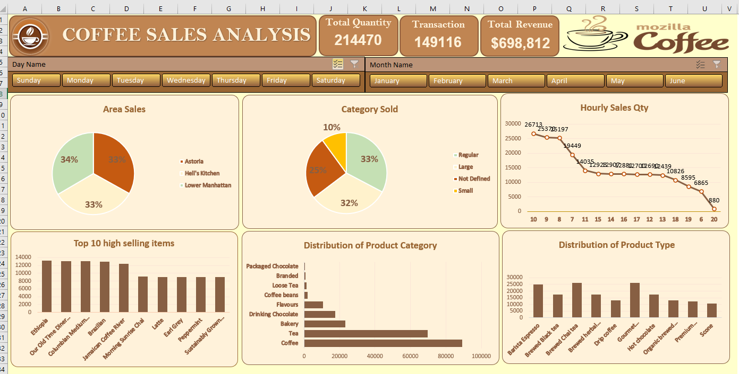

Slide 4
Mozilla coffee: Sales analysis and Insights
All store locations performed almost equal with slight difference of 1%, all standing at 34% and 33%, the performance in all three area is consistent.
Category sales: Regular coffee sold most among all with the contribution of 33%, followed by Large coffee at 32%, small coffee was least in demand with contribution of 10%, rest 25% of the sales came from not defined category.
7 AM to 10 AM turned out to be the highest selling time duration, with sales frequently crossing 20000 mark and generating average sale revenue of 25000.
While most of the sales, made between 11PM and 18PM were consistent with an average of 12500 each hour. 18PM to 19PM gave an average of 7500. Sales at 8PM hit the bottom low standing at 880.
Ethiopia la, Our old time diner, Columbian Medium, Brazilian, Jamaican coffee are the star performer all averaging at 13000, followed by morning Sunrise, Latte Earl Grey, Peppermint, Sustainably Grown standing at 9000.
It's best we offer more side categories during peak hour that compliment the morning coffee during 7AM till 10 AM, During second peak, if we offer enough categories to complement the lunch time, the satisfaction will rise. it's best we give a serious thought to our 8PM business by either offering dinner options, quick snacks to sustain the revenue or shut the store around these hours and increase our focus during morning peak hours.
Distribution: Barista espresso, Brewed chai, Gourmet averaged above 25000 in distribution, followed by Brewed black tea, Brewed herbal tea, and hot chocolate averaging at 18000, last were drip coffee, Organic brewed , premium, Scone Averaging at 13000.
Coffee and tea had the highest business distrubution share, followed by bakery, drinking, chocolate and flavours. while top two stands above 70 thousand crucial mark, the bakery and drinking chocolate have scope to bring more business to the portfolio with current business standing around 20000, with right marketing at high demand area and promotional campaign at newly acquired area will increase the potential to reach 30000 mark.

Slide 5
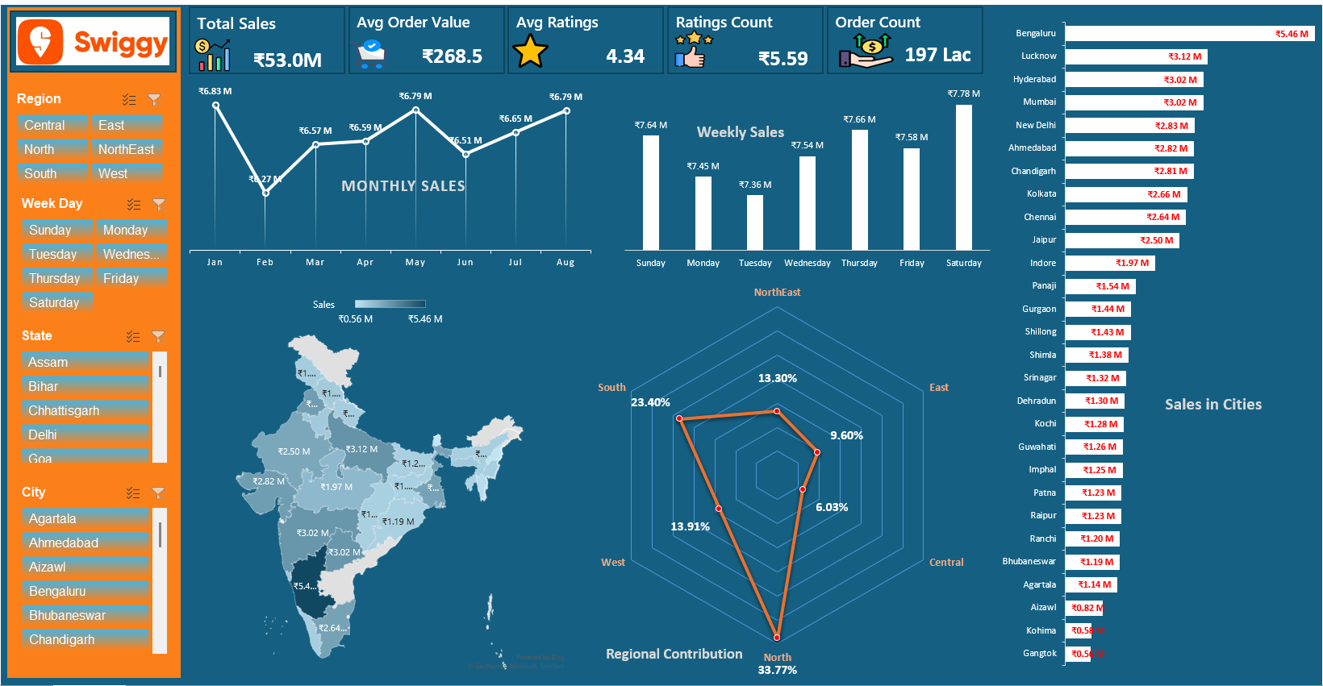
Data table had sales, city, rigion and date data along with ratings and quantity
Removed duplicates, chaged formating using power query.
With the help of pivot table made table to draw insights on dashboard
The Dashboard shows sales data devided into regions, cities, month and weekdays.
North is bringing most of the sales followed by south. People ordered most on Saturdays. August, May and Jan are the peak sales month

Slide 6
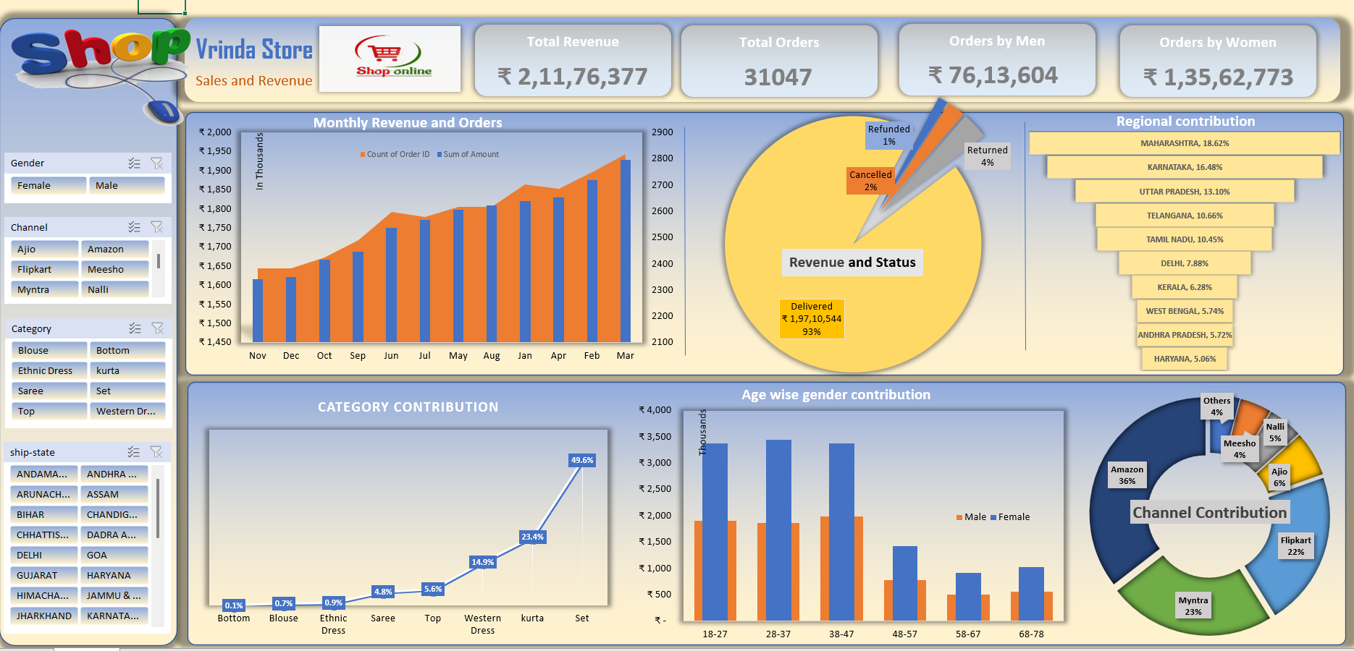

Slide 7
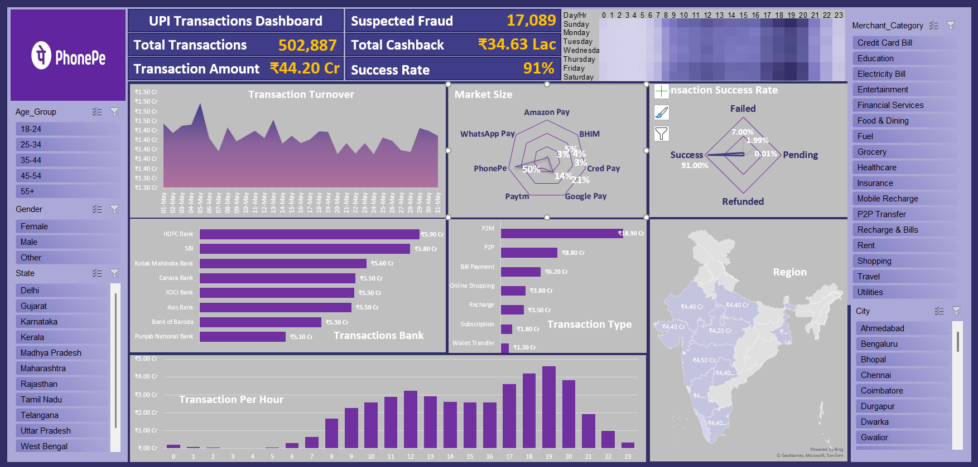

Slide 8
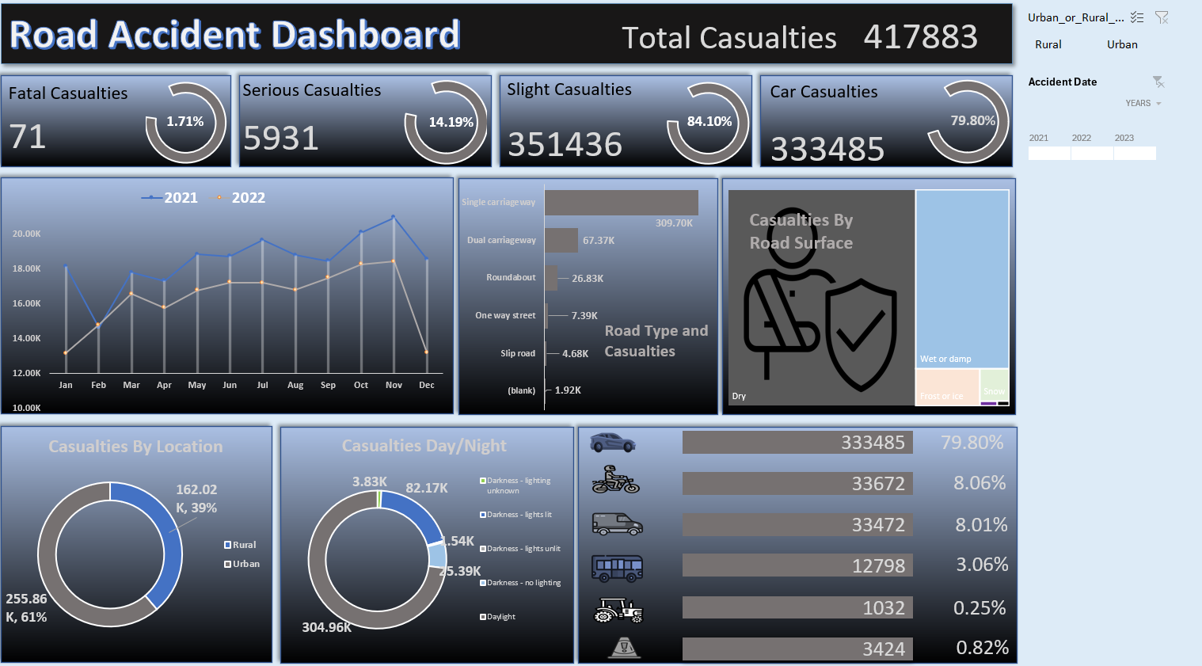

Slide 9
