Slide 1
Online Railway Reservation System
Team Members
LAKSHMI SOWMYA CHILAKA
VARUN YADAV
UJUAL SREEDHARAN MURIKKAL
ABHISHEK SATISH DASARI
SHUBHAM VINOD VERMA
SIDDHANT SUNIL PATOLE
PUJA SAMADDER
BALAJI JAYAKUMAR
DHARMA REJESH
ISAN BAIN (TL)

Slide 2
TABLE OF CONTENTS
Problem Statement
Solution
UML Diagram
Sequence Diagram
Use Case Diagram
Activity Diagram
Class Diagram
Database Diagram

Slide 3
Problem statement
The current system for railway ticket booking is to go to railway station and stand in queue for a long time to get the tickets which is very difficult for the user.
It is very time-consuming
User must go to the railway station and search which all trains are available.
It is less user-friendly.
And for printing tickets more papers are wasted.

Slide 4
Solution Statement
In the proposed system user will not be required to go to the railway station. Users can book the ticket anytime and from anywhere according to their comfort. There will be an admin who will be updating the train details. The motive of this system is to:
To make things easier and user friendly and flexible.

Slide 5
UML Diagrams

Slide 6
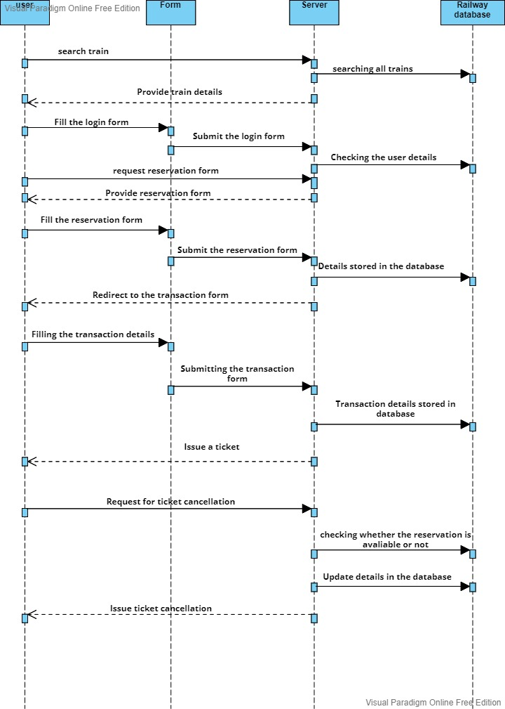
Sequence Diagram
(user)

Slide 7
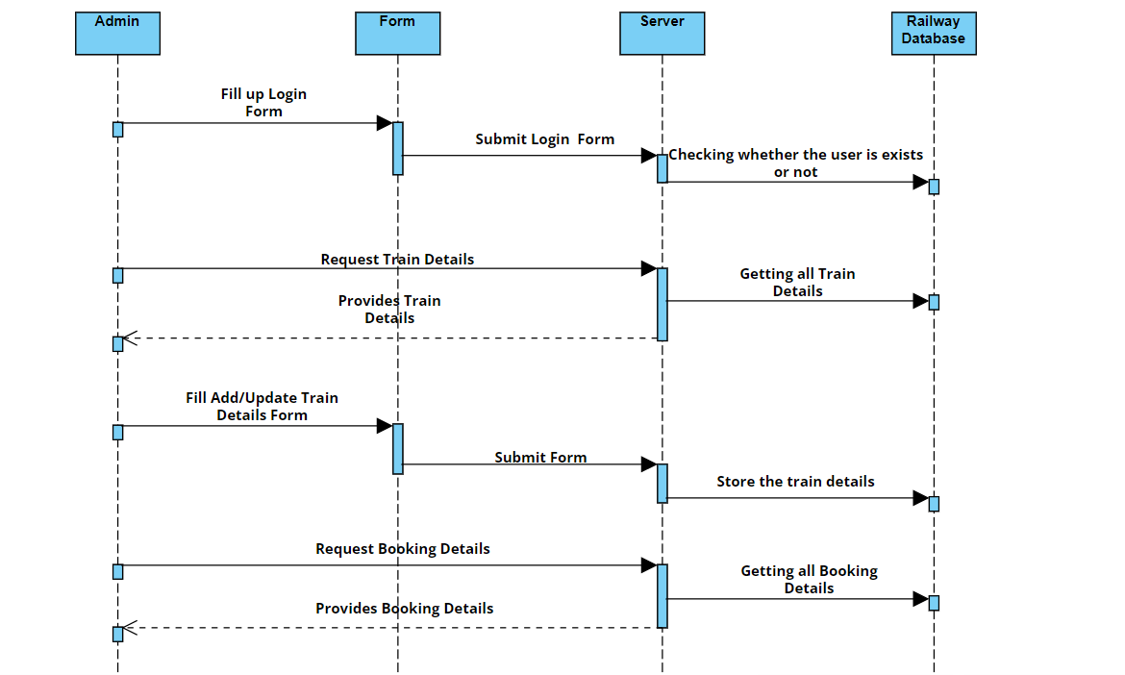
Sequence Diagram
(Admin)

Slide 8
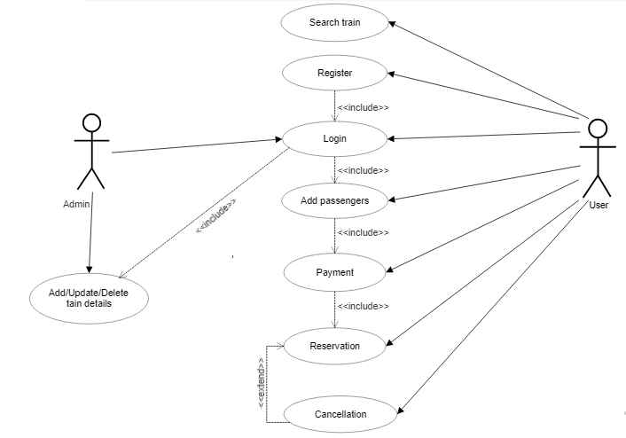
Use-Case Diagram

Slide 9
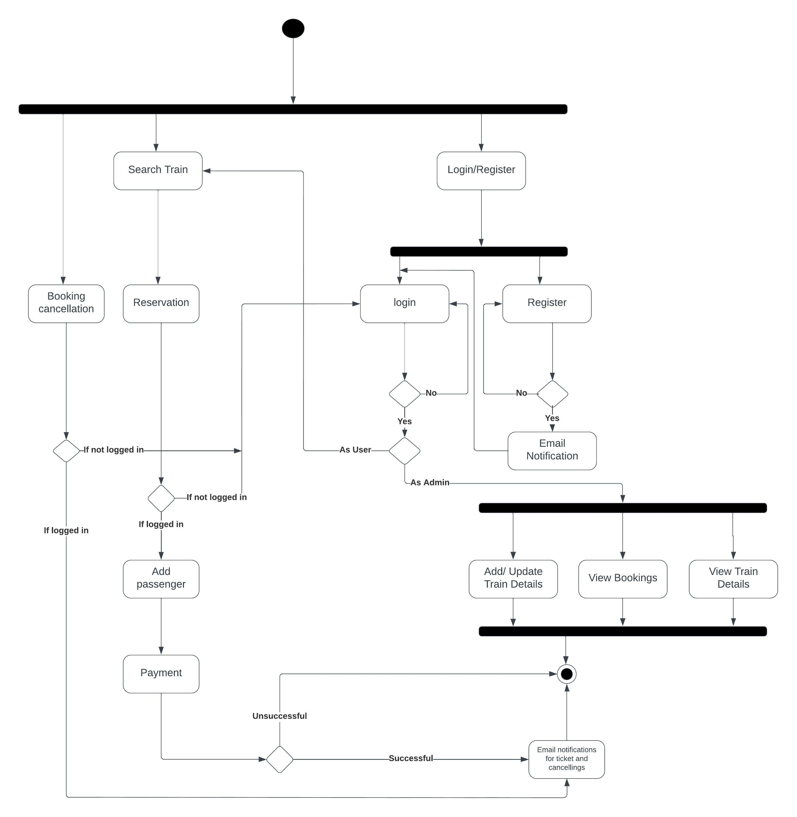
Activity Diagram

Slide 10
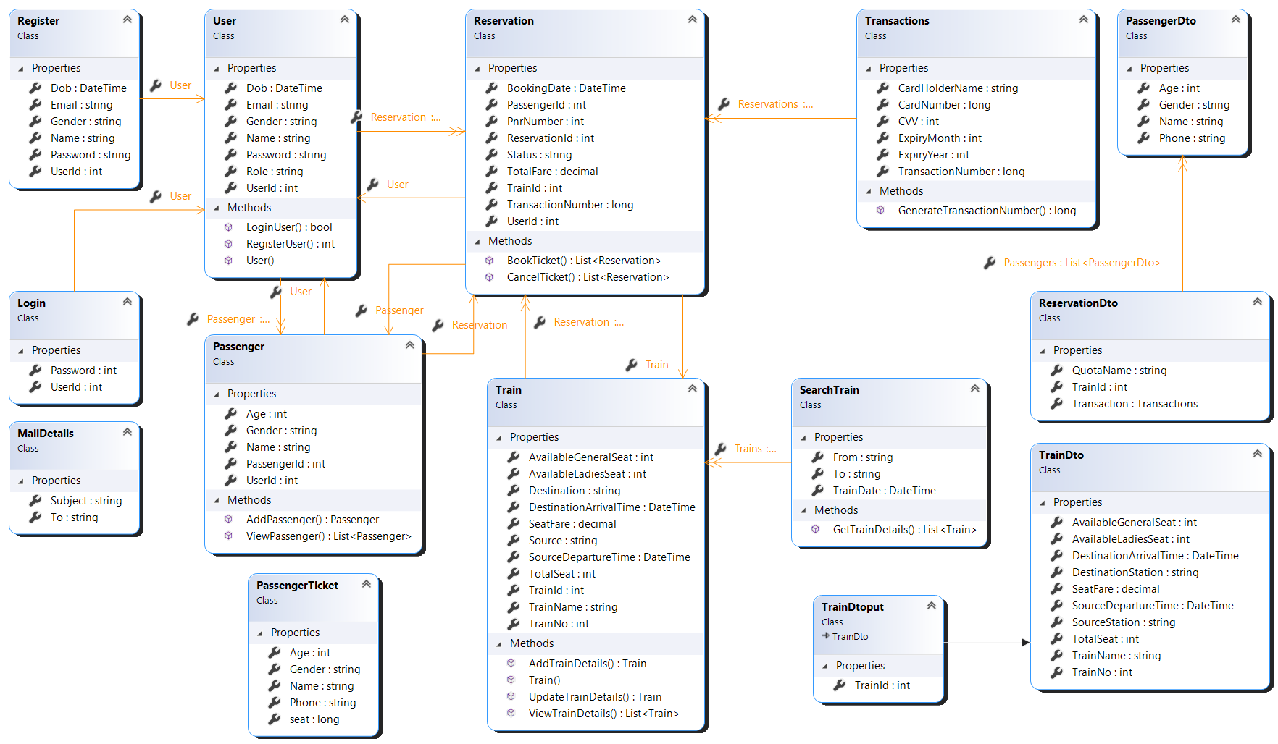
Class Diagram

Slide 11
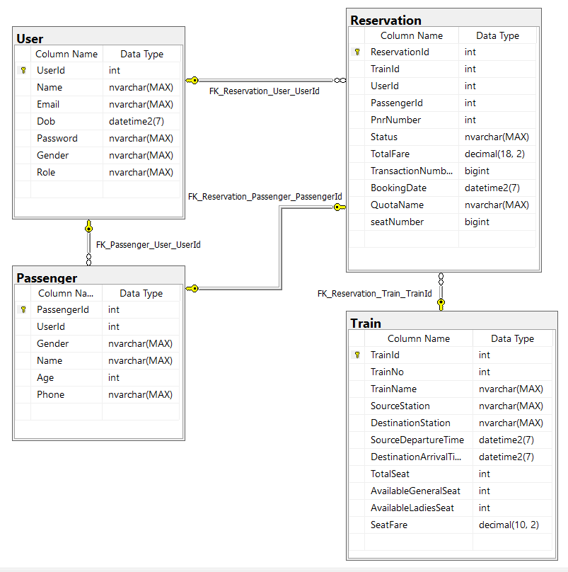
Database Diagram

Slide 12
Thank You

