Slide 1
ICICV 2021 Survey On Deadlocks In Distributed Database Systems
By
Dr. Y. Bhavani, Associate Professor
Dr. K. Praveen Kumar, Assistant Professor
K. Dharmateja, Student
P. Pranathi, Student
R. Sowmya, Student
Dept. Of IT, Kakatiya Institute Of Technology & Science, Warangal, Telangana, India.

Slide 2
Overview
Abstract
Introduction
Related Work
Comparison of Deadlock Detection Algorithms
Conclusion & Future Work

Slide 3
Abstract
In Distributed Database System (DBS) and multitasking system, occurrence of deadlocks is one of the most serious problems. If a site request a resource that is already hold by another site and which is waiting for another resource then the scenario is called as distributed deadlock. Different distributed environments require a suitable deadlock detection algorithm to detect deadlocks. Different distributed environments needs to maintain their platforms by avoiding deadlocks. To achieve this the environment should be fed with optimized deadlock detection and avoidance algorithms. In this paper different deadlock detection algorithms that uses Wait For Graph and resolution algorithms to trace out deadlocks are discussed. We have also elucidated optimization techniques, for resolving deadlock in an efficient manner. We made a comparison between different deadlock detection algorithms based on different parameters like, delay time, message size, number of messages and whether the algorithm detects false deadlocks or not. Based on the comparisons we have suggested few deadlock detection algorithms for the distributed environment.

Slide 4
Introduction
Distributed Database (DDB) is associated with many sites and each has its database.
The software that handles DDB is called Distributed Database Management System (DDBMS).
The combination of both DDB and DDBMS is known as Distributed Database System (DBS).
Deadlocks can be handled in three ways:
Prevention: prevention requires the configuration of system, so that no deadlock will occur.
Avoidance: allocation of resources to be done at runtime or real-time, to ensure that no deadlock will form.
Detection: first deadlocks are permitted to occur and some protocols will detect them later.

Slide 5
Deadlock Detection
Centralized algorithm: In Centralized algorithm a single node works to detect deadlock.
Distributed algorithm: Unlike centralized algorithm in Distributed algorithm different nodes work together to detect deadlocks.
No single point failure, because if one node is failed other node can work and make the system reliable.
Speed of deadlock detection also increases.

Slide 6
Related Work

Slide 7
Kawazu’s Algorithm
Kawazu’s algorithm consists of LOCAL and GLOBAL sub-algorithms.
Local deadlocks are detected by Algorithm LOCAL with the help of Sub-Wait-Graph.
Global Deadlocks are detected by algorithm GLOBAL with the help of the Pseudo-Wait-Graph.
When compared to centralized systems this algorithm is advantages because of its distributed nature and overall network throughput.

Slide 8
HO’s Algorithm
HO’s algorithm is based on centralized technique.
Uses only two levels i.e., Master control nodes and Cluster control nodes.
Detection of inter-cluster deadlocks is the responsibility of the master control node.
Cluster control nodes are used to detect deadlock among their members and report dependencies to the master control node outside their cluster.

Slide 9
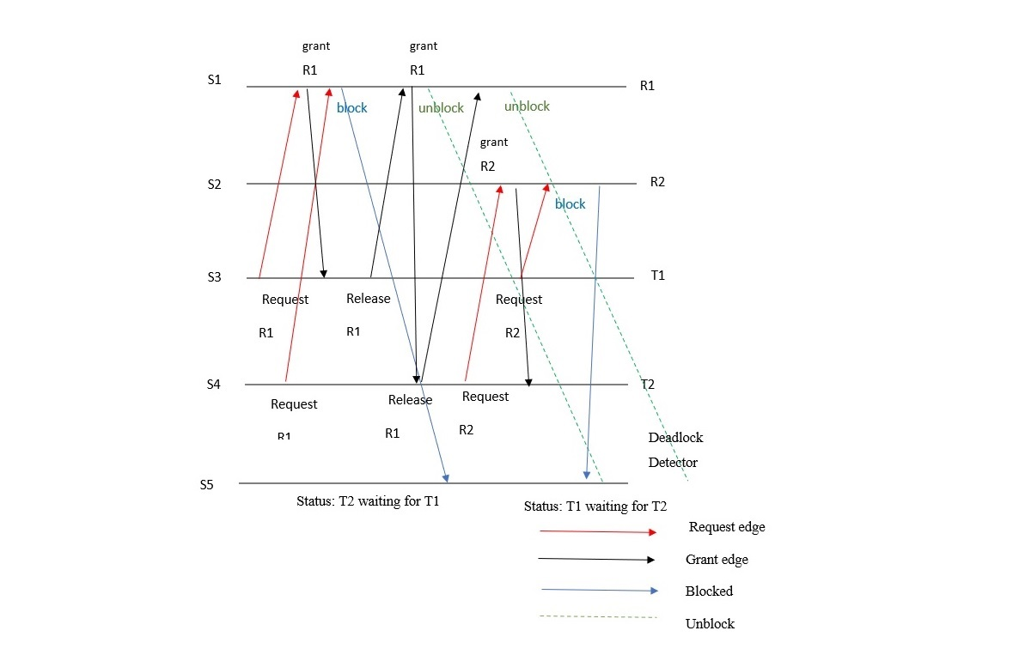
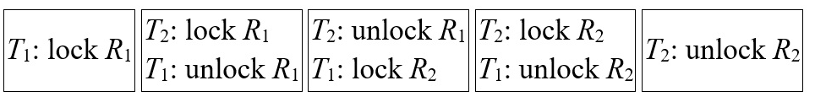
Event trace diagram
Two transactions running concurrently.

Slide 10
Edge-Chasing Algorithm
This algorithm uses data packets called probes to recognize cycle in WFG.
At whatever point active transaction gets a probe it will be abandoned. At the point when Blocked transaction gets a probe, the path information will be modified and again it begins propagating.
Limitation: It is unable to identify deadlock if starting transaction does not belongs to deadlock cycle.

Slide 11
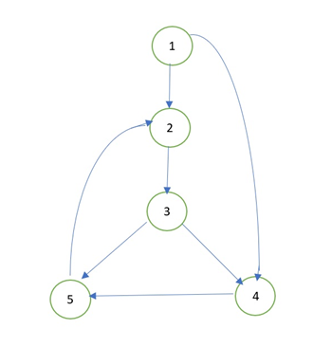
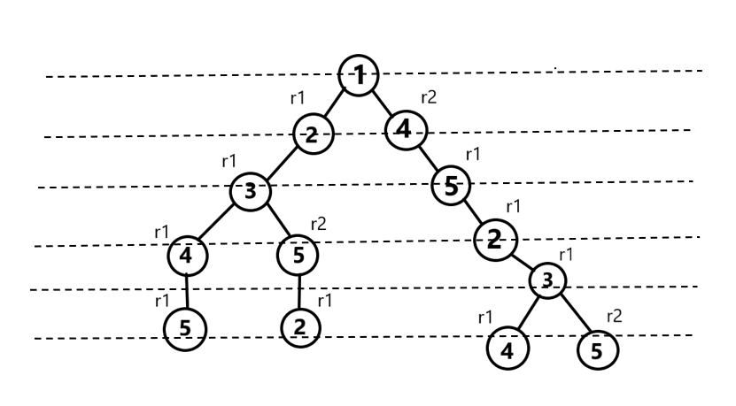
Implementation of algorithm

Slide 12
B.M. Alom algorithm
This approach utilizes LTS and DTS deadlock detection techniques and also uses priorities to recognize and resolve deadlock.
Transactions with least priority are terminated and hence the data items will be accessible for different transactions in waiting state.
Limitation for this algorithm is, it unable to recognize deadlock if sequence of priorities gets changed.

Slide 13
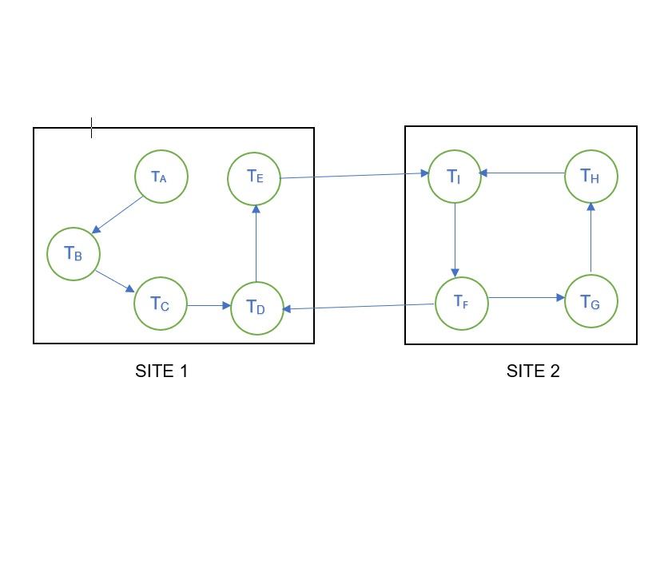
Local and Global deadlock cycles

Slide 14
Sinha’s Scheme
This scheme depends on needs of transactions, by this way we can decrease the quantity of messages needed for Detecting algorithm.
Sinha's algorithm doesn't develop the TWF diagram.
This model comprises of transactions and information directors that are answerable for conceding and delivering locks.
Disadvantages of this algorithm is detecting false deadlocks and unable to report complete deadlocks.

Slide 15
Safety Detection Algorithm
Momotaz Begum et al proposed a Safety Detection algorithm, which depends on sorting and linked list data structure.
The processes in this approach are arranged in ascending order depending on the amount of resources required.
Linked list data structure is used to reserve resources of all processes in descending order depends on number of resource instances it required to complete its execution.

Slide 16
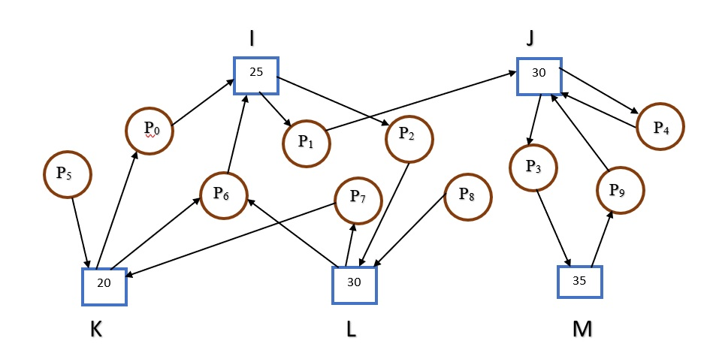
Resource Allocation Graph

Slide 17
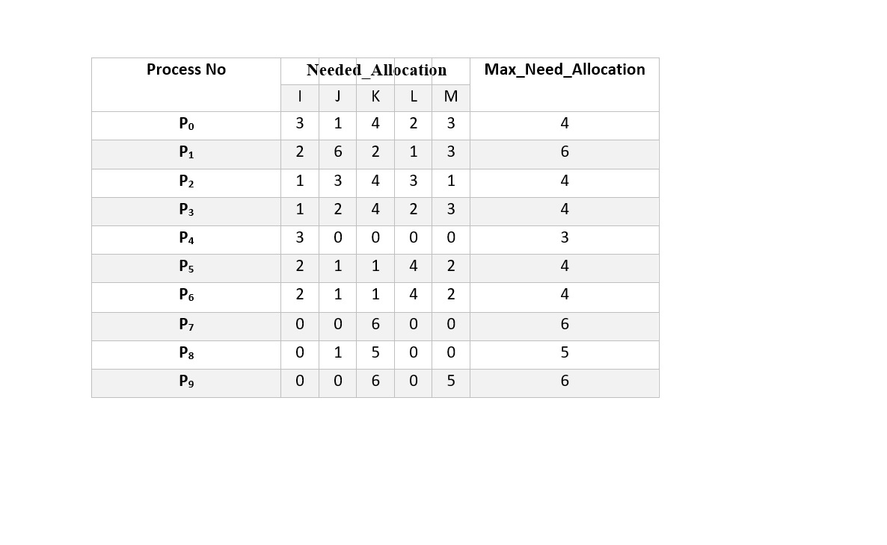
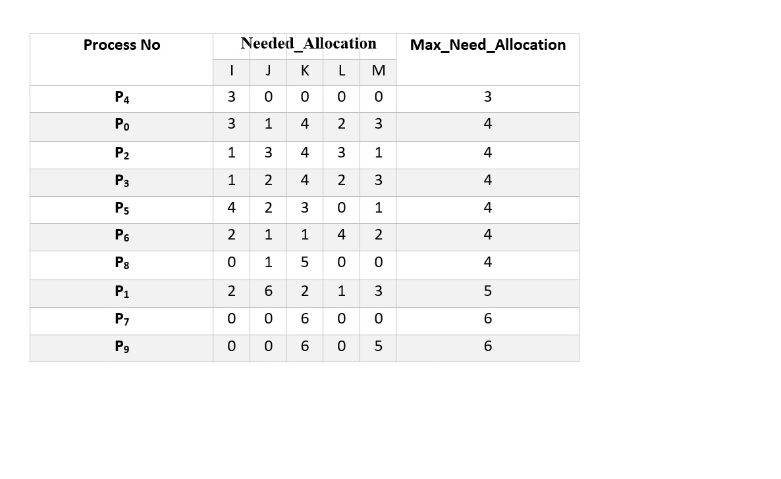
Representation of resources which are Needed and Max Needed
Max_needed_Allocation ≤ Min_Available
Since Available resource = Available resource + Current_allocation.
Finally, <P₄, P₀, P₂, P₃, P₅, P₆, P₈, P₁, P₇, and P₉> is the final Safe Sequence

Slide 18
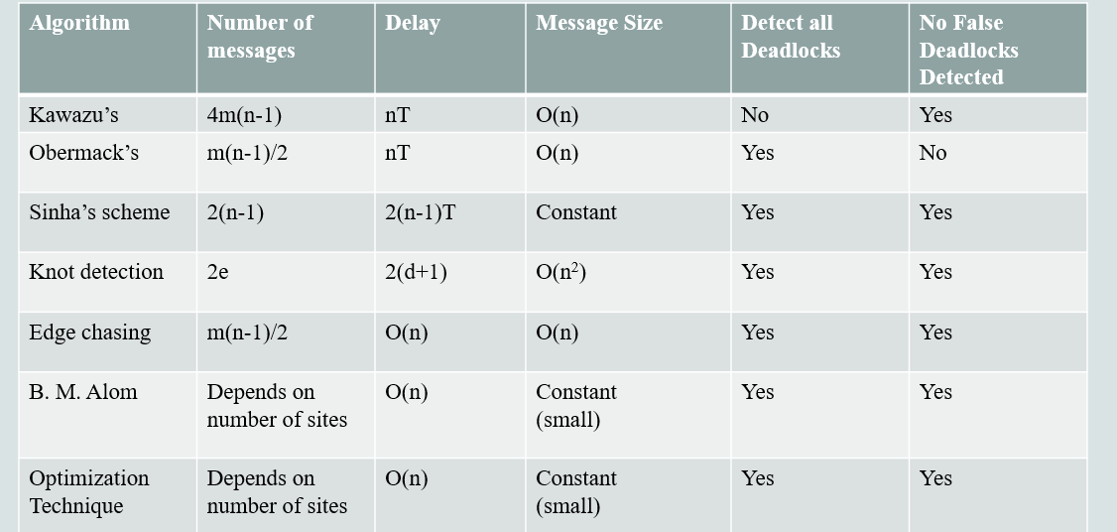
Comparison of Deadlock Detection Algorithms

Slide 19
Conclusion & Future work
The serious problem of distributed environment is resource starvation which is caused by deadlocks. To overcome these problems choosing an efficient deadlock detection and resolution algorithm is necessary. This paper, we have discussed on the performance of various deadlock detection and deadlock resolution approaches.
On comparing, it is clearly depicted that algorithm which used optimization technique gave a better performance with more efficient time complexity and memory management. These algorithms used dynamic memory allocation as data structures that decreases the space needed.
In future, new algorithms can be designed which will avoid the deadlocks more efficiently compared to these present algorithms. An advanced research work is inevitable on distributed environment to increase resource sharing, concurrency control, fault tolerance and transparency.

Slide 20
Reference papers
Kawazu, Seiichi, et al. "Two-phase deadlock detection algorithm in distributed databases." Fifth International Conference on Very Large Data Bases, 1979. IEEE, 1979.
Obermarck, Ron. "Distributed deadlock detection algorithm." ACM Transactions on Database Systems (TODS) 7.2 (1982): 187-208.
Chandy, K. Mani, and Jayadev Misra. "A distributed algorithm for detecting resource deadlocks in distributed systems." Proceedings of the first ACM SIGACT-SIGOPS symposium on Principles of distributed computing. 1982.
Ho, Gary S., and C. V. Ramamoorthy. "Protocols for deadlock detection in distributed database systems." IEEE Transactions on Software Engineering 6 (1982): 554-557.
Mitchell, Don P., and Michael J. Merritt. "A distributed algorithm for deadlock detection and resolution." Proceedings of the third annual ACM symposium on Principles of distributed computing. 1984.
Sinha, Mukul K., and N. Natarajan. "A priority based distributed deadlock detection algorithm." IEEE Transactions on Software Engineering 1 (1985): 67-80.

Slide 21
Reference papers Contd.
Manivannan, D., and Mukesh Singhal. "An efficient distributed algorithm for detection of knots and cycles in a distributed graph." IEEE Transactions on Parallel and Distributed Systems 14.10 (2003): 961-972.
Farajzadeh, Nacer, et al. "An efficient generalized deadlock detection and resolution algorithm in distributed systems." The Fifth International Conference on Computer and Information Technology (CIT'05). IEEE, 2005.
Alom, BM Monjurul, Frans Alexander Henskens, and Michael Richard Hannaford. "Optimization of detected deadlock views of distributed database." 2010 International Conference on Data Storage and Data Engineering. IEEE, 2010.
Tao, Zhi, et al. "A semi-centralized algorithm to detect and resolve distributed deadlocks in the generalized model." 2014 IEEE 17th International Conference on Computational Science and Engineering. IEEE, 2014.
Kate, Vandana, Akansha Jaiswal, and Ambika Gehlot. "A survey on distributed deadlock and distributed algorithms to detect and resolve deadlock." 2016 Symposium on Colossal Data Analysis and Networking (CDAN). IEEE, 2016.

Slide 22
Reference papers Contd.
Haque, Waqar, Matthew Fontaine, and Adam Vezina. "Adaptive Deadlock Detection and Resolution in Real-Time Distributed Environments." 2017 IEEE 19th International Conference on High Performance Computing and Communications; IEEE 15th International Conference on Smart City; IEEE 3rd International Conference on Data Science and Systems (HPCC/SmartCity/DSS). IEEE, 2017.
Begum, Momotaz, et al. "An Improved Safety Detection Algorithm Towards Deadlock Avoidance." 2020 IEEE 10th Symposium on Computer Applications & Industrial Electronics (ISCAIE). IEEE, 2020.
Jain, Sumika, Nitin Kumar, and Kuldeep Chauhan. "An Overview on Deadlock Resolution Techniques."

Slide 23
THANK YOU

