Slide 1
AutoTrust
A dApp for buying and selling automobiles
Dharmendra Agarwal
CS23M508
Muzaffar Ahmed
CS23M517

Slide 2
Agenda
01. Problem statement
02. Motivation to solve
What are we trying to solve?
Why solve this problem?
03. Architecture
04. Improvements
05. Closing
How are we solving this?
What’s next?

Slide 3
Problem Statement
Vehicle history data is often incomplete, outdated, or manipulated.
Hard for buyers to verify ownership, maintenance, and accident records.
Centralized systems are prone to delays, errors, and tampering.
Leads to a trust gap among buyers, sellers, insurers, and service providers.

Slide 4

Motivation to solve
Build Trust: Enable transparent and tamper-proof vehicle history to increase buyer and seller confidence
Boost Market Value: Reliable records can increase resale value and reduce price disputes.
Fair Transactions: Prevent fraud, odometer rollbacks, and hidden accident histories.
Enable Ecosystem Growth: Improve coordination among dealerships, service centres, and insurance companies.
Tap Growing Market: Used car sales are rising globally—solving this problem unlocks major business potential

Slide 5

Technical Dive

Slide 6
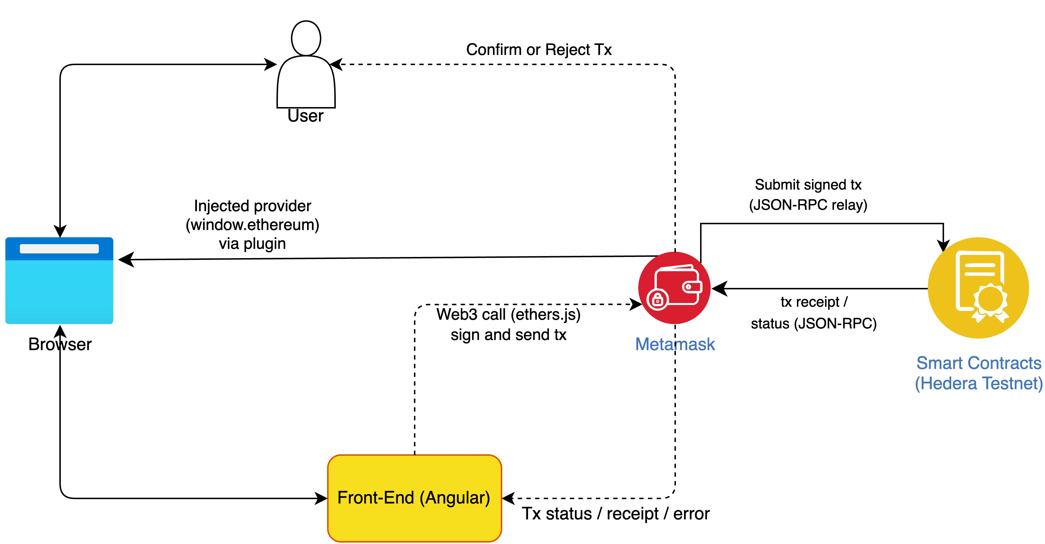
Architecture

Slide 7
Potential future works
Trusted nodes
Purchasing with cryptocurrency
Onboard car manufacturers and government agencies to integrate their data with this system.
Add support for buying and selling using HBAR itself, or any cryptocurrency.
Integration with Web3 Storage
Servicing history
Integration with IPFS, Pinata etc. for document tracking and uploads.
Add support for more data points like servicing history, kilometres driven etc.

Slide 8

Thank you
Dharmendra and Muzaffar

