Slide 1

Polymorphism

Slide 2
Polymorphism in Python:
Polymorphism is derived from Greek words:
Poly => many
morphism => forms
Same method is defined on object of different types. len() function can be the example

Slide 3
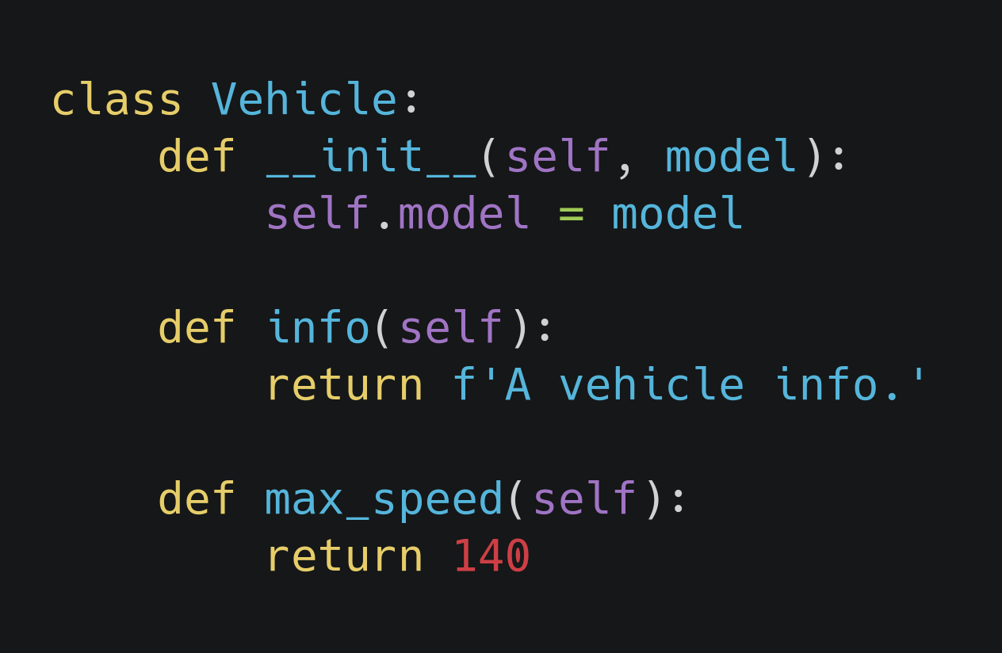
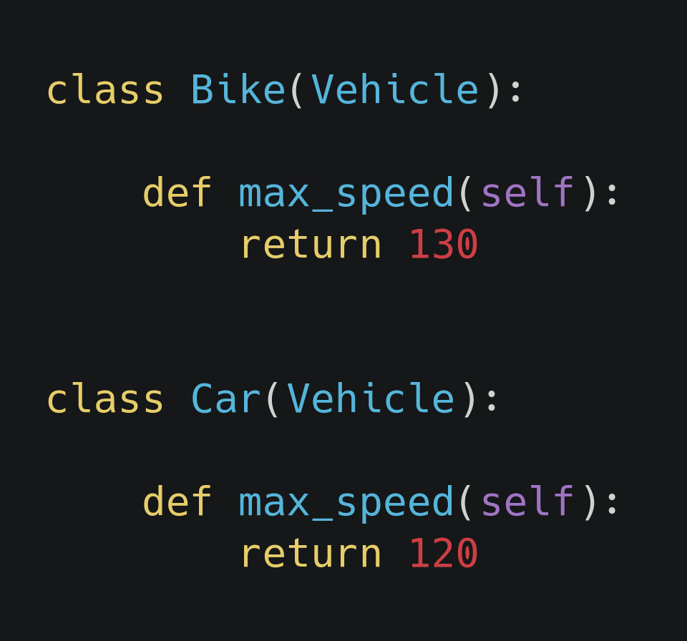
Polymorphism in Python ...
Two child classes Bike and Car are inherited from parent class Vehicle:
Vehicle class as parent class
Bike and Car class derived from Vehicle class

Slide 4
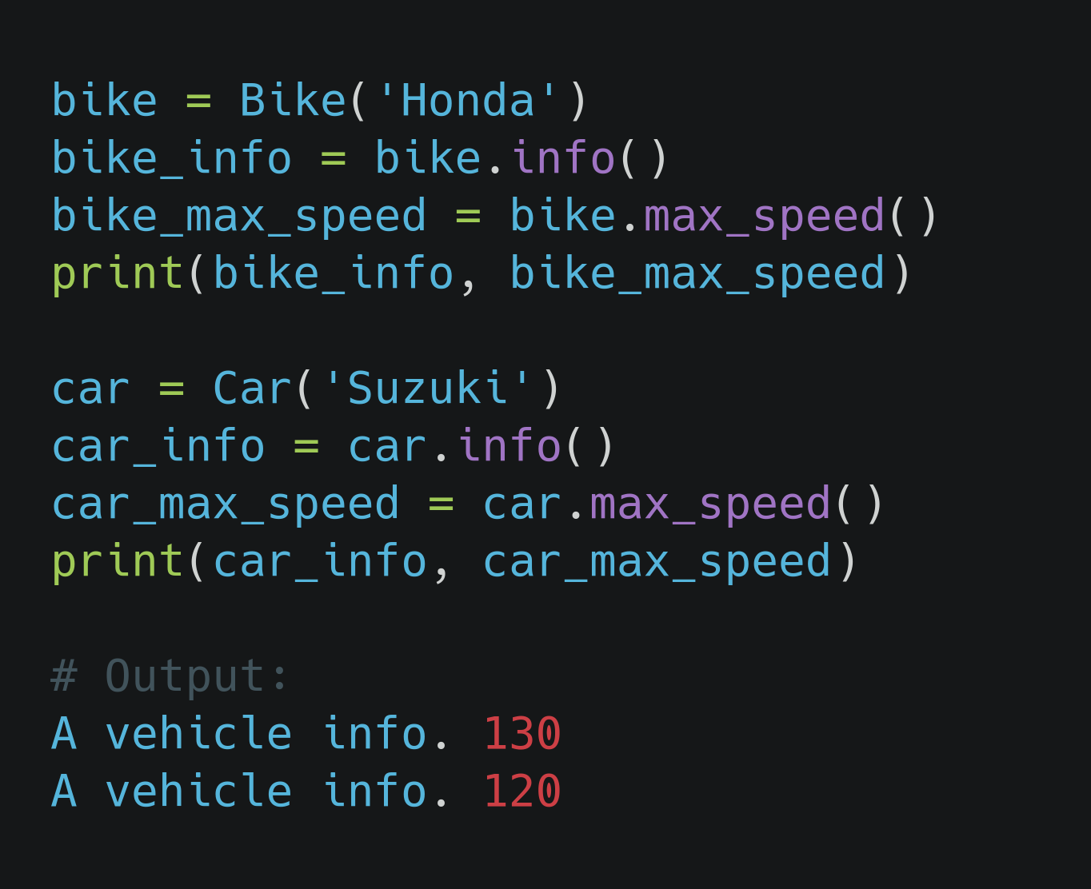
Polymorphism in Python ...
From previous example, while trying to access the same method info() and max_speed() from objects of different classes we will get the following result:
Info() method will return the same result as we initialized
max_speed() method will return the value returned from object specific class.
Result of polymorphism implementation

Slide 5
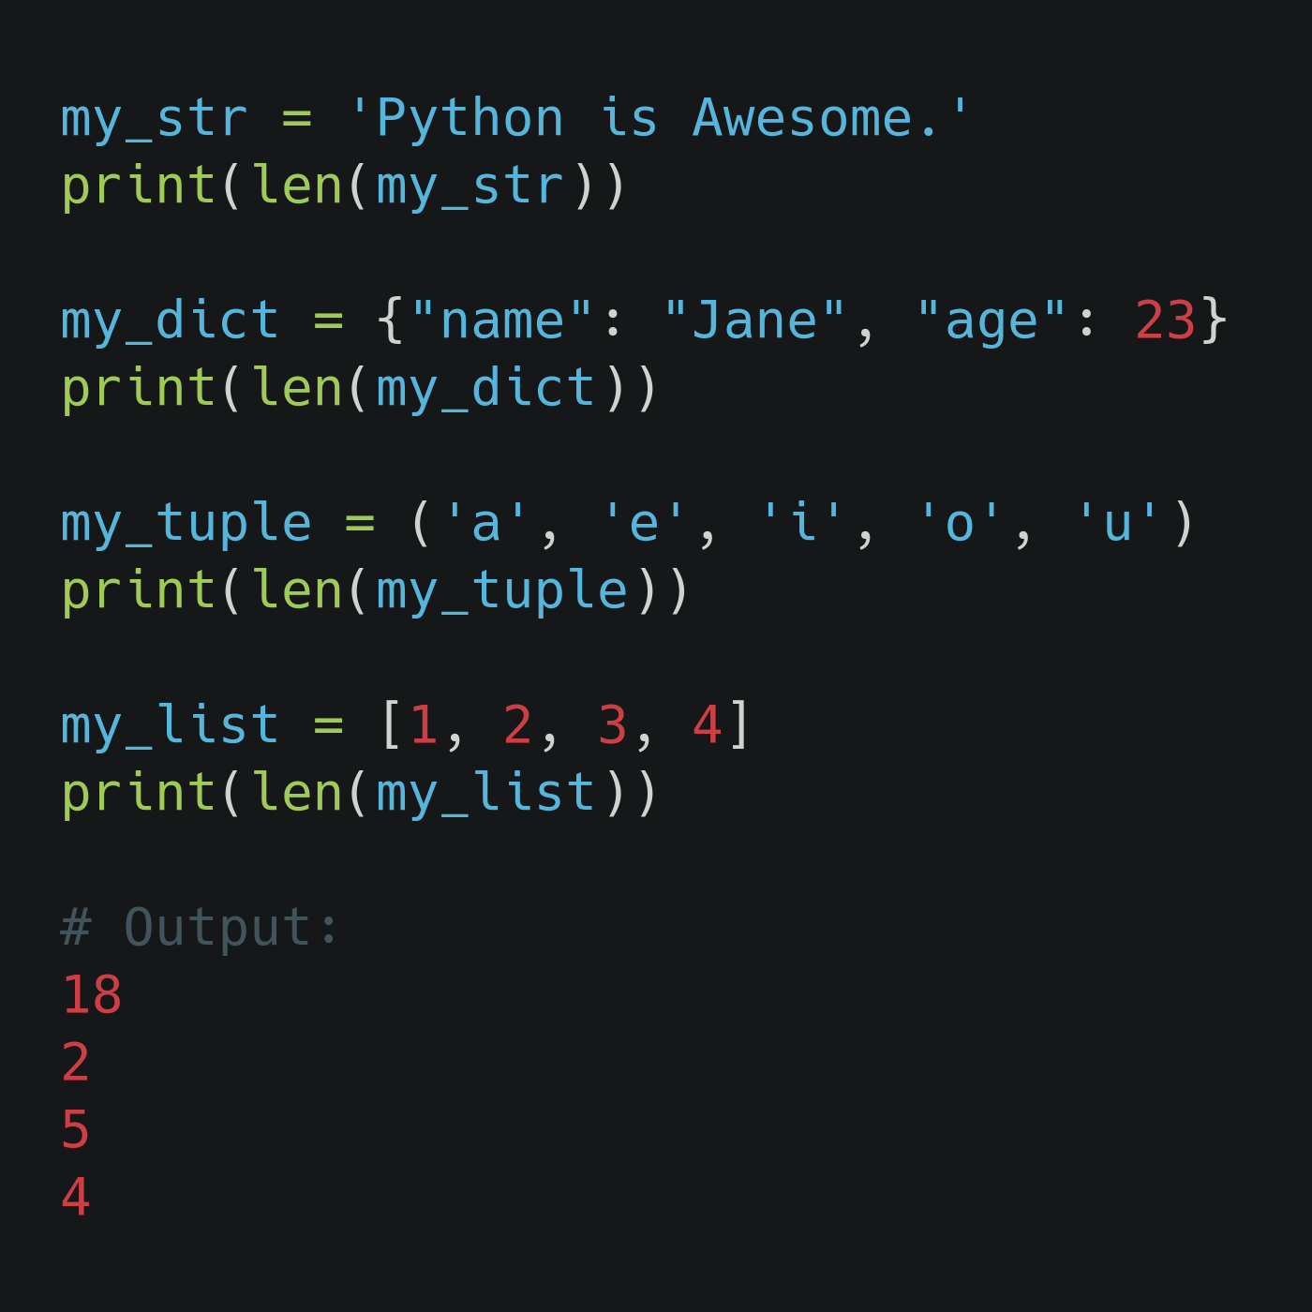
More on Polymorphism in Python ...
In Python there are few functions which works fine for multiple data types.
len() function is one among such functions.
It will call __len__() method of built-in str class when we pass string object
It will call __len__() method of built-in dict class when we pass dictionary object
and so on... (we will see in next example)
len() function used in multiple data types

Slide 6
Method Overloading and Method Overriding

Slide 7
Method Overloading:
More than one method shares the same name in the class but having different signature.
Unlike other programming languages like c++, and Java, Python doesn't support for method overloading by default.
The latest defined method will replace the previously defined methods and its behavior will also change. (forgets the previous method definition)
We need to do extra work to get the taste of method overloading in Python.

Slide 8
Method Overloading...
Also known as the compile time polymorphism.
It may or may not need inheritance.
Relationship is between the methods of same class.
Doesn't require more than one class for overloading.

Slide 9
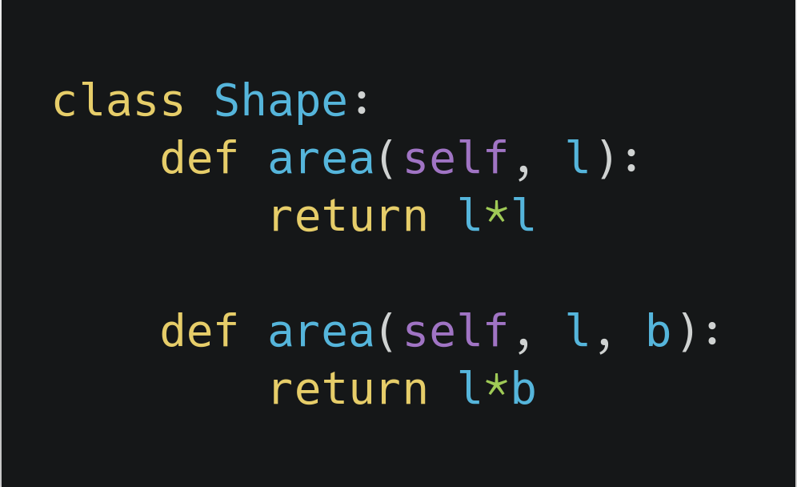
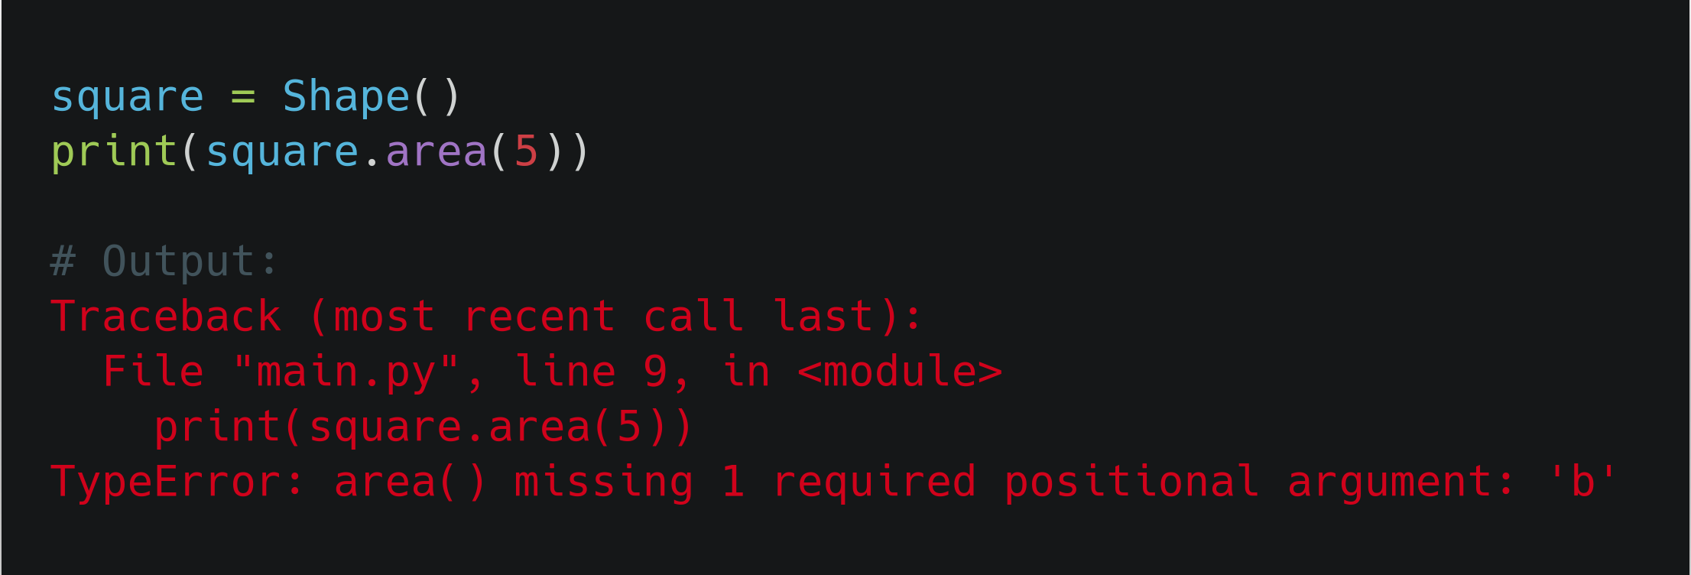
Method Overloading...
Let's look at the example where we will define a class Shape with two methods with same name but different types of arguments and behavior.

Slide 10
Method Overloading...
When we define two methods with same name but different arguments, the first method area(self, l) is forgotten by the class and there is only one method area(self, l, b).
So, we need to give two positional argument to the method area() and it was raising the error when it didn't get the value for b.
We can use the same method for different types of arguments passed to it, which is not the practical approach for method overloading but we will have a look into that example:

Slide 11
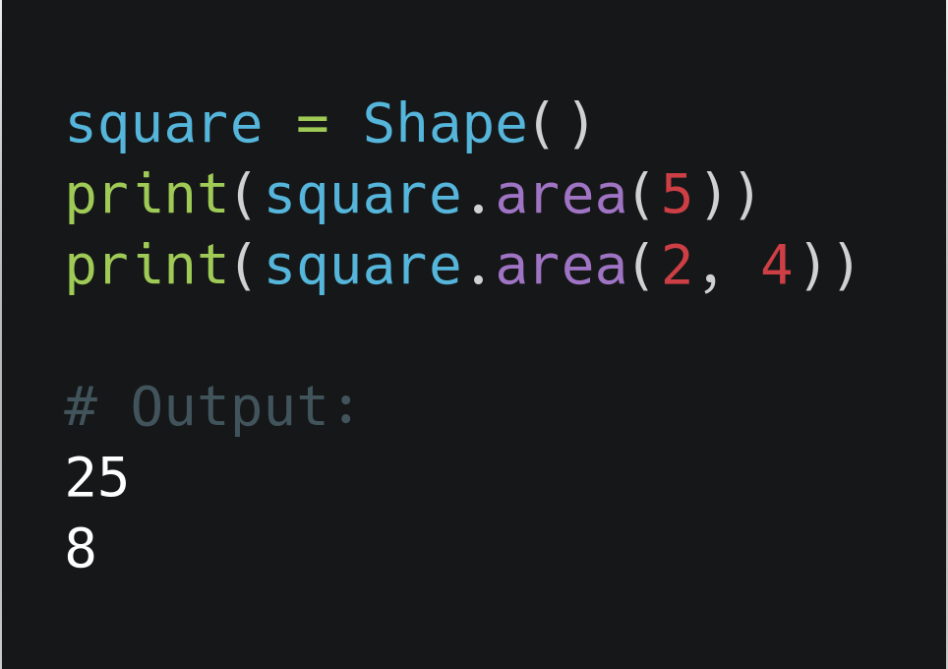
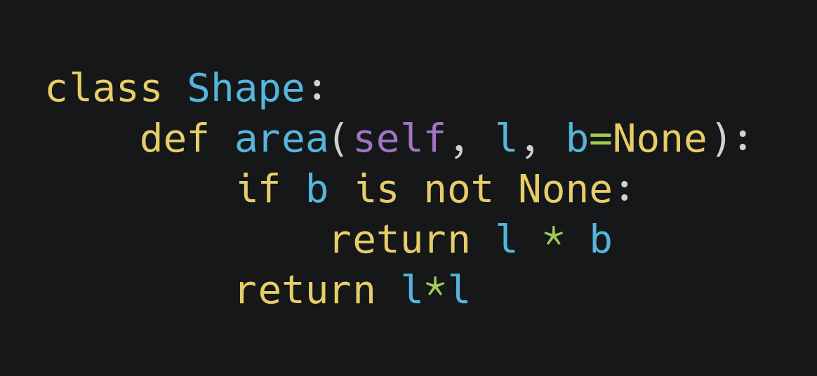
Method Overloading...

Slide 12
Method Overriding:
Method which is in super class is re-defined in sub class with the same signature
Relationship is between methods of super class and sub class.
At least one level of inheritance is required.
Also known as run time polymorphism.
An overriding method in a derived class (of the same name) can:
extend base class method.
or replace the base class method.

Slide 13
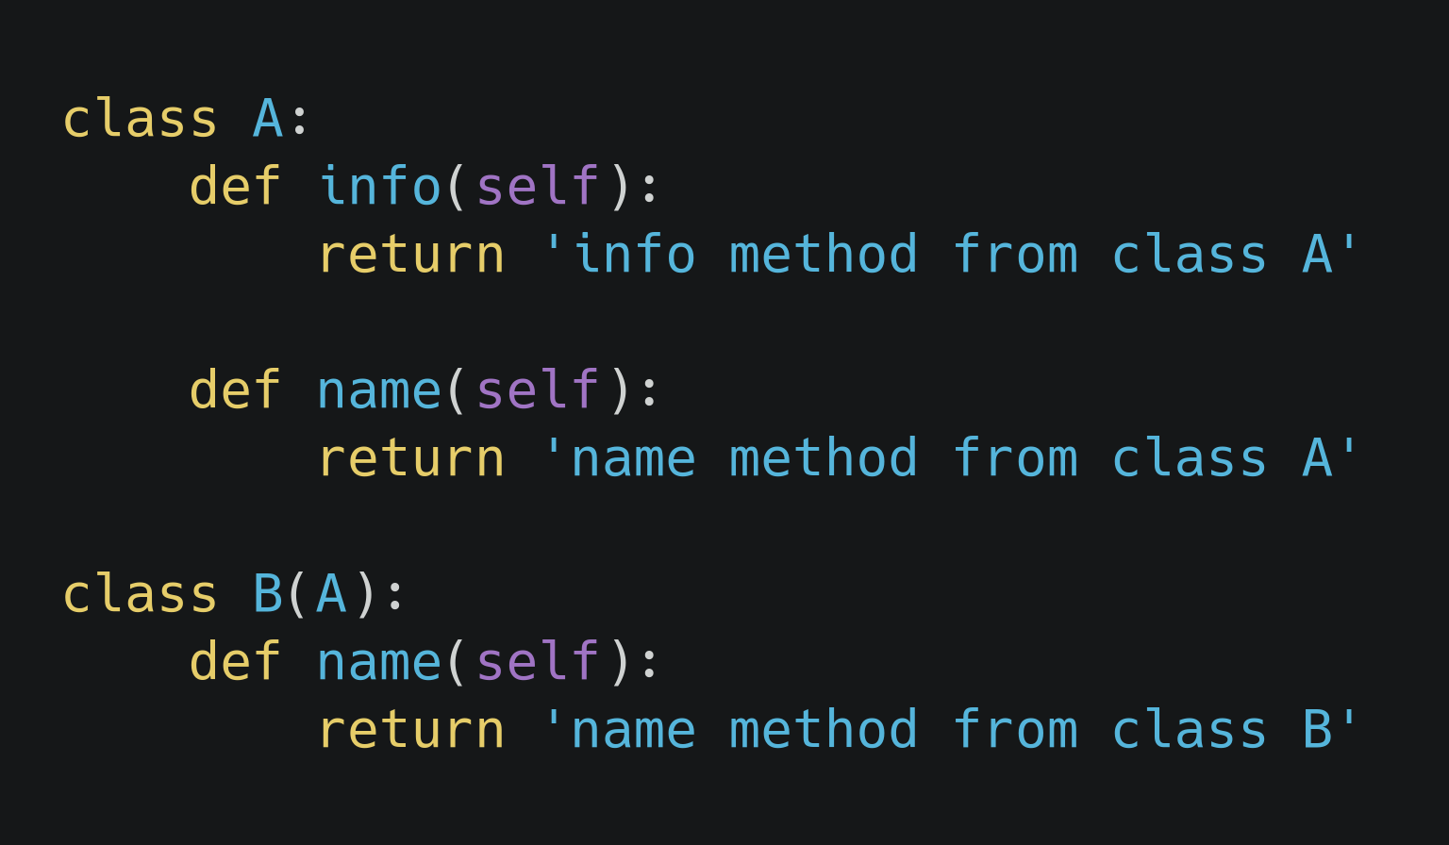
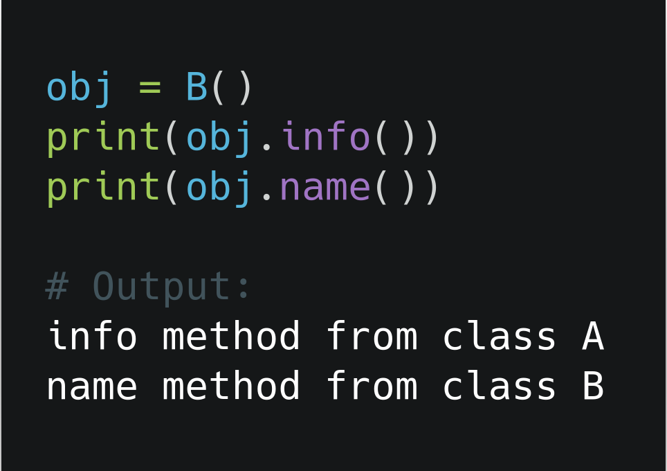
Method Overriding...
Let's walk through a very basic example where the overriden method will replace the super class's method of the same name:

Slide 14
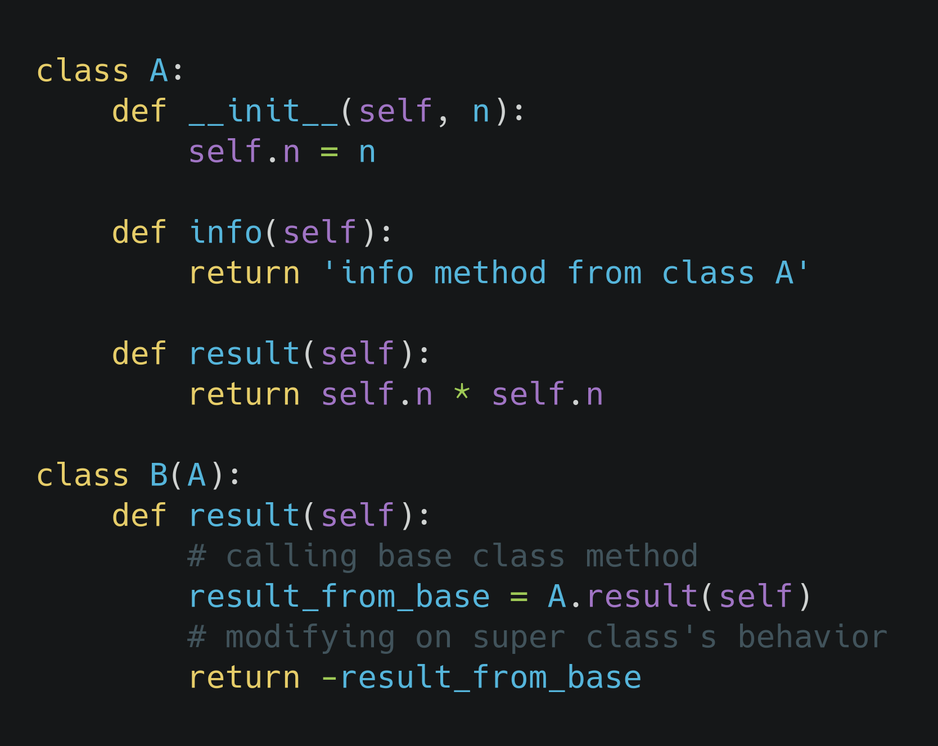
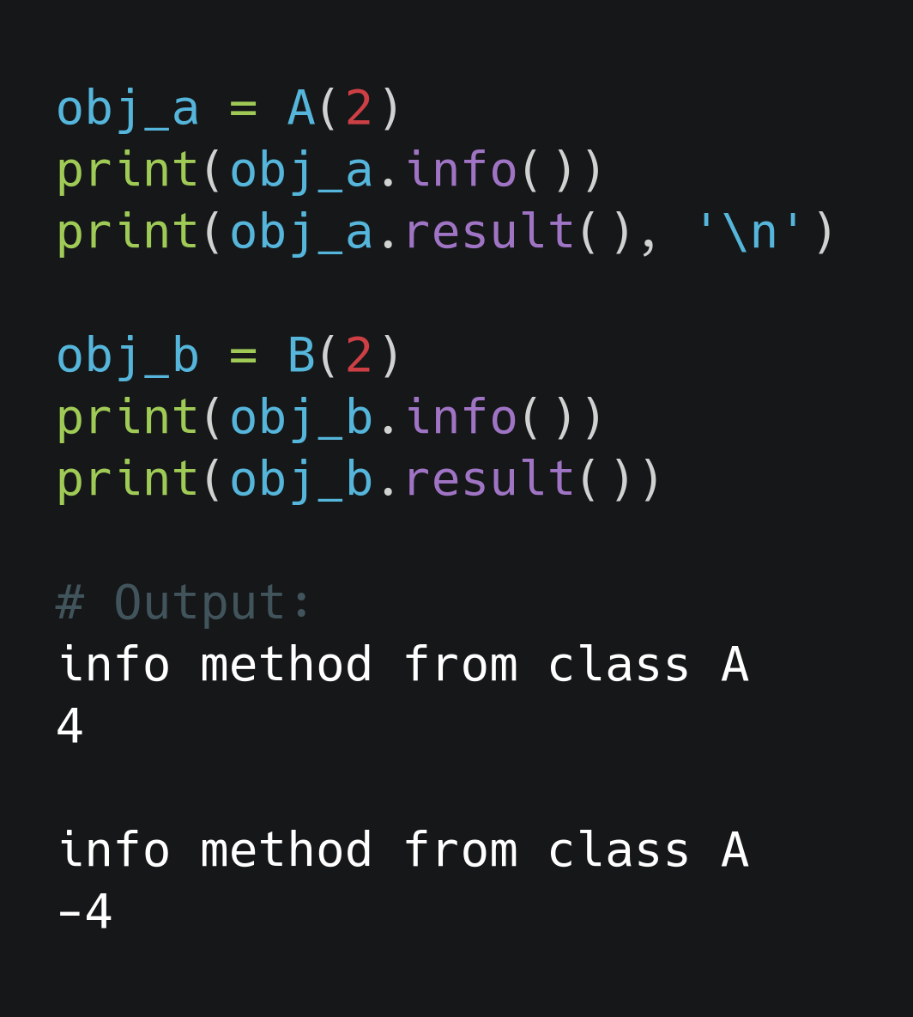
Method Overriding...
Another example where the overriden method will extend the super class's method of the same name:

Slide 15
Class methods & Static methods

Slide 16
Class methods
A class method is a method that is bound to a class rather than its object, it is shared among all objects.
The @classmethod decorator, is a builtin function decorator that is an expression that gets evaluated after your function is defined.
A class method receives the class as implicit first argument
It can modify a class state that would apply across all the instances of the class. For example it can modify a class variable that will be applicable to all the instances.

Slide 17
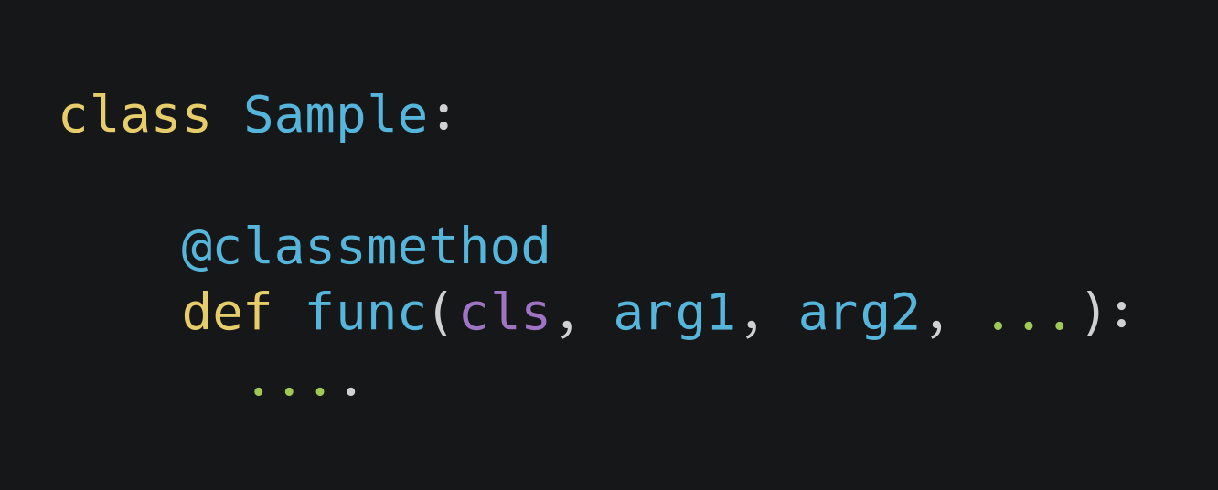
Class method
Here, we have class Sample
func is the function that needs to be converted into a class method so we have @classmethod decorator to do so.
As we see, func has the class as implicit first argument and arg1, arg2 … can be other arguments

Slide 18
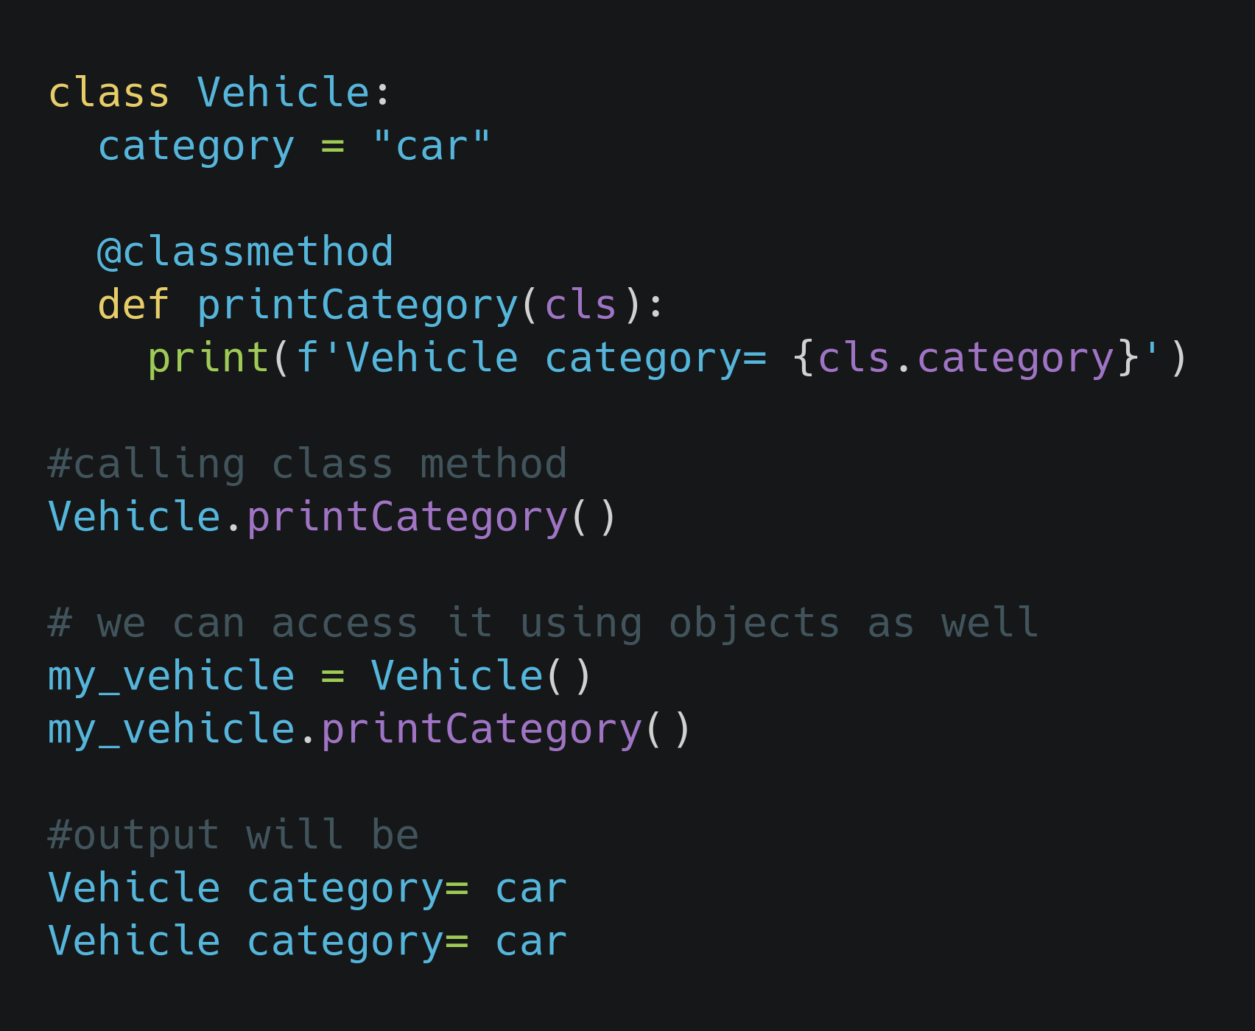
Class method Example
Here, we have a class Vehicle with class attribut category
printCategory is a classmethod
As we see, it is accessible from class and from an object as well.

Slide 19
When do you use class method?
We use class method to create factory methods
Factory methods are those methods which return a class object (like constructor) for different use cases.

Slide 20
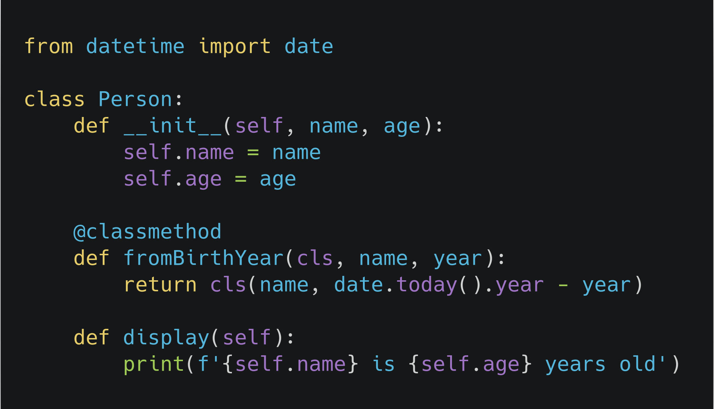
Factory methods
Here, we have two class instance creator, a constructor and a fromBirthYear method.
Constructor takes normal parameters name and age.
fromBirthYear takes class, name and year, calculates the current age by subtracting it with the current year and returns the class instance.

Slide 21
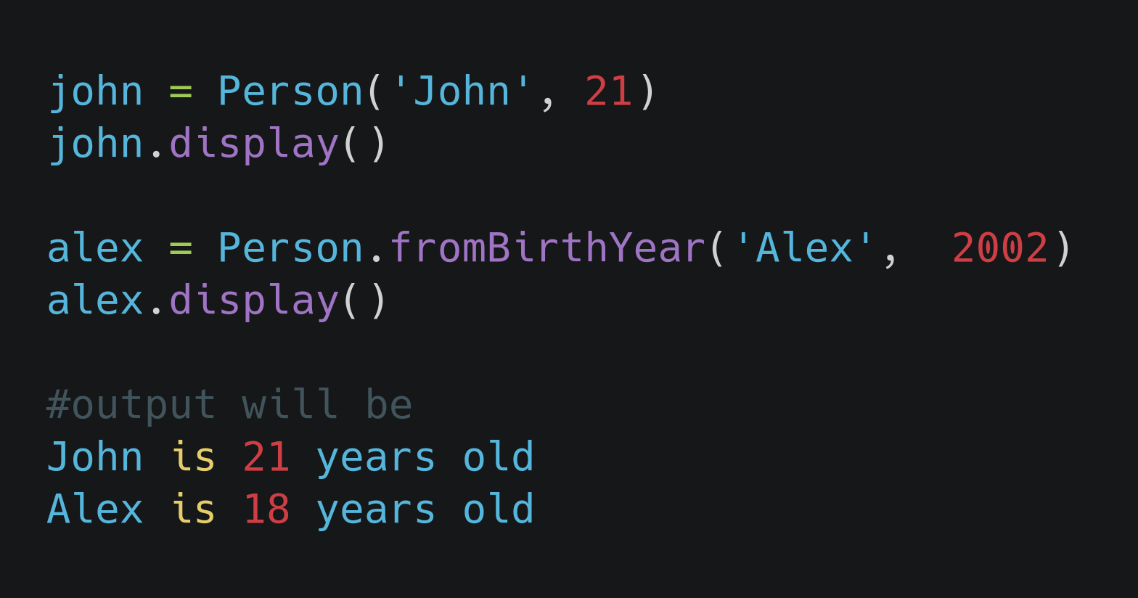
Factory methods
object john instantiated using the constructor whereas object alex is created using our factory method fromBirthYear
As we see, the age of object alex is calculated using the birth year as shown in fromBirthYear factory method which returns class object and object is instantiated.

Slide 22
Static methods
Static methods, much like class methods, are methods that are bound to a class rather than its object.
You can use the @staticmethod decorator to create a static method
They do not require a class instance creation. So, they are not dependent on the state of the object and can’t access or modify class state.
This type of method takes neither a self nor a cls parameter (but of course it’s free to accept an arbitrary number of other parameters).
Therefore a static method can neither modify object state nor class state.

Slide 23
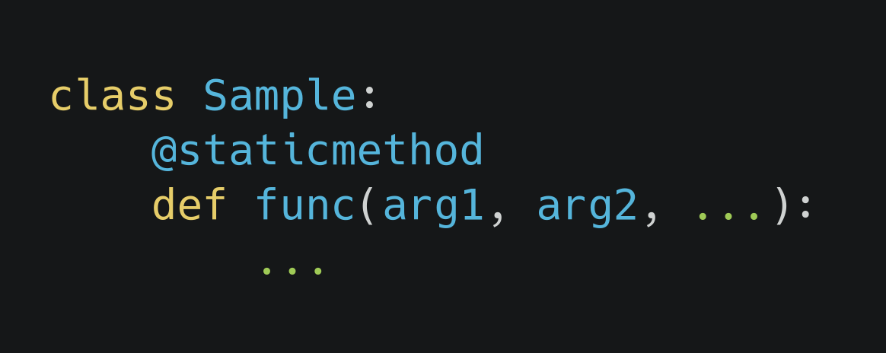
Static methods
Here, we have class Sample
We have used @staticmethod decorator to create a static method func
As discussed in previous slide, static methods take neither a self nor a cls parameter, so there are arbitary number of other parameters arg1, arg2 …
Usually, we use static methods to create utility functions which perform common, often re-used tasks.

Slide 24
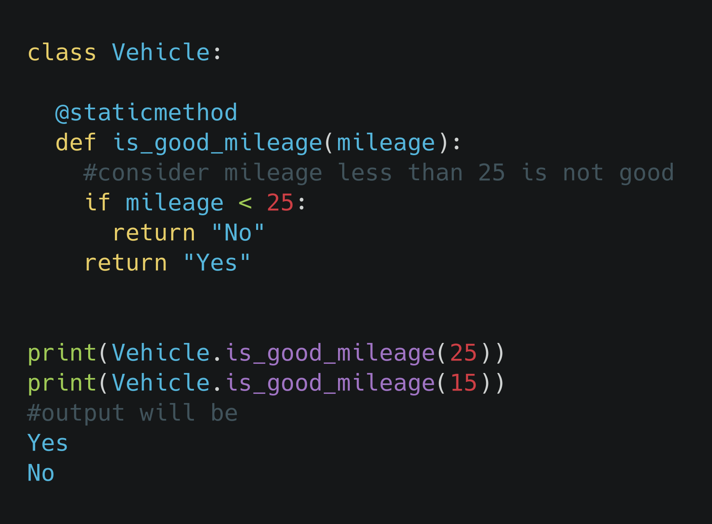
Static methods : Example
Here, we have class Vehicle and static method is_good_mileage
Static method takes 1 argument 'mileage' and returns 'Yes' or 'No' as shown
We can use static method as shown in the code or we can use is through an object as well.

Slide 25
Class method vs Static Method
A class method takes cls as first parameter while a static method needs no specific parameters.
A class method can access or modify class state while a static method can’t access or modify it.
In general, static methods know nothing about class state. They are utility type methods that take some parameters and work upon those parameters. On the other hand class methods must have class as parameter

Slide 26
Task 1
Create a class Department with parameters name and number_of_students. Create a method total students, which takes department object as a parameter and return the total number of students from all departments.

Slide 27
Task 2
Create a class Cricketer that has the properties name, age and number of match played. Create another class Batsman that inherits class Cricketer with properties number of runs and number of centuries. Similarly, create another class Bowler that inherits the class Cricketer with property number of wickets.
Create get_info() method in each classes that prints the information accordingly.

Slide 28
Task3
Create a class Person with instance attributes name and age. Create a method get_details in this class to print name and age.
Create another class Employee with attributes salary and designation and inherits the Person class. Create a method get_details in this class to print name, age, salary and designation of the Employee.

Slide 29
Task4
Create a class Circle with an instance attribute radius. Create two objects of circle c1 and c2. Add the radius of the circles and print the result.
Do the above task using a method and then a magic method.
Compare the size of the circle and print the result using magic method.

