Slide 1

BANKRUPTCY PREVENTION GROUP NO : 2
GROUP MEMBERS:
VIVEK JOSEPH
NAMRATA APARADH
SAURABH INGLE
ABHISHEK GANDHI
SHUBHAM KUMAR RAI
NEHA SHARMA
DHARMENDRA YEOLE

Slide 2

Business objective:
The fundamental goal here is to model the probability that a business goes bankrupt.

Slide 3
PROJECT ARCHITECTURE & PROJECT FLOW:
Model deployment
Model Evaluation
Model Building
Exploratory Data Analysis
(EDA)
Data Preprocessing
Data understanding

Slide 4
DATA SET DETAILS:
The dataset contains 7 columns and 250 rows.
INDUSTRIAL RISK - 0=Low Risk, 0.5=Medium Risk, 1= High Risk.
MANAGEMENT RISK - 0=Low Risk, 0.5=Medium Risk, 1= High Risk.
FINANCIAL FLEXIBILITY - 0=Low Flexibility, 0.5=Medium Flexibility, 1= High Flexibility.
CREDIBILITY - 0=Low Credibility, 0.5=Medium Credibility, 1= High Credibility.
COMPETITIVENESS - 0=Low Competitiveness, 0.5=Medium Competitiveness,
1= High Competitiveness.
OPERATING RISK - 0=Low Risk, 0.5=Medium Risk, 1= High Risk.
CLASS – Bankruptcy, Non-bankruptcy (Target Variable)

Slide 5
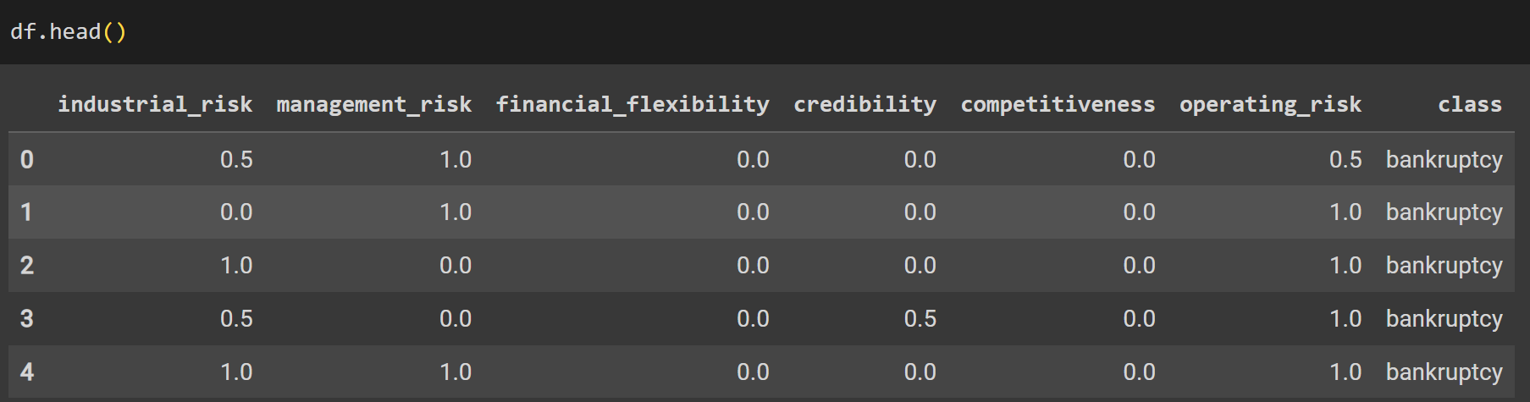
Data Set with top 5 rows:

Slide 6

EXPLORATORY DATA ANALYSIS (EDA)

Slide 7
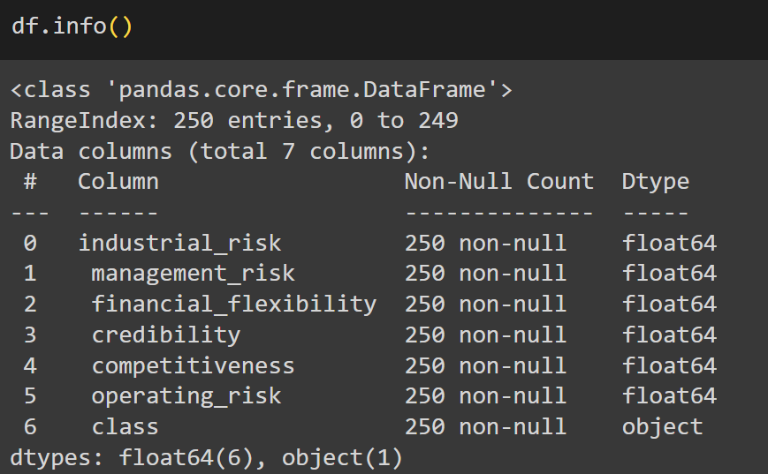
EXPLORATORY DATA ANALYSIS:
Checking Data types and Null values:

Slide 8
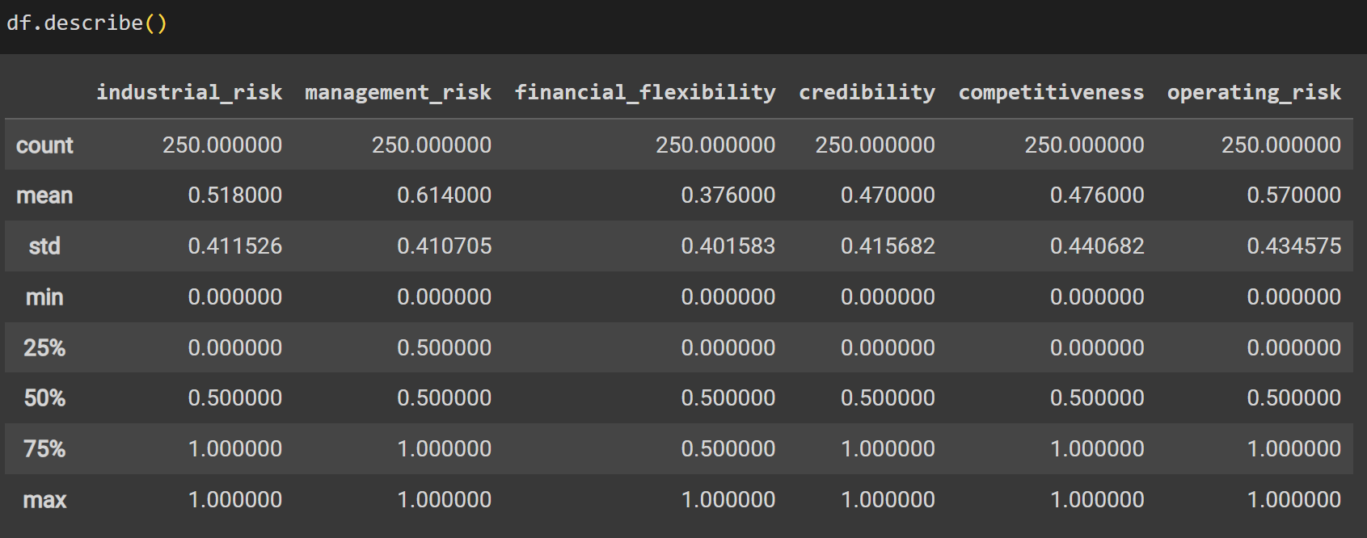
EXPLORATORY DATA ANALYSIS
Insight of different statistical distribution of features and label:

Slide 9
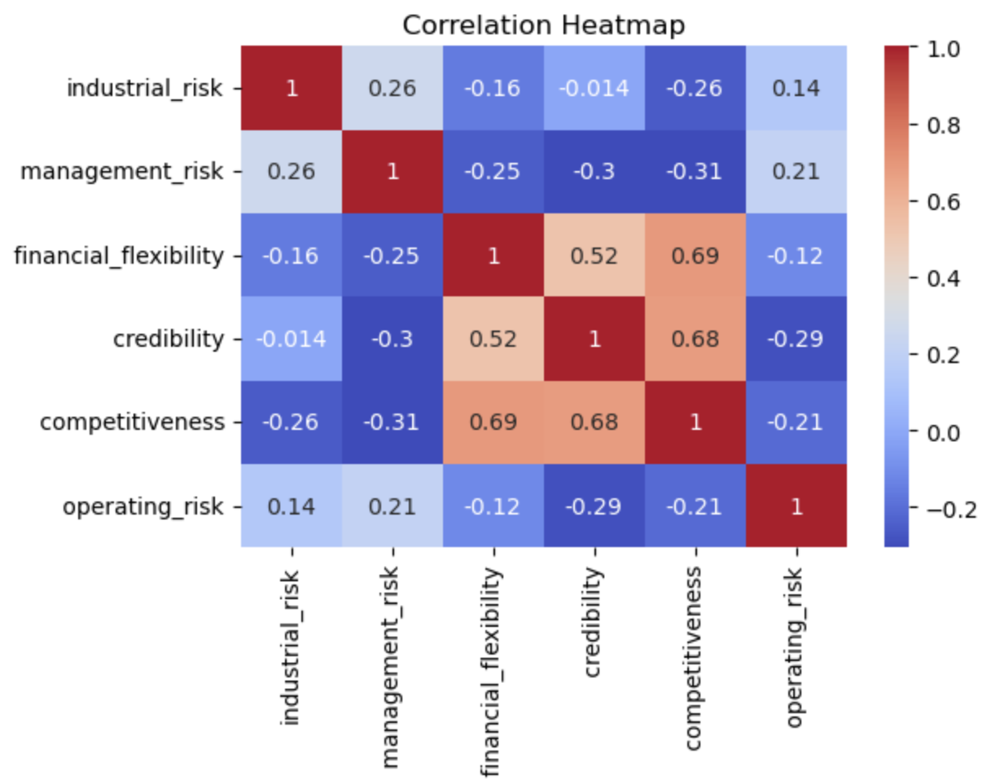
EXPLORATORY DATA ANALYSIS
Correlation between features and label:

