Slide 1

DHARMESH BHANUSHALI AMAN CHAWLA
DISHANT KALYANI OREN GAZIT
TEAM 5
SUPERVISOR: DR.WEI XU

Slide 2

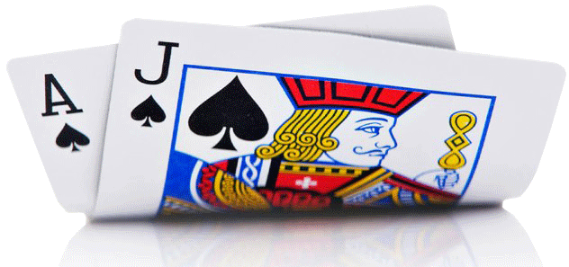
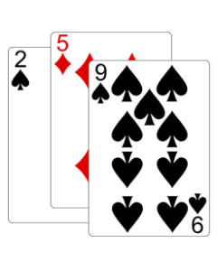


ARCHITECTURE
DEALER
SERVER
Player

Slide 3
DEFINED SERVICES
-> We have used concurrent TCP protocol services in our application
-> We have implemented Multithreading in our application using Select function
-> Scalability and Availability

Slide 4
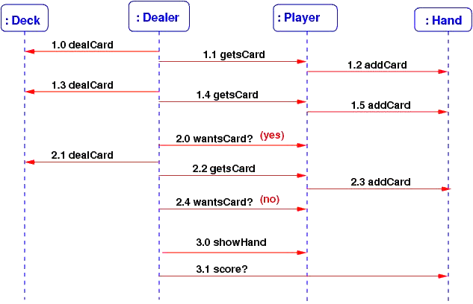
GAME IMPLEMENTATION(SEQUENCE DIAGRAM)

Slide 5
CARDS
-> This file maintains the deck of card and shuffles the cards every time we draw one
-> It allocates the card to the dealer and the player. It helps in calculating the total of the dealer and player’s hand value
-> Maintains the wait time for the connection of new clients and receiving the client request whether to hit or stand in the on going hand

Slide 6
SERVER
-> The server starts the game by handling the first client request and providing the cards to the player
-> The server ensures that if the client doesn’t connect within the given time frame the connection between the client and the server terminates
-> The server handles multiple players(clients) simultaneously at the same time

Slide 7
DEALER
->This file uses multithreading to handle multiple clients at the same time
pthread_mutex_lock and pthread_mutex_unlock
-> The Dealer will keep on playing the game till the count reaches the value of less than 17 and if it's 17 or more than 17 the dealer has the option to HIT or STAND the game
-> The comparison of the final scores and calculation of the result to be displayed on server side is performed here

Slide 8
CLIENT
-> Client(Player) starts the communication with the server by providing the IP address and the port number
-> Client provides the input to play the game within the given time frame and plays one-on-one game with the dealer
-> Clients do not communicate with each other and they don’t know the gameplay of other players

Slide 9
MULTITHREADING
PLAYER
(Slave Thread)
PLAYER
(Slave Thread)
SERVER
MASTER
THREAD
PLAYER
(Slave Thread)
PLAYER
(Slave Thread)

Slide 10
CONCURRENCY
SERVER

Slide 11
SCALABILITY
SERVER
The server can accept multiple client requests allowing each player to play the game at the same time

Slide 12
AVAILABILITY
DEALER
DEALER
Can i also Play??
Player 1
Player 1
Player 2
Player 2

Slide 13
DEMO

Slide 14
FUTURE SCOPE
Incorporate Graphical User Interface to enhance the gameplay
Include username and password to implement user account manageability
Implement a load balancer and backup server in order to make our program more robust and redundant

Slide 15
THANK YOU

