Slide 1
REALM DATABASE

Slide 2
Realm database is a third party resource.
It is open source .
It is a local storage for mobile app .
It simplify the process of creating model , entities and relationships, and it is easy to learn and use .

Slide 3
REALM STUDIO AND REALM BROWSER
The data is stored in realm file and can be opened and editable in realm studio or realm browser .

Slide 4
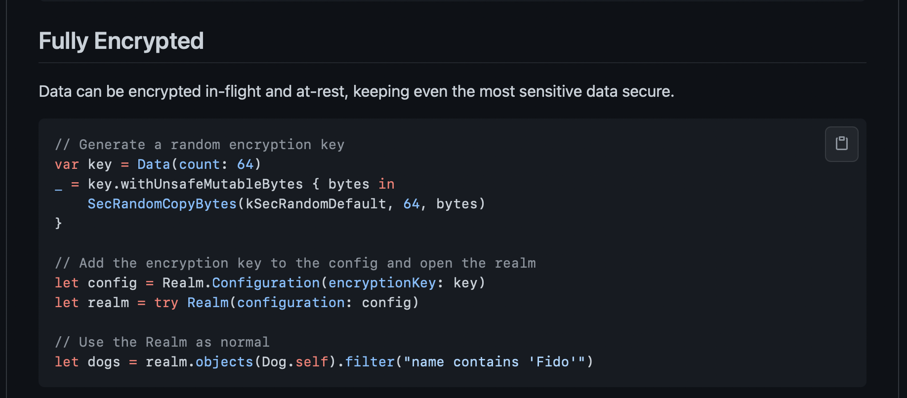

Slide 5
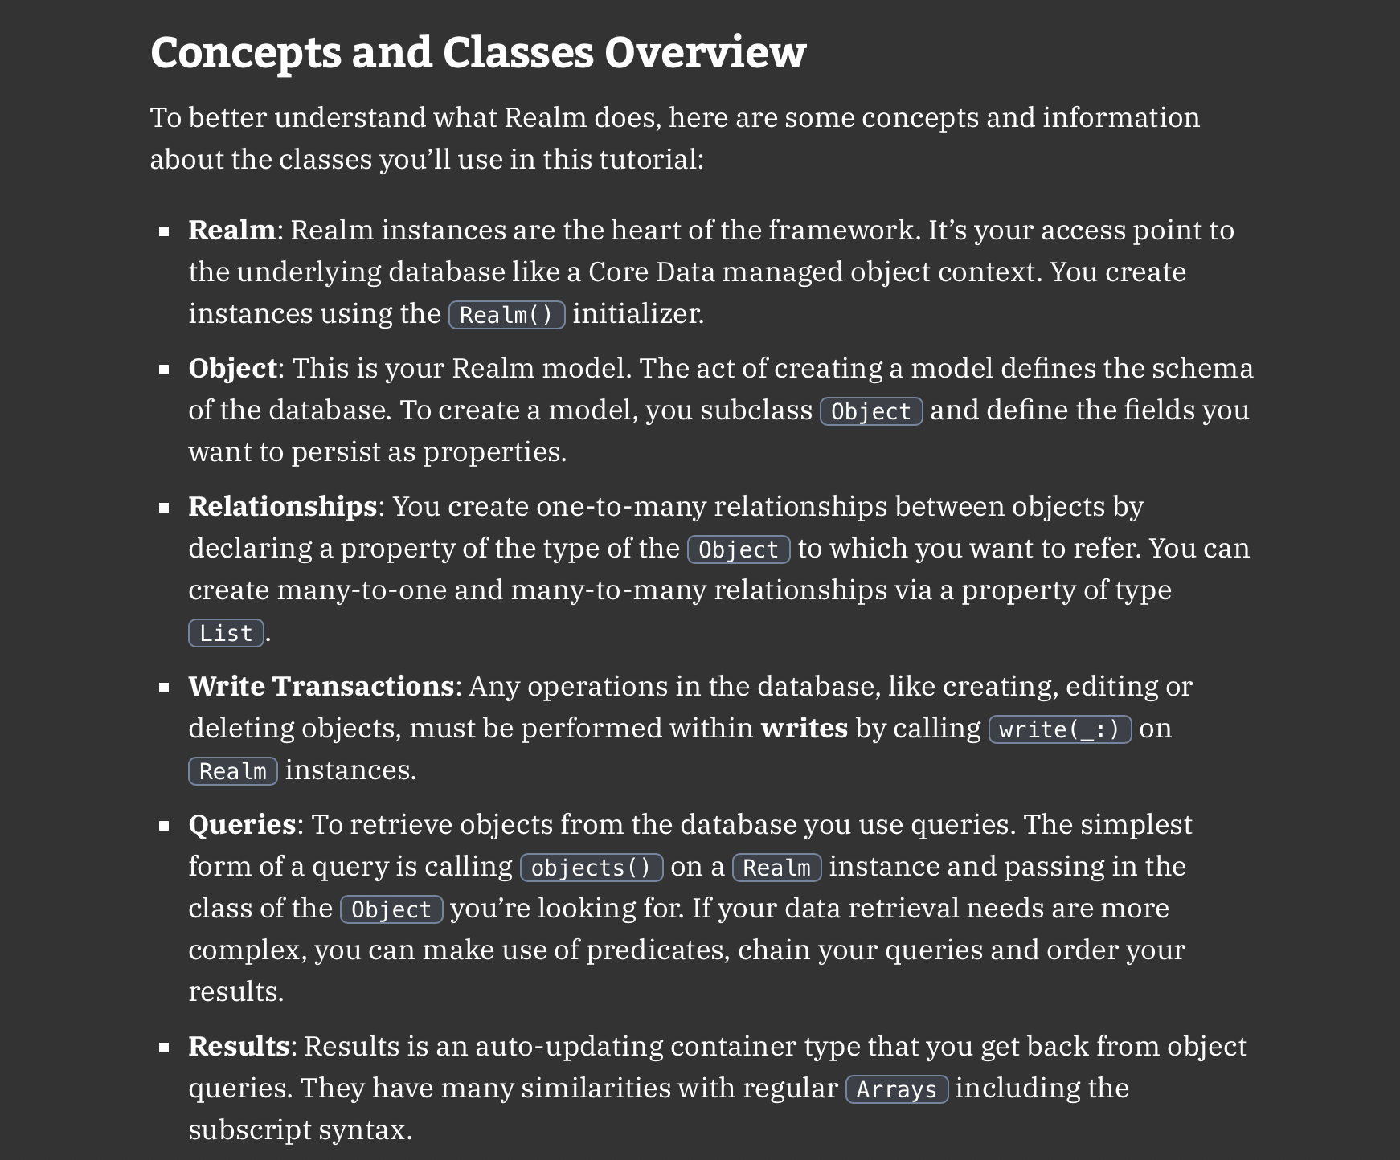

Slide 6
REALM OBJECT
The model class is easily turned into Realm object model class abcd: Object { @Persisted var name = “ “ @Persisted(primaryKey: true) var _id = ObjectId }
After release of v10.10.0 Properties can now be declared as @Persisted rather than @objc dynamic.

Slide 7
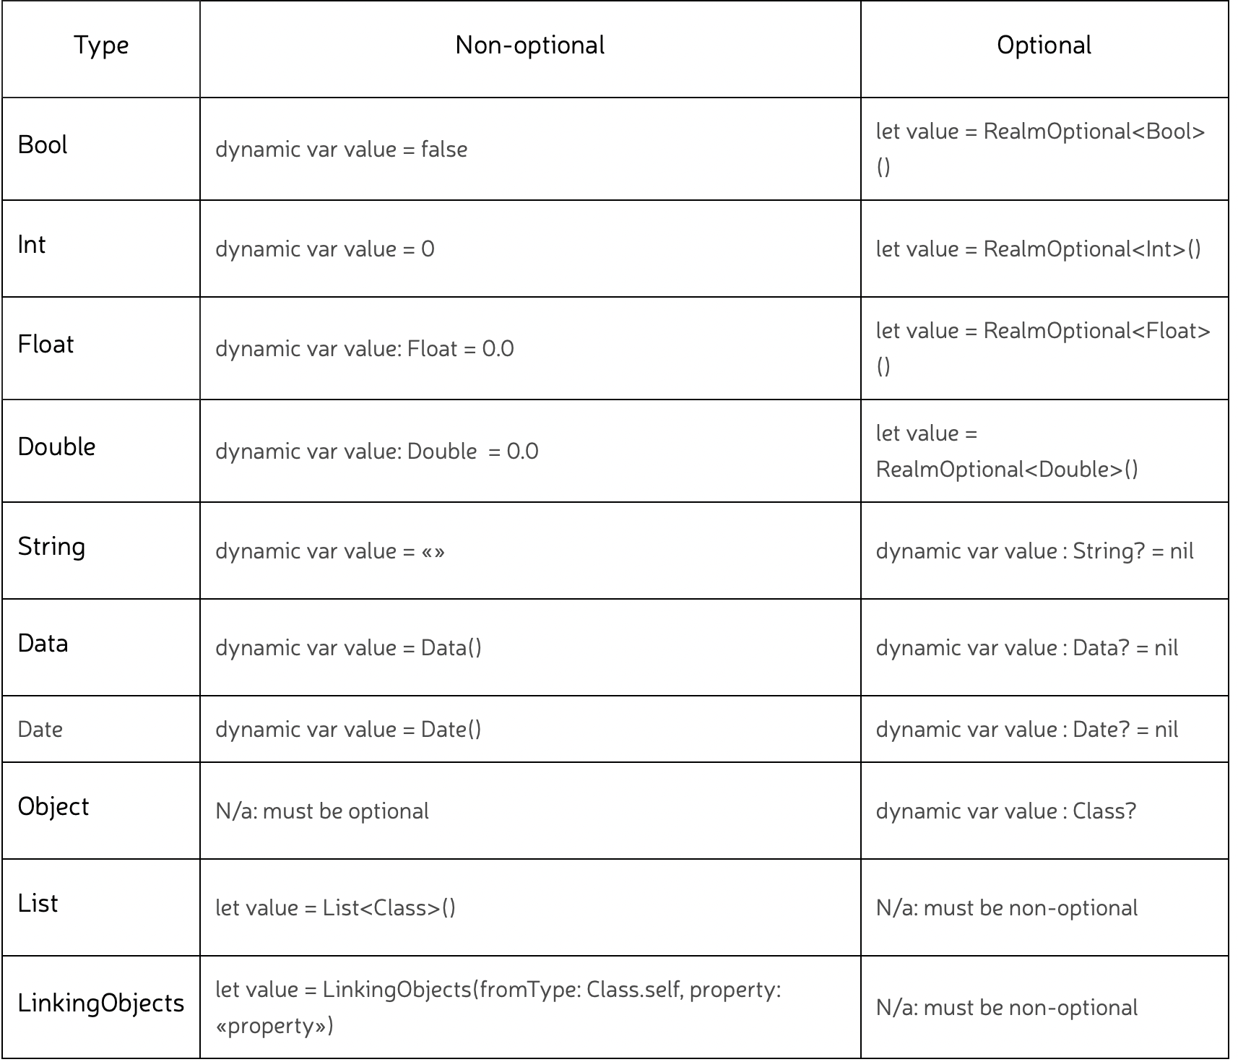

Slide 8
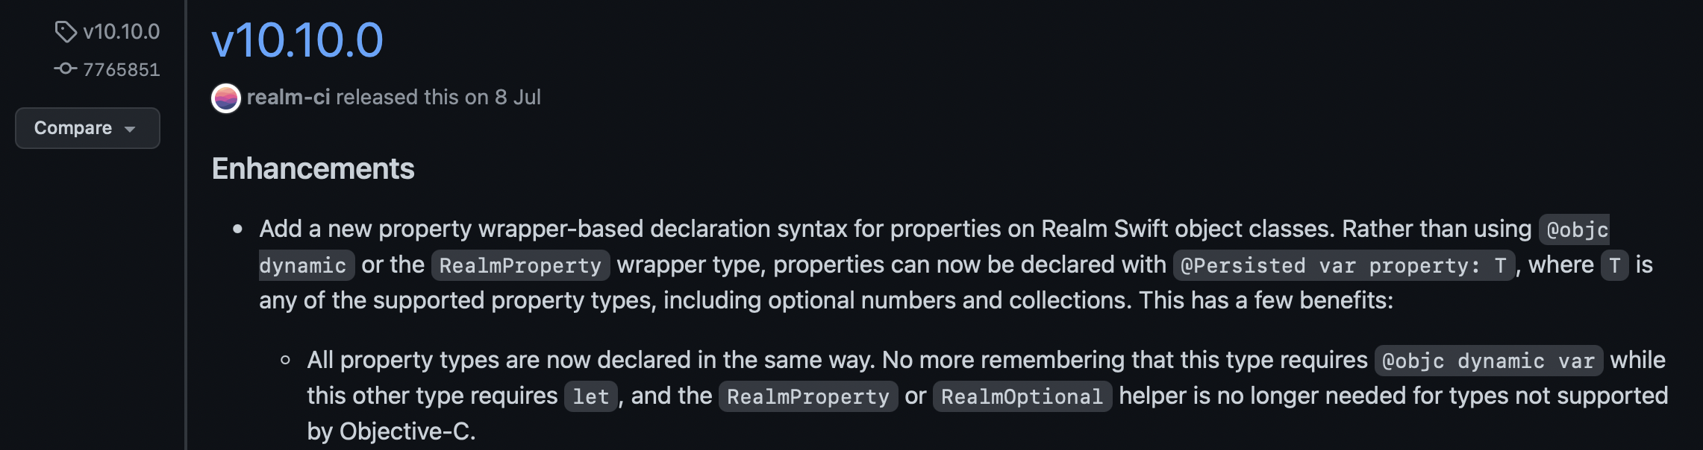
RECENT UPDATE
@objc dynamic -> @Persisted

Slide 9
REALM CRUD OPERATIONS
We can perform operation on Realm reference object like realm.write { realm.add() } realm.object() { } realm.write { realm.delete() } Also we can apply multiple operation while reading data from realm realm.object().filter().sort() { }

Slide 10
CORE DATA VS REALM DATABASE

Slide 11
The task of choosing the best database solutions when developing a mobile application is much more important than it might seem at first glance.

Slide 12
Realm isn’t based on ORM (Object-Relational Mapping). It works on its own engine, the main differences of which are simplicity and speed

Slide 13
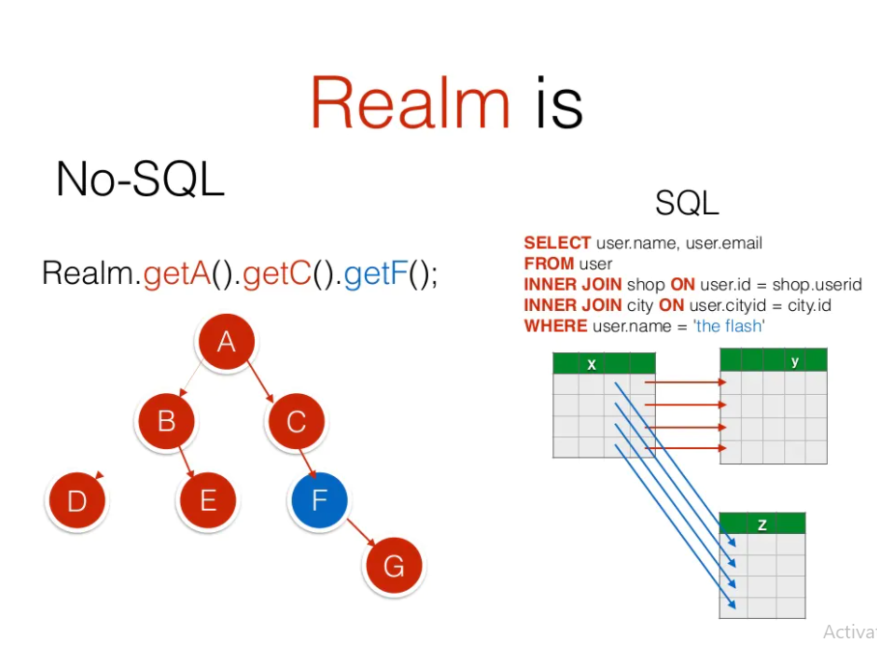

Slide 14
Pros of Core Data
The main advantage of CoreData is a graph diagram allowing us to establish relations between entities (one-to-one, one-to-many, etc.).
Apple framework offers a visual representation of the model in the Xcode model editor. And this is one of the reasons why some developers still consider Core Data to be the best mobile database.

Slide 15
Pros of Realm Database
Realm uses its own engine, simple and fast. Thanks to its zero-copy design, Realm is much faster than ORM, and often faster than SQLite either.
There is also a Realm database for Android and iOS. So we don't have to change the logic when working on different platforms, just use the same models in Java, Swift, and Objective-C.

Slide 16
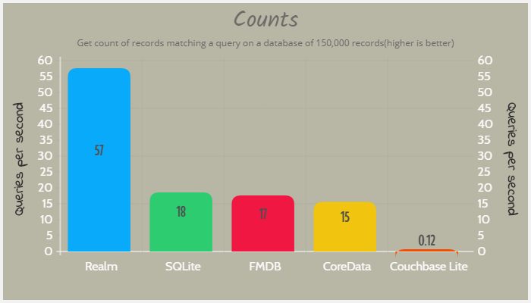

Slide 17
Thank You Have a Nice Weekend

