Slide 1
Customer Churn Analytics,
Revenue Risk & Retention Optimization
project: Python • SQL Server • Tableau • Machine Learning
Total Customers
Churn Rate
Revenue at Risk
7,032
26.58%
$1.67M

Slide 2
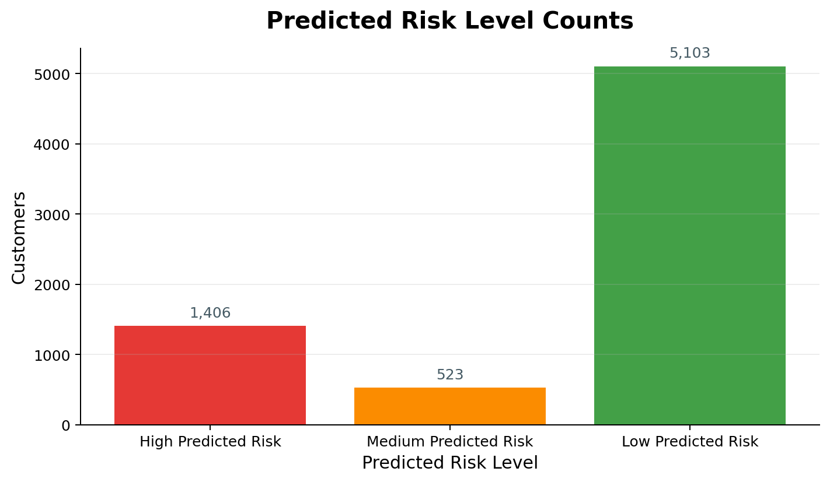
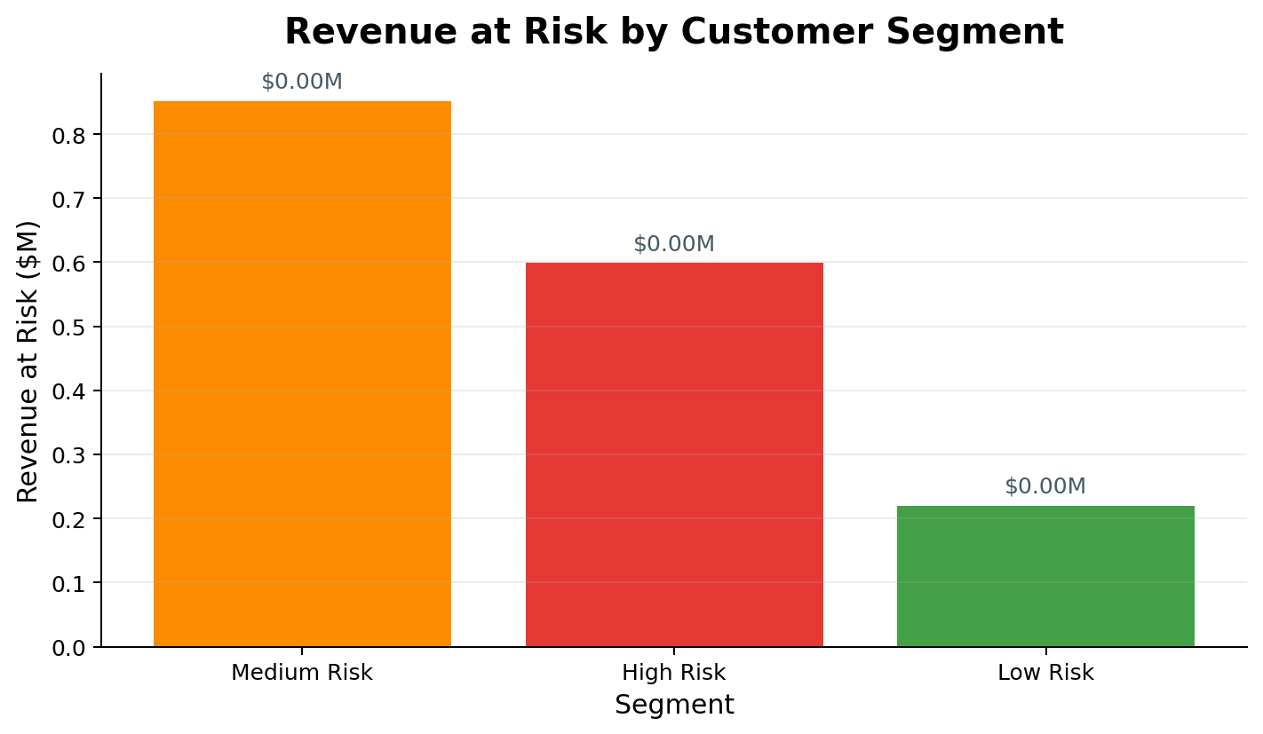
Executive summary
Customer base
Churn rate
Annual revenue
Revenue at risk
7,032
26.58%
$5.47M
$1.67M
clean records after data preparation
about 27 customers out of 100 left
estimated from monthly charges
linked to churned customers
The main churn pattern is clear: customers with month-to-month contracts, low tenure, and electronic check payments are much more likely to leave.
The business should move from only reporting churn to prioritizing active customers with high predicted risk and high annual value.
Predicted churn risk groups
Revenue impact by risk segment

Slide 3
Business problem and analytics approach
Business question
Workflow used in the project
1
Python
Cleaned data, created revenue and risk features
Which customers are likely to leave, why are they leaving, and how can the company reduce churn while protecting revenue?
2
SQL
Wrote business queries for churn and revenue
3
ML
Built churn probability and risk level scoring
4
Tableau
Built dashboard for decision-making
The workflow mirrors a real analytics request: define the business question, prepare reliable data, analyze drivers, quantify revenue impact, predict risk, and communicate actions.
Clean rows
Final outputs
Decision focus
7,032
Notebook + SQL + Tableau + README
Retention priority

Slide 4
Data preparation: from raw file to business-ready dataset
Dataset after cleaning
Feature engineering
Converted TotalCharges from text to numeric values.
Removed 11 records with missing TotalCharges after conversion.
Created a clean customer table with 7,032 records.
Saved clean outputs for SQL, Tableau, and machine learning.
ChurnFlag
1 = churned, 0 = stayed
EstimatedAnnualRevenue
MonthlyCharges × 12
TenureGroup
0–12, 13–24, 25–48, 49+ months
RevenueAtRisk
Annual revenue linked to churned customers
CustomerRiskSegment
High / Medium / Low business risk
PredictedRiskLevel
ML-driven churn risk group
Why this matters: the project does not stop at cleaning. It turns raw customer data into metrics that business leaders can use for retention decisions.

Slide 5
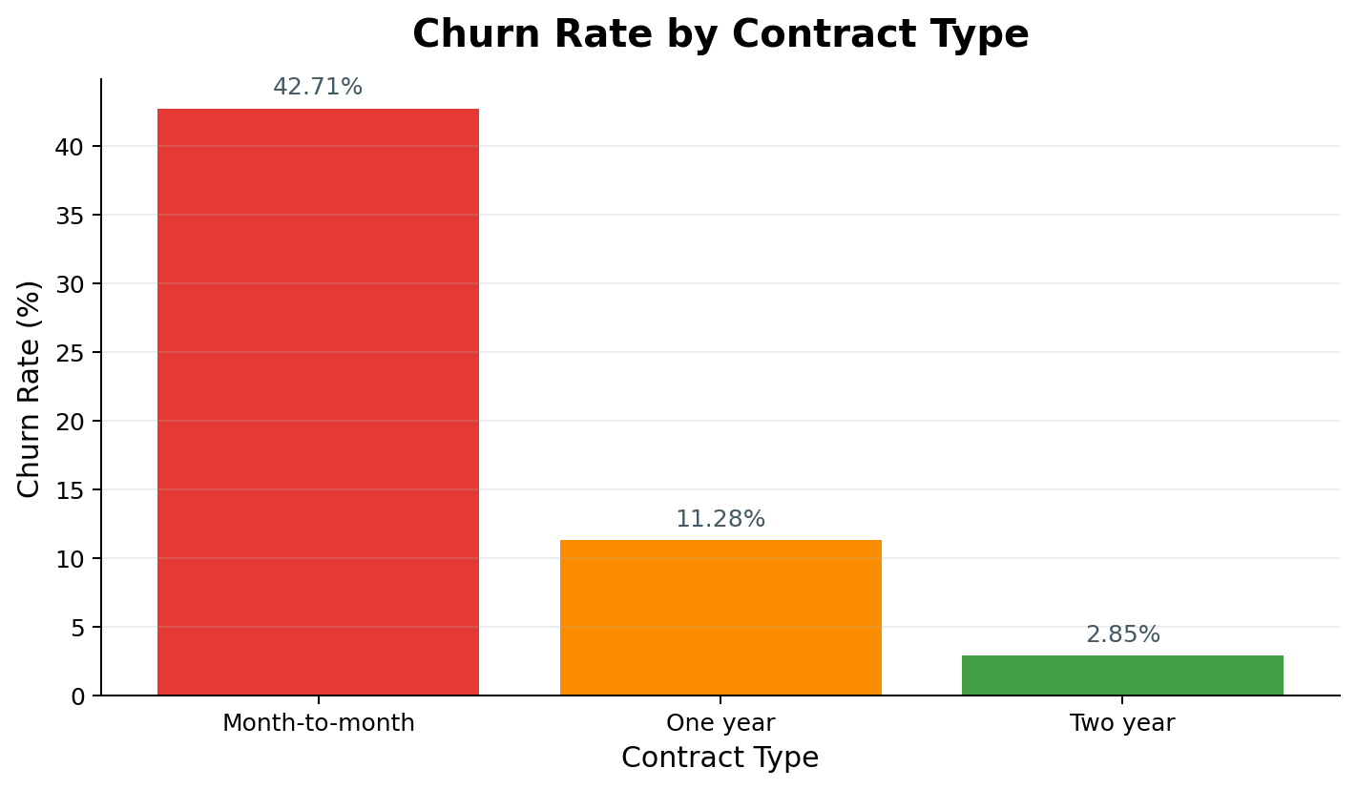
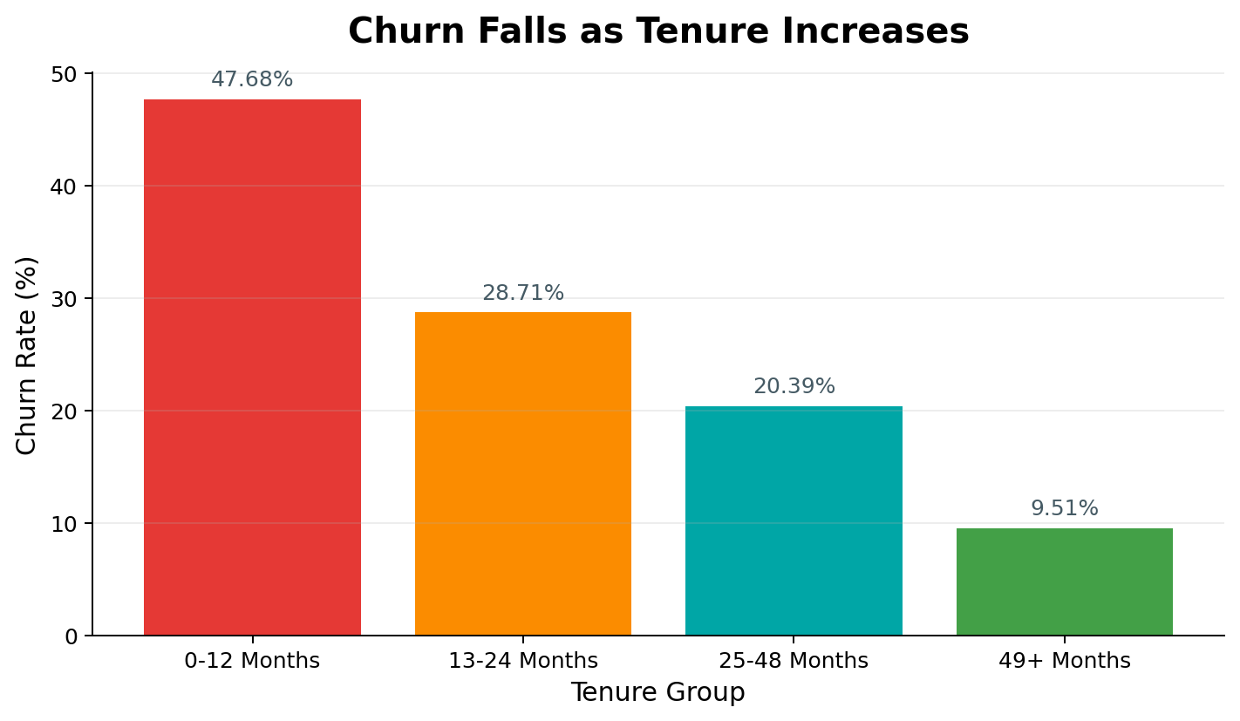
Core churn drivers: contract and tenure
Contract type is the strongest business signal
New customers churn much more often
Interpretation: Month-to-month customers churn at 42.71%, while two-year customers churn at only 2.85%. Customers in the first 12 months churn at 47.68%.

Slide 6
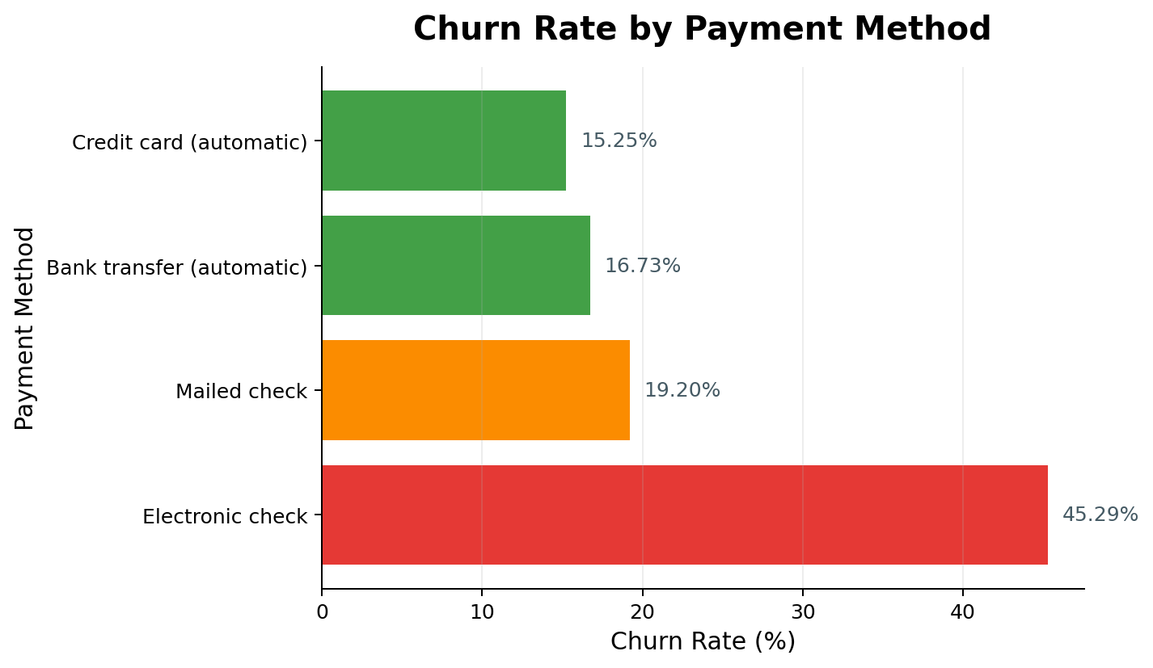
Payment method and customer risk segmentation
Payment method shows retention friction
Customer risk logic used
High Risk
Month-to-month, monthly charges ≥ $70, tenure ≤ 12 months
Medium Risk
Month-to-month customers not captured in High Risk
Low Risk
One-year or two-year contract customers
Electronic check customers churn at 45.29%, much higher than credit card automatic payment customers at 15.25%.
Business meaning: payment method may be a simple but actionable retention lever.

Slide 7
Revenue impact: churn becomes a financial priority
Total estimated annual revenue
Estimated revenue at risk
Churn rate
$5.47M
$1.67M
26.58%
based on MonthlyCharges × 12
annual revenue tied to churned customers
overall customer churn rate
Revenue at risk by risk segment
Medium-risk customers account for the largest revenue at risk because the group is larger. High-risk customers have the highest churn rate, so both groups matter for retention.
Use revenue at risk to prioritize retention budget.
Do not only count churned customers; measure value impact.
Combine churn risk and annual value to identify priority accounts.

Slide 8
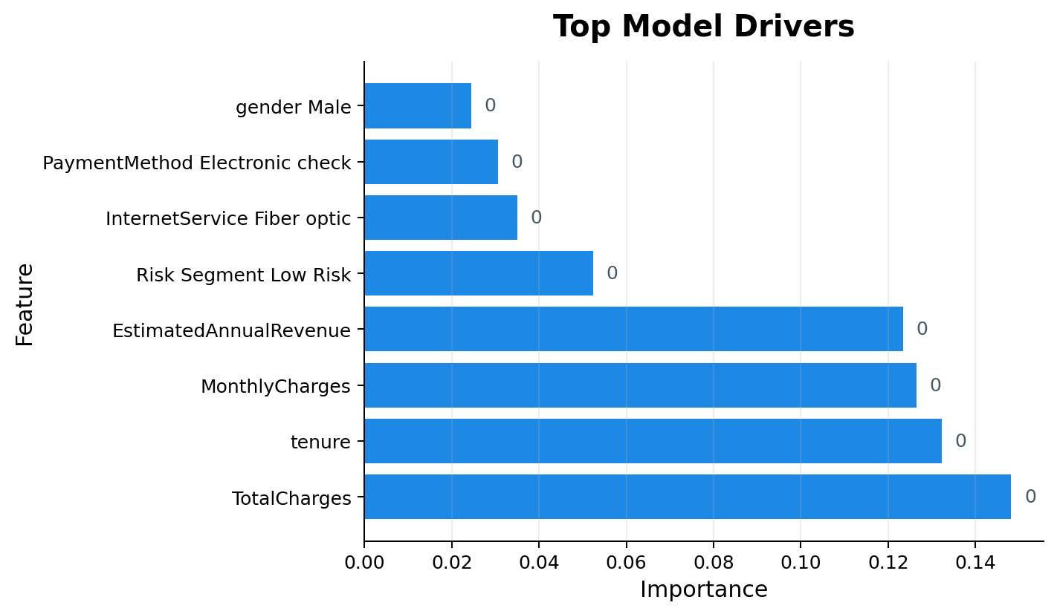
Machine learning: customer-level churn probability
Model accuracy
High predicted risk
Medium predicted risk
Low predicted risk
78.54%
1,406
523
5,103
test set result
customers with ≥70% churn probability
customers with 40–69% churn probability
customers below 40% churn probability
Top model drivers
Predicted risk distribution
Use case: the model score helps the business contact customers before they churn, instead of only reporting customers who already left.

Slide 9
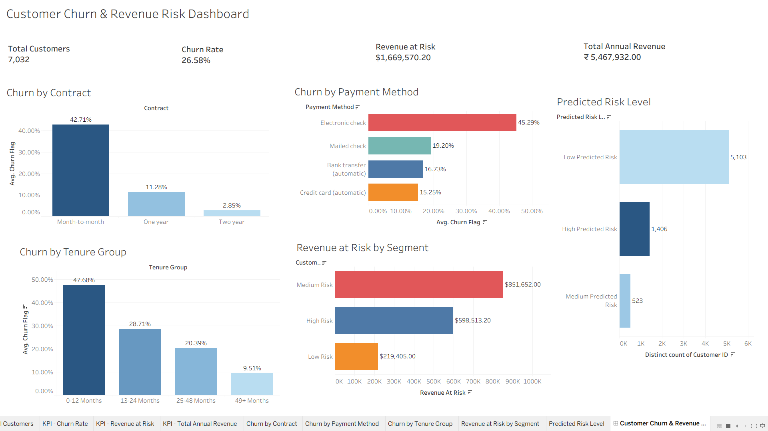
Tableau dashboard: executive view of churn and revenue risk

Slide 10
Retention recommendations
Move month-to-month customers toward longer contracts
1
Offer loyalty discounts, bundled services, or annual contract incentives.
Prioritize high-value customers at risk
4
Use churn probability + annual revenue to build retention priority lists.
Improve first-year customer onboarding
2
Focus on early support, welcome offers, and customer success touchpoints.
Monitor churn through Tableau
5
Track churn rate, revenue at risk, and predicted risk level monthly.
Reduce payment friction
3
Encourage automatic bank transfer or credit card payment options.
The best retention strategy is not one campaign for everyone. The business should prioritize by churn probability, contract type, tenure, payment method, and revenue at risk.

Slide 11
Why this project is strong for analytics roles
Python + Pandas
SQL Server
Cleaned data, created features, performed EDA, built model input.
Wrote business queries with aggregation, grouping, and retention lists.
Tableau
Machine Learning
Built an executive dashboard for churn, revenue risk, and prediction results.
Created churn probability and predicted risk levels for customers.
Business Storytelling
Sales Analytics Fit
Connected churn behavior to retention actions and revenue impact.
Mirrors work around customer segmentation, revenue risk, and stakeholder reporting.
Recruiter-facing takeaway: this project shows the ability to turn a business question into a complete analytics solution: clean data, analyze patterns, quantify impact, predict risk, and communicate recommendations.

Slide 12
Churn is both a customer problem and a revenue problem.
This analysis identified the biggest churn drivers, quantified revenue at risk, and created a model-driven way to prioritize retention actions before customers leave.
Best next business action
Prioritize high-value customers with high predicted churn risk
Thank you

