Slide 1
Supply Chain Performance
& Delivery Delay Analysis
54.82%
Identifying late delivery risk, profit impact, and operational improvement opportunities
late delivery rate
More than half of orders were delivered late.
Portfolio presentation | Python • SQL • Tableau
Prepared by Dharmik Nakrani
01

Slide 2
Business problem
The analysis begins with one simple question: where is the delivery process breaking down?
The company is moving a high volume of orders, but delivery reliability is weak.
TOTAL ORDERS
LATE ORDERS
65,752
36,048
Late deliveries can damage customer trust, increase support issues, and make premium shipping feel unreliable.
unique orders analyzed
orders delivered late
LATE DELIVERY RATE
AVG DELAY
54.82%
0.57 days
main business problem
average across all rows
Business goal
Find which shipping modes, regions, and product categories create delay risk — then turn those findings into operational recommendations.
Portfolio project | Python • SQL • Tableau
02

Slide 3
How the project was built
The workflow follows a real analyst process: prepare the data, validate it, analyze it, and communicate the decision.
1
Raw dataset
2
Clean & validate
3
Feature engineering
4
Analysis
5
Dashboard & story
180,519 rows / 53 columns
removed duplicates, fixed dates, checked missing values
delay_days, delivery_result, profit_margin, month fields
KPIs, shipping mode, region, category, profit, trend
Tableau executive dashboard with recommendations
CLEANED ROWS
CLEANED COLUMNS
MISSING VALUES
DATE RANGE
180,511
25
0
2015–2018
after removing duplicates
analysis-ready fields
validated before analysis
historical order data
Portfolio project | Python • SQL • Tableau
03

Slide 4
Executive KPI snapshot
The first view summarizes scale, revenue, profit, and the delivery reliability gap.
Total Orders
Late Orders
Late Delivery Rate
Total Sales
Total Profit
65,752
36,048
54.82%
$36.78M
$3.97M
unique orders
delivered late
main issue
order revenue
profit captured
The business has enough sales volume to be meaningful — but the reliability problem is also large enough to be urgent.
A 54.82% late delivery rate means delay is not a small operational issue. It is a core performance problem that should be monitored as a monthly KPI.
Portfolio project | Python • SQL • Tableau
04

Slide 5
Where the delay risk shows up
Premium shipping is underperforming, and several regions show consistently high late delivery rates.
Shipping mode: premium options are failing expectations
Top regions: geography also matters
Human takeaway: First Class should feel reliable, but it has a 95.27% late delivery rate. That is the strongest signal for operational review.
Portfolio project | Python • SQL • Tableau
05

Slide 6
Profit impact and product category risk
The project checks not only where delays happen, but also whether they matter for business performance.
Profit comparison
High-volume categories: where to focus operations
On-time orders have slightly better efficiency
Profit margin: 10.97% on time vs 10.63% late. The gap is small, but it supports the idea that delivery reliability matters.
Better analyst thinking: high percentages are useful, but high-volume delayed categories deserve priority because they affect more customers.
Portfolio project | Python • SQL • Tableau
06

Slide 7
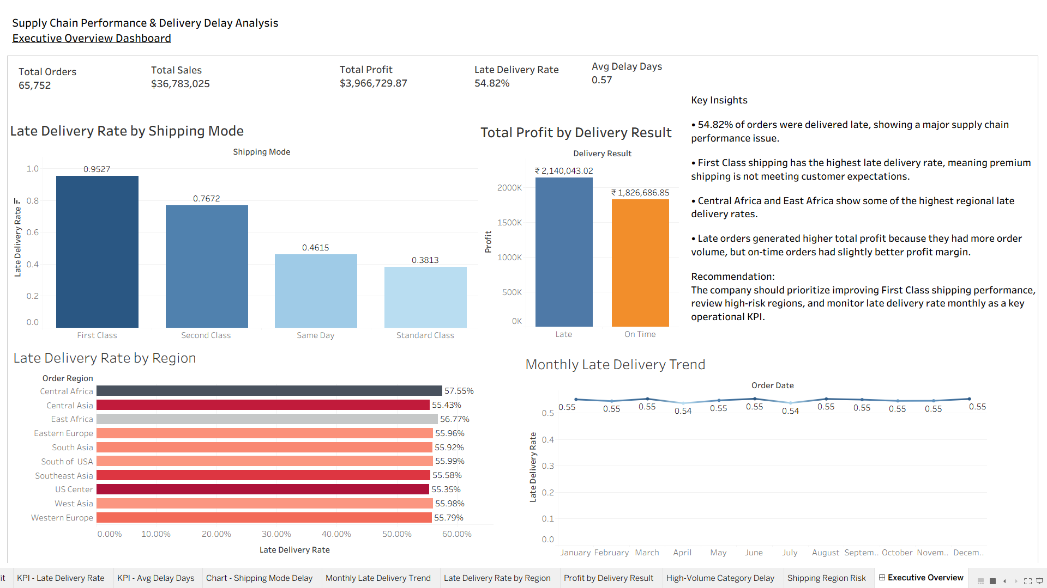
Tableau dashboard: executive view
The dashboard turns the analysis into a simple business view for decision makers.
What the dashboard helps answer
•
How serious is the late delivery problem?
•
Which shipping modes create the most risk?
•
Which regions are most affected?
•
How do late orders compare with on-time orders?
•
What actions should the business take next?
Built for storytelling, not just charts.
Portfolio project | Python • SQL • Tableau
07

Slide 8
Recommended actions
The goal is not only to explain what happened, but to show what the business should do next.
1
Improve First Class shipping
2
Review high-risk regions
3
Monitor delays monthly
95.27% late delivery rate makes it the highest-priority operational issue.
Central Africa and East Africa should be reviewed for carrier and route performance.
Use late delivery rate as a monthly supply chain KPI with alerts.
4
Focus on high-volume categories
5
Compare carriers by region + mode
Cleats, Electronics, Accessories, and Golf Gloves can affect many customers.
Find weak logistics partners and set performance targets.
Final goal: reduce late deliveries, improve customer trust, and make supply chain performance easier to manage.
Portfolio project | Python • SQL • Tableau
08

