Slide 1


Hostel Management System
MD HOSTEL
By Viradiya Dharmik - 21I174

Slide 2

Agenda
Introduction
Problem Statement
Objectives
Flutter Setup
Major Functionality
Work Done & Demo
References

Slide 3

Introduction
Hostel Management System Application: Streamlining and automating hostel management for administrators and residents.\
Core functionalities: Student profiles, fee management, admissions, room allotment, leave management, food ordering, and complaint registration.
Benefits: Convenience, transparency, accountability, and improved hostel management.

Slide 4

Problem statement
Challenges with existing hostel management: Manual processes, errors, delays, and communication issues.
Need for a modern solution: Automate tasks, online fee payment, room allocation, and communication improvement.

Slide 5

Objective
Primary objective: Provide a user-friendly platform for hostel management.
Specific objectives: Automation, online fee payment, efficient room allotment, streamlined communication, complaint management, attendance tracking, data security, user-friendly interface, real-time insights, scalability, and adaptability.

Slide 6


Technology Description
Dart
Dart is an open-source, general-purpose, object-oriented programming language with C-style syntax developed by Google in 2011. The purpose of Dart programming is to create a frontend user interfaces for the web and mobile apps. It is compiled to native machine code for building mobile apps, inspired by other programming languages such as Java, JavaScript, C#, and is Strongly Typed.

Slide 7

Technology Description ( Contd. )
Flutter
Flutter is a free and open-source mobile UI framework created by Google and released in May 2017. it allows you to create a native mobile application with only one codebase. This means that you can use one programming language and one codebase to create two different apps (for iOS and Android).
Flutter consists of two important parts:
•An SDK (Software Development Kit)
•A Framework (UI Library based on widgets)

Slide 8

Major Functionality
Functionalities for Admin, Student, Rector, Parent, Staff, Counsellor, Food Manager, Helpers.
Key features for each user role.

Slide 9

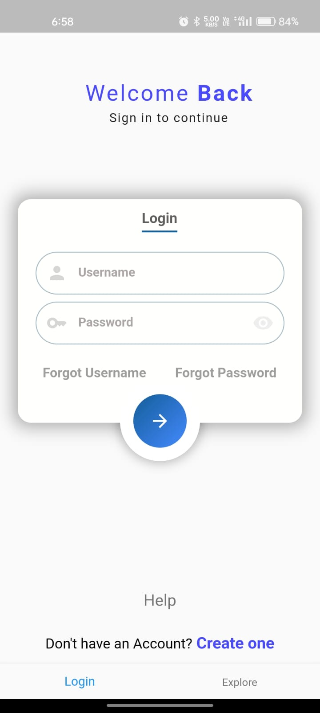
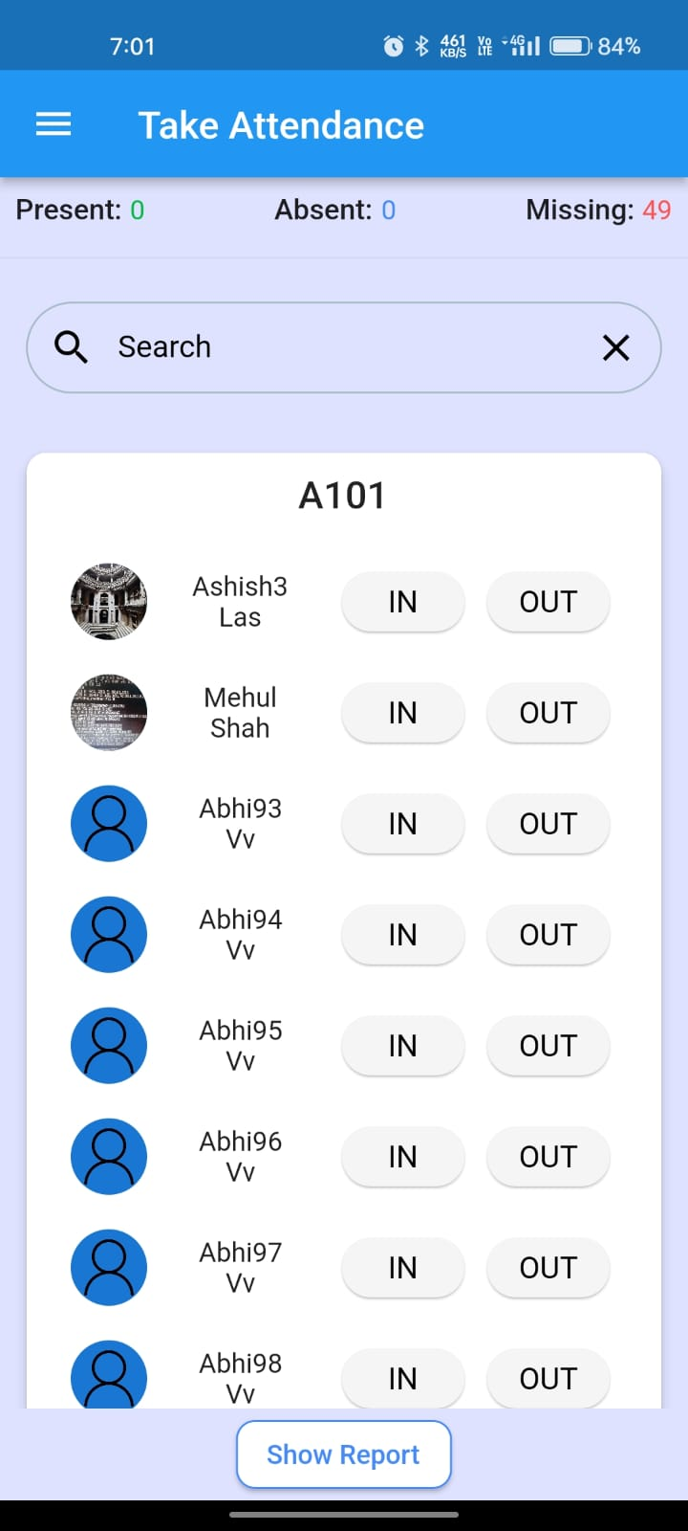
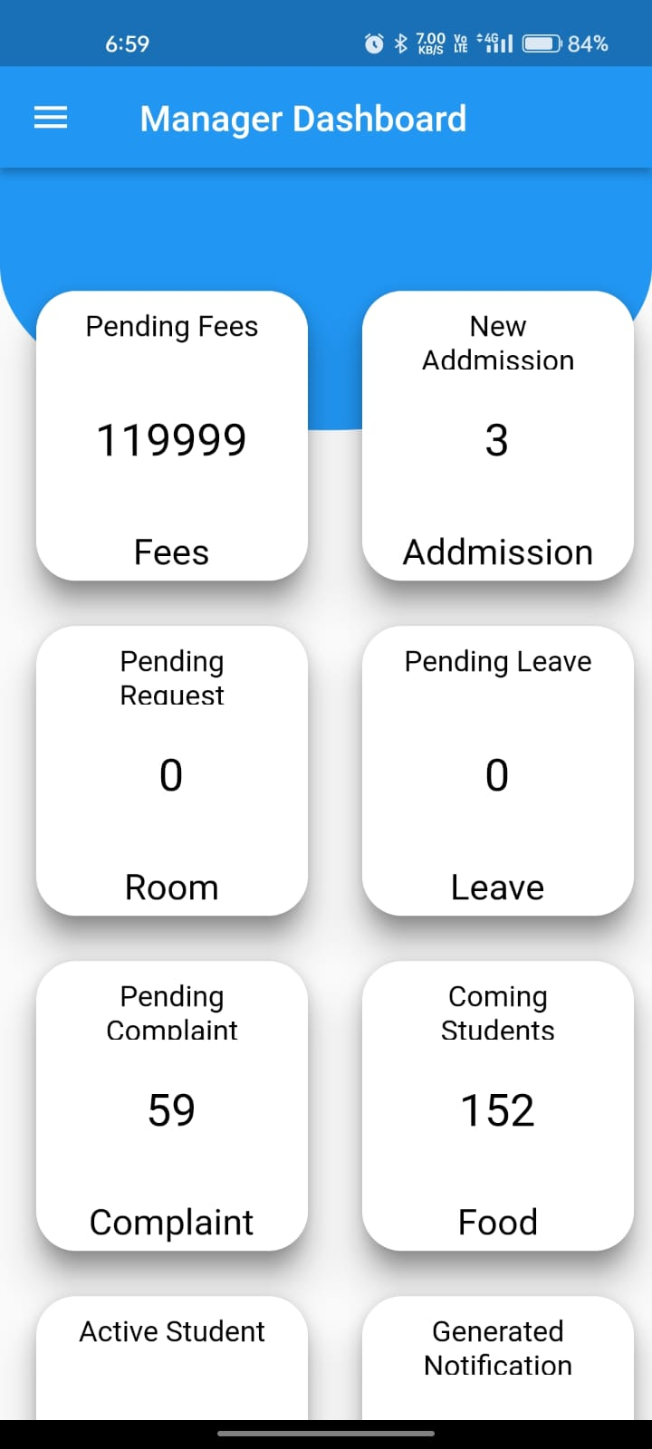
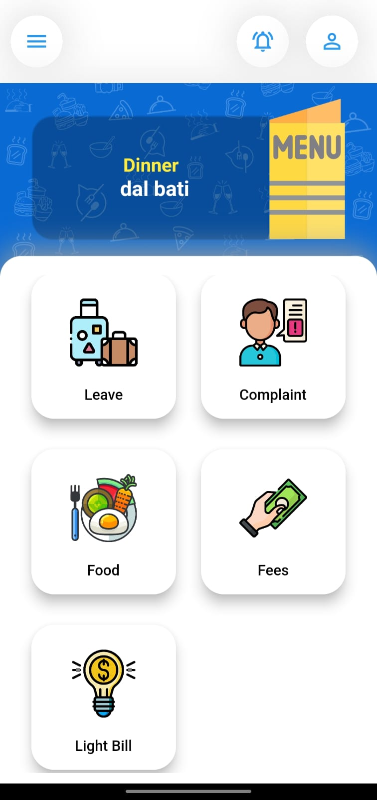
Overview

Slide 10

End of Presentation
Thank You

