Slide 1


Marker following & Car2x integration
Dharmil Shah, Matthias Grimm, Neeraj Sujan, Bashar Al-Ani
Practical course: Hardware Software co-design
Winter - 2015

Slide 2

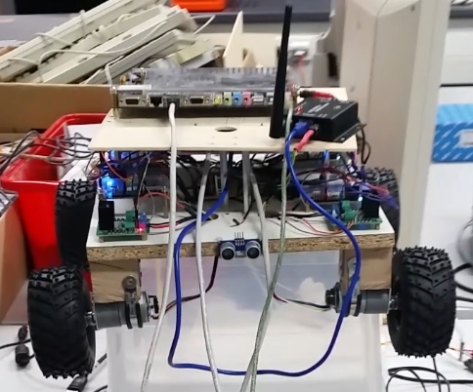
Problem statement
The car should follow a marker which represents another car
The car exchange autonomous and emergency messages coming from other cars and from base stations
Fix problems of and optimize the previous years code
Notes:
PowerPC acronym for Performance Optimization With Enhanced RISC – Performance Computing

Slide 3
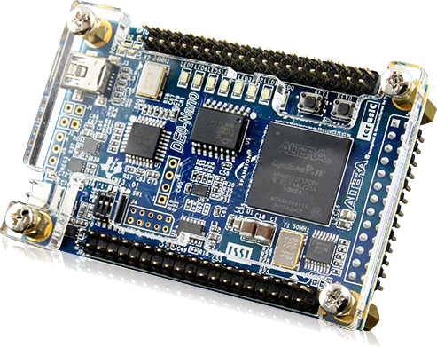
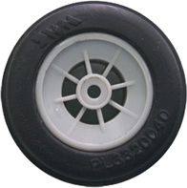
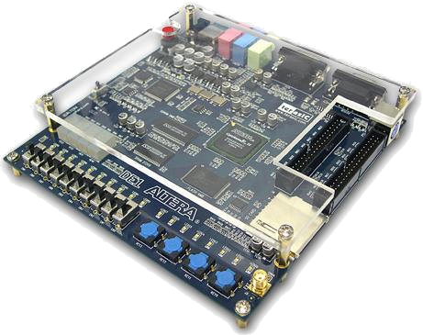

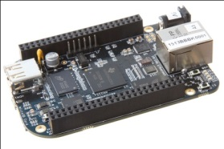
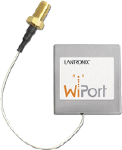
Setup (Hardware)
DE2-115 FPGA board with two cores
4 DE0-Nano board FPGAs
Ethernet switch
Wireless tranceiver
Beaglebone black (linux board)
Creative webcam
4x
H-Bridge

Slide 4
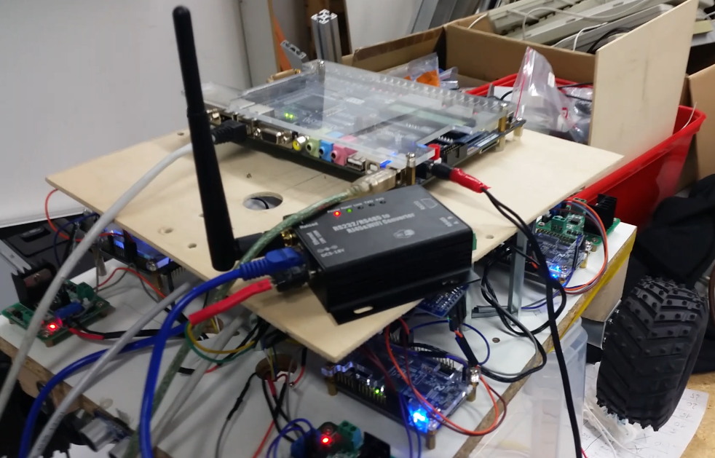
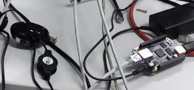
Organization (Hardware)

Slide 5
Setup (Platform and Tools)
uc/os-ii real-time kernel
Linux - Ubuntu 12.04
ROS
OpenCV
Altera Quartus Web edition
Host OS: Windows and Ubuntu
Power supply

Slide 6
Setup (Software/Hardware)
Communication Module
Message control Module
Control Module
Marker detection Module
niosII cores – QSYS configuration

Slide 7
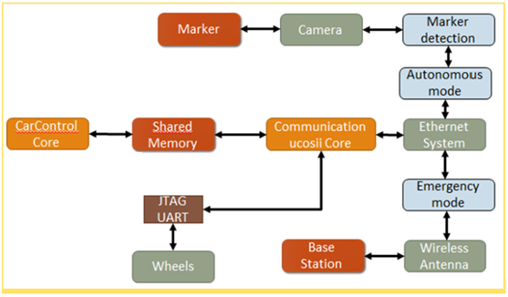
Current System design

Slide 8
Approach – What was achieved
Go through the documentations
Consult with previous teams
Thanks to Hardik Shah, Alexander Narr, Florian Janssen and Hagen Schmidtchen
Initialize the car2x system
Initialize the Beagle bone and marker detection system
Perform Handshake between car2x and Beaglebone

Slide 9
Approach – What was achieved
Send velocity messages from BB to car2x based on marker distance
Integrate the wireless module into the project
Send Wireless message to control the car
Setup GDB debugger during runtime
Fix cache incoherence
Re-modify the code to work for 4 wheels instead on the current 3 wheels

Slide 10
Approach – What was achieved
Remodify the code to start the cores in any order
Analyzing ros functionalities
Control the Car using python/C messages from BB by accessing it wirelessly
Fix PID control of the nano boards
Send wireless emergency message to stop the car while following a marker
Fixing clock skew
Try to change the FPGA architecture/board

Slide 11
Some of the problems
Connection to Beaglebone
Camera calibration
Loose and misplaced cables
Defective FPGAs
Random car behavior
Delays in buffers while sending TCP/IP packets
Buffers were not freed before being reused.
Conversion of velocity and steering from rotating wheels to fixed wheels
Receiving random velocities from BB

Slide 12
Results
Initializing the Car2x system (4 wheels) consistently
Initializing Beaglebone
Send Velocity message from BB to Car2x correctly to follow the marker autonomously
Send wireless emergency message from laptop to Car2x correctly
Make it all work together
Demo

Slide 13
What we have learned
Insight to embedded systems integration
Hands on with multiple technologies
A lot of debugging and interesting issues (impact of changing hardware, cache coherency, clock skews…)
Utilized Knowledge of
Hardware: FPGAs, BB, H-bridge, PWM
Computer vision: Calibration, Marker tracking, lane detection
Control: PID control scheme
Operating Systems: Multithreading, ROS, Linux
Networking: connections, protocol and packets

Slide 14
Discussion
Thank you
Q&A
Notes:
Media Local Bus

