Slide 1
FMS – Finance Management System.

Slide 2
Our Team Members
Dharmil Chhadva
Urvi Shah
Abhidnya Marathe
Shruti Kanatt
Harsh Parekh

Slide 3
Introduction
This Project belongs to Finance domain. In general, when user wants to purchase products using EMI feature of online shopping, user must have a credit card. While payment of EMI every month, user must pay some interest with EMI which varies for credit cards of different banks. "Finance Management System" is a web application in which the concept of no cost EMI is introduced where user doesn't have to pay any interest on EMI and it is not mandatory for user to have credit card in order to purchase product via EMI since an EMI card will be given to users after Registration on this system if the user meets the eligibility criteria.
Users:
There are two types of users in our system:
Admin
Customers

Slide 4
Modules in our project
Register Module
User has to register and enter their personal details.
They can apply for any of the two cards depending on their requirements. The cards have a limit. Once the user is verified and registered with the company, he/she will be eligible to avail the services of the card. The two cards being gold and Titanium cards. The users will have to pay a minimum joining fee depending on the card type.
Login Module
Login can be for the user or for the admin.
Registered users can login and purchase any products from the market place.
Admin can login and then he/she is able to access all the details of the registered user and will be able to accept the user or reject it.

Slide 5
Modules in our project
Buy Product Module
All the products will be listed here. According to the product type, cost of the product and the tenure period, monthly tenures will be deduced.
Once the user clicks on buy product, he will be redirected to an info page where all the details, features and the frequently asked questions will be displayed for user's convenience.
The user can buy a product with different EMI options available
3 Months
6 Months
9 Months
12 Months

Slide 6
Modules in our project
Dashboard Module (Users)
EMI Card
The EMI card will give details about the registration number, validity period, and name of the user.
List of products purchased
The list of products purchased by the User will also be displayed along with the last transaction. Previous transactions will also be displayed if asked by the user.
It will also give information about the remaining balance in users membership card.

Slide 7
Modules in our project
Dashboard Module (Admin)
Admin can login and then he/she is able to access all the details of the registered user and will be able to accept the user or reject it.

Slide 8
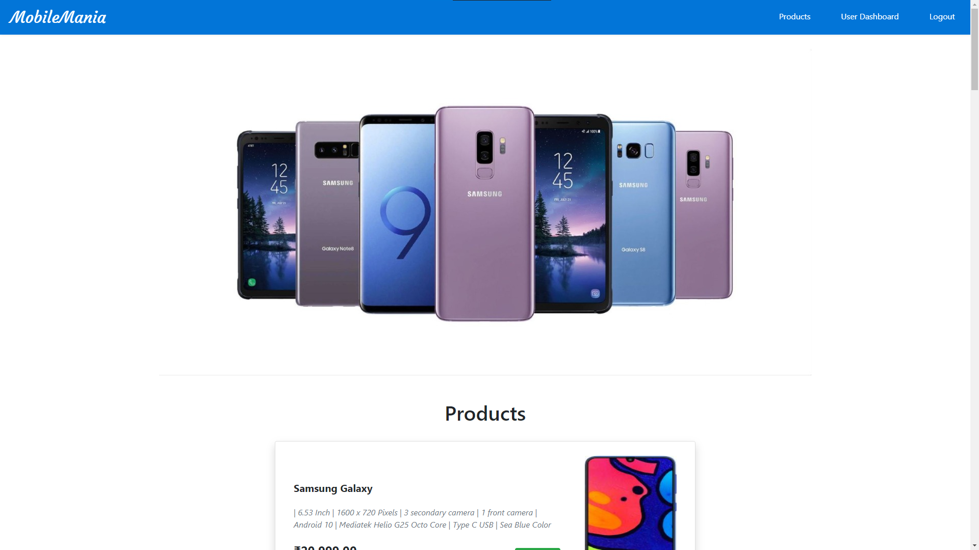
Screenshots of User Interface
Home page

Slide 9
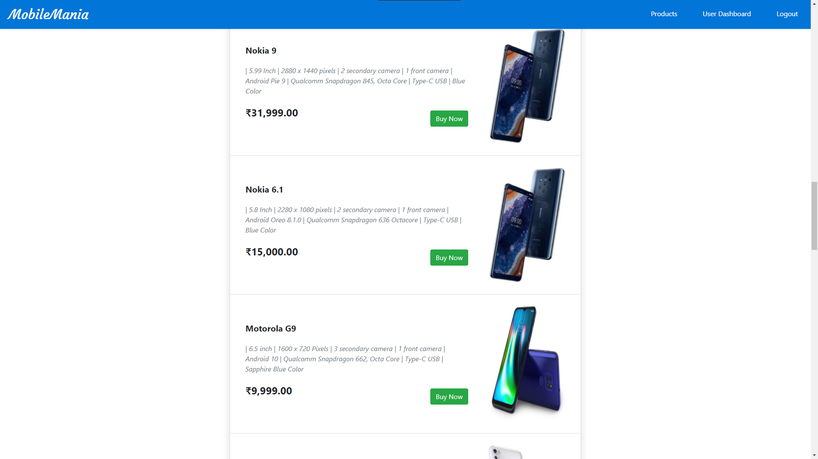
Screenshots of User Interface
Home page

Slide 10
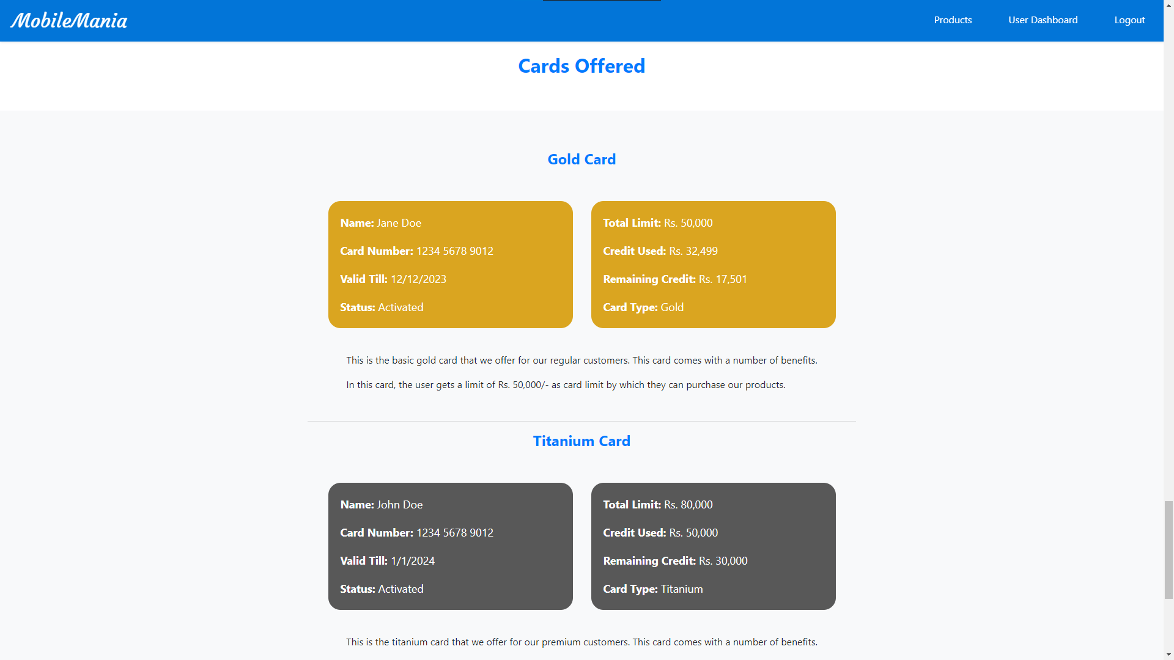
Screenshots of User Interface
Home page

Slide 11
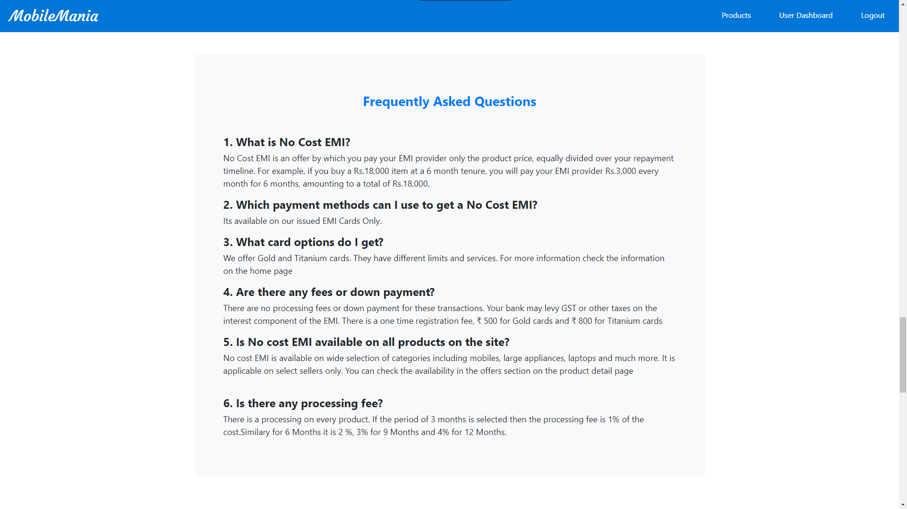
Screenshots of User Interface
Home page

Slide 12
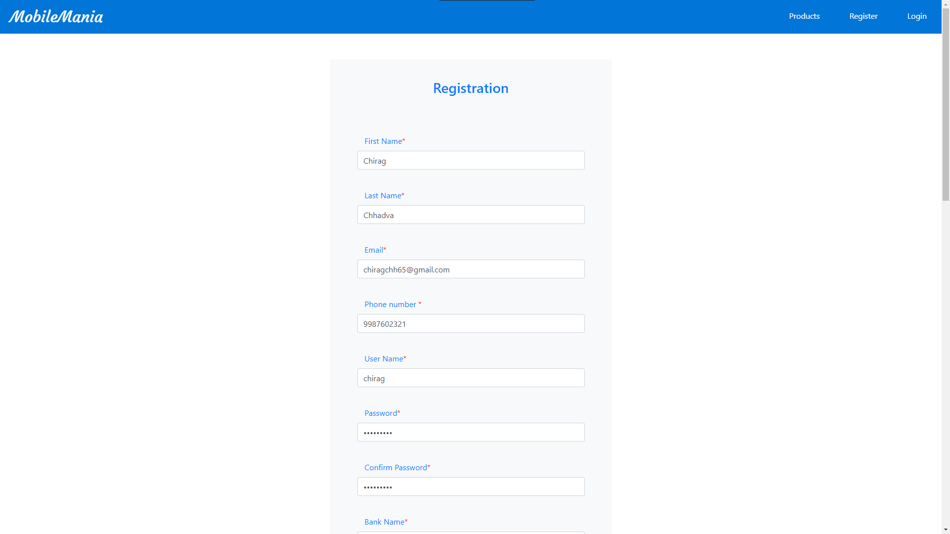
Screenshots of User Interface
Registration Page

Slide 13
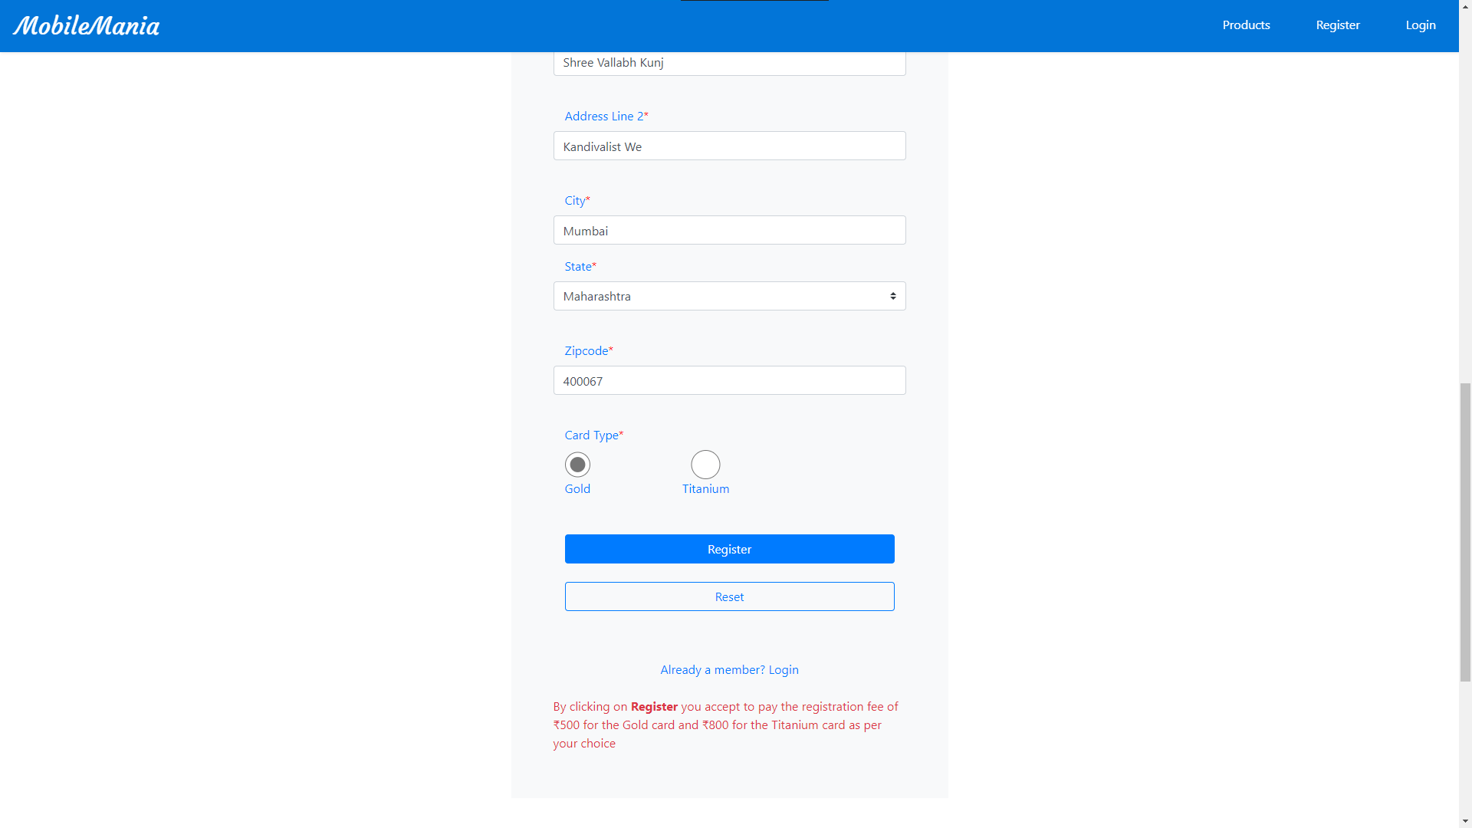
Screenshots of User Interface
Registration Page

Slide 14
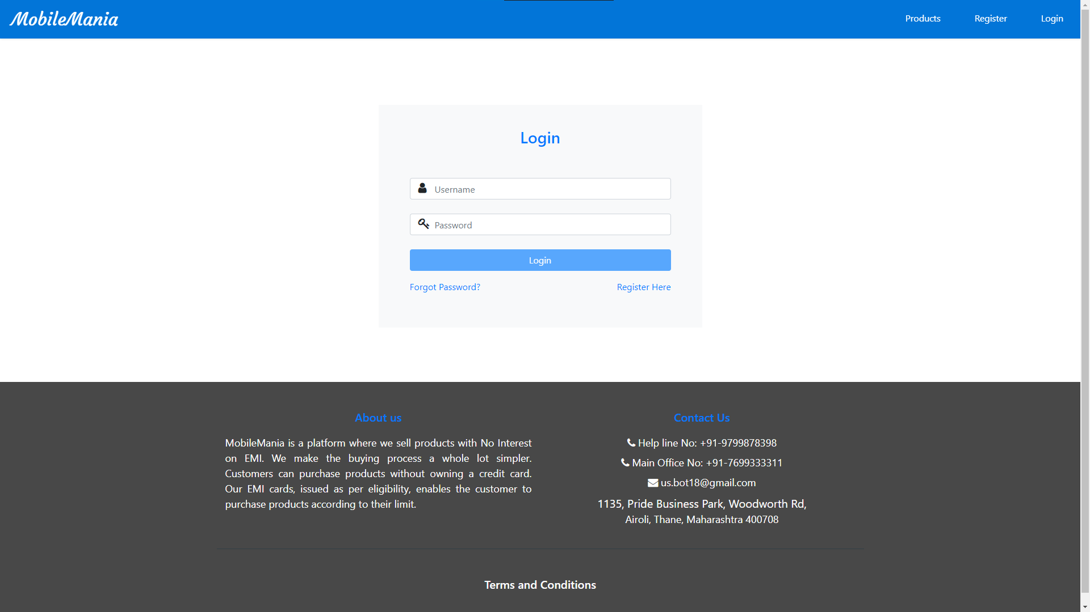
Screenshots of User Interface
Login Page

Slide 15
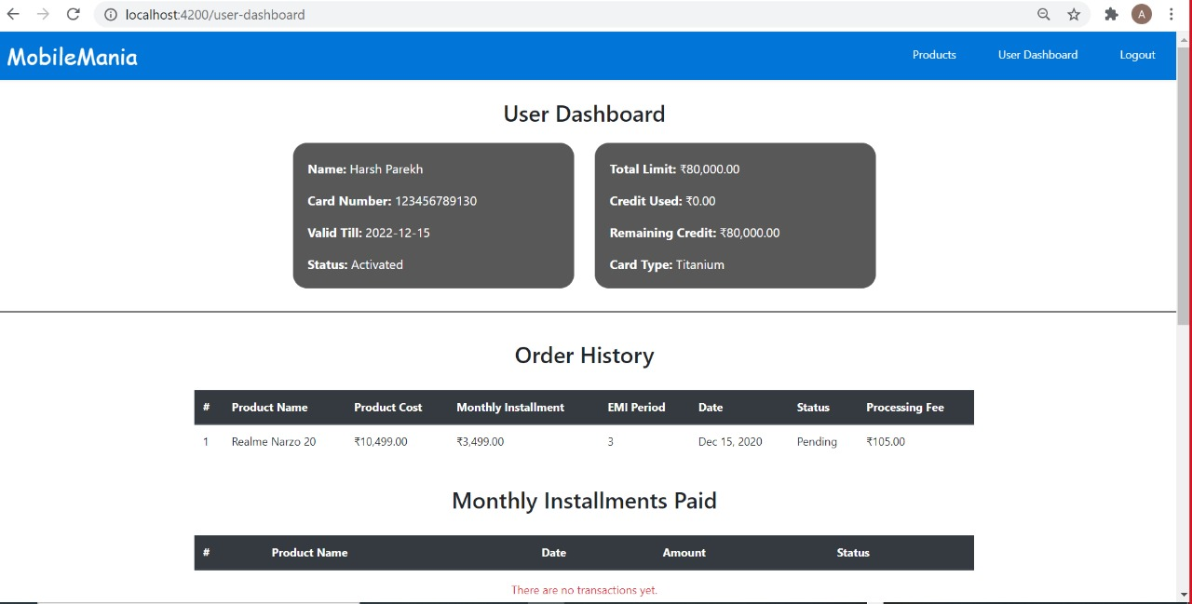
Screenshots of User Interface
User Dashboard for Titanium card users - Activated

Slide 16
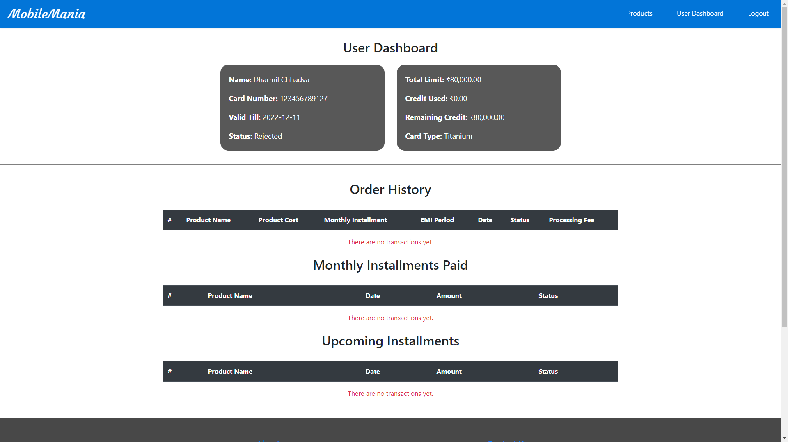
Screenshots of User Interface
User Dashboard for Titanium card users – Rejected

Slide 17
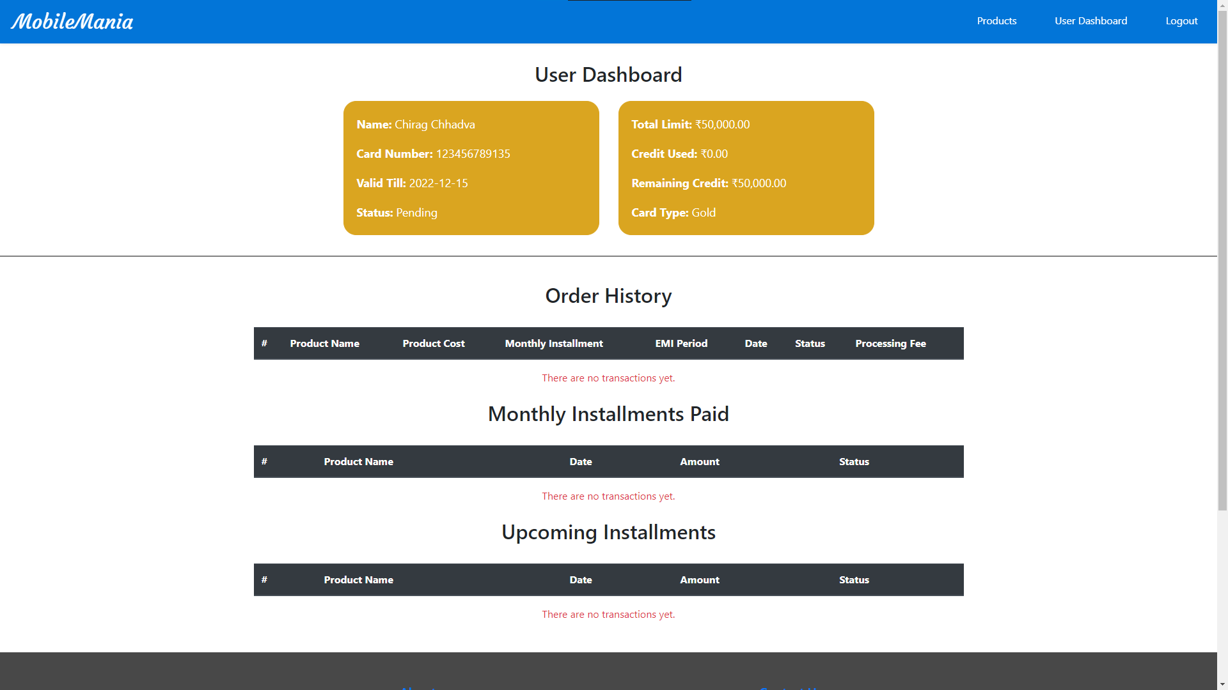
Screenshots of User Interface
User Dashboard for Pending Gold card users

Slide 18
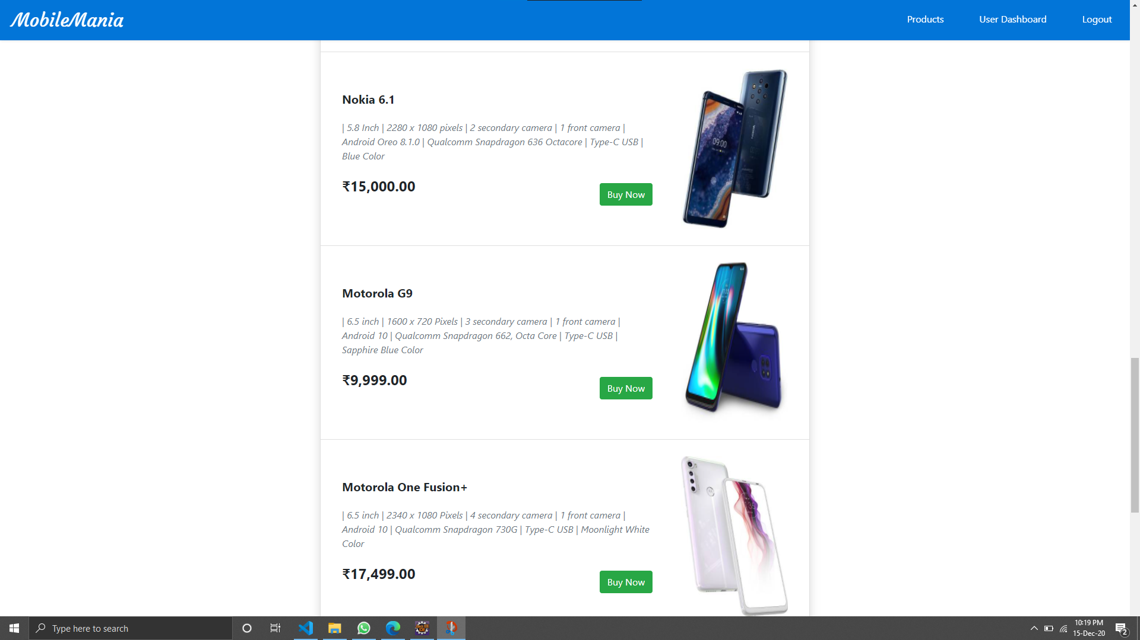
Screenshots of User Interface
Product List

Slide 19
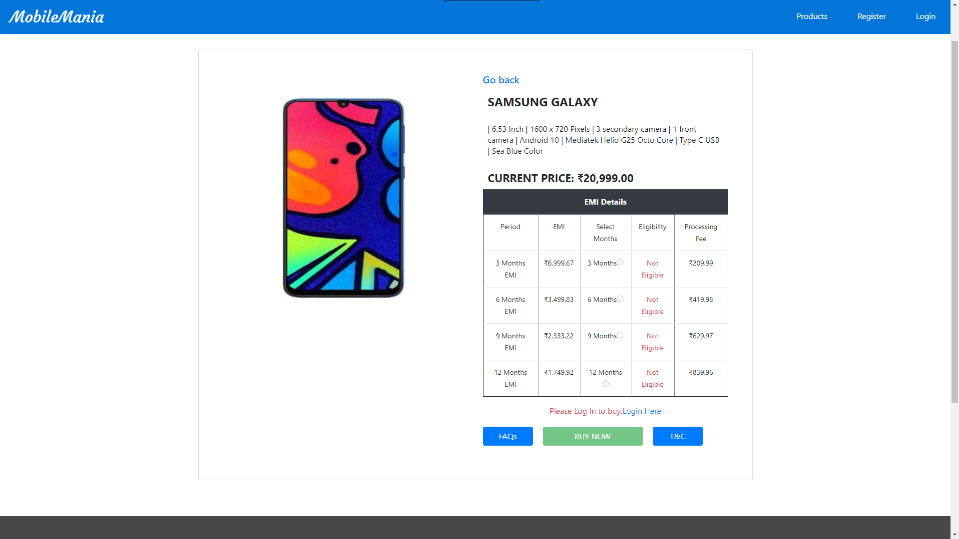
Screenshots of User Interface
Product List

Slide 20
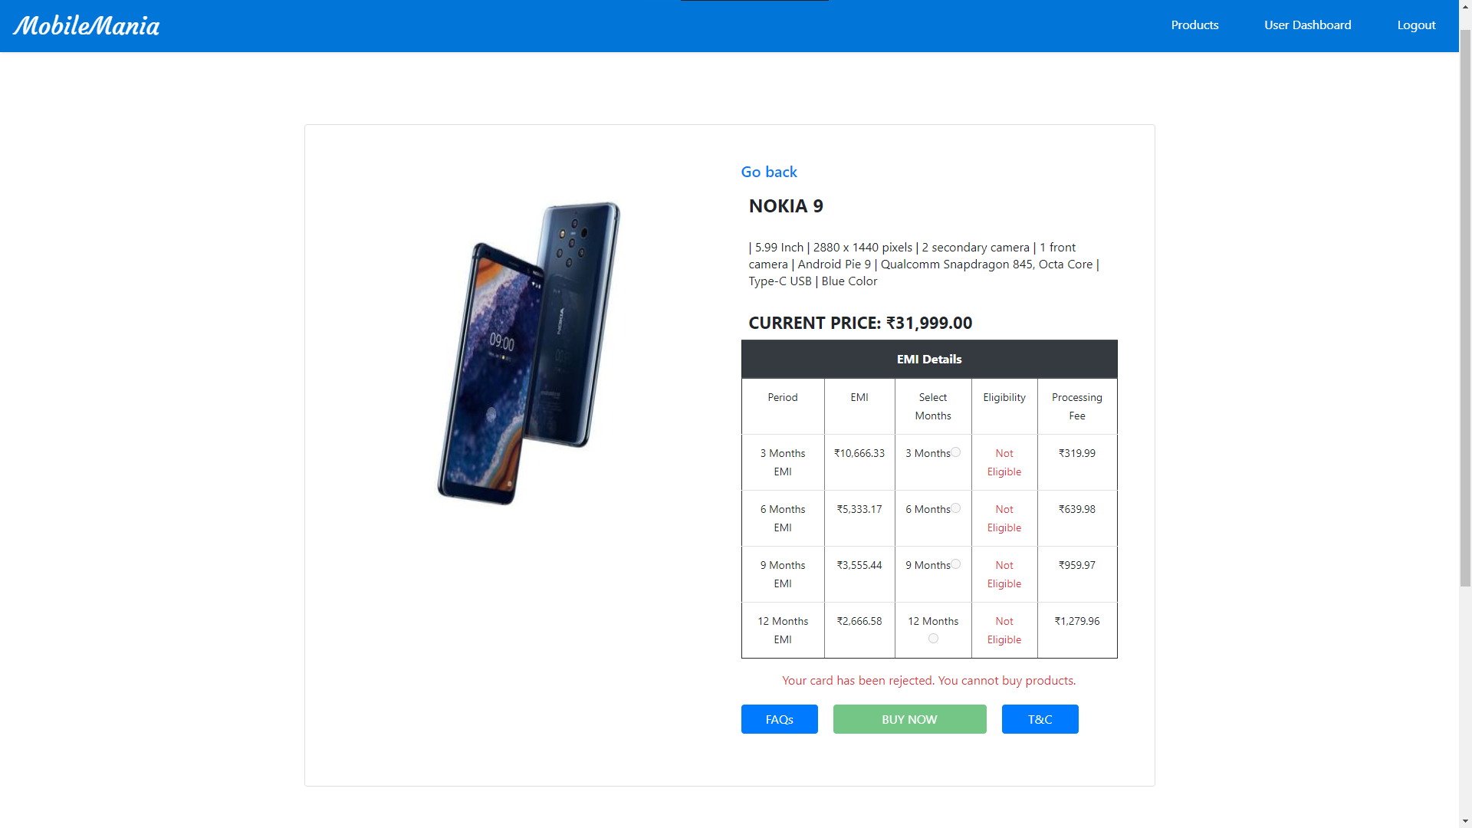
Screenshots of User Interface
Product Details

Slide 21
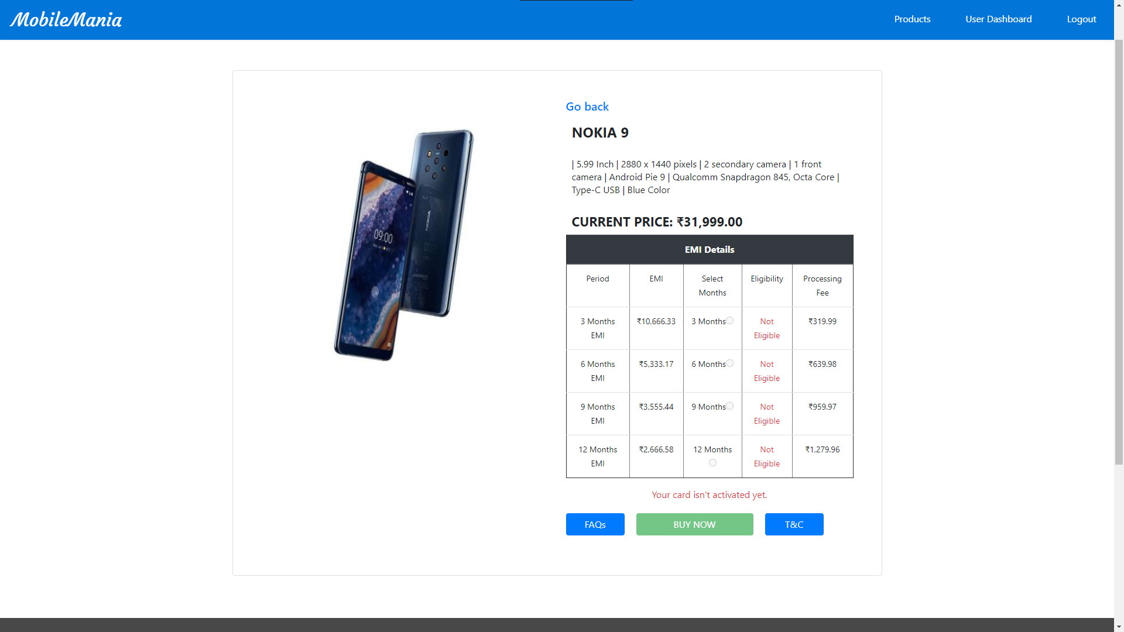
Screenshots of User Interface
Product Details

Slide 22
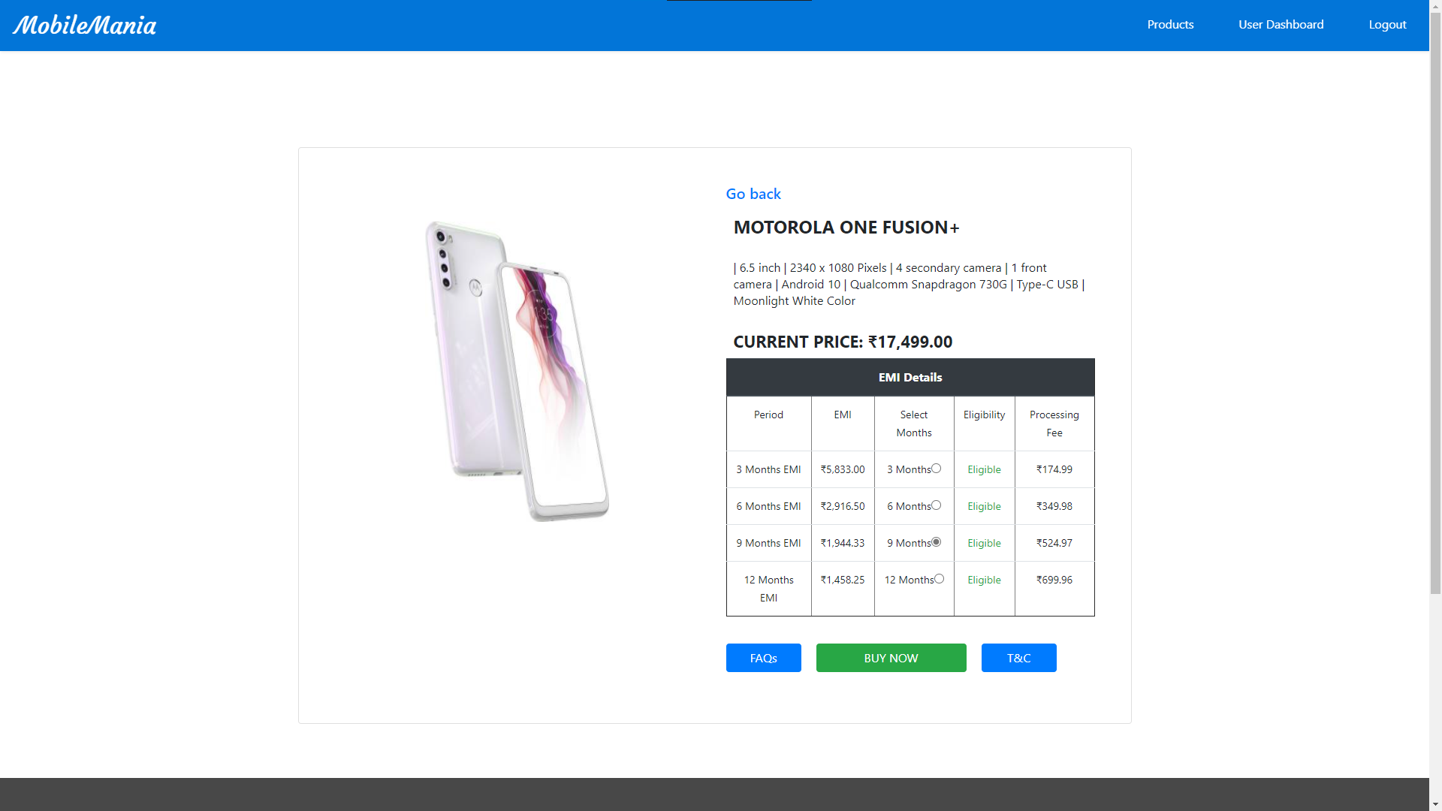
Screenshots of User Interface
Product Details

Slide 23
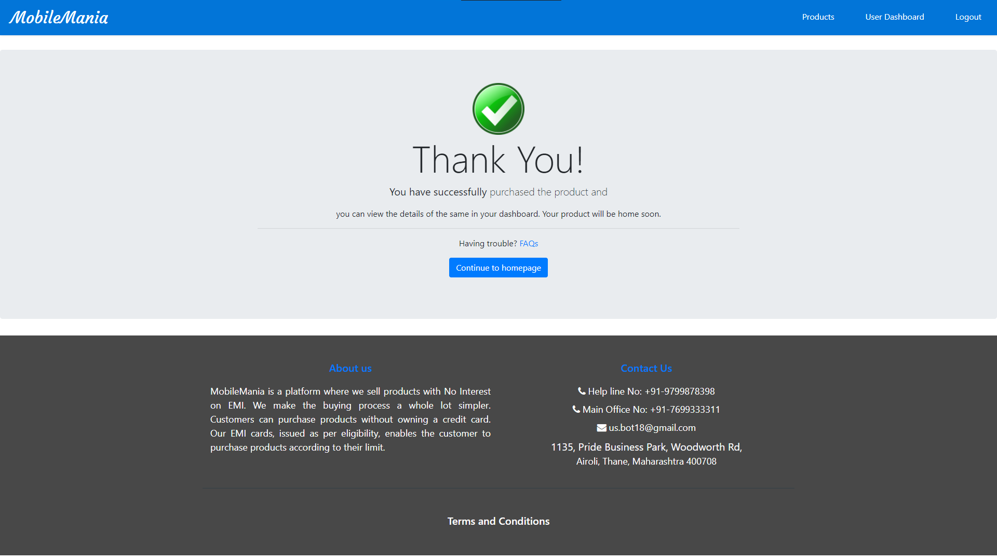
Screenshots of User Interface
Success Page after buying project

Slide 24
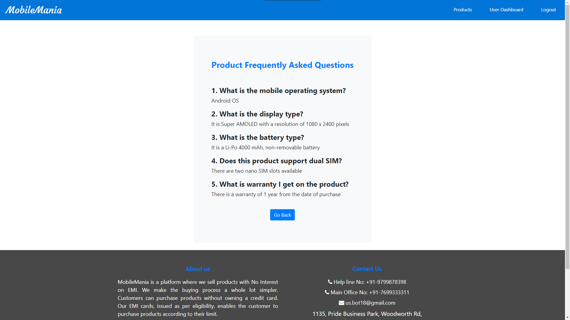
Screenshots of User Interface
Product FAQ

Slide 25
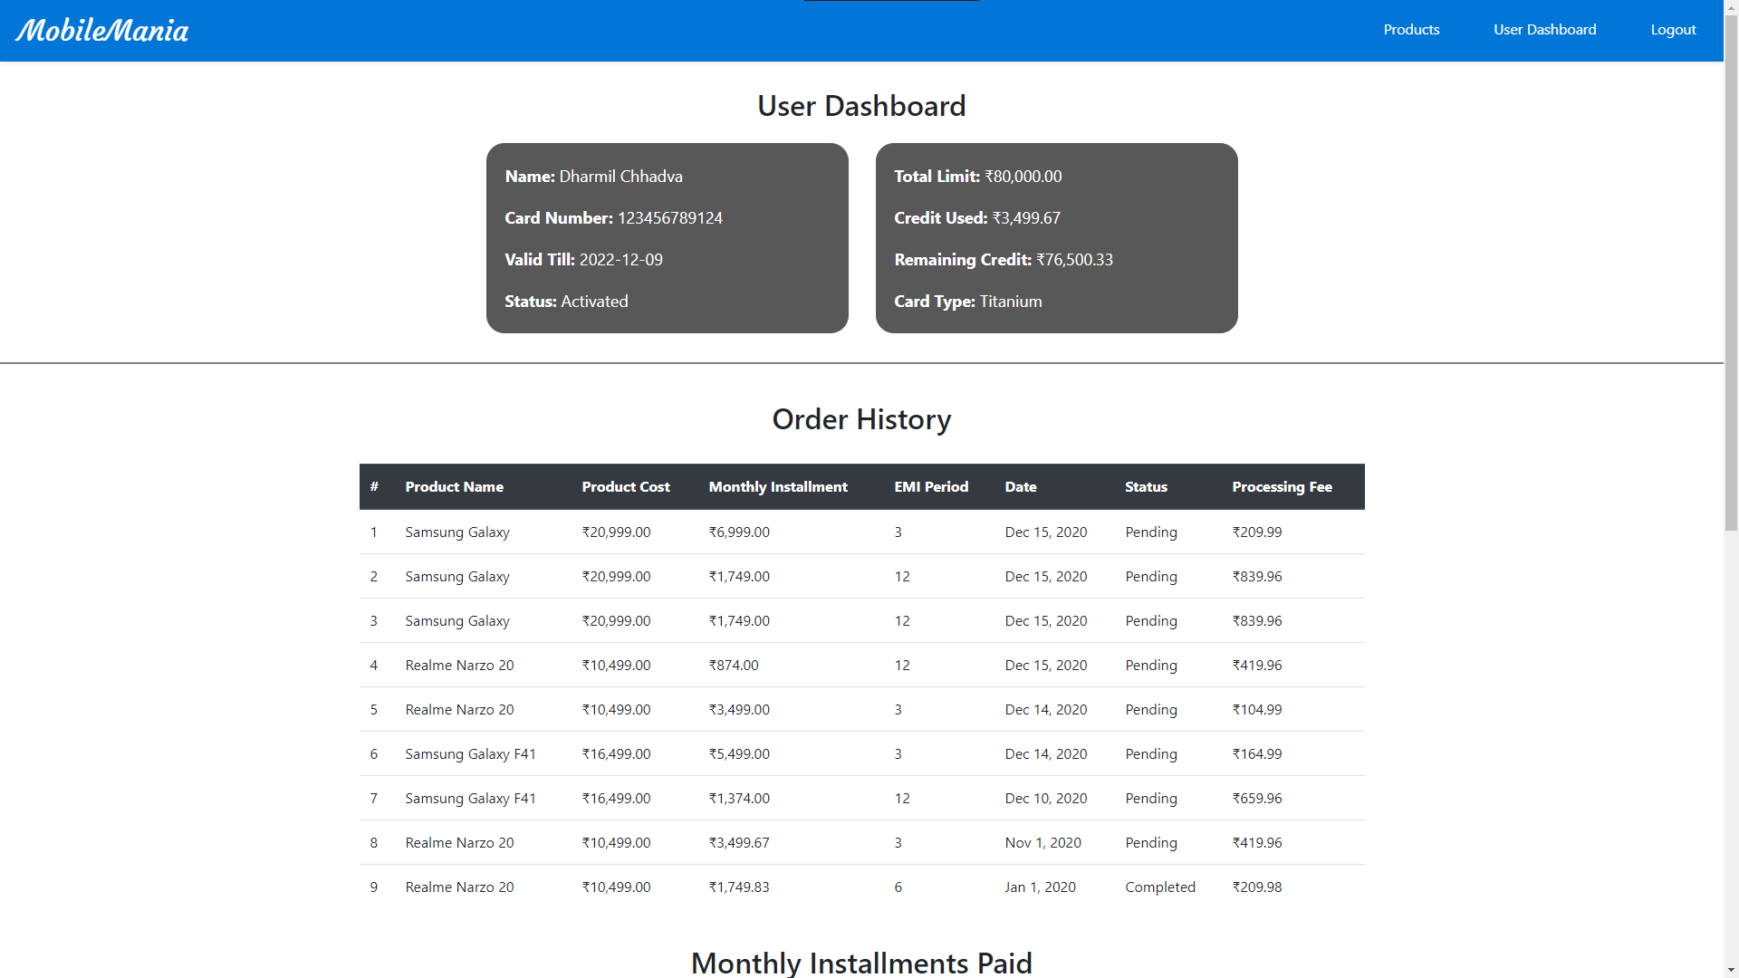
Screenshots of User Interface
Order History for the User

Slide 26
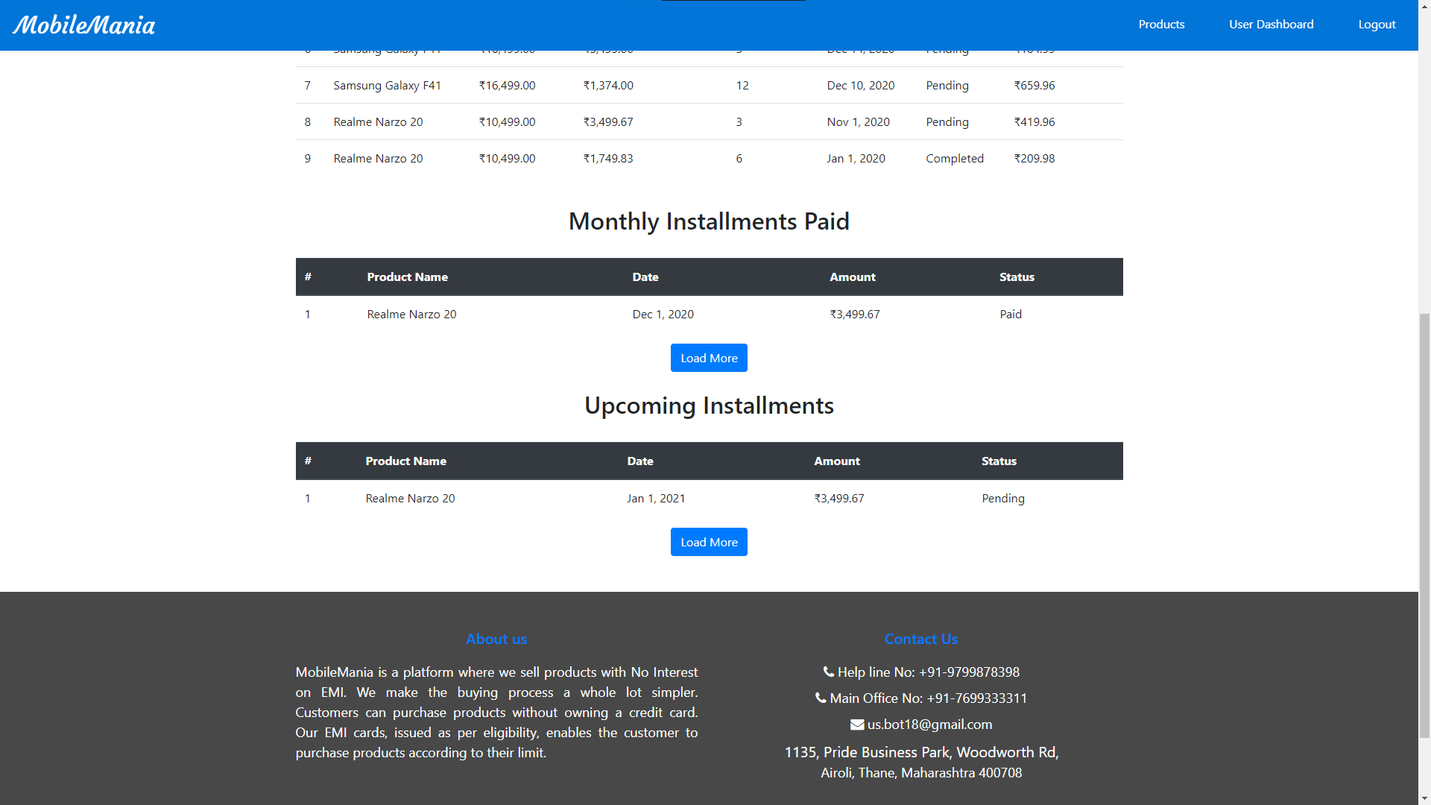
Screenshots of User Interface
Monthly Installments with Load More Option

Slide 27
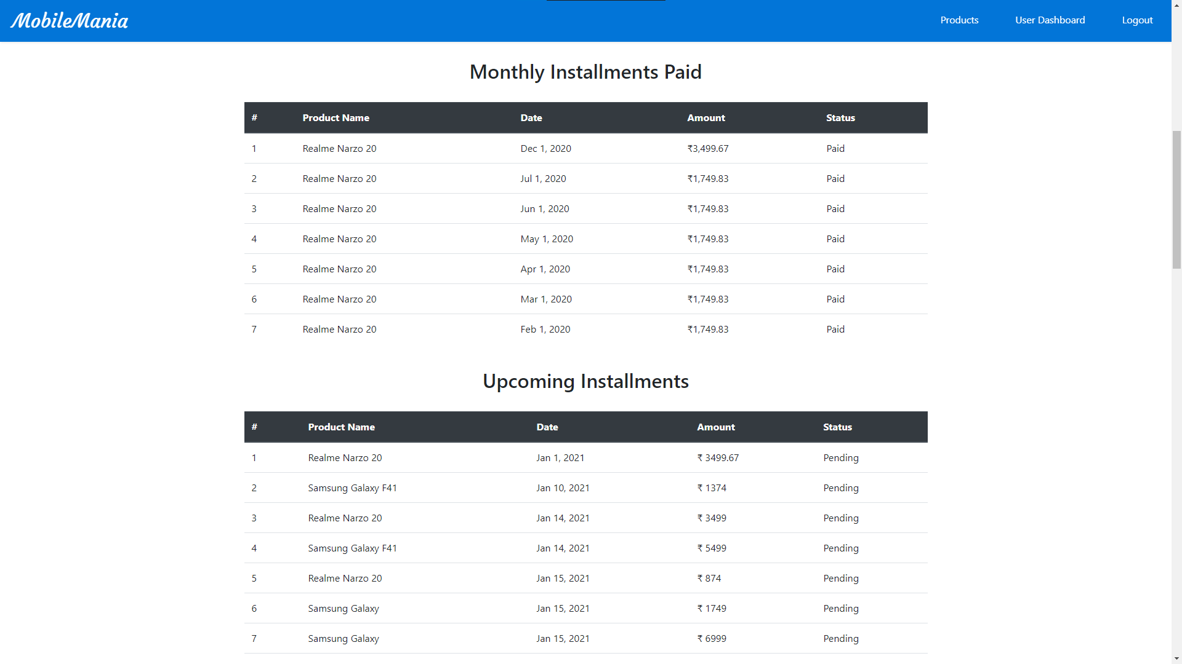
Screenshots of User Interface
Monthly Installments for the User

Slide 28
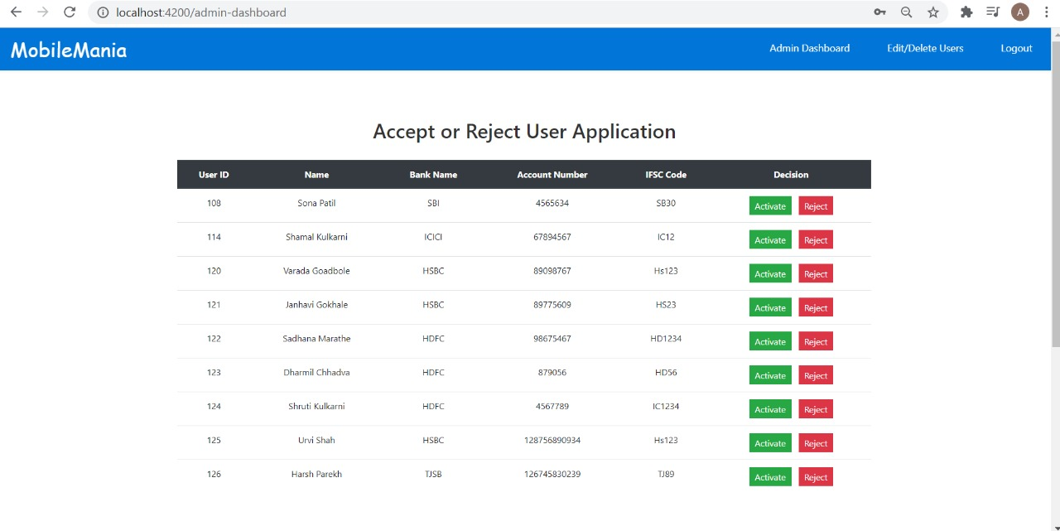
Screenshots of User Interface
Admin’s Dashboard

Slide 29
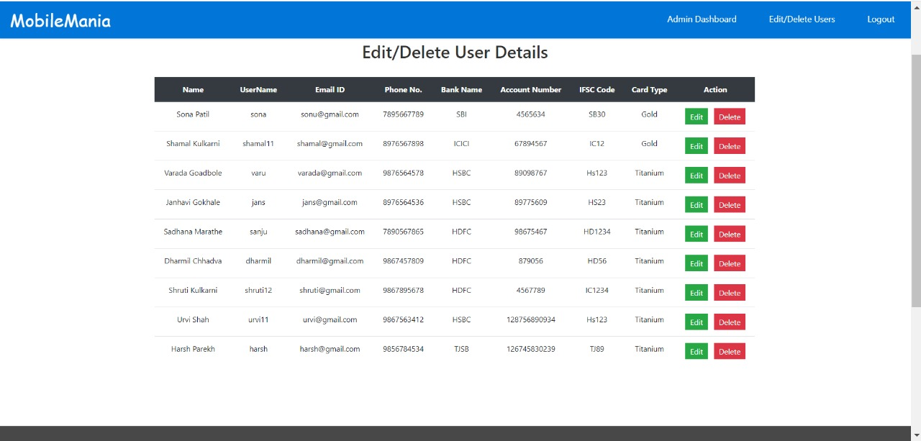
Screenshots of User Interface
Admin’s Dashboard

Slide 30
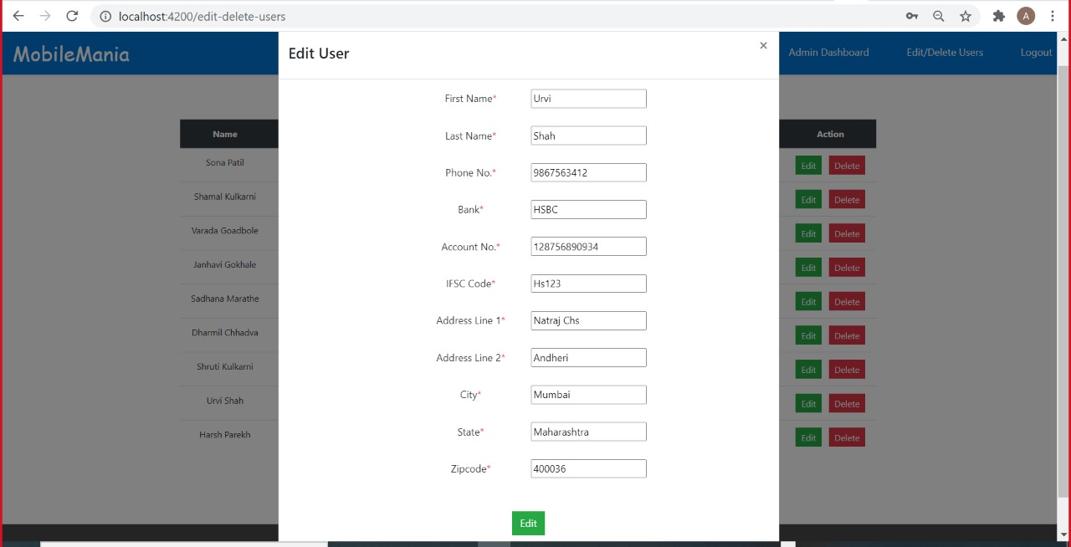
Screenshots of User Interface
Admin’s Dashboard

Slide 31
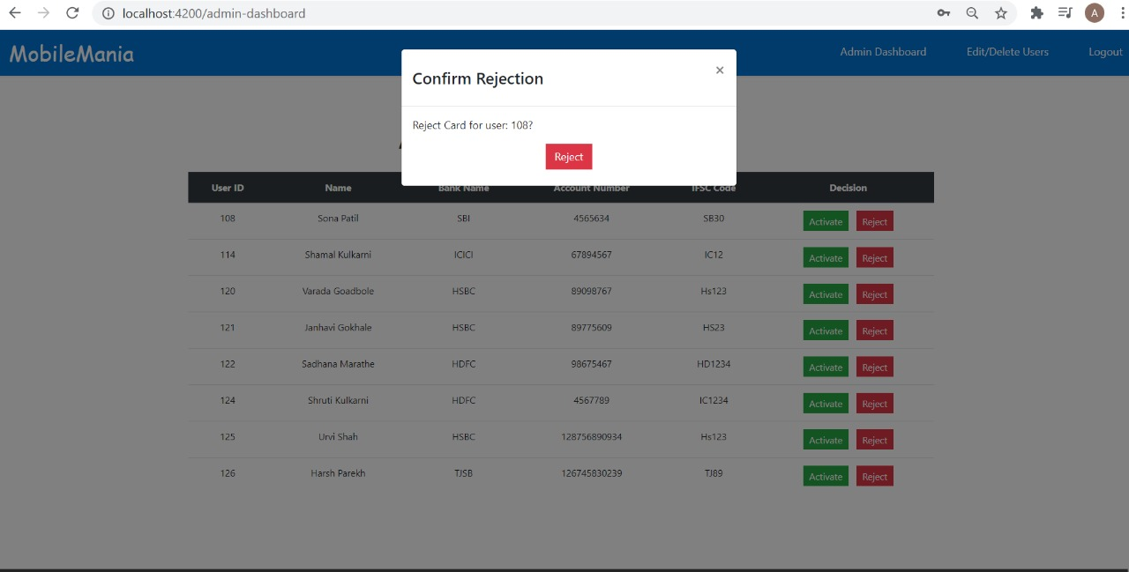
Screenshots of User Interface
Admin’s Dashboard

Slide 32
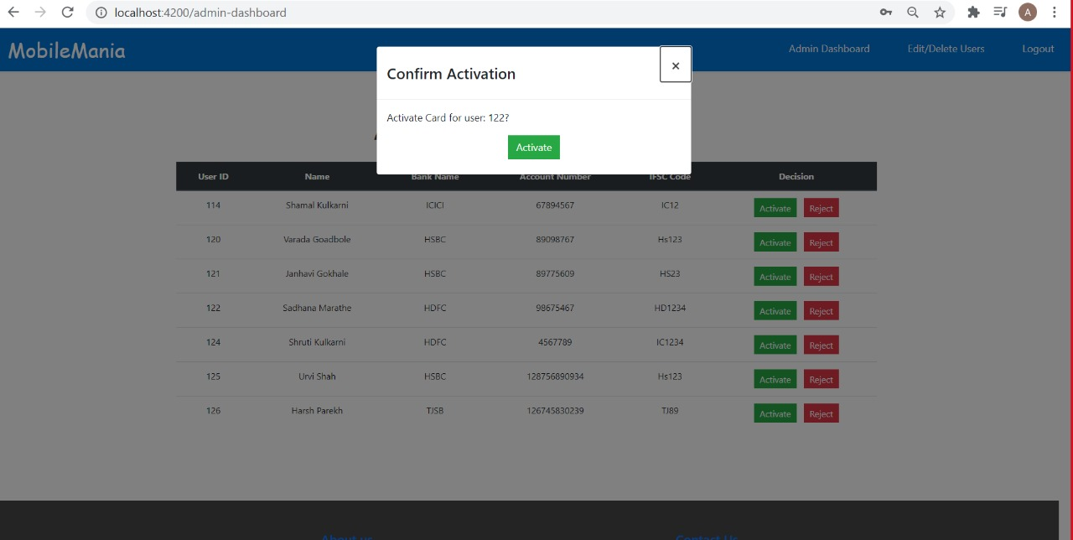
Screenshots of User Interface
Admin’s Dashboard

Slide 33
Screenshots of User Interface
Products FAQs

Slide 34
Screenshots of User Interface
FAQs Page

Slide 35
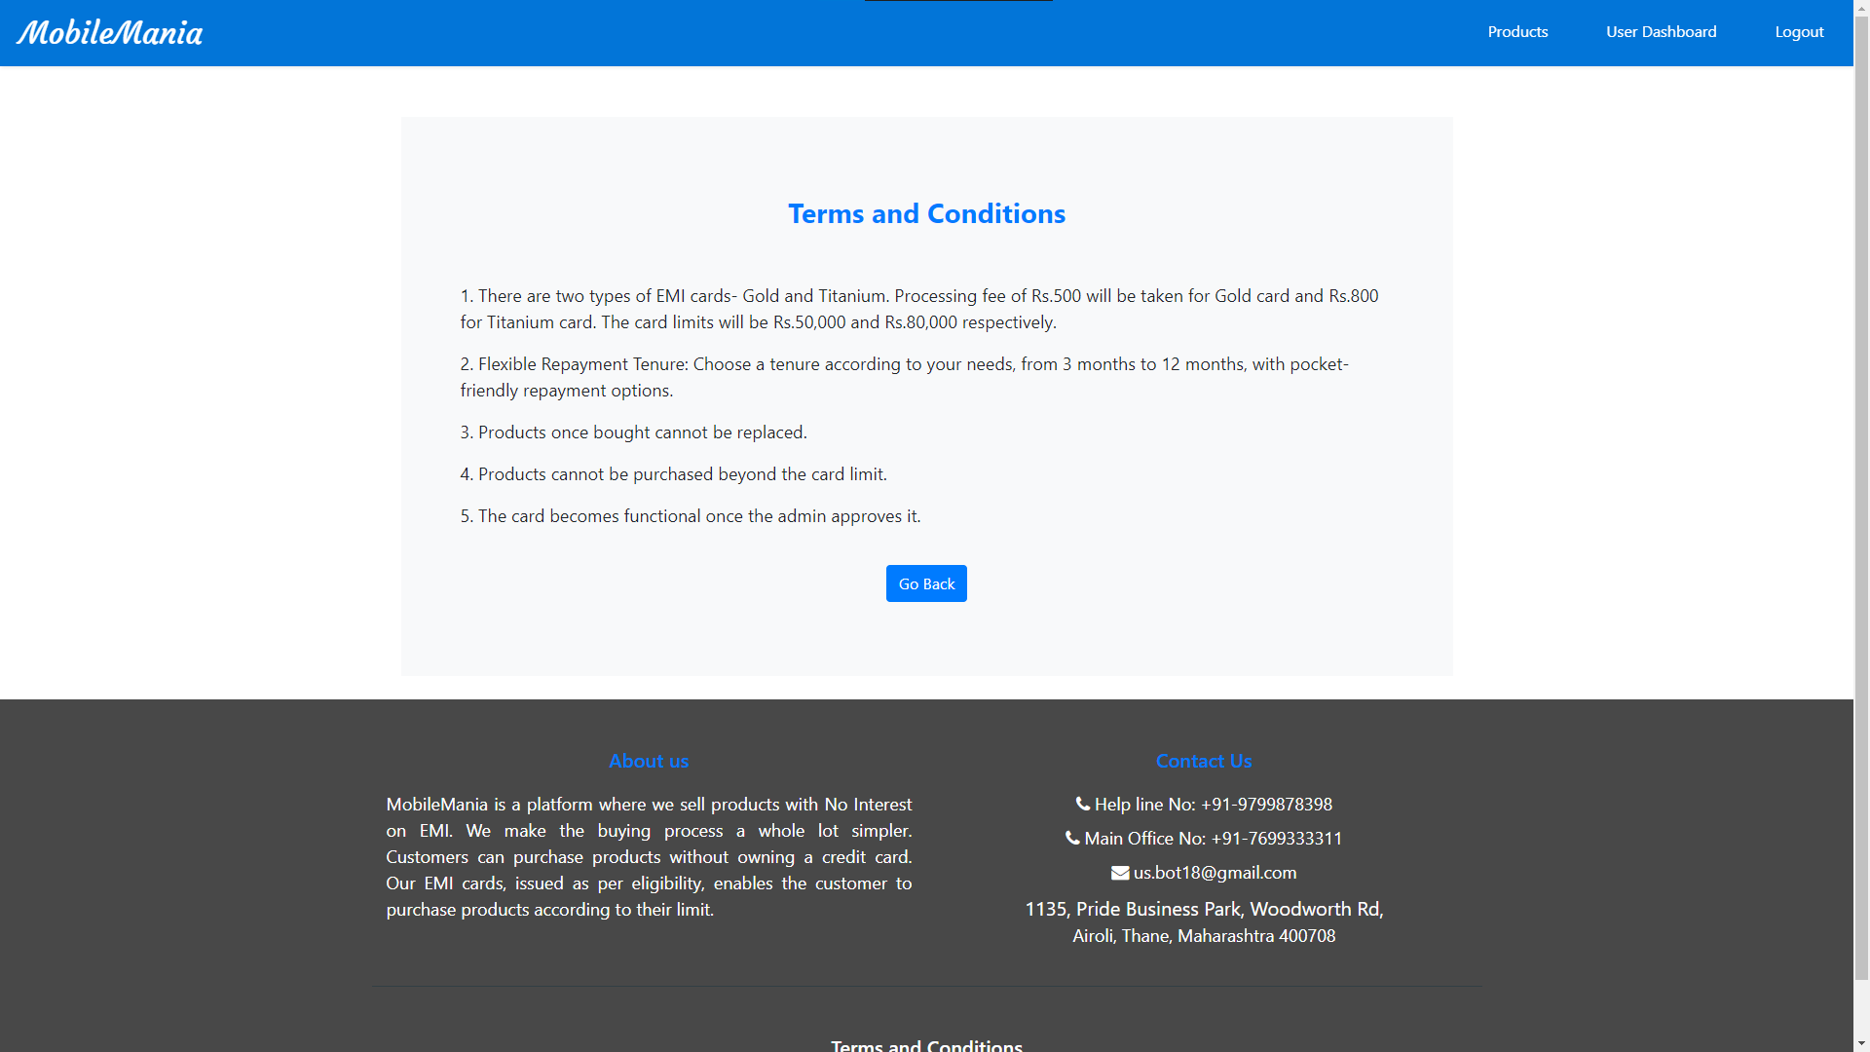
Screenshots of User Interface
Terms & Conditions Page

