Slide 1
PhonePe Transaction Insights
Interactive Data Analytics Dashboard
Submitted By
Dharminder Singh Virk

Slide 2
Project Objective
Analyze transaction trends
Identify top regions
Detect fraud
Generate business insights

Slide 3
Tech Stack
Python, Streamlit
Pandas, SQLite
Plotly, PyDeck

Slide 4
Key Features
KPI Metrices
Filters
Interactive Charts
Download Option

Slide 5
Visualizations
Bar, Line, Pie
Heatmap
Choropleth Map
District Map

Slide 6
Business Insights
P2P dominates
Merchant growth
Tier-2 growth strong

Slide 7
Fraud Detection
99th percentile logic
Detect anomalies
Improves trust

Slide 8
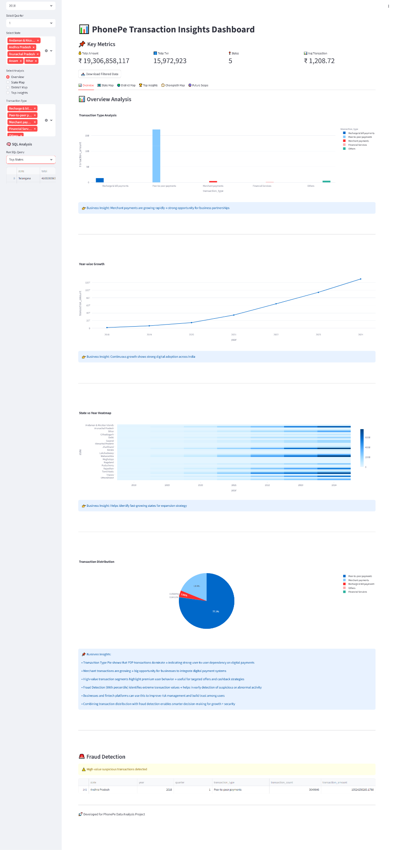
Dashboard Preview

Slide 9
Future Scope
ML models
Real-time APIs
Predictive analytics

Slide 10
Conclusion
Data-driven insights
Growth + Security
Business value

