Slide 1
HCAHPS Patient Experience Analytics
Executive Presentation | National Healthcare Quality Commission (NHQC)
Prepared by: Healthcare Business Intelligence Analyst | Dharmistha Rathod

Slide 2
Organization Overview & Business Problem
Who is NHQC?
The Business Problem
The National Healthcare Quality Commission monitors and improves patient experience across hospitals nationwide, using the annual HCAHPS survey to track how patients rate communication, cleanliness, discharge information, and more.
Although millions of patient responses are collected every year, administrators lack an easy way to compare performance across states, regions, time periods, and quality measures — making it hard to identify where to focus improvement efforts.

Slide 3
Project Objectives & Scope
• Consolidate all HCAHPS data into a single, connected Power BI model
• Build executive dashboards to compare states, regions & measures
• Track satisfaction trends from 2015 to 2023
• Identify measures needing improvement
• Provide data-driven recommendations for policy decisions

Slide 4
Dataset Overview & Data Model
7 connected tables, following a Star Schema design
Dimension Tables
Fact Tables
• States (50 + DC)
• State_Results
• Measures (10 quality measures)
• National_Results
• Questions
• Responses
• Reports (2015-2023)
Data Quality Note: 'Not Available' text values found in Response Rate were cleaned to blank; 5 US territory codes excluded from region-level scope, consistent with the official data dictionary (50 states + DC).

Slide 5
KPI Framework
71.41%
26.61%
51
10
National Top-box %
Survey Response Rate
Participating States
Quality Measures Tracked
Key measures also include: State/Regional Ranking, Highest/Lowest Performing Measure, and Year-over-Year Satisfaction Change — each defined with a DAX formula documented in the KPI Definition Report.

Slide 6
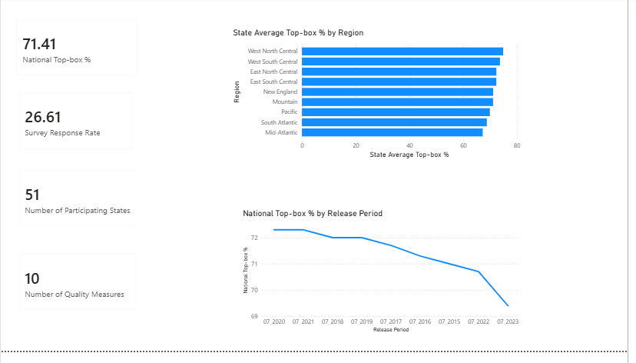
Dashboard: Executive Overview

Slide 7
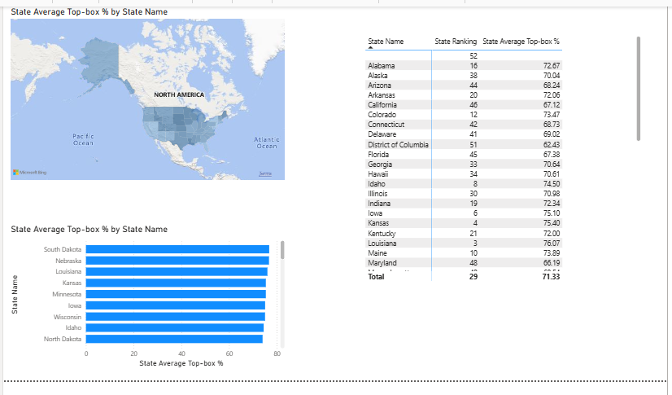
Dashboard: State Performance & Benchmark

Slide 8
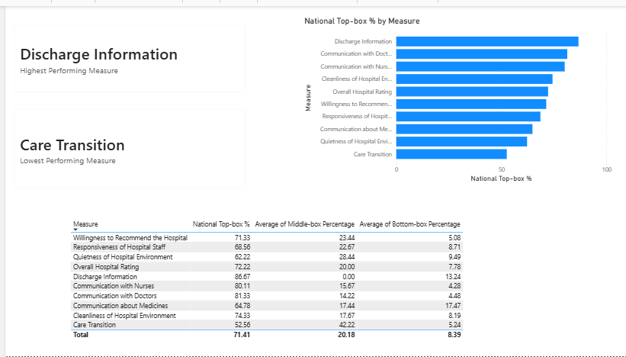
Dashboard: Patient Experience Measures

Slide 9
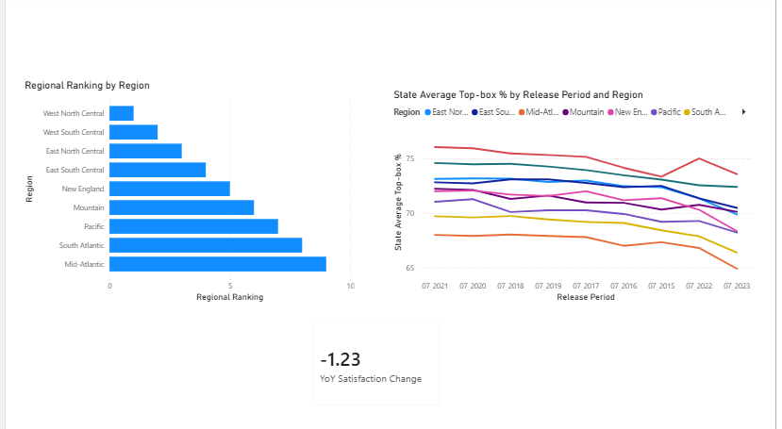
Dashboard: Regional & Trend Analysis

Slide 10
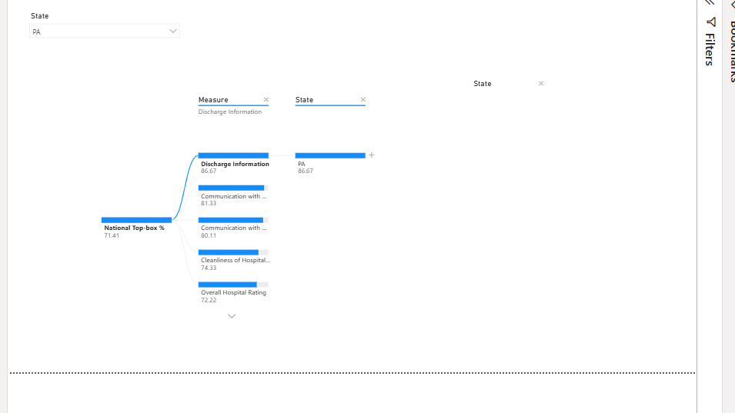
Dashboard: Root Cause Analysis (Decomposition Tree)

Slide 11
Advanced Interactivity Features
Conditional Formatting
Color-scale icons (green/yellow/red) on the State Performance page highlight high vs. low performing states at a glance
Bookmark + Navigation Button
One-click button on the Regional & Trend page returns users to the Executive Overview
Decomposition Tree
Interactive root-cause exploration — breaks down National Top-box % by Measure and State on demand

Slide 12
Business Impact
How this solution supports NHQC
• Provides a centralized view of patient experience across all participating states
• Enables faster identification of high-performing and underperforming regions
• Supports evidence-based decision making through interactive dashboards
• Simplifies monitoring of quality measures and patient satisfaction trends
• Reduces manual reporting effort and improves executive reporting efficiency

Slide 13
Key Findings
• Discharge Information (86.7%) is the strongest measure; Care Transition (52.6%) is the weakest — a 34-point gap, the largest of any dimension analyzed
• National satisfaction peaked in 2020-2021 (~72.3%) but has declined to 69.4% in 2023
• West North Central is the top region (74.9%); Mid-Atlantic is the weakest (67.3%)
• South Dakota & Nebraska lead all states (~76.8%); DC and New Jersey trail (~62-66%)
• Average survey response rate is only 26.6%, affecting reliability of small-facility comparisons

Slide 14
Strategic Recommendations
• Launch a national Care Transition improvement initiative — the single highest-impact opportunity
• Investigate the 2022-2023 decline in national satisfaction before assuming it is temporary
• Direct additional support to Mid-Atlantic and South Atlantic regions
• Improve survey participation, especially at low-response facilities
• Use South Dakota & Nebraska as benchmark case studies for lower-performing states

Slide 15
Future Roadmap
• Incorporate Order Date-level granularity for deeper trend analysis, if available in future data
• Extend benchmarking to facility level, once response-rate reliability improves
• Automate refresh of this Power BI model as new HCAHPS survey cycles are released
Thank You

