Slide 1
V-Mark Application
Presented By:-
D Vikas (13MSE0274)
E.Dharaneshwar (13MSE0256)
Jagadeesh (13MSE0425)
V Naveen(13MSE0003)

Slide 2
Project Description:-
V-mark is an Vegetable-Marketing Android application that manages the buying and selling of vegetables through online.
Generally the users are Customers, Farmers and the Market Yard Managers.
Farmers can sell their products to various markets based on their choice of cost and flexibility.
Customers can buy products through online by ordering them which Admin provides the Cost Price.
Market Yard Managers will offer the cost of different vegetables on daily basis in their respective markets.

Slide 3
Features:-
Cost and flexibility:-Farmers can sell their products to various markets based on their choice of cost and flexibility.
Price Comparison:-The Cost which Market-yard Distributor offers can be view by farmers from whom they will buy.
Cash on Delivery:-It delivers to the doorstep of the people in their favored time.
Confirmation message :-The Customers will get the Confirmation message when the Admin accepts the customers order requests.

Slide 4
Continued..
Instant results in the drop down.
It saves a lot time and energy of the customer.
Price comparison
Prices of all items are displayed on the screen are inclusive of taxes.

Slide 5
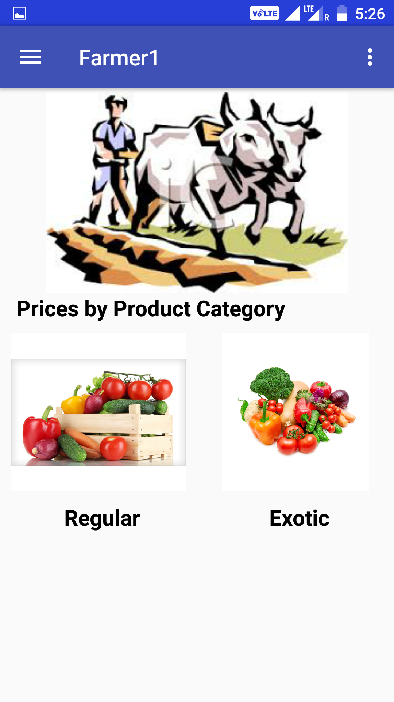
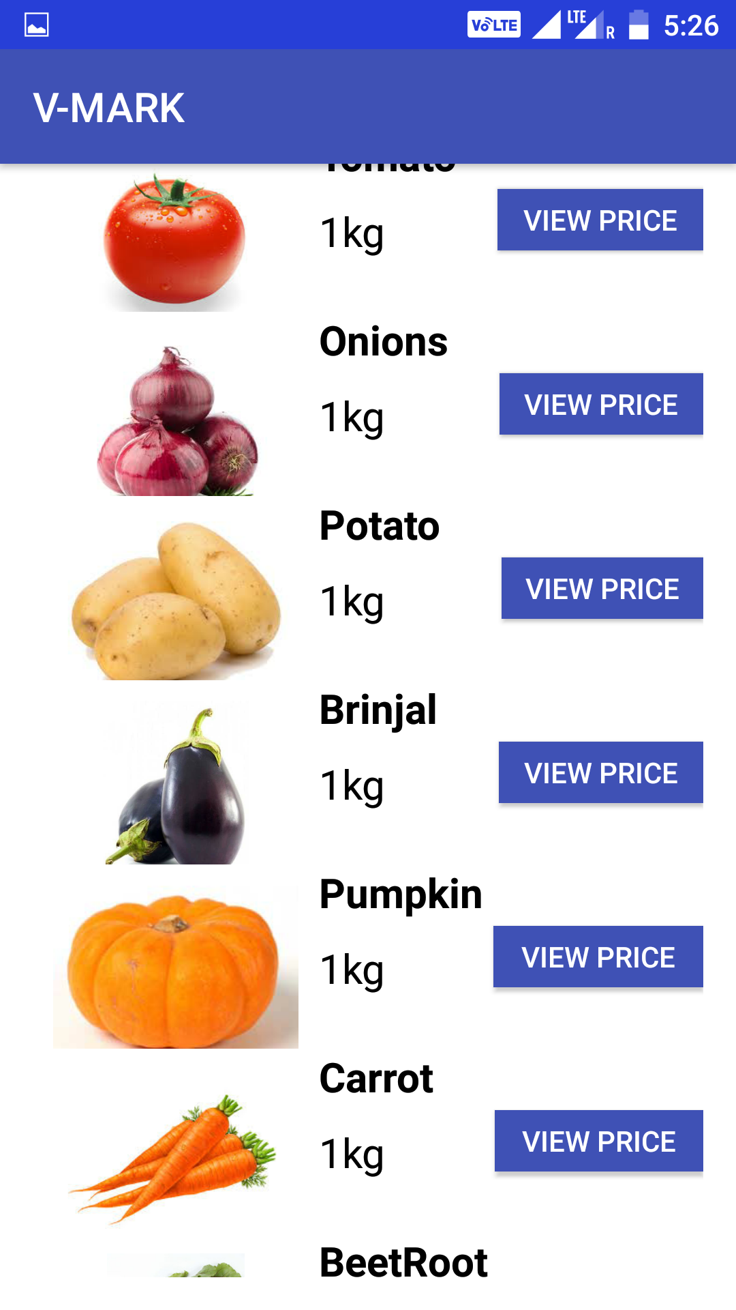
Screen Shots:
Farmer User Interface
Prices view User Interface

Slide 6
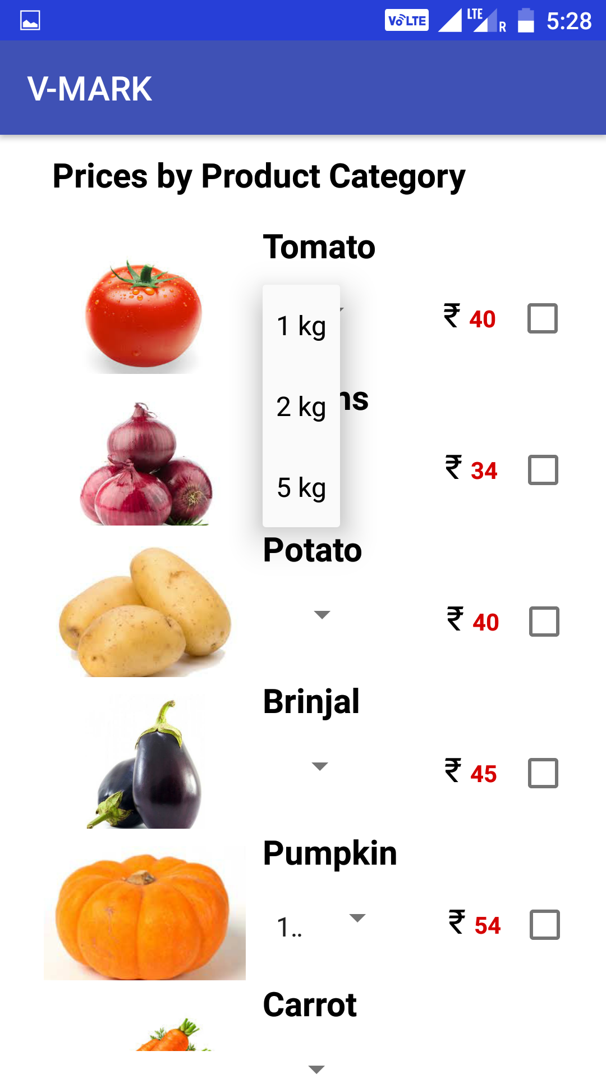
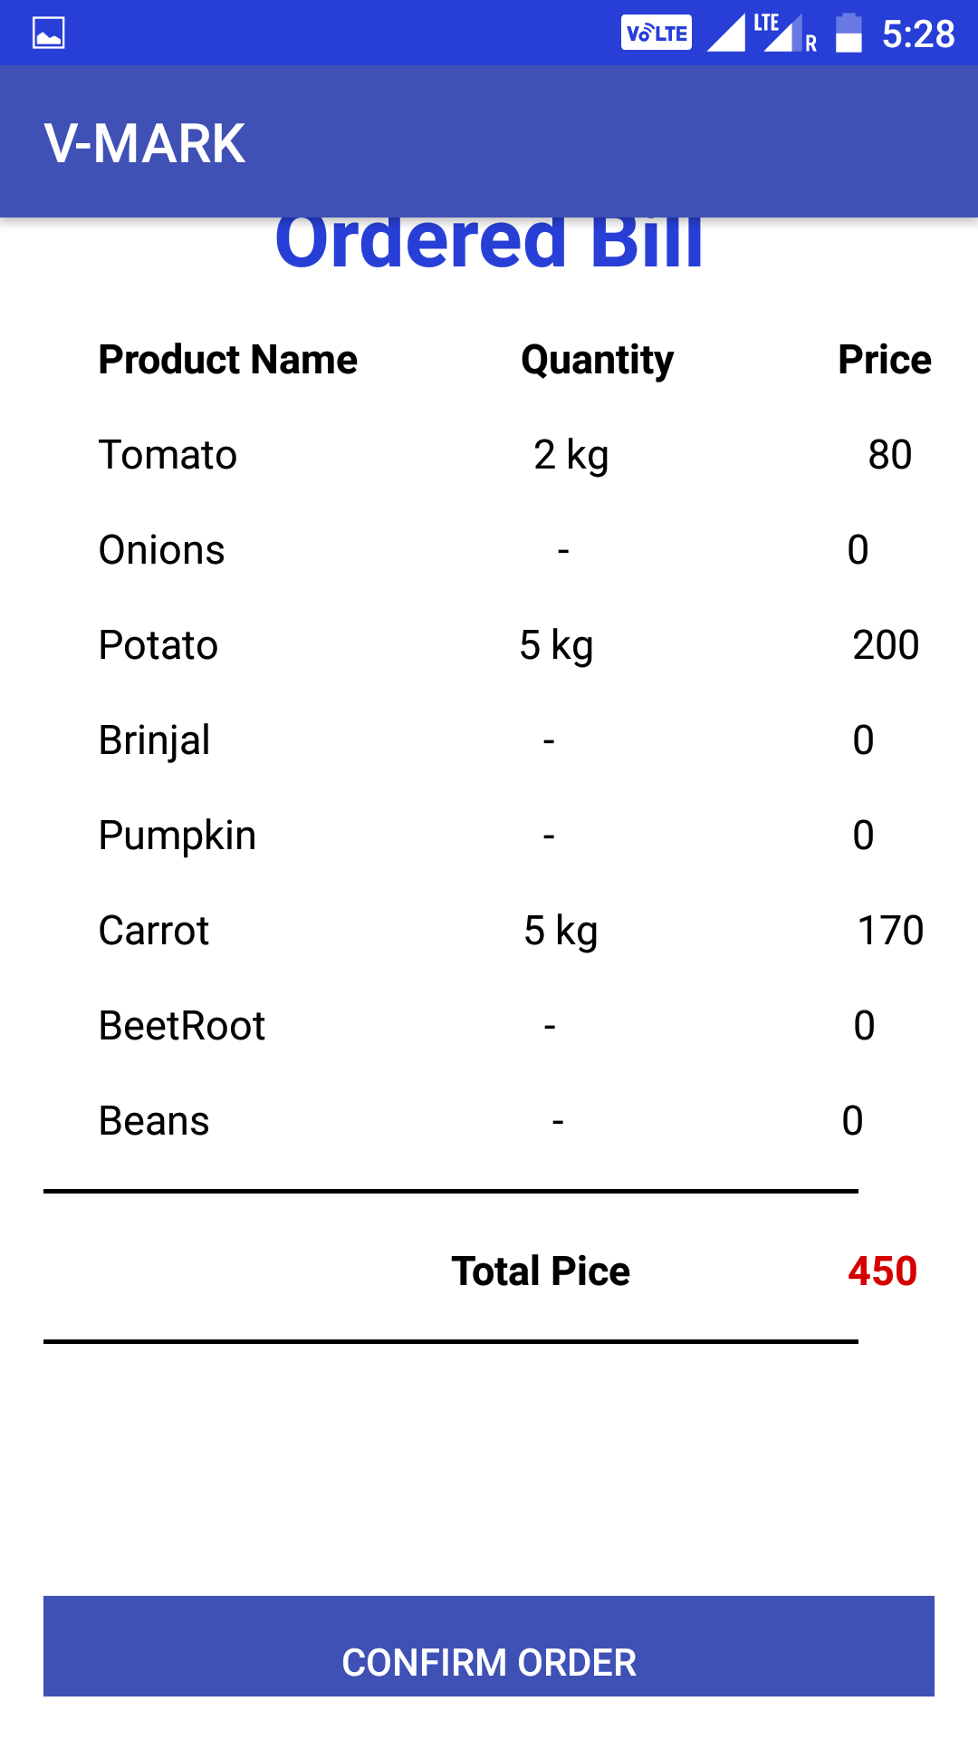
Customer can Order their product by selecting product quantity
Order Summary of the Customer

Slide 7
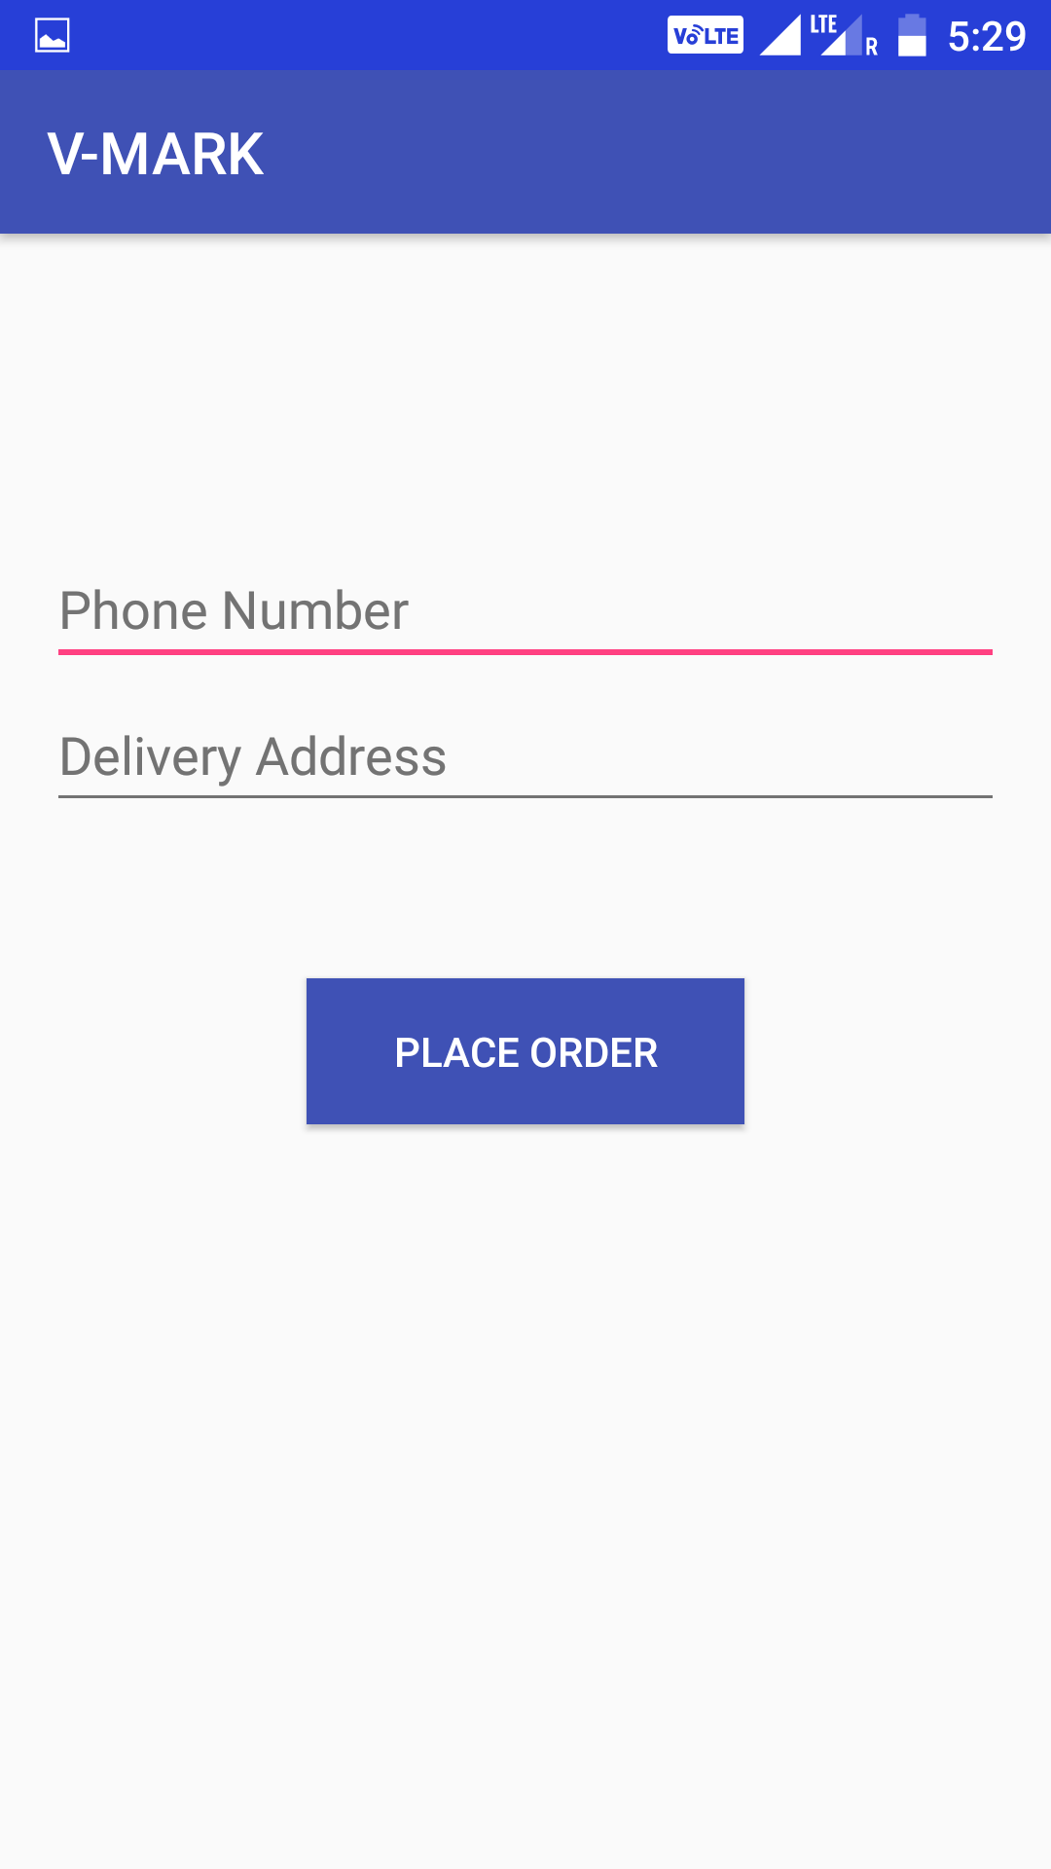
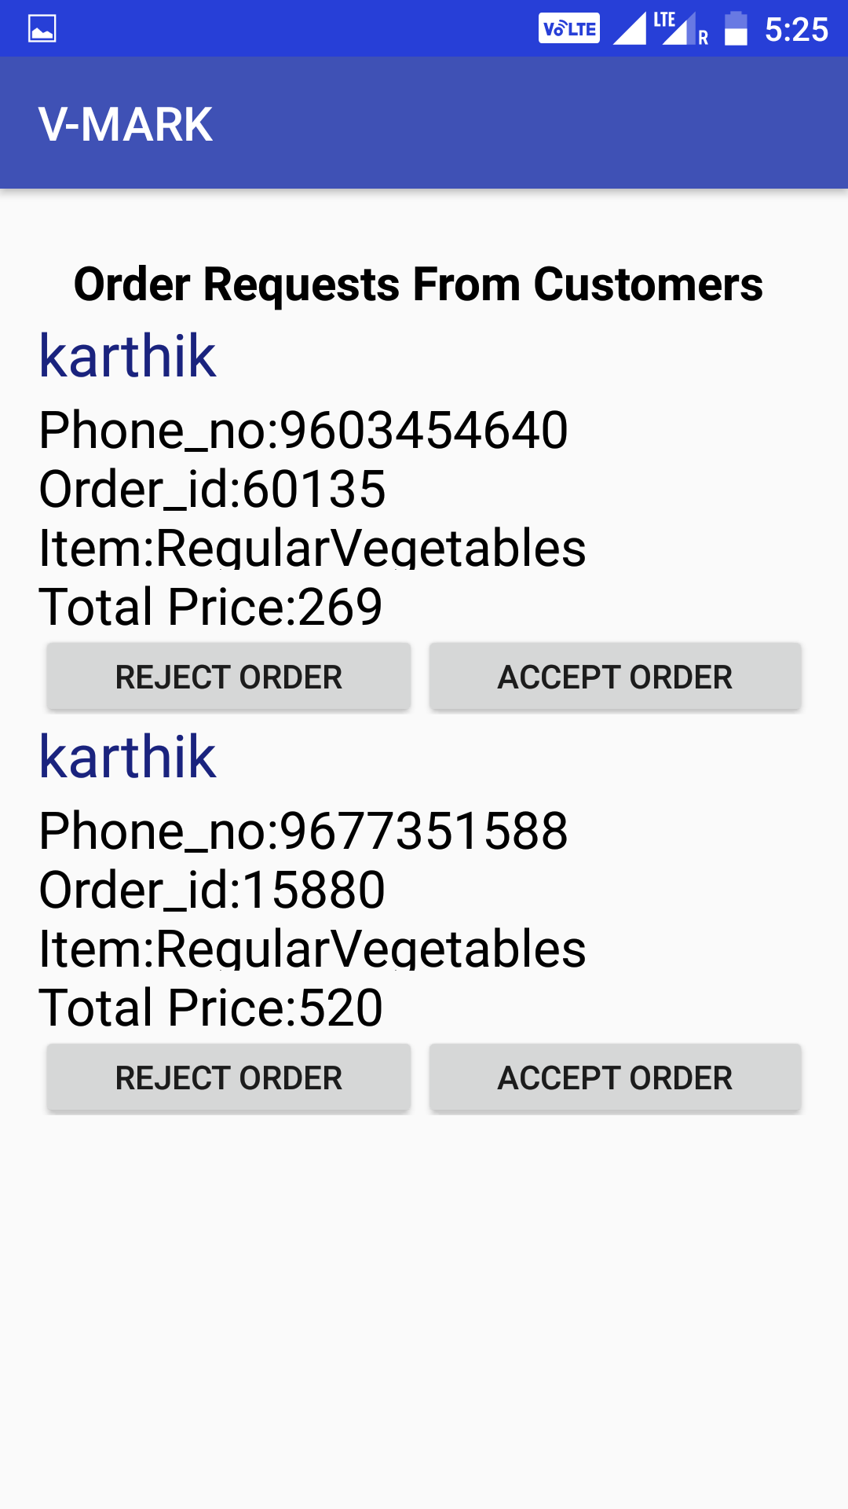
Customer can place order by entering their Delivery address and phone number
Admin Accepts the Order Requests by Customers

Slide 8
ROLES
Change Manager .
Change Advisory Board (CAB).
Change Requestor or Change Initiator.
Change Implementer.
Auditor.

Slide 9
Change Requestor or Initiator:-
Raising the change request
Ensuring that the change request is approved
Identifying the technical need for the change
Discussing change with the authorizing manager before raising the change request.Attends CAB meeting and provide necessary inputs to them and updates the user with the change activity

Slide 10
Change Control Board (CCB):-
A change control board (CCB) delivers support to a change management team by approving requested changes and assisting in the assessment and prioritization of changes.
The change manager and CCB both together are responsible for approval and authorize a change. The CCB members should selectively be chosen to ensure that the requested changes are thoroughly checked

Slide 11
Change Manager:-
Identifying, defining and tracking the benefits and outcomes required of the program
Ensuring that maximum improvements are made in the existing and new business operations
Establishing and implementing the mechanisms by which benefits can be delivered and measured. He can implement or reject change.
Taking the lead on transition management
Optimizing the timing of the release of project deliverables into the business operations

Slide 12
Change Implementer:-
Receives approved changes from the CAB/Change Management Team
Validating that the change request has been assigned to the correct Change Implementer.
Provides change status feedback to the change manager and CAB
Document the change procedure after its implementation

Slide 13
Auditor:-
Evaluates the change
Checks for the consistency of the change.
Auditors are End users of the system.
He checks weather the change implemented meets the criteria mentioned during the CCB meetings.

Slide 14
1. Roles Designated to our Team Members:
Roles | Person | Contact_Number
Change Initiator | Naveen | 9629778039
CCB | Vikas | 9629765912
Change Manager | Jagadeesh | 9603454640
Change Implementer | Dharaneshwar | 9092166325
Auditor | Vikas,Naveen | 9629778039,9629765912

Slide 15
2. Criteria for selecting CI:
Configuration Item Identification is very important phase in the SCM.
Generally the change is requested from more number of users.
Any item that is directly or indirectly affected by the change made can be considered as an CI.
The CI identification is very important as they help in reducing the risk.
While implementing the new features it may cause more Risk of failure or rejection.
CI’s can be hardware or software which are changed during the new version or revision of the product.
Documents that needs to be updated or changed whenever change has been made.

Slide 16
Configuration Item’s:-
SRS Document
Source code
Cloud database
Test cases
Test results
User Interface
SDS document
System Design
Vision Document
System Architecture

Slide 17
Structural Hierarchy:
Configuration items
Test cases
Testing
Documents
Test documents
SRS Document
SDS Document
Sub systems
Source code
Test results
Modules
User Interface
APK File
Cloud Database
Software Interface
System architecture

Slide 18
Naming scheme:
Documents:
configitem_documents.doc
1.0
SRS Document:
configitem_documents_srsdoc
1.1
SDS Document:
configitem_documents_sdsdoc
1.2
Modules:
configitem_modules
1.1.0
Software Interface:
configitem_modules_si
1.1.1

Slide 19
Continuation..
System Architecture:
configitem_modules_sysarch
1.1.2
Sub System:
configitem_subsystem
1.2.0
User Interface:
configitem_subsystem_ui
1.2.1
Cloud Database:
configitem_subsystem_clouddb
1.2.2
Source code:
configitem_sourcecode
1.3.0

Slide 20
Continuation…
APK File:
configitem_sourcecode_apk
1.3.1
Testing:
configitem_testing
1.4.0
Test cases:
configitem_testing_testcases
1.4.1
Test results:
configitem_testing_testresults
1.4.2

Slide 21
Criteria for placing your items under Configuration control:-
Stage of the project lifecycle
When the acquirer work product is ready for review and approval
Degree of control desired on the work product
Cost and schedule limitations
Customer requirements

Slide 22
3. Changes to be made in Existing Product:-
Online Payment.
To provide cost estimation of vegetables based on seasons to the farmers.
Social media login.
Web site can also be developed.
Saved card.
Add to cart.

Slide 23
4.Steps to be followed in Change management process:-
Change Creation
Build a Team
Create a Vision
Communication of Vision
Removing Obstacles
Go for Quick Wins
Let the Change Mature
Integrate the Change

Slide 24
Change Management Process
Process | Roles | Activity
Change Creation | Change Initiator | Use statistics and visual presentations to convey why the change should take place.
Build a team | Change Manager | Organize our team structure and assign responsibilities to the team members.
Create a vision | Change Manager | our team members know why they are working on the change initiative
Communication of vision | Change Control Board(CCB), Change Manager and Change Implementer | This communication should take place frequently and at important forums.

Slide 25
Change Management Process Contd…
Process | Roles | Activity
Removing Obstacles | Change Manager | Always watch out for obstacles and remove them as soon as they appear.
Go for Quick Wins | CCB,Change Manager | By quick wins, our team will have a great satisfaction
Let the Change Mature | Change Implementer | Many change initiatives fail due to early declaration of victory.
Integrate the Change | Auditor | Use mechanisms to integrate the change into people's daily routine work in the company.

Slide 26
Change Creation
A change is only successful as we really wants it.
We are planning to make a change that create urgency around what we want to change and create hype.
This will make our idea well received when we start our initiative.
Use statistics and visual presentations to convey why the change should take place.

Slide 27
Building a Team
We can now build a team to carry out the change from the people, who support us.
Since changing is our idea, we make sure and lead the team.
Organize our team structure and assign responsibilities to the team members.
Make them feel that they are important within the team.

Slide 28
Create a Vision
When a change takes place, having a vision is a must. The vision makes everything clear to everyone.
When we have a clear vision, our team members know why they are working on the change initiative and rest of the staff know why our team is doing the change.

Slide 29
Communication of Vision
Deriving the vision is not just enough to implement the change.
We need to communicate our vision across the company.
This communication should take place frequently and at important forums. We get the influential people in the company to endorse our effort.
We use every chance to communicate our vision this could be a board meeting or just talking.

Slide 30
Removing Obstacles
No change takes place without obstacles. Once we communicate with our vision, we will only be able to get the support of a fraction of the staff. Always, there are people, who resist the change.
Sometimes, there are processes and procedures that resist the change tool.
Always watch out for obstacles and remove them as soon as they appear.
This will increase the morale of our team as well the rest of the staff.

Slide 31
Go for Quick Wins
Quick wins are the best way to keep the momentum going.
By quick wins, our team will have a great satisfaction and the company will immediately see the advantages of our change initiative.
Every now and then, produce a quick win for different stakeholders, who get affected by the change process. But always remember to keep the eye on the long-term goals as well.

Slide 32
Let the Change Mature
Many change initiatives fail due to early declaration of victory.
If you haven't implemented the change 100% by the time you declare the victory, people will be dissatisfied when they see the gaps.
Therefore, complete the change process 100% and let it be there for sometime. Let it have its own time to get integrated to the people's lives and organizational processes before you say it 'over.'

Slide 33
Integrate the Change
Use mechanisms to integrate the change into people's daily routine work in the company.
Have a continuous monitoring mechanism in place in order to monitor whether every aspect of the change taking place in the organization. When we see non compliance, act immediately.

Slide 34
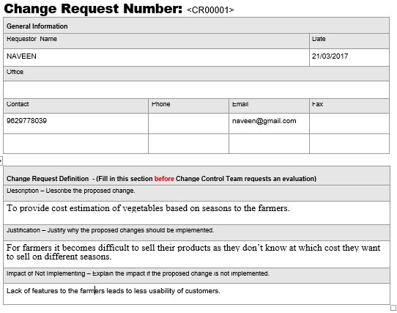
5. Change request forms:

Slide 35
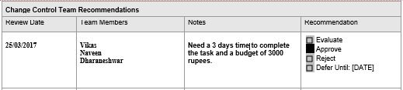

Change Request Recommendation and Approval:

Slide 36
Change requests are evaluated and assigned one of the following change types:
Type | Usage of ensemble approach
Scope | It will lead to greater features for V-MARK Application
Time | 3 Days
Duration | 3 Days
Cost | ₹ 5,000
Resources | It affects new source code, efficiency and accuracy
Deliverables | Delivered on time.
Product | Product features get increased.
Processes | Developer need to be understand well.
Quality | Quality can be increased

Slide 37

Analysis Document:-
Document Purpose | To provide an overview of new features and application changes included in version 1.1 related to previous version 1.0 for V-Mark application project.This document may be used to provide the assess the extent of application changes.
Scope of Project | Version 1.1 includes new features like online payment,social media login,saved card and add to cart
Pre-Requisites | Version 1.0
Classification of Application Changes | Implementation of each proposed change has been subjected to a change impact analysis that would adversely impact software stability or data integrity for the system.
Recommended Re-qualification Activities | Customers who are considering the version 1.1 are requested to review and check for application changes that are applicable or not.
Functional areas affected by

Slide 38
6.SCM Plan

Slide 39
7. Status Accounting Database
The recording and reporting of information needed for configuration management including the status of configuration items (CIs), proposed changes and the implementation status of approved changes.
Status accounting provides the means by which the current state of the development can be judged and the history of the development life cycle can be traced.

Slide 40
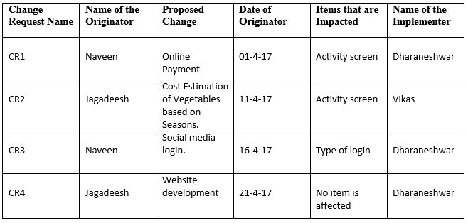
Status Accounting Database

Slide 41
Contents in status accounting database
Status
Affected items
Late status
Date of approval
Approved person
Priority change request status
Differences between new and old versions

Slide 42
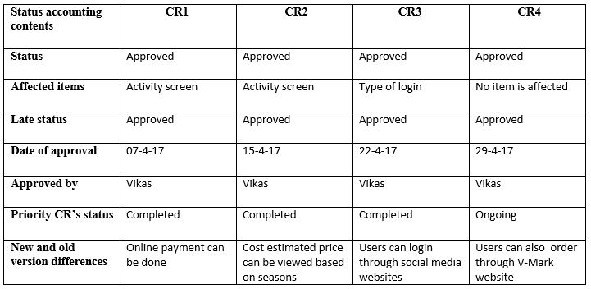
Status accounting database

Slide 43
Configuration verification and Audits:
Verification and auditing is responsible for ensuring that information Configuration Management is accurate and that all Configuration Items (CIs) are identified and recorded in Configuration Management.
Verification includes routine checks that are part of other processes .
Audit is a periodic, formal check.
You should verify and audit your configurations regularly to ensure proper functioning of the entire Configuration Management process, and for related IT service management processes

Slide 44
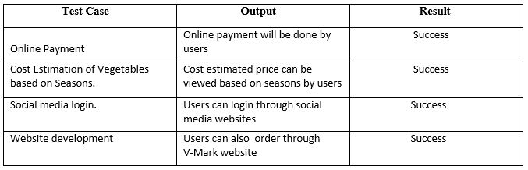
Configuration verification and Audits:

Slide 45
Configuration verification and Audits include:
Verify that the correct and authorized versions of any CI exists and is correctly identified and described
Check that release documentation and configuration administration are present before making a release
Confirm that the current environment is as expected and documented in the CMS, and that any Change requests are resolved
Check that configuration modifications are implemented through authorized changes

Slide 46
Configuration verification and Audits:
Verify that CI specifications are compliant with defined configuration policies and baselines
Validate that all required documentation for each CI is available.
Check data quality for accuracy and completeness
Initiate an incident for discovered unauthorized changes

Slide 47
9. Tool chosen for your project

