Slide 1
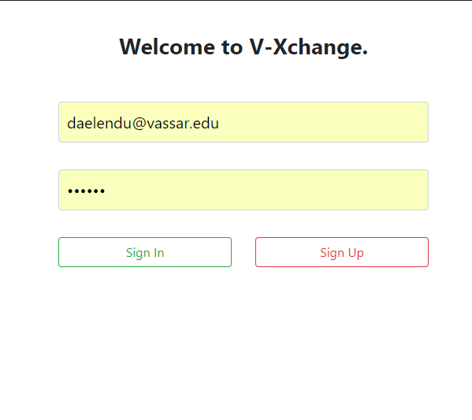
V-Xchange
DANIEL ELENDU

Slide 2
BOOK EXCHANGE AND SALE ON CAMPUS
At the moment, book exchange (and sale) on the campus is done on a Facebook group named ‘Free and For Sale’. People advertise their books as posts and then interested students can comment and commence negotiations on the platform

Slide 3
WHAT V-XCHANGE/X-CHANGE?
An organized platform that would help one keep track of book exchanges and/or sales.
It does this while maintaining a good amount of interaction that is available on the other social media platforms, but it aims to restrict posts to what a user will want to see.

Slide 4
SYSTEM ARCHITECTURE
Node.js
SQLite3
HTML
CSS
JavaScript
Bootstrap
Passport (for authentication)
jQuery

Slide 5
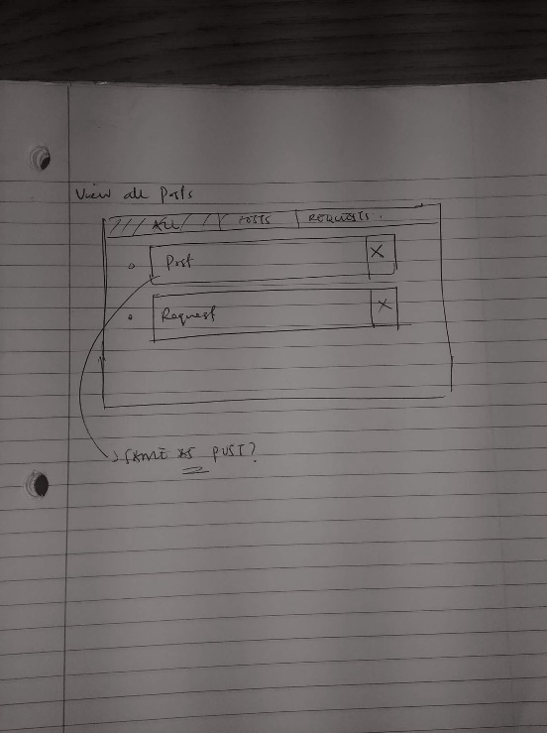
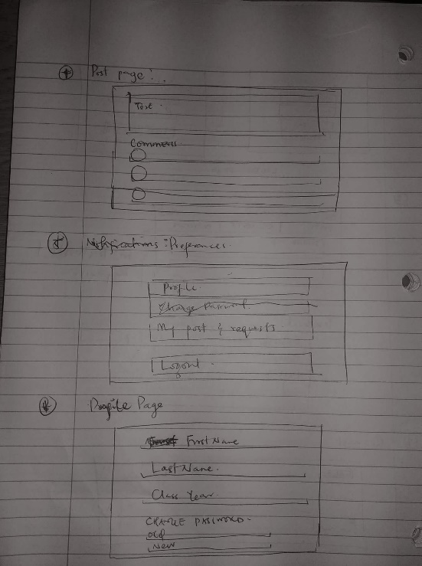
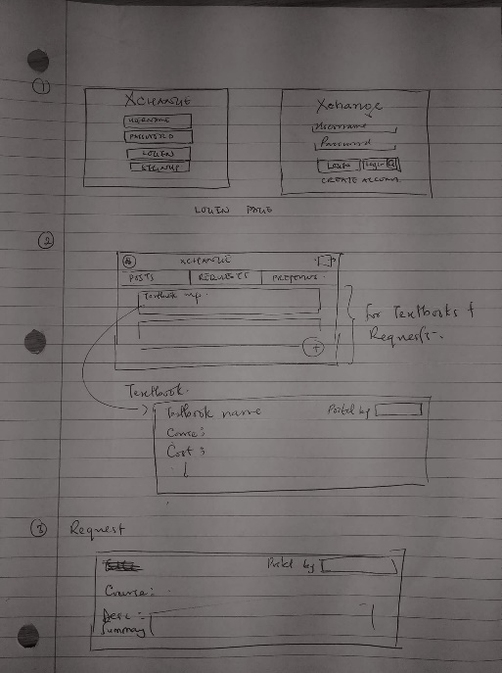
MOCKUPS

Slide 6
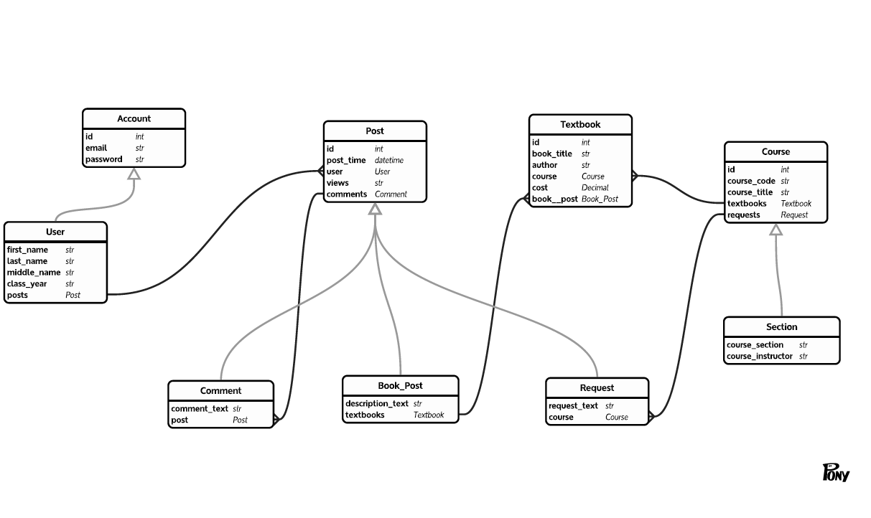
DATABASE

Slide 7
FEATURES & DEMO
Authentication
Adding Books
Adding Requests
Restricting viewing choices (unfinished)
Initiating Interaction through comments

Slide 8
OTHER FEATURES
Search (unfinished)
Adding options for payment links (if that’s what a seller is using)
A chat (or private comments).

