Slide 1

Finance Analysis

Slide 2
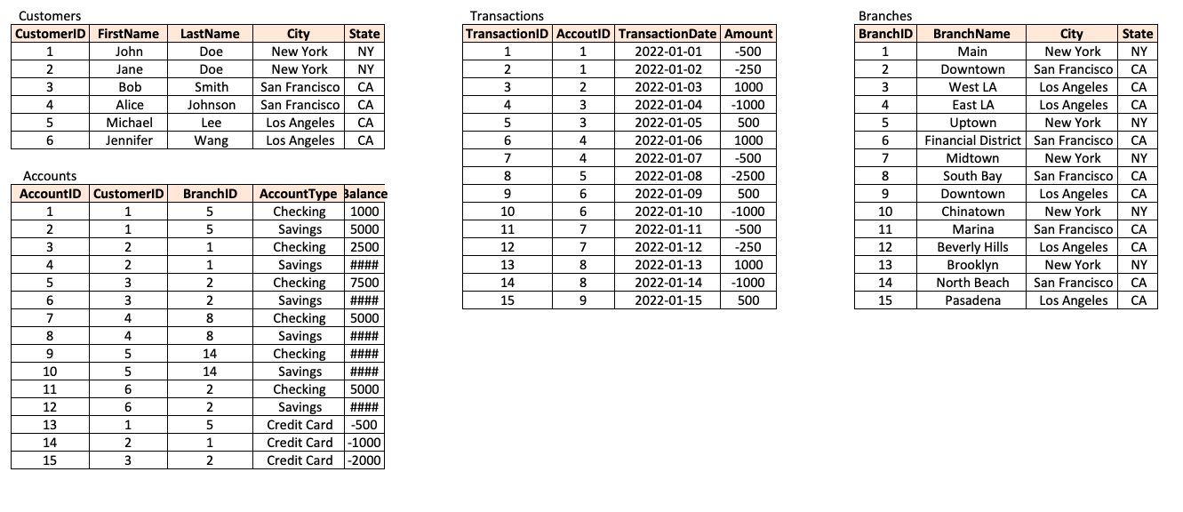
TABLES

Slide 3
SQL SCHEMA
-- Create the Customers table CREATE TABLE Customers ( CustomerID INT PRIMARY KEY, FirstName VARCHAR(50) NOT NULL, LastName VARCHAR(50) NOT NULL, City VARCHAR(50) NOT NULL, State VARCHAR(2) NOT NULL ); -------------------- -- Populate the Customers table INSERT INTO Customers (CustomerID, FirstName, LastName, City, State) VALUES (1, 'John', 'Doe', 'New York', 'NY'), (2, 'Jane', 'Doe', 'New York', 'NY'), (3, 'Bob', 'Smith', 'San Francisco', 'CA'), (4, 'Alice', 'Johnson', 'San Francisco', 'CA'), (5, 'Michael', 'Lee', 'Los Angeles', 'CA'), (6, 'Jennifer', 'Wang', 'Los Angeles', 'CA'); --------------------

Slide 4
SQL SCHEMA
-- Create the Branches table CREATE TABLE Branches ( BranchID INT PRIMARY KEY, BranchName VARCHAR(50) NOT NULL, City VARCHAR(50) NOT NULL, State VARCHAR(2) NOT NULL ); -------------------- -- Populate the Branches table INSERT INTO Branches (BranchID, BranchName, City, State) VALUES (1, 'Main', 'New York', 'NY'), (2, 'Downtown', 'San Francisco', 'CA'), (3, 'West LA', 'Los Angeles', 'CA'), (4, 'East LA', 'Los Angeles', 'CA'), (5, 'Uptown', 'New York', 'NY'), (6, 'Financial District', 'San Francisco', 'CA'), (7, 'Midtown', 'New York', 'NY'), (8, 'South Bay', 'San Francisco', 'CA'), (9, 'Downtown', 'Los Angeles', 'CA'), (10, 'Chinatown', 'New York', 'NY’),

Slide 5
SQL SCHEMA
(11, 'Marina', 'San Francisco', 'CA'), (12, 'Beverly Hills', 'Los Angeles', 'CA'), (13, 'Brooklyn', 'New York', 'NY'), (14, 'North Beach', 'San Francisco', 'CA'), (15, 'Pasadena', 'Los Angeles', 'CA'); -------------------- -- Create the Accounts table CREATE TABLE Accounts ( AccountID INT PRIMARY KEY, CustomerID INT NOT NULL, BranchID INT NOT NULL, AccountType VARCHAR(50) NOT NULL, Balance DECIMAL(10, 2) NOT NULL, FOREIGN KEY (CustomerID) REFERENCES Customers(CustomerID), FOREIGN KEY (BranchID) REFERENCES Branches(BranchID) );
-------------------- -- Populate the Accounts table INSERT INTO Accounts (AccountID, CustomerID, BranchID, AccountType, Balance) VALUES (1, 1, 5, 'Checking', 1000.00),

Slide 6
SQL SCHEMA
(2, 1, 5, 'Savings', 5000.00), (3, 2, 1, 'Checking', 2500.00), (4, 2, 1, 'Savings', 10000.00), (5, 3, 2, 'Checking', 7500.00), (6, 3, 2, 'Savings', 15000.00), (7, 4, 8, 'Checking', 5000.00), (8, 4, 8, 'Savings', 20000.00), (9, 5, 14, 'Checking', 10000.00), (10, 5, 14, 'Savings', 50000.00), (11, 6, 2, 'Checking', 5000.00), (12, 6, 2, 'Savings', 10000.00), (13, 1, 5, 'Credit Card', -500.00), (14, 2, 1, 'Credit Card', -1000.00), (15, 3, 2, 'Credit Card', -2000.00); -------------------- -- Create the Transactions table CREATE TABLE Transactions ( TransactionID INT PRIMARY KEY, AccountID INT NOT NULL, TransactionDate DATE NOT NULL,

Slide 7
SQL SCHEMA
Amount DECIMAL(10, 2) NOT NULL, FOREIGN KEY (AccountID) REFERENCES Accounts(AccountID) ); -------------------- -- Populate the Transactions table INSERT INTO Transactions (TransactionID, AccountID, TransactionDate, Amount) VALUES (1, 1, '2022-01-01', -500.00), (2, 1, '2022-01-02', -250.00), (3, 2, '2022-01-03', 1000.00), (4, 3, '2022-01-04', -1000.00), (5, 3, '2022-01-05', 500.00), (6, 4, '2022-01-06', 1000.00), (7, 4, '2022-01-07', -500.00), (8, 5, '2022-01-08', -2500.00),
(9, 6, '2022-01-09', 500.00), (10, 6, '2022-01-10', -1000.00), (11, 7, '2022-01-11', -500.00), (12, 7, '2022-01-12', -250.00), (13, 8, '2022-01-13', 1000.00), (14, 8, '2022-01-14', -1000.00), (15, 9, '2022-01-15', 500.00);

Slide 8
QUESTIONS
Answer the following questions:
1. What are the names of all the customers who live in New York? 2. What is the total number of accounts in the Accounts table? 3. What is the total balance of all checking accounts? 4. What is the total balance of all accounts associated with customers who live in Los Angeles? 5. Which branch has the highest average account balance? 6. Which customer has the highest current balance in their accounts? 7. Which customer has made the most transactions in the Transactions table? 8.Which branch has the highest total balance across all of its accounts? 9. Which customer has the highest total balance across all of their accounts, including savings and checking accounts? 10. Which branch has the highest number of transactions in the Transactions table?

Slide 9
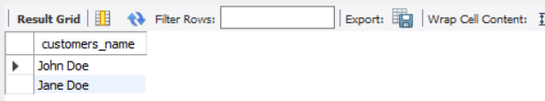
1] What are the names of all the customers who live in New York?
SELECT CONCAT(FirstName, ' ',LastName) AS customers_name FROM customers
WHERE City = 'New York';
Output:

Slide 10
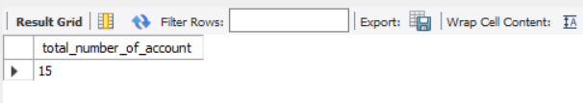
2] What is the total number of accounts in the Accounts table?
SELECT COUNT(DISTINCT AccountID) AS total_number_of_account FROM accounts;
Output:

Slide 11

3] What is the total balance of all checking accounts?
SELECT SUM(Balance) AS total_balance FROM accounts
WHERE AccountType = 'Checking';
Output:

Slide 12

4] What is the total balance of all accounts associated with customers who live in Los Angeles?
SELECT SUM(Balance) AS total_balance FROM accounts a
JOIN customers c ON a.CustomerID = c.CustomerID
WHERE c.city = 'Los Angeles';
Output:

Slide 13

5] Which branch has the highest average account balance?
SELECT BranchName, AVG(Balance) AS Avg_Balance FROM branches b
JOIN accounts a ON b.BranchID = a.BranchID
GROUP BY BranchName
ORDER BY Avg_Balance DESC LIMIT 1;
Output:

Slide 14

6] Which customer has the highest current balance in their accounts?
SELECT CONCAT(FirstName,’ ',LastName) AS customer_name, Balance FROM customers c
JOIN accounts a ON c.CustomerID = a.CustomerID
GROUP BY customer_name
ORDER BY Balance DESC LIMIT 1;
Output:

Slide 15
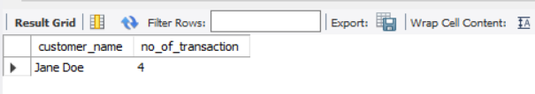
7] Which customer has made the most transactions in the Transactions table?
SELECT CONCAT(FirstName,' ',LastName) AS customer_name, COUNT(TransactionID) AS no_of_transaction FROM customers c
JOIN accounts a ON c.CustomerID = a.CustomerID
JOIN transactions t ON a.AccountID = t.AccountID
GROUP BY c.CustomerID
ORDER BY no_of_transaction DESC LIMIT 1;
Output:

Slide 16
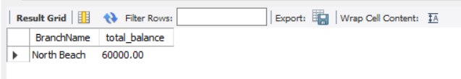
8] Which branch has the highest total balance across all of its accounts?
SELECT BranchName, SUM(Balance) AS total_balance FROM branches b
JOIN accounts a ON b.BranchID = a.BranchID
GROUP BY b.BranchName
ORDER BY total_balance DESC LIMIT 1;
Output:

Slide 17

9] Which customer has the highest total balance across all of their accounts, including savings and checking accounts?
SELECT CONCAT(FirstName,' ',LastName) AS customer_name, SUM(Balance) AS total_balance FROM customers c
JOIN accounts a ON c.CustomerID = a.CustomerID
GROUP BY customer_name
ORDER BY total_balance DESC LIMIT 1;
Output:

Slide 18
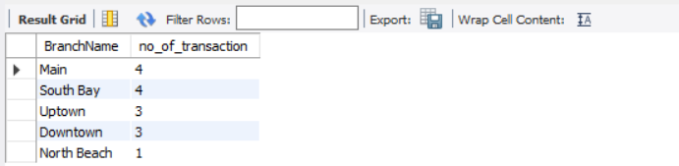
10] Which branch has the highest number of transactions in the Transactions table?
SELECT BranchName, COUNT(TransactionID) AS no_of_transaction FROM branches b
JOIN accounts a ON b.BranchID = a.BranchID
JOIN transactions t ON a.AccountID = t.AccountID
GROUP BY BranchName
ORDER BY no_of_transaction DESC;
Output:

