Slide 1

DEPARTMENT OF CSE (ARTIFICIAL INTELLIGENCE AND MACHINE LEARNING) ACADEMIC YEAR 2025 - 2026 SEMESTER IV MACHINE LEARNING LABORATORY MINI PROJECT REVIEW SPAM EMAIL CLASSIFICATION USING NAÏVE BAYES AND LOGISTIC REGRESSION
REGISTER NUMBER | 2117240030028
NAME | DHARRINI SELVI R
YEAR | II
SECTION | A
FACULTY IN-CHARGE | Mrs. M. Divya

Slide 2
PROBLEM STATEMENT
• Traditional methods of filtering spam messages rely on basic keyword matching and manual rules, which are often ineffective against evolving spam patterns.
• These methods may fail to accurately detect new or disguised spam messages, leading to security risks such as phishing and fraud.
• Spam messages contain various textual patterns, promotional content, and misleading information that are difficult to analyze manually.
• Manual filtering of messages is time-consuming, inefficient, and prone to errors, especially with large volumes of data.
• Without an automated system, users may be exposed to malicious content that can compromise personal and financial information.
• There is a need for a smart and efficient system that can automatically classify messages as spam or ham in real time.
• Therefore, a machine learning-based spam detection system is required to improve accuracy, enhance security, and provide reliable message classification.

Slide 3
THEORETICAL BACKGROUND
• Machine Learning is a branch of Artificial Intelligence that enables systems to learn from data and make predictions automatically.
• It uses historical data to identify patterns and classify new data accurately.
• In the domain of communication systems, Machine Learning is widely used to detect and filter spam messages.
• Spam detection is a text classification problem where messages are categorized as Spam or Ham (Non-Spam).
• This project uses Naive Bayes and Logistic Regression, which are supervised learning algorithms used for classification tasks.
• Naive Bayes is a probabilistic algorithm based on Bayes’ Theorem and is effective for text classification.
• Logistic Regression predicts the probability of a message being spam or not using a sigmoid function.
• Text data is converted into numerical form using techniques like TF-IDF vectorization for model training.
• These methods help improve accuracy and automate spam detection efficiently.
• The system classifies messages in real-time and assists users in identifying unwanted or malicious content.

Slide 4
THEORETICAL BACKGROUND
• Load the SMS Spam dataset containing labeled messages (Spam/Ham).
• Preprocess the data by converting text to lowercase and removing punctuation.
• Convert text data into numerical form using TF-IDF vectorization.
• Assign labels to messages (Spam = 1, Ham = 0).
• Split the dataset into training (80%) and testing (20%) sets.
• Train the Naive Bayes model for probabilistic classification.
• Train the Logistic Regression model for probability-based prediction.
• Take user input from the GUI and preprocess the message.
• Transform the input message using the trained TF-IDF vectorizer.
• Predict whether the message is Spam or Ham using the selected model.
• Evaluate model performance using Accuracy, Precision, Recall, F1 Score, and Confusion Matrix.
• Display classification results through a user-friendly Tkinter GUI.
• Visualize performance using graphs and comparison charts.
ALGORITHM

Slide 5
IMPLEMENTATION AND CODE
Link to code in Git-hub Repository
report
https://github.com/dharrini06/Spam-Email-Classification-using-Naive-Bayes-and-Logistic-Regression
Git Hub Link of the project and report

Slide 6
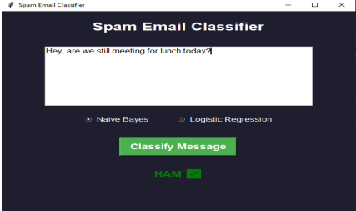
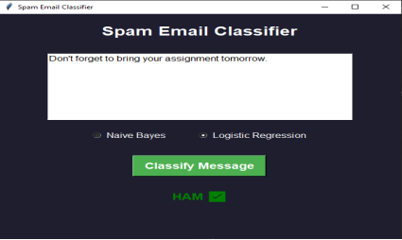
OUTPUT AND RESULTS
Ham Message Detection
The message contains normal conversational content without any promotional or suspicious keywords, so it is correctly classified as ham (non-spam) with both Naïve Bayes and Logistic Regression.

Slide 7
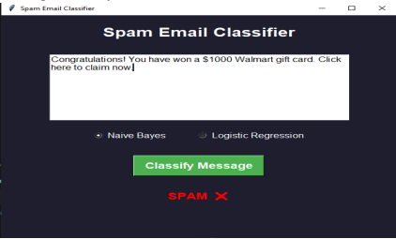
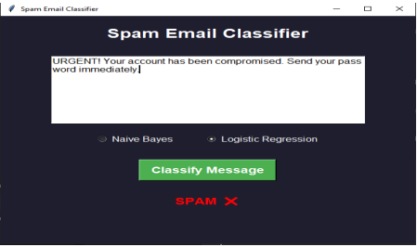
OUTPUT AND RESULTS
Spam Message Detection
The messages contain promotional and urgent keywords such as “won,” “gift card,” and “URGENT,” which are strong indicators of spam, so they are correctly classified as spam by both Naive Bayes and Logistic Regression.

Slide 8
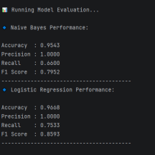
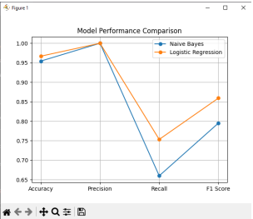
OUTPUT AND RESULTS
The performance graphs and metrics display the effectiveness of the spam classification models using evaluation measures such as accuracy, precision, recall, F1 score, and confusion matrix. These visualizations help in understanding how well the models classify messages as spam or ham and allow comparison between Naive Bayes and Logistic Regression.

Slide 9
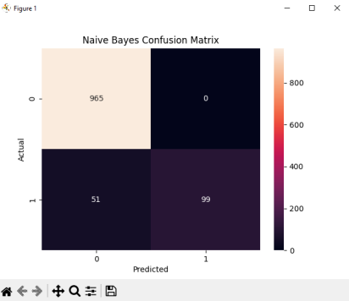
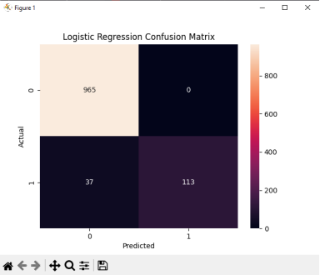
OUTPUT AND RESULTS
• The confusion matrix shows the number of correct and incorrect predictions made by the model for spam and ham messages, helping to evaluate classification performance.
• It displays values such as true positives, true negatives, false positives, and false negatives, providing a clear understanding of how well the model distinguishes between spam and non-spam messages.

Slide 10
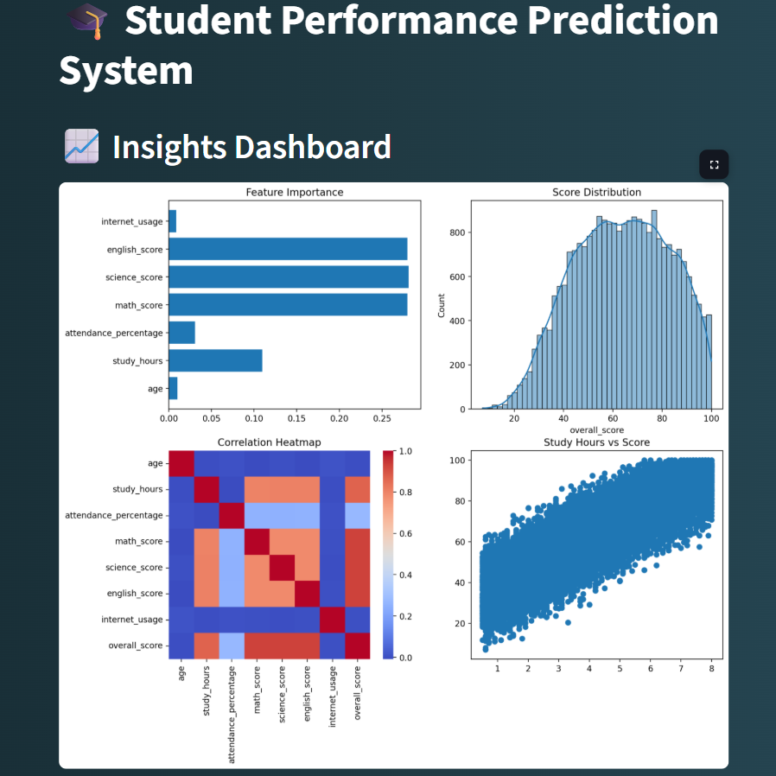

OUTPUT AND RESULTS
Modern visualization shows data insights using simple graphs like bar charts, heatmaps, and scatter plots to understand student performance.
Recommendations give easy tips to students like improving study time, maintaining attendance, and focusing on weak subjects.

Slide 11
OUTPUT AND RESULTS
• The system successfully classifies messages as Spam or Ham (Non-Spam) using machine learning algorithms.
• Both Naive Bayes and Logistic Regression provide reliable and accurate prediction results.
• Logistic Regression achieves higher performance in terms of accuracy, recall, and F1 score compared to Naive Bayes.
• The model effectively identifies spam messages based on textual patterns and keywords.
• The Tkinter-based GUI enables real-time message input and instant classification results.
• Performance evaluation using accuracy, precision, recall, and confusion matrix shows strong model effectiveness.
• Visualization graphs and charts help in comparing both models and understanding their performance clearly.
Results

Slide 12
OUTPUT AND RESULTS
• Improve model performance using advanced algorithms like Support Vector Machines (SVM), XGBoost, or Deep Learning models.
• Expand the dataset to include emails, multilingual messages, and real-time data for better accuracy and generalization.
• Enhance the GUI by adding features like message history, confidence score display, and batch message classification.
• Deploy the system as a web or mobile application for real-world usage.
• Implement continuous learning to adapt to evolving spam patterns.
• Incorporate additional features such as sender information, links, and attachments for more robust spam detection.
Future enhancements

Slide 13
REFERENCES
UCI Machine Learning Repository, “SMS Spam Collection Dataset”. [Online]. Available: https://archive.ics.uci.edu/ml/datasets/sms+spam+collection
Kaggle, “SMS Spam Collection Dataset”. [Online]. Available: https://www.kaggle.com/datasets/uciml/sms-spam-collection-dataset
T. M. Mitchell, Machine Learning, McGraw-Hill Education, 1997.
C. M. Bishop, Pattern Recognition and Machine Learning, Springer, 2006.
S. Raschka and V. Mirjalili, Python Machine Learning, 3rd Edition, Packt Publishing, 2019.
Scikit-learn Documentation, “Machine Learning in Python”. [Online]. Available: https://scikit-learn.org/stable/

