Slide 1
Student Achievement in Secondary Education
SYSC5807
Dharmik Trivedi
101235680
Prof Fateme Rajabiyazdi

Slide 2
Index
Introduction
Dataset
Design
Demo
Evaluation Method
Participant Consent
Evaluation Results
Lesson Learned from Evaluation Study
Recommendation for next time

Slide 3
Introduction and Motivation
Visualization is about “Student Grades in Secondary Education”
The target audience, using the visualization, would be able to:
-Compare the grades between St. Mary and St. Thomas Schools
-Compare the grades among Male and Female students
-Observe trend of student habits having particular grade/grades’ range
After using this visualization, one would be able to comment about “School Performance” and “Gender wise Student Performance”, and “Habits of top performing/least performing” students
Notes:
Why one should use my visualization?

Slide 4
Dataset
Link to the dataset: https://www.kaggle.com/datasets/whenamancodes/student-performance
Well, dataset is about student achievement in secondary education of two Portuguese schools for the subjects: Portuguese language and Mathematics. The data attributes include student grades, demographic, social and school related features) and it was collected by using school reports and questionnaires.
Size :
1) Portuguese.csv: Column: 33, Rows : 650
2) Mathematics.csv: Column: 33, Rows: 396

Slide 5
Dataset
Entire file maths.csv is merged with Portuguese.csv in order to compare the student performance between these two subjects
Some excel operations like sorting, filtering and transposing were done in order to sort the data

Slide 6
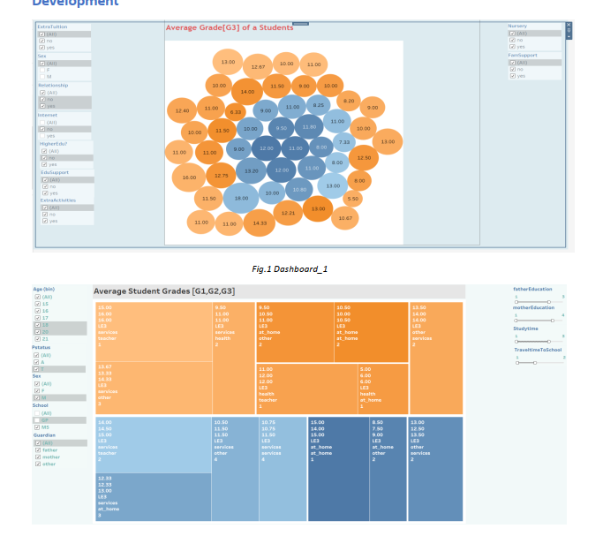
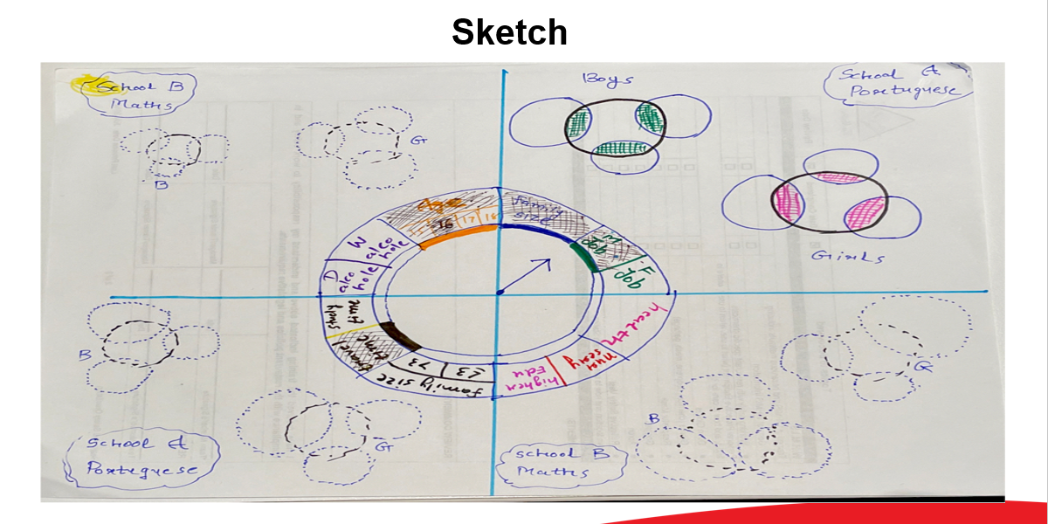
Design and Improvements
Design itself is completely changed!

Slide 7
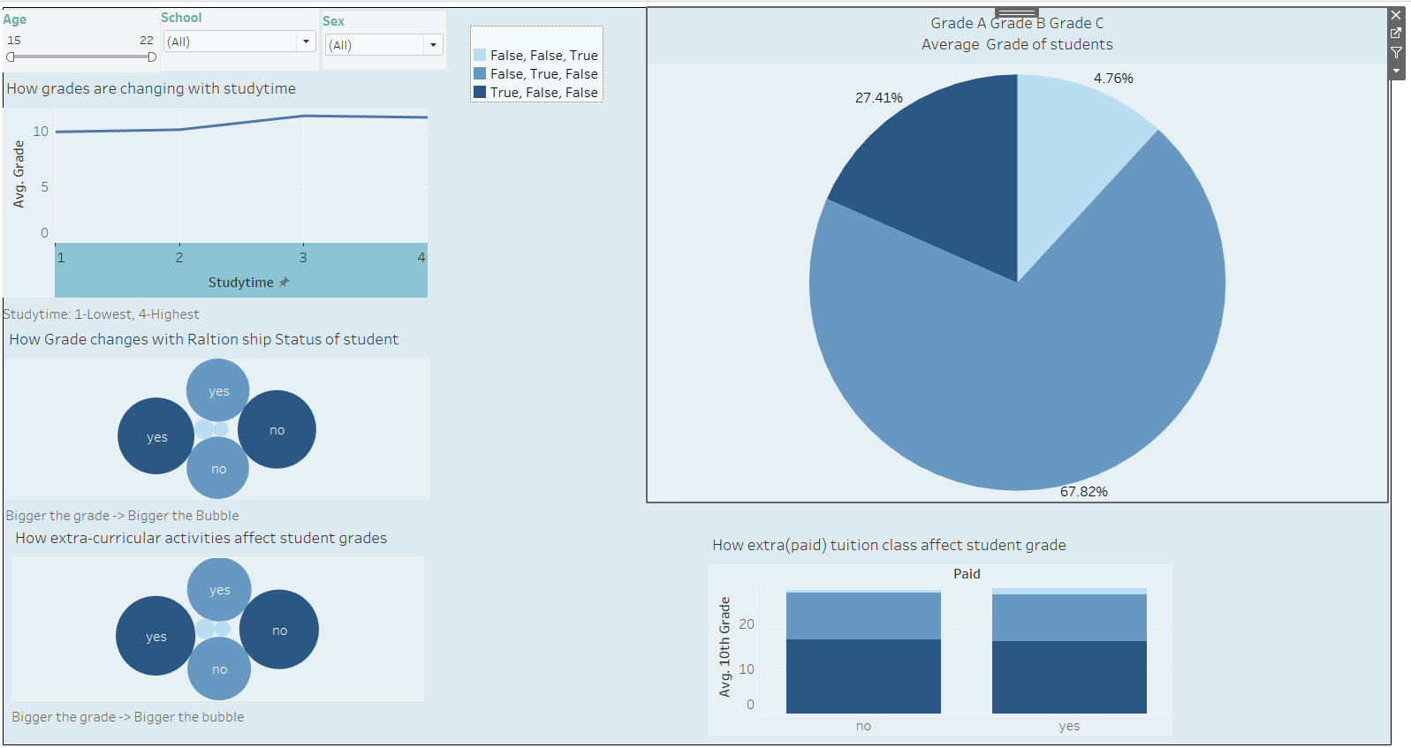
2nd Improvement

Slide 8
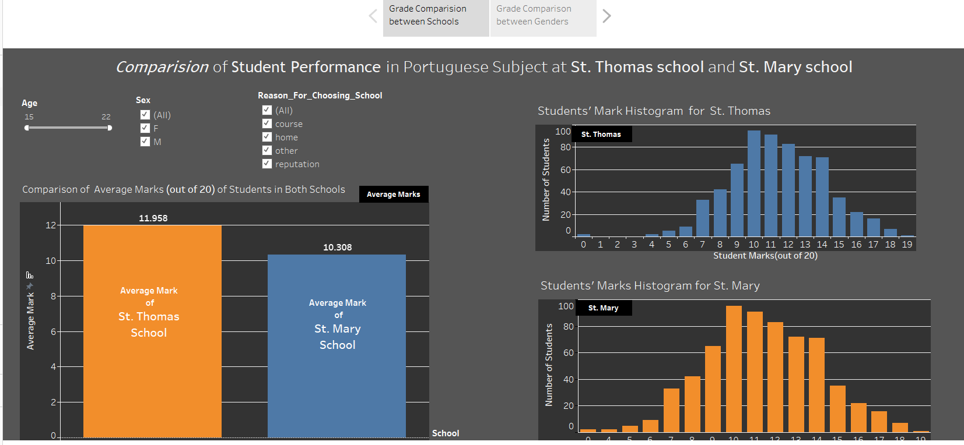
Final Version!
Notes:
Why I selected these charts?

Slide 9
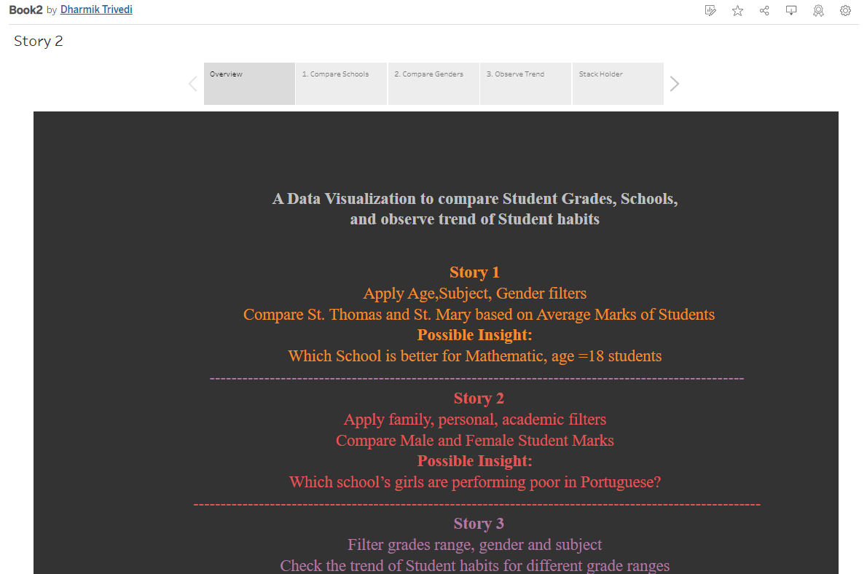
Design
Link to the visualization: Data Visualization

Slide 10
Tasks
Which School is better for Mathematic, age =18 students
Which school’s girls are performing poor in Portuguese?
Check the study time, health, going out frequency, weekly alcoholic consumption of students scoring less than 13(out of 20) marks

Slide 11
Evaluation Method
Type of Evaluation : in- person
Relation : Friend
Time: 20 minutes
Location: Home
Connection as a target audience: To some extent!
Way of collecting feedback: Oral
Type of Consent: Signed consent form (Electronic)

Slide 12
Evaluation Method
General Questions
How long it took to understand each and every functionality correctly?
Were filters easy to play around and useful ?
Were you able to find insights at the end or able to comment about your conclusion?
Can it be proposed to general audience/target audience?
Was it easy to navigate though different graphs and understand the relation between them?

Slide 13
Evaluation Results
Factors for rating | Rating out of 5
General Que 1(3 Minutes – 5.0, 5 Minutes-4.0, 7 Minutes-3.0, More than 7 minutes: 1.0) | 3
General Que 2 (Very Easy and Useful-5.0, Complex and Useful-4.0, Complex and Not Useful-3.0, Not understood-1.0) | 4
General Que 3 (2 Conclusions-5.0, 1 Conclusion-4.0, No Conlcusion-1.0) | 4
General Que 4 (Yes without changes-5.0, Yes with Minor changes-3.0, Yes with Major changes-3.0,No Conlcusion-1.0) | 3
General Que 5 (Very Easy and Useful-5.0, Complex and Useful-4.0, Complex and Not Useful-3.0, Not understood-1.0) | 5
 | Avg = 3.8

Slide 14
Thank you!
Email:
dharmiktrivedi@cmail.Carleton.ca

