Slide 1
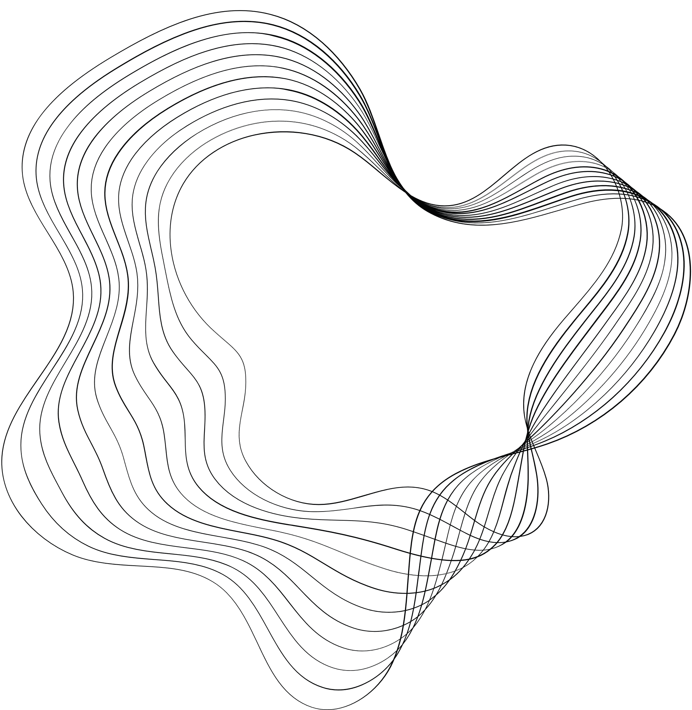
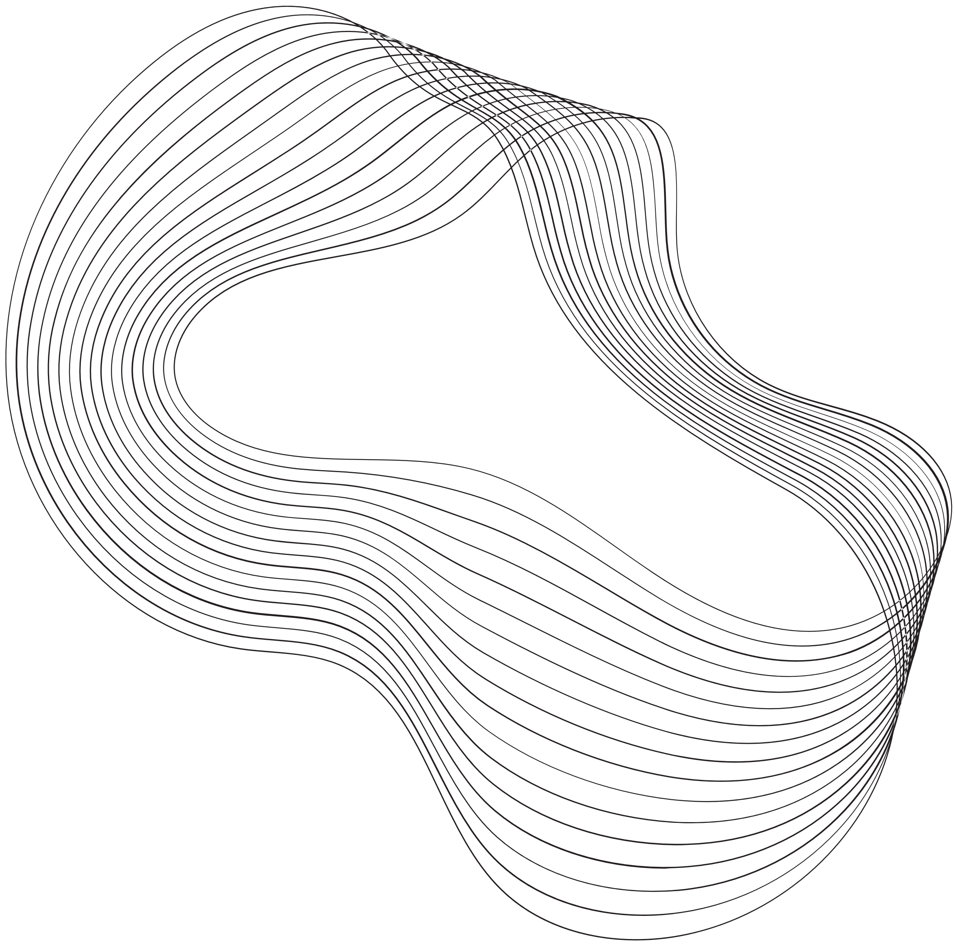

DATA STRUCTURES AND ALGORITHMS
19CSE212
CASE STUDY-HYBRID DATA STRUCTURES

Slide 2

TITLE :E-COMMERCE HYBRID DATA STRUCTURES
TEAM MEMBERS
DEEPTHIKA R CB.EN.U4CSE21217
TOPIC
E-COMMERCE
DHARSAN S CB.EN.U4CSE21219

Slide 3

CONTENT
01
INTRODUCTION
02
OBJECTIVE
03
IMPLEMENTATION
04
PRACTICAL APPLICATION
05
PERFORMANCE ANALYSIS
06
EXPERIMENTAL EVALUATION
07
DISCUSSION
08
CONCLUSION
09
REFERENCE

Slide 4
WHAT ARE HYBRID DATA STRUCTURES
Significance :
Improved performance
Enhanced Functionality
Increased Flexibility
overall, it can provide a powerful tool for solving complex data management problems by combining the strenghths of different data structures to achieve better performance.
Hybrid data structures are those with 2 or more different types of data structure.They are designed to leverage the strengths of each individual data structure while mitigating their weaknesses
Hybrid data structures are often used in situations where a single data structure cannot meet all the requirements of a given problem. By combining different data structures, we can create a specialized data structure that is specific to the needs of the problem at hand.
Challenges :
Complexity
Inefficiency
Lack of support
Hybrid data structures can be more complex than their individual components, but are better in performance than a single data structure.

Slide 5





OBJECTIVE
DESIGNING
HYBRID DATA STRUCTURES USED
TIME AND SPACE COMPLEXTITY
We have designed an
e-commerce platform where the users should register and then login to use.
They can enter their choices from a menu driven list ,there are features like add products, add product to cart, ,checkout the product and etc
Hash table
Binary search tree
Linked list
time complexity ranges from O(n) to O(n log n).
space complexity ranges from O(n) to O(n^2).

Slide 6
CHOSEN HYBRID DATA STRUCTURES FUNCTIONS:
Hash Table: Used to store the Product objects with their unique product id as the key.
Binary Search Tree: Used to store the Product objects in a sorted order based on their product id.
LinkedList: Used to implement a shopping cart as a linked list of Product objects.

Slide 7
PRACTICAL APPLICATIONS:
The practical application is the development of an online shopping system that is fast, efficient, and user-friendly. This concept can be integrated into the backend of the website or application to provide users with a seamless shopping experience.
The use of a hybrid data structure in the above code provides several advantages, including improved performance, reduced memory usage, flexibility, scalability, and simplified code. By combining the strengths of multiple data structures, the hybrid structure can efficiently handle the specific requirements of an online shopping cart system.

Slide 8
IMPLEMENTATION AND DESIGN CHOICE:
We used separate data structures for various purposes like hash tables to store and retrieve the products.
This code has separate functions for adding products to the cart, viewing the cart, and checking out.
It ensures the product is consistent across the hash table and BST.
It has unique product IDs to identify the product and retrieve it.

Slide 9
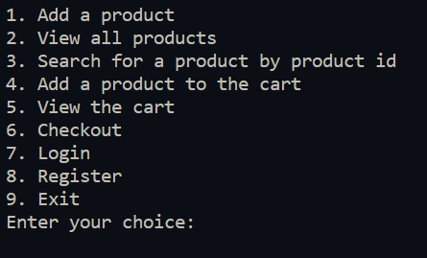
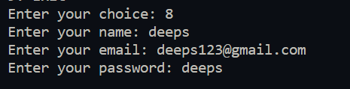
IMPLEMENTATION RESULTS:
MAIN MENU
REGISTER

Slide 10

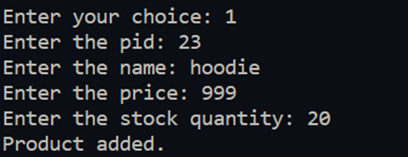
IMPLEMENTATION RESULTS:
LOGIN
ADD NEW PRODUCT

Slide 11
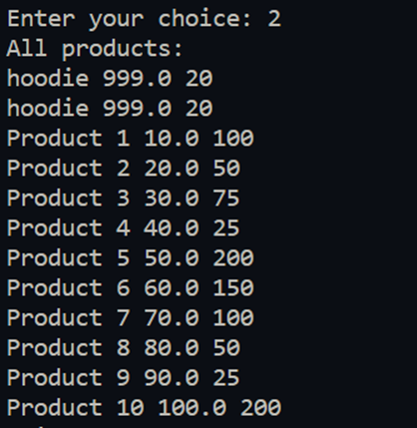

IMPLEMENTATION RESULTS:
VIEW PRODUCTS
SEARCH PRODUCT

Slide 12




IMPLEMENTATION RESULTS:
ADD TO CART
CHECK OUT
VIEW CART
LOGOUT

Slide 13
LIMITATIONS AND CHALLENGES:
It depends on various factors, such as the size and distribution of the data, the frequency of insertions and deletions, and the specific use case.
If the data has a skewed distribution, the hash table may experience collisions, which can degrade its performance.
If the data has frequent insertions and deletions, the binary search tree may become unbalanced, which can increase lookup time.
CONCLUSION:
The project is an implementation of an e-commerce platform that allows users to add, view, search, and purchase products. The platform uses a hybrid data structure that combines a hash table and a binary search tree to efficiently store and retrieve products based on their product ID. The platform also provides user management functionalities such as login, registration, and logout. Transactions are stored in a list, and it calculates the total cost of the products in the cart, and can also check out.

Slide 14

THANK YOU

