Slide 1

Guided By : Dr. Josephine Mam
FLAPPY BIRD GAME
BY:
Dharshan H D(1CD21CS045)
Department of Computer Science Engineering
www.cambridge.edu.in

Slide 2

CONTENTS:
Introduction
System Requirements
Code
Algorithm
Flowchart
Snapshots
Conclusion
Department of Computer Science Engineering
www.cambridge.edu.in

Slide 3
Introduction
Flappy Bird is a simple yet highly addictive mobile game developed by Dong Nguyen and released in 2013.
The game quickly gained worldwide popularity due to its straightforward mechanics and challenging gameplay.
The player controls a bird attempting to fly through a series of green pipes without hitting them. Despite its simple concept, Flappy Bird's design and difficulty captivated millions of players globally, making it a phenomenon in mobile gaming. This project aims to replicate the core gameplay of Flappy Bird while exploring potential innovations in its mechanics and user experience.
Department of Computer Science Engineering
www.cambridge.edu.in

Slide 4
Despite its simple concept, Flappy Bird's design and difficulty captivated millions of players globally, making it a phenomenon in mobile gaming.
This project aims to replicate the core gameplay of Flappy Bird while exploring potential innovations in its mechanics and user experience.
Department of Computer Science Engineering
www.cambridge.edu.in

Slide 5
System Requirements
1. Programming Language: C or C++ (for Unreal Engine).
2. Development Environment: Linux, Visual Studio, Rider, or any compatible IDE for scripting and debugging.
Software Requirements:
Hardware Requirements:
1. Development Machine:
Minimum: Dual-core CPU, 8GB RAM, integrated graphics.
Recommended: Quad-core CPU, 16GB RAM, discrete graphics card (NVIDIA/AMD).
2. Testing Devices:
Windows (Linux/Visual studio)
iOS devices (iMac/iPad)
Department of Computer Science Engineering
www.cambridge.edu.in

Slide 6
Code:
void drawBird() {
glPushMatrix();
glTranslatef(50, birdY, 0);
glColor3f(1.0, 1.0, 0.0); // Yellow color for the bird
glBegin(GL_POLYGON);
glVertex2f(-20, -20);
glVertex2f(20, -20);
glVertex2f(0, 20);
glEnd();
glPopMatrix();
}
void drawPipe() {
glPushMatrix();
glTranslatef(pipeX, 0, 0);
glColor3f(0.0, 1.0, 0.0); // Green color for the pipe
// Lower pipe
glBegin(GL_POLYGON);
glVertex2f(-20, 0);
glVertex2f(20, 0);
glVertex2f(20, pipeY - pipeGap / 2);
glVertex2f(-20, pipeY - pipeGap / 2);
glEnd();
#include <GL/glut.h>
#include <stdlib.h>
#include <time.h>
#include <stdio.h>
int birdY = 300; // Initial bird position
int birdVelocity = 0; // Vertical velocity of the bird
int pipeX = 200;
int pipeY = 0;
int score = 0;
int gameState = 0; // 0: Start, 1: Playing, 2: End
int gameSpeed = 30; // Initial game speed (lower value means faster updates)
int pipeGap = 150; // Height of the gap in the pipes
void init() {
glClearColor(0.53, 0.81, 0.92, 1); // Sky blue background
glMatrixMode(GL_PROJECTION);
glLoadIdentity();
gluOrtho2D(0, 400, 0, 600);
}
Department of Computer Science Engineering
www.cambridge.edu.in

Slide 7
void draw() {
glClear(GL_COLOR_BUFFER_BIT);
if (gameState == 0) { // Start screen
drawStartScreen();
} else if (gameState == 1) { // Playing
drawBird();
drawPipe();
// Draw the score
char scoreText[20];
sprintf(scoreText, "Score: %d", score);
drawText(scoreText, 10, 570);
} else if (gameState == 2) { // End screen
drawEndScreen();
}
glutSwapBuffers();
}
void update(int value) {
if (gameState == 1) {
// Update bird position with gravity
birdY += birdVelocity;
birdVelocity -= 1; // Apply gravity (adjust as needed)
// Ensure bird doesn't go below ground or above screen
if (birdY < 20) {
birdY = 20;
birdVelocity = 0; // Reset velocity if bird hits ground (adjust as needed)
} else if (birdY > 580) {
birdY = 580;
birdVelocity = 0; // Reset velocity if bird hits top (adjust as needed)
}
// Upper pipe
glBegin(GL_POLYGON);
glVertex2f(-20, pipeY + pipeGap / 2);
glVertex2f(20, pipeY + pipeGap / 2);
glVertex2f(20, 600);
glVertex2f(-20, 600);
glEnd();
glPopMatrix();
}
void drawText(const char* text, int x, int y) {
glRasterPos2i(x, y);
glColor3f(1.0, 1.0, 1.0); // White color for the text
for (const char* c = text; *c != '\0'; c++) {
glutBitmapCharacter(GLUT_BITMAP_TIMES_ROMAN_24, *c);
}
}
void drawStartScreen() {
drawText("Press SPACE to Start", 120, 300);
}
void drawEndScreen() {
char scoreText[20];
sprintf(scoreText, "Final Score: %d", score);
drawText(scoreText, 150, 320);
drawText("Game Over! Press R to Restart", 100, 300);
}
Department of Computer Science Engineering
www.cambridge.edu.in

Slide 8
birdVelocity = 0;
pipeX = 400;
pipeY = rand() % (600 - pipeGap) + pipeGap / 2;
score = 0;
gameSpeed = 30;
glutTimerFunc(0, update, 0);
}
}
else if (gameState == 1)
{
if (key == ' ') {
birdVelocity = 10; // Flap the bird by setting a positive velocity (adjust as needed)
}
}
else if (gameState == 2)
{
if (key == 'r' || key == 'R') {
gameState = 0;
birdY = 300;
birdVelocity = 0;
pipeX = 400;
pipeY = rand() % (600 - pipeGap) + pipeGap / 2;
score = 0;
gameSpeed = 30;
glutPostRedisplay();
}
}
}
// Update pipe position
pipeX -= (5 + score / 5); // Increase pipe speed as score increases
if (pipeX < -50) {
pipeX = 400; // Reset pipe position
pipeY = rand() % (600 - pipeGap) + pipeGap / 2; // Randomize pipe gap position
score++;
gameSpeed = 30 - score / 5; // Increase game speed as score increases
if (gameSpeed < 10) gameSpeed = 10; // Cap the speed at a minimum value
}
// Check collision with pipe
if ((birdY < pipeY - pipeGap / 2 || birdY > pipeY + pipeGap / 2) && pipeX < 70 && pipeX > 30) {
gameState = 2; // End game
}
glutPostRedisplay();
glutTimerFunc(gameSpeed, update, 0); // Adjust update interval based on game speed
}
}
void keyboard(unsigned char key, int x, int y) {
if (gameState == 0) {
if (key == ' ') {
gameState = 1;
birdY = 300;
Department of Computer Science Engineering
www.cambridge.edu.in

Slide 9
int main(int argc, char **argv) {
srand(time(NULL));
glutInit(&argc, argv);
glutInitDisplayMode(GLUT_DOUBLE | GLUT_RGB);
glutInitWindowSize(400, 600);
glutInitWindowPosition(100, 100);
glutCreateWindow("Flappy Bird");
init();
glutDisplayFunc(draw);
glutKeyboardFunc(keyboard);
glutMainLoop();
return 0;
}
Department of Computer Science Engineering
www.cambridge.edu.in

Slide 10
Algorithm:
Step 1: Initialize Game State
Set gameState to 0 (start screen)
Initialize birdY to 300 (initial bird position)
Initialize birdVelocity to 0 (initial bird velocity)
Initialize pipeX to 400 (initial pipe position)
Initialize pipeY to a random value between 0 and 600 - pipeGap (initial pipe gap position)
Initialize score to 0
Initialize gameSpeed to 30 (initial game speed)
Step 2: Handle User Input
If gameState is 0 (start screen), wait for user to press space bar
If user presses space bar, set gameState to 1 (playing) and start the game loop
If gameState is 1 (playing), handle user input:
If user presses space bar, set birdVelocity to 10 (flap the bird)
If gameState is 2 (end screen), wait for user to press 'R' or 'r' to restart the game
Department of Computer Science Engineering
www.cambridge.edu.in

Slide 11
Step 3: Update Game State
If gameState is 1 (playing), update the game state:
Update birdY by adding birdVelocity to it (apply gravity)
Update birdVelocity by subtracting 1 from it (apply gravity)
Ensure birdY is within the screen boundaries (20 to 580)
Update pipeX by subtracting 5 + score / 5 from it (move the pipe to the left)
If pipeX is less than -50, reset pipeX to 400 and generate a new random pipeY
Increment score by 1
Update gameSpeed to 30 - score / 5 (increase game speed as score increases)
Check for collision with the pipe:
If birdY is less than pipeY - pipeGap / 2 or greater than pipeY + pipeGap / 2, and pipeX is between 30 and 70, set gameState to 2 (end screen)
Department of Computer Science Engineering
www.cambridge.edu.in

Slide 12
Step 4: Draw Game Screen
If gameState is 0 (start screen), draw the start screen
If gameState is 1 (playing), draw the game screen:
Draw the bird at birdY
Draw the pipe at pipeX and pipeY
Draw the score at the top of the screen
If gameState is 2 (end screen), draw the end screen:
Draw the final score
Draw the restart prompt
Step 5: Repeat
Repeat steps 2-4 until the game is quit or restarted.
Department of Computer Science Engineering
www.cambridge.edu.in

Slide 13
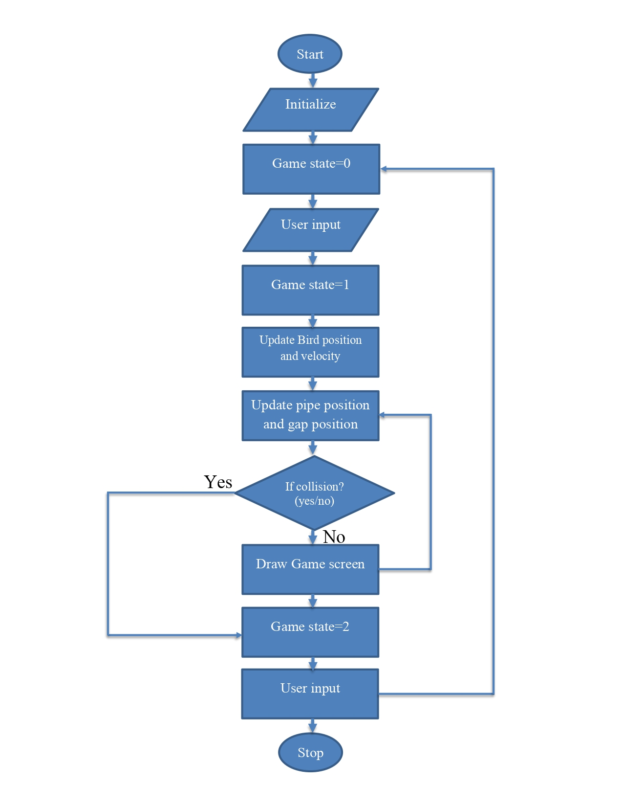
Flow chart
Department of Computer Science Engineering
www.cambridge.edu.in

Slide 14
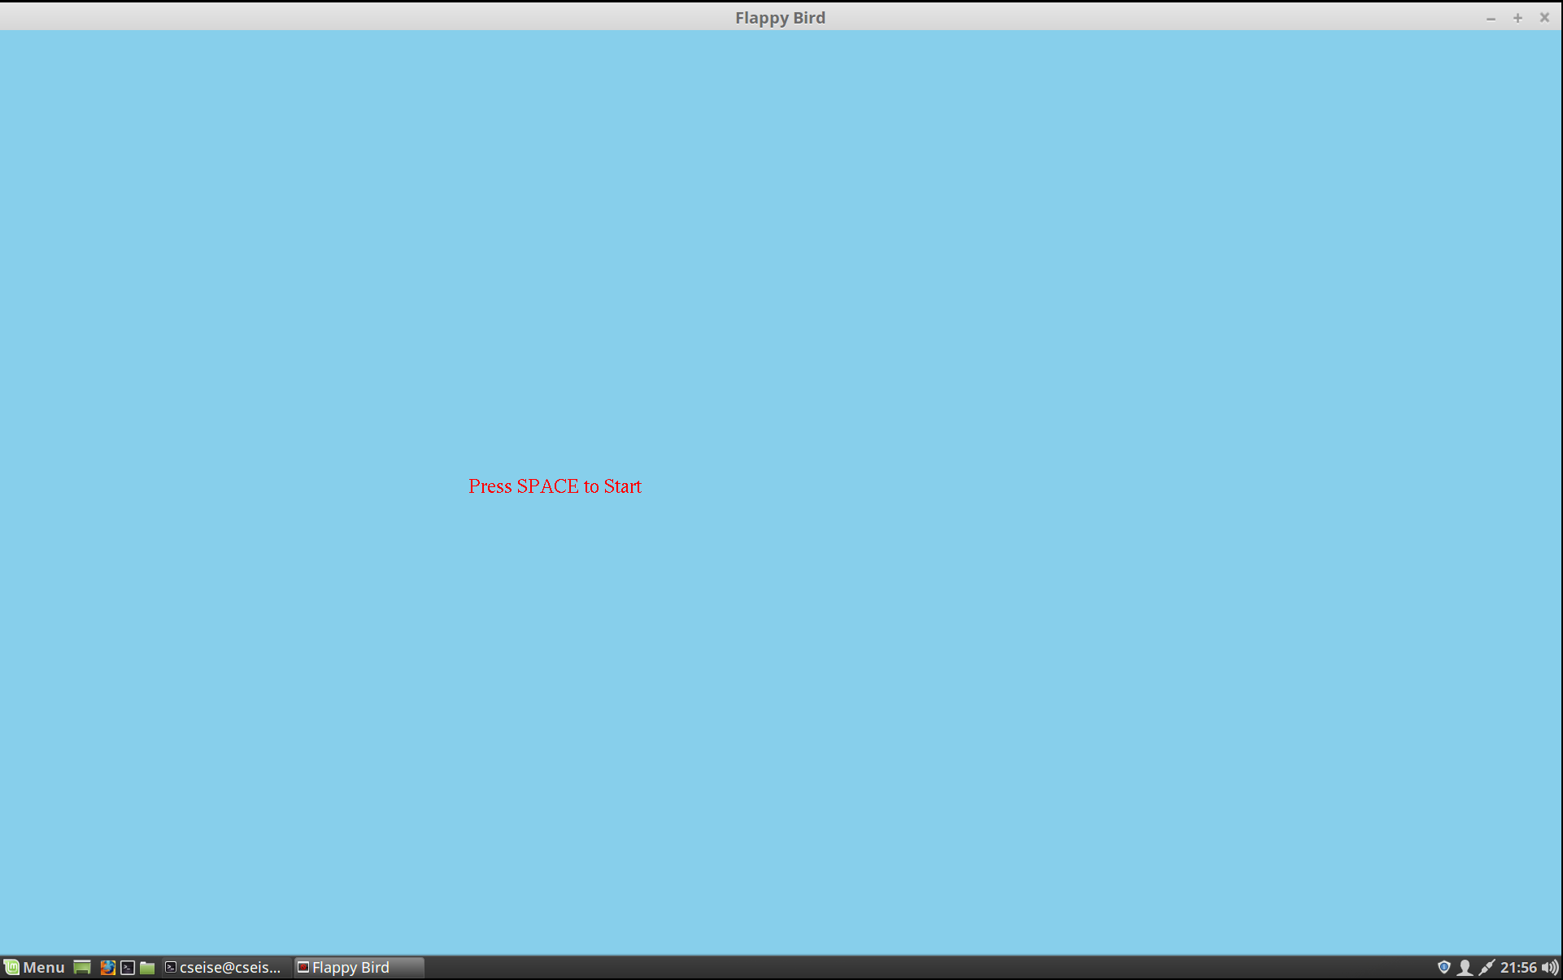
Snapshots
Fig.1: Starting Interface
Department of Computer Science Engineering
www.cambridge.edu.in

Slide 15
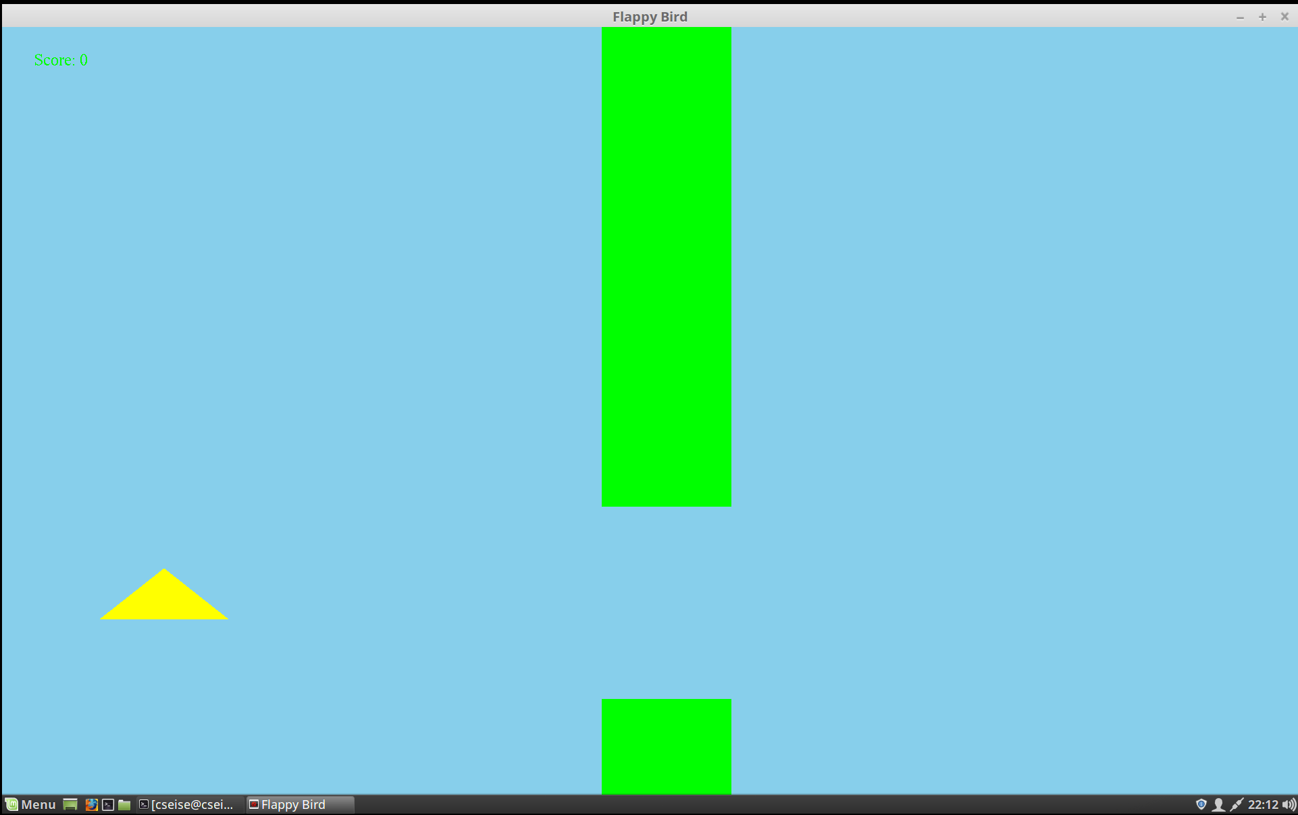
Fig.2: Game has started
Department of Computer Science Engineering
www.cambridge.edu.in

Slide 16
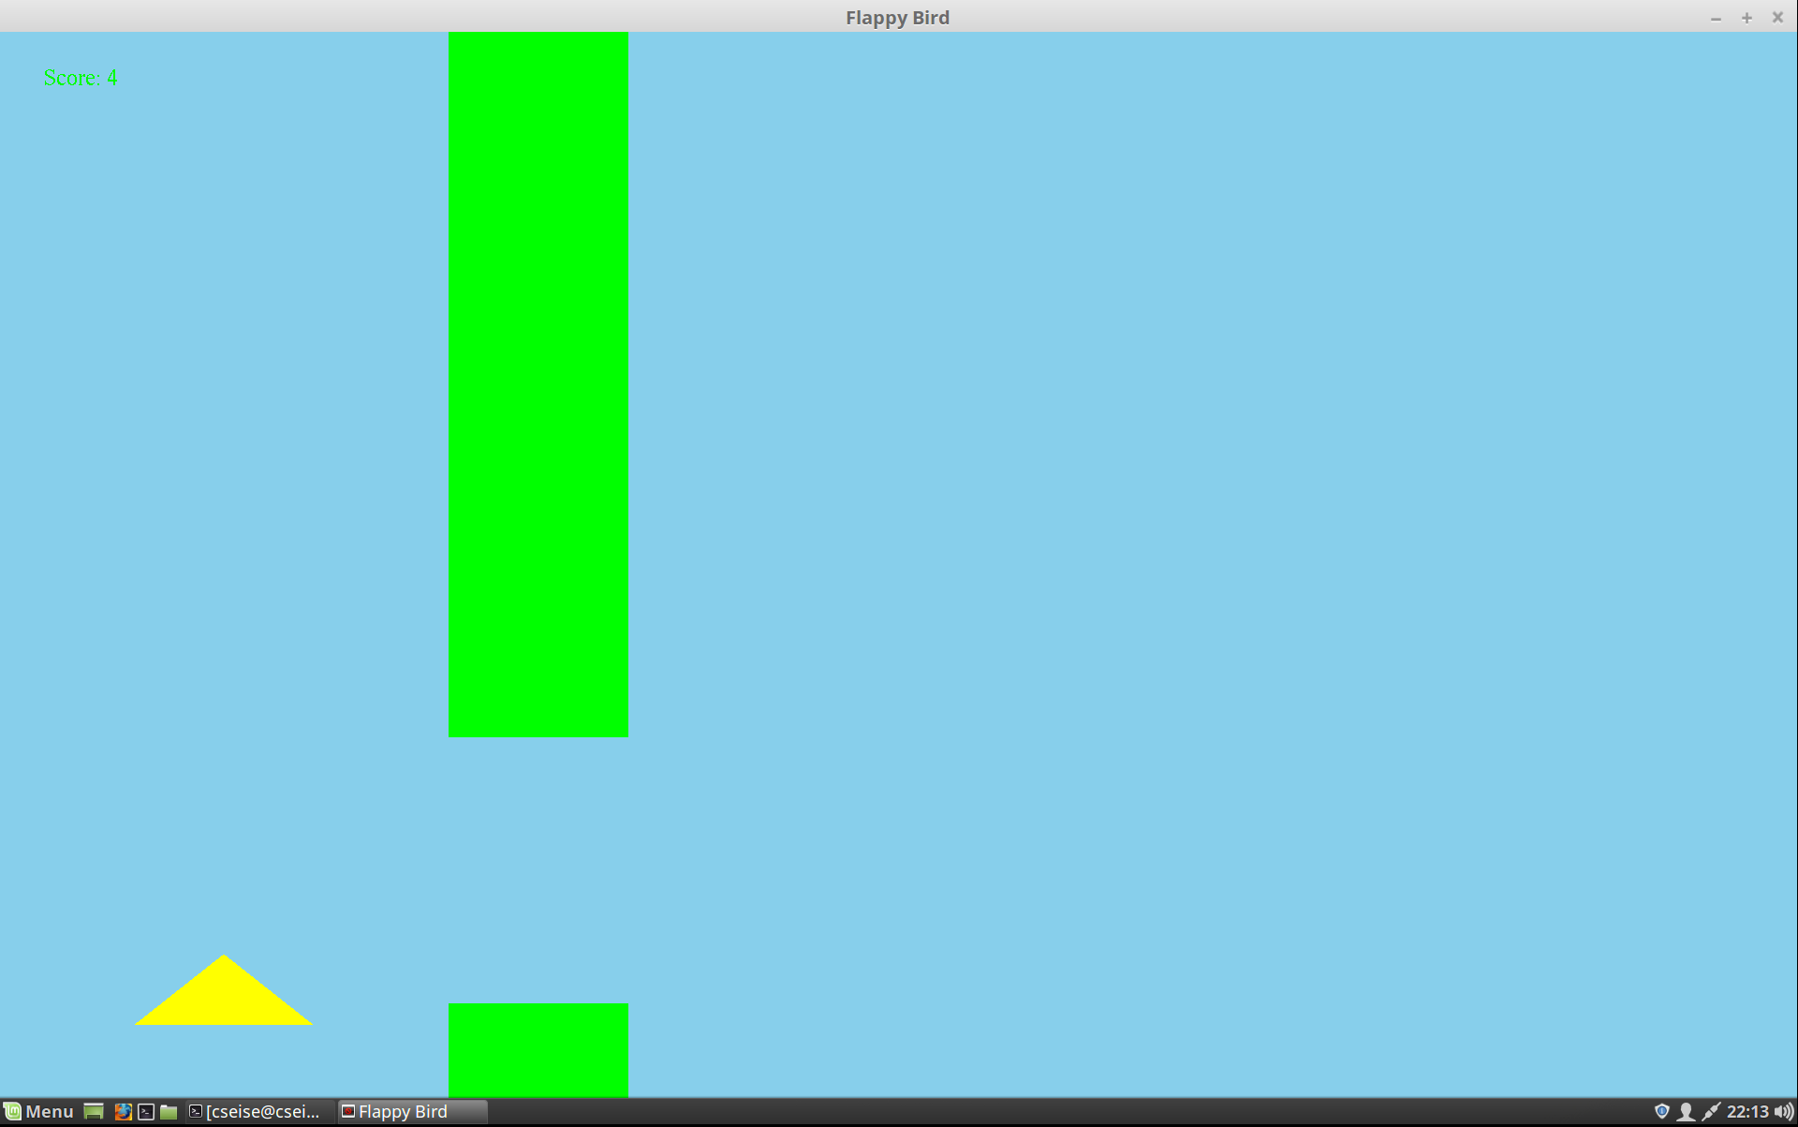
Fig.3: Score is 4
Department of Computer Science Engineering
www.cambridge.edu.in

Slide 17
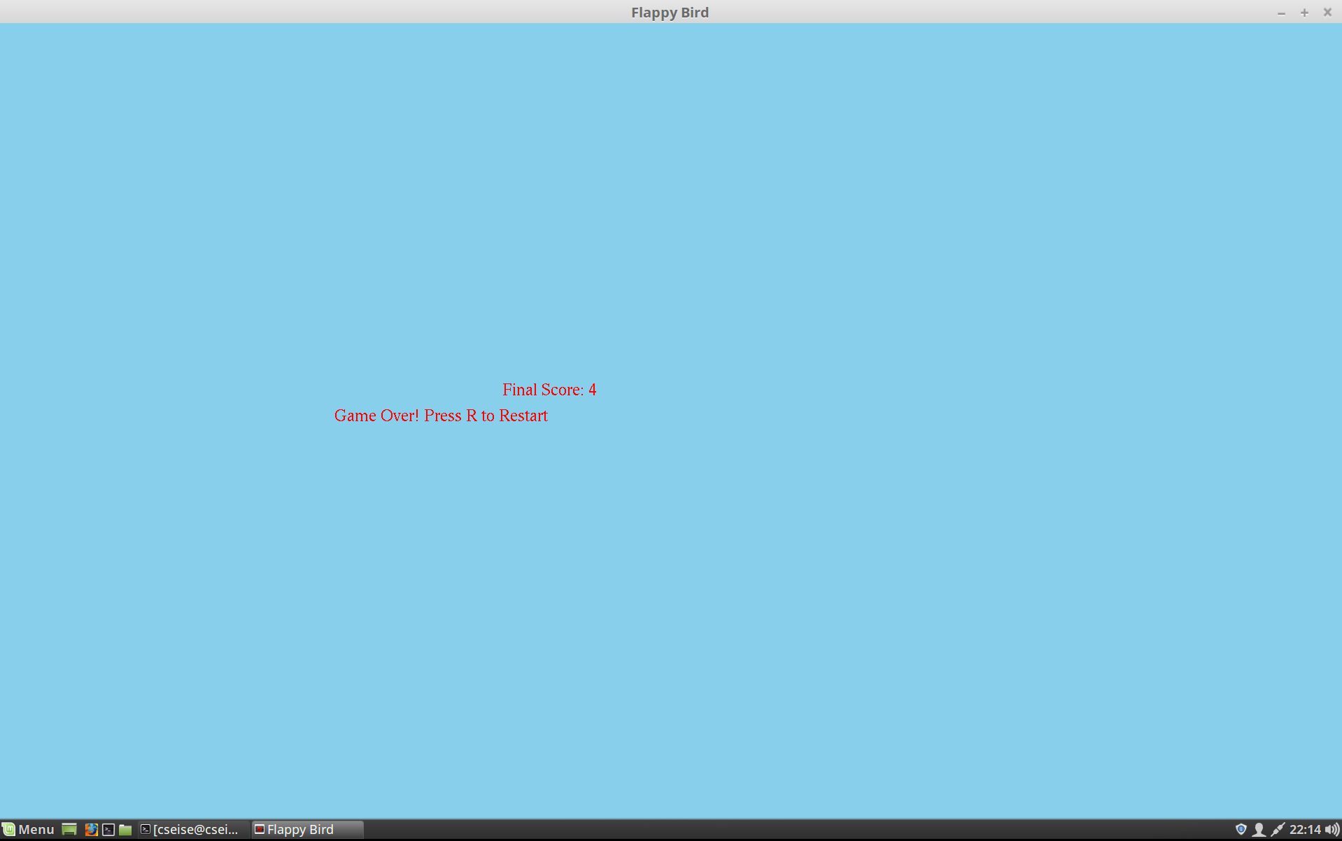
Fig.4: Game Over
Department of Computer Science Engineering
www.cambridge.edu.in

Slide 18
Conclusion
The game is designed to be interactive and user-driven. It has a clear start and end point, with a game loop in between. The game waits for user input to start and responds accordingly.
Error handling is implemented to prevent unexpected behavior. The game displays a score at the end, tracking user performance.
The game has a simple and linear structure, easy to understand. It is a basic game with a clear sequence of events. Overall, the game is a simple, interactive, and user-friendly experience.
Department of Computer Science Engineering
www.cambridge.edu.in

Slide 19

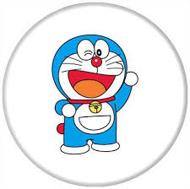
Department of Computer Science Engineering
www.cambridge.edu.in

