Slide 1
DEBUGGING in c# and angular

Slide 2
Debugging in c#
Debugging is the process of locating and removing coding mistakes in computer programs. In information technology and engineering, the word 'bug' is a synonym for the word 'error.' The goal of debugging is to identify and correct an error's root cause.

Slide 3
Why debugging?
Debugging is an important activity during software development and maintenance. Testing is performed to check if the code contains errors whereas de- bugging is done to locate and fix these errors.
Identification of the problem and ready the report.
Describe the bug and Assigning the report to the software engineer.
Defect Analysis using modelling, documentation, finding and testing candidate flaws, etc.
Defect Resolution by making the required changes to the system. Based on that try to find the cause of the bug.
During the fix existing bug check that any new bug does not occur.

Slide 4
breakpoints
Breakpoint – A line number of interest in your program. When the debugger is running it halts execution of the program at this line.
Call stack – A list of functions in the debugger that explains how the program got to where it currently is. Think of this as a live stack trace, without the exception.
Continue – An action to take in the debugger that will continue execution until the next breakpoint is reached or the program exits
Step over – An action to take in the debugger that will step over a given line. If the line contains a function the function will be executed and the result returned without debugging each line.
Step into – An action to take in the debugger. If the line does not contain a function it behaves the same as “step over” but if it does the debugger will enter the called function and continue line-by-line debugging there.
Step out – An action to take in the debugger that returns to the line where the current function was called.

Slide 5
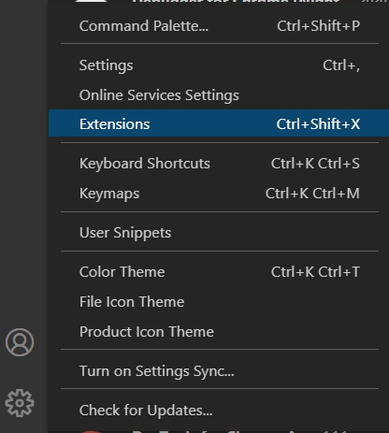
Debugging in angular
STEP 01:
Install Debugger for Chrome (you could install other debuggers you like, such as Firefox Debugger)
In VS Code environment: Left Click Manage (Left Bottom Corner) > Extensions (or Ctrl+Shift+X)

Slide 6
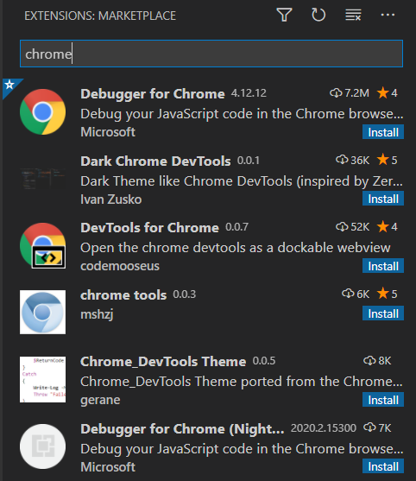
STEP 02:
Open the Extensions view. Then type 'chrome' in the search box. You'll see the extensions: Debugger for Chrome.
In VS Code environment: Click Run Button on the left side (or Ctrl+Shift+D)

Slide 7
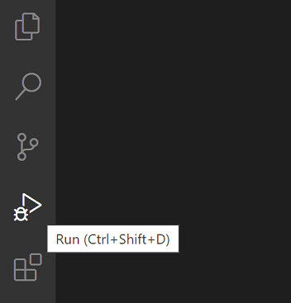
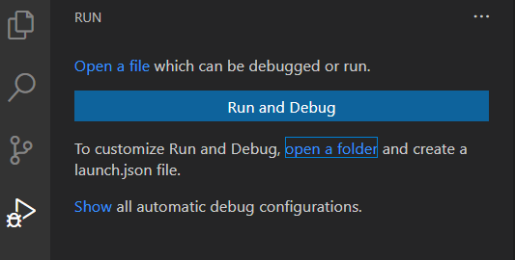
STEP 03:
If running and debugging is not yet configured (no launch.json has been created), VS Code shows the Run start view,

Slide 8
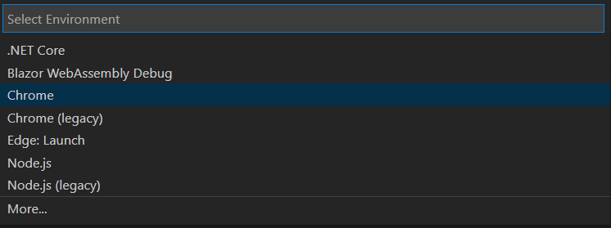
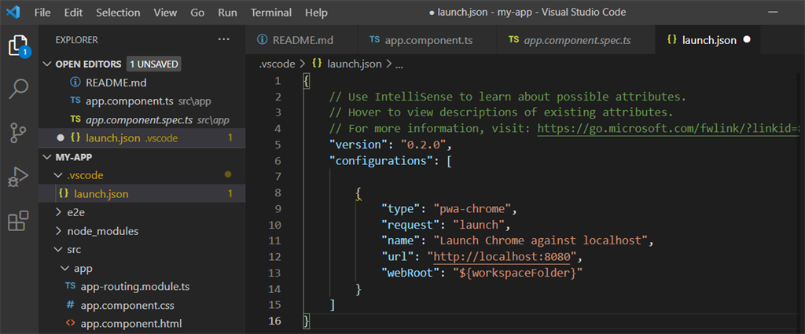
You can configure the environment by creating launch.json file yourself manually, but you can do that automatically by Clicking the Run and Debug button to open the Select Environment dialog box,

Slide 9
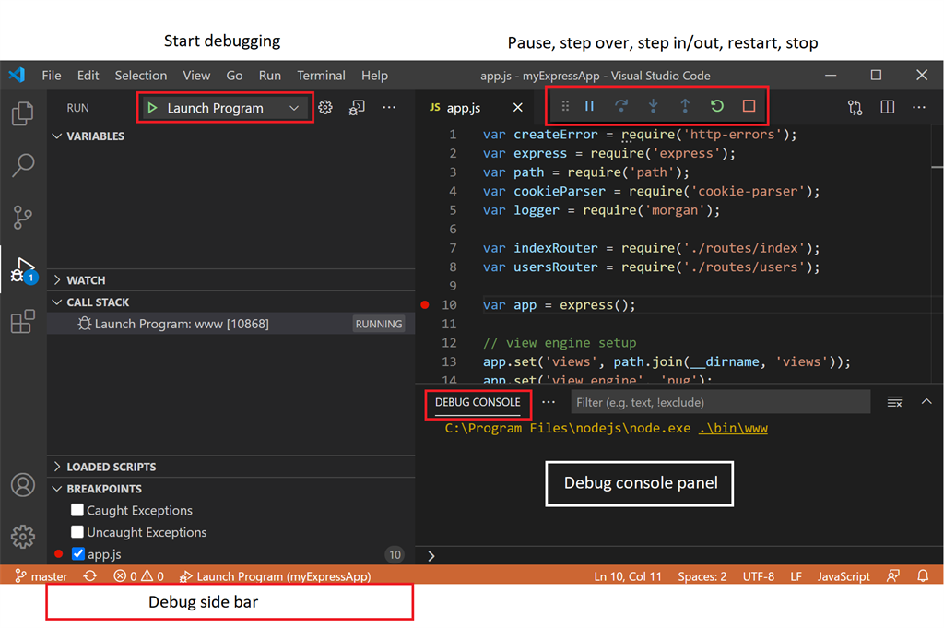
STEP 04: Now, in VS Code, if you Click Run Button on the left side (or Ctrl+Shift+D), you will have a debugging environment like this,

Slide 10


STEP 05:
Now, set your breakpoint, and run debug,
Once a debug session starts, the Debug toolbar will appear on the top of the editor.
Continue / Pause - F5
Step Over - F10
Step Into - F11
Step Out -Shift+F11
Restart - Ctrl+Shift+F5
Stop - Shift+F5

Slide 11
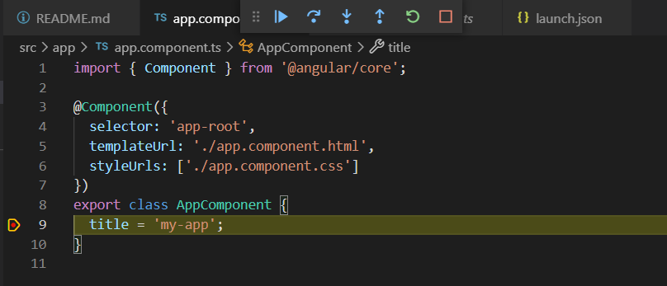
STEP 06:
The debug session is on like this,

Slide 12


