Slide 1
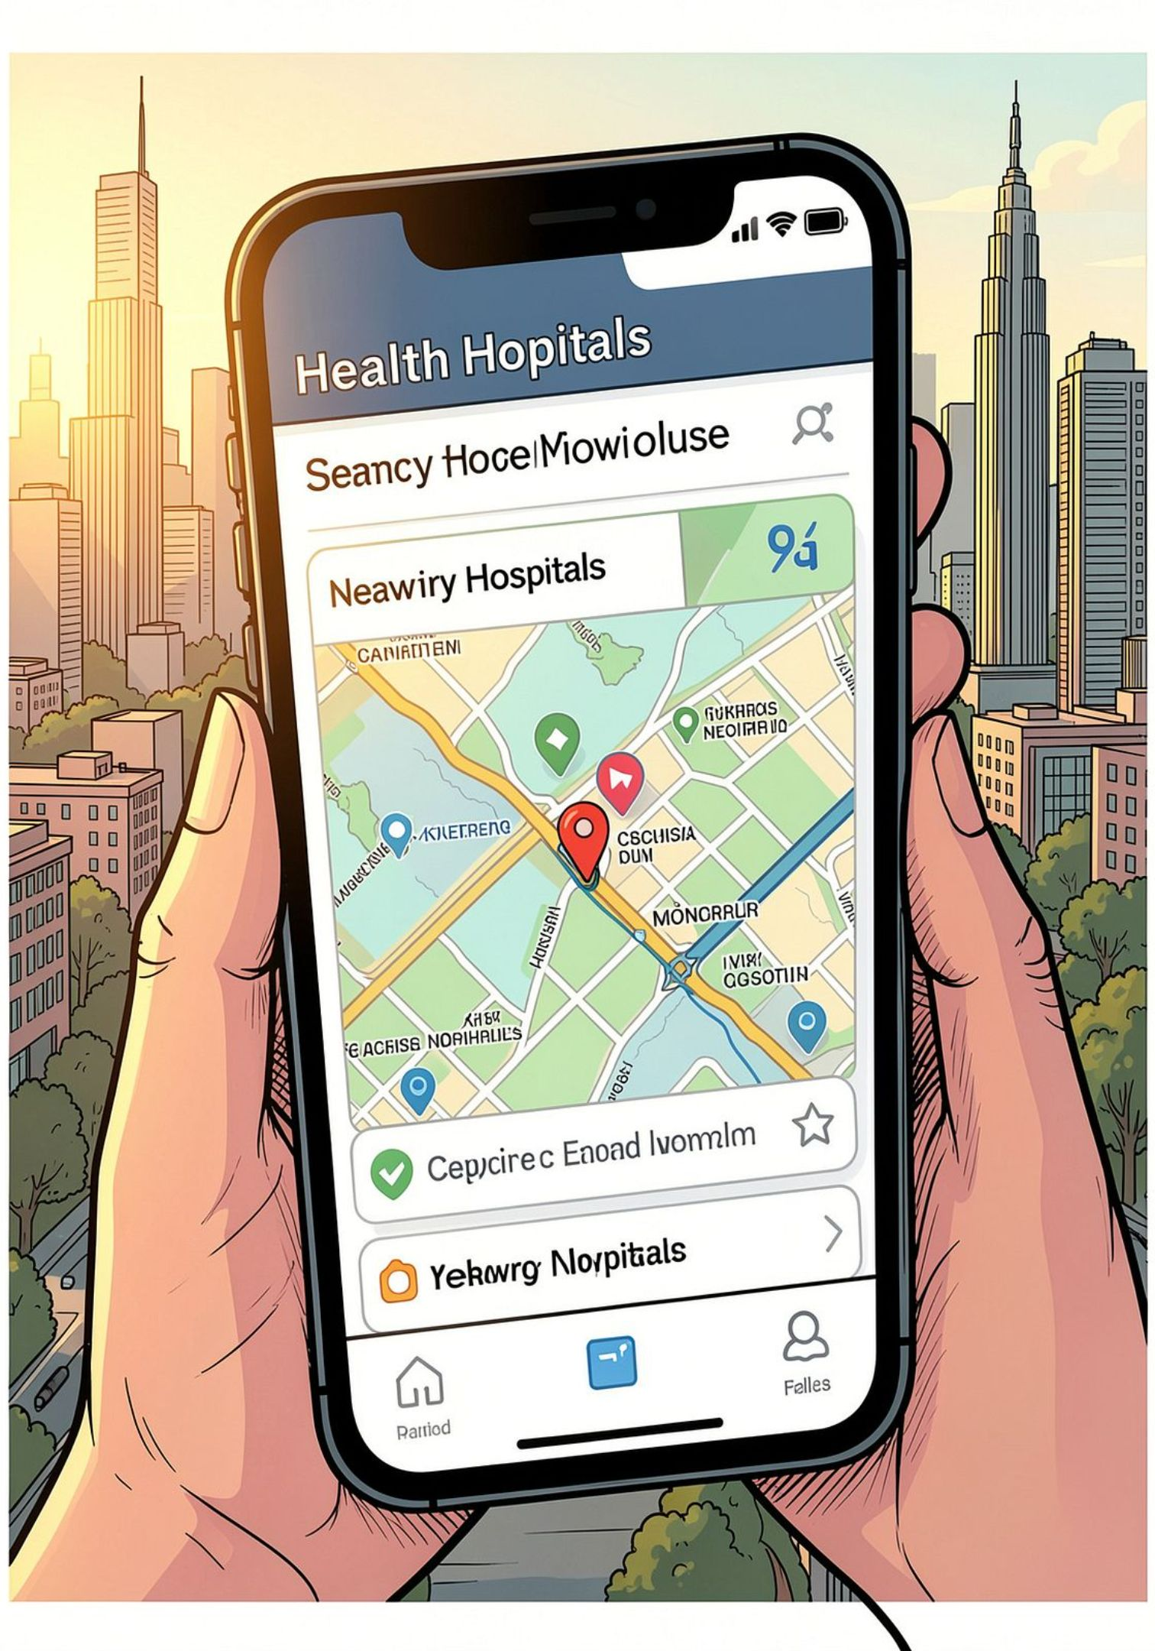
CareConnect — A Mobile App for Finding & Managing Medical Care
A patient-centered medical app concept that helps users discover nearby hospitals and specialist doctors, view rich facility profiles, book and track appointments, communicate remotely, and get quick, evidence-backed answers from a medical AI assistant. This deck outlines core features, user journeys, data needs, and an implementation roadmap for stakeholders — patients, caregivers, and healthcare app developers.

Slide 2


Why this app matters
Many patients struggle to find appropriate care quickly, verify facility details, or keep appointments. CareConnect reduces friction by: - Locating nearby hospitals and specialists based on real-time location, - Providing verified hospital profiles and contact/appointment tools, - Tracking attendance and automating rescheduling, - Enabling remote voice/video consultations, and - Offering a medical AI assistant that provides referenced, easy-to-understand guidance.
Focus: convenience, trust, and continuity of care — designed for patients, caregivers, and clinicians.

Slide 3
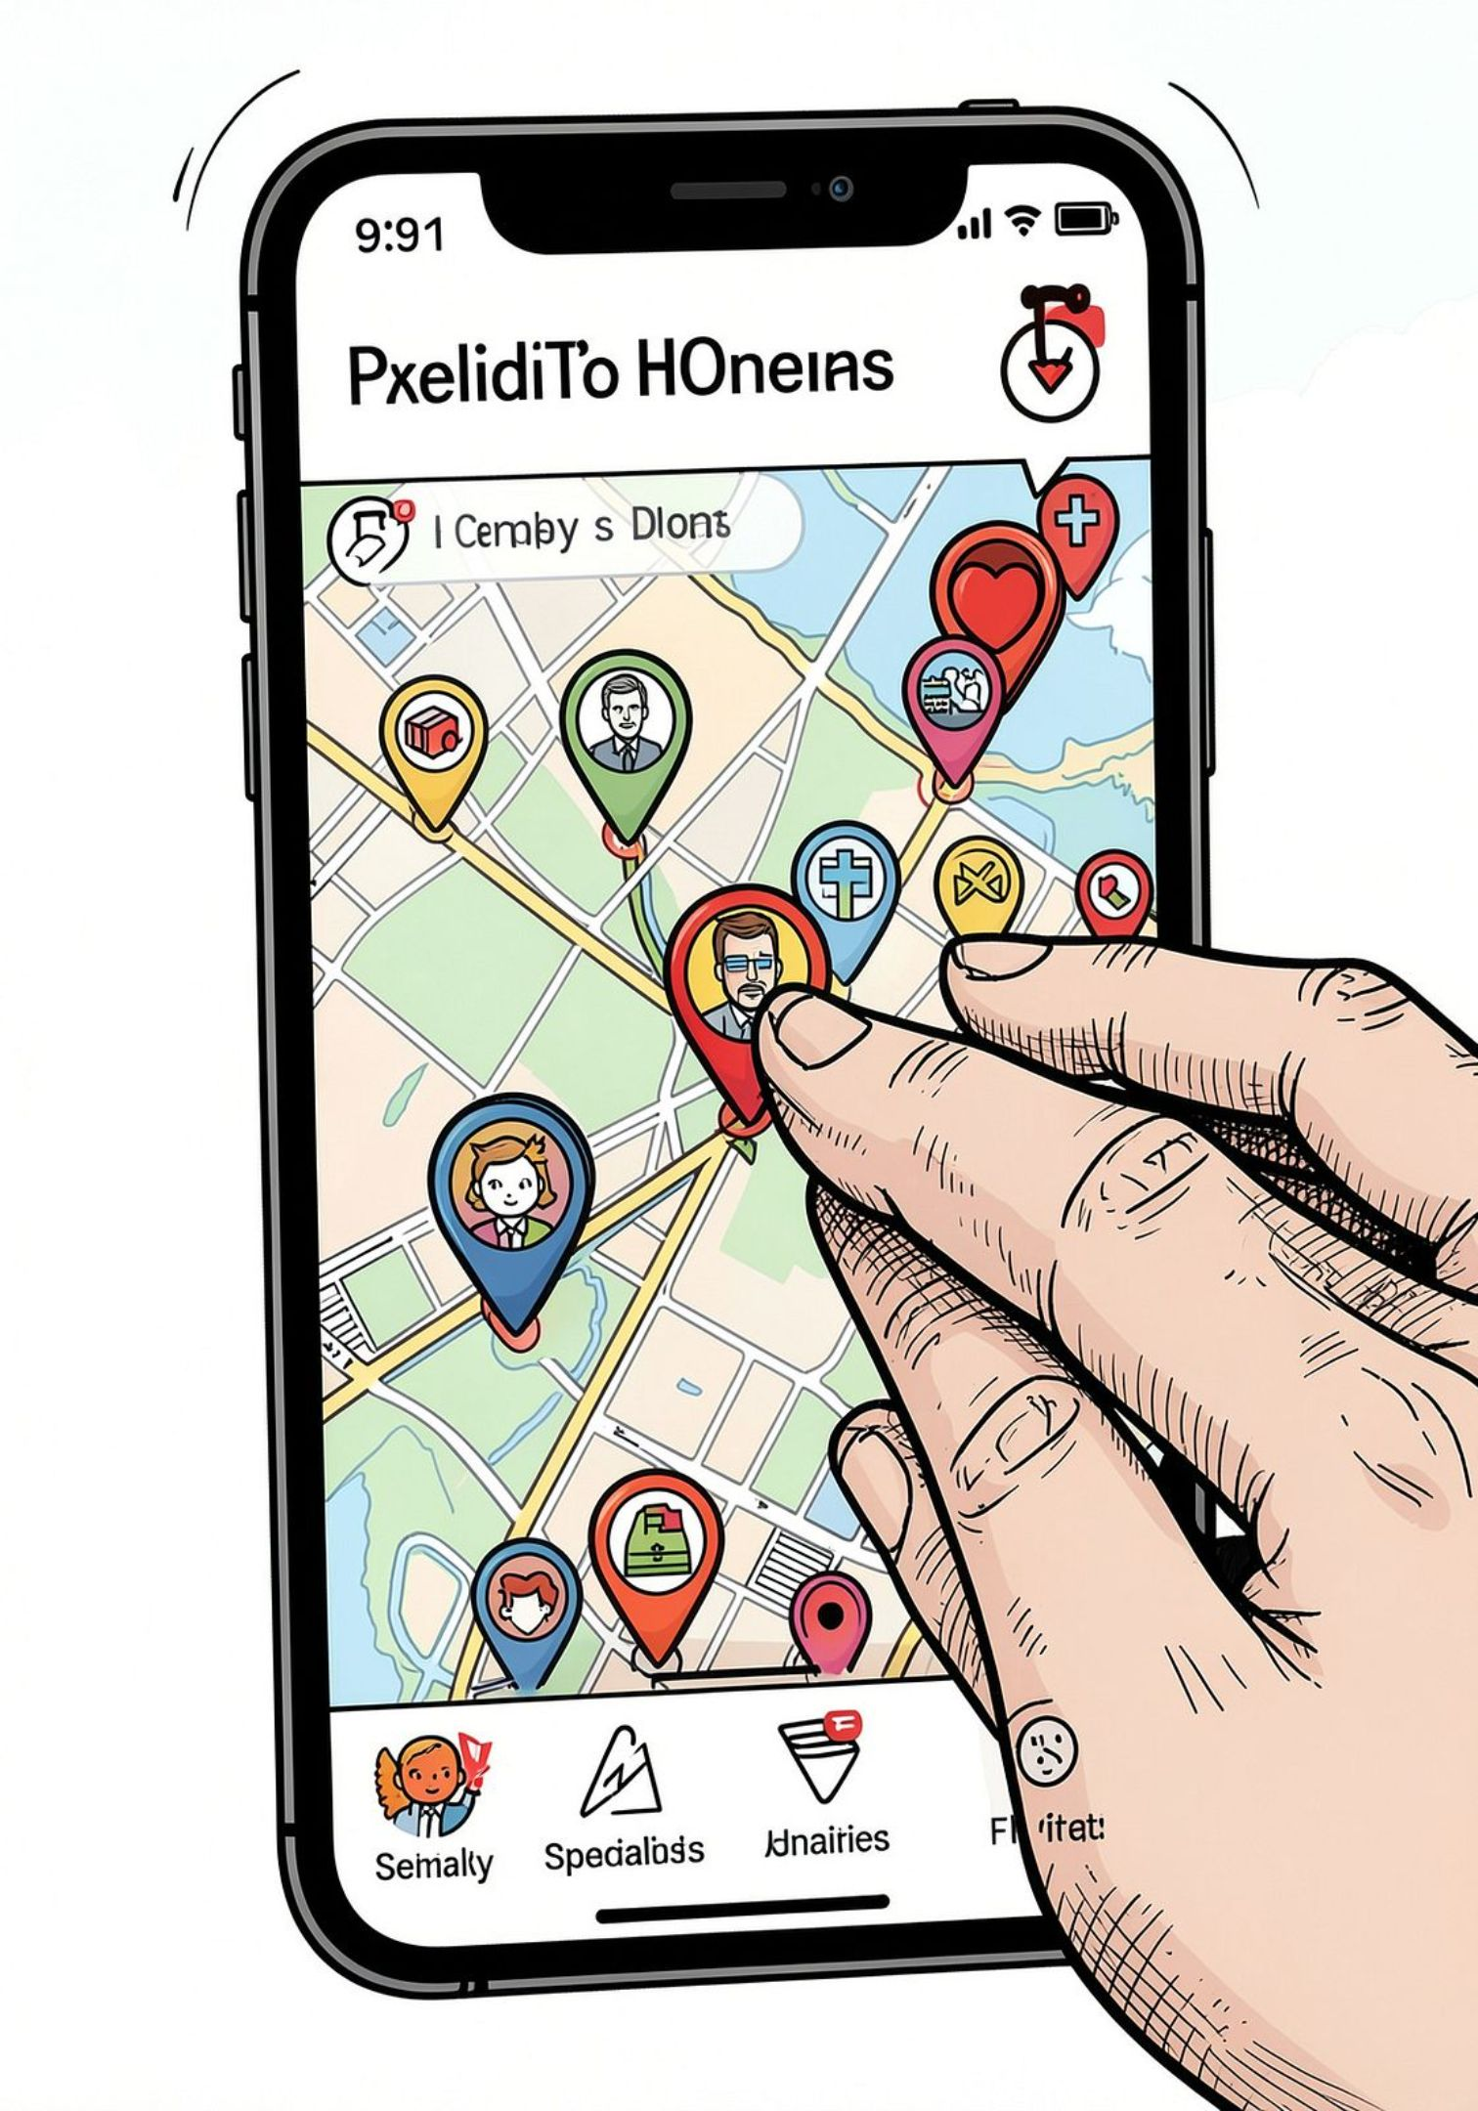



Core feature 1 — Find nearby hospitals & specialists
Real-time geolocation
Automatic detection of user location and dynamic listing of nearby hospitals, clinics, and urgent care centers with distance and travel time estimates.
Advanced filters
Filter by specialty, open now, insurance accepted, ratings, or telehealth options so users quickly find the care they need.
List & map toggle
Switch between a map view for location context and a list view for quick scanning and sorting.

Slide 4

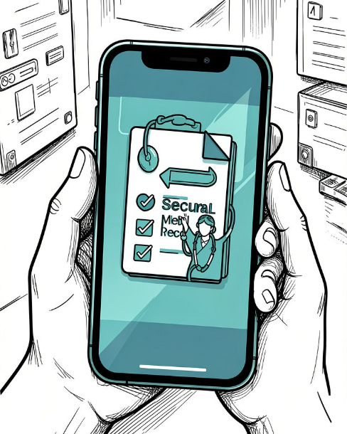
Core feature 2 — Hospital & doctor profiles
Each hospital entry includes structured sections to ensure consistent, actionable information: - Hospital name, address, hours, photos, departments, accreditation and specialties, - Specialist doctor roster (name, specialty, credentials, availability), - Patient records link (secure access to past visits, documents, imaging), - Contact numbers and direction links, - In-app appointment booking form and confirmation flow available for any searched hospital.
Verified clinician details
Patient records
Qualifications, languages, consultation modes (in‑person / telehealth), and verified patient reviews.
Encrypted storage of visits, lab results, prescriptions, and uploaded documents accessible to the patient and authorized providers.

Slide 5
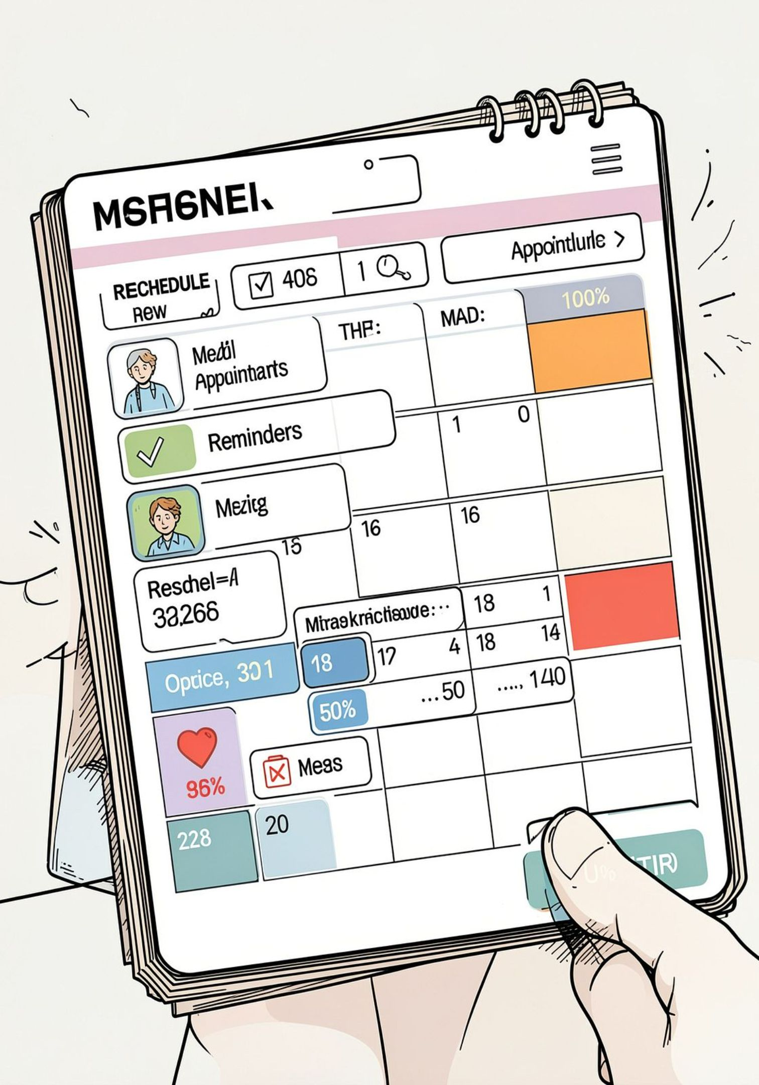

Core feature 3 — Appointment booking & schedule tracking
The app manages the full appointment lifecycle: - Book: Choose date/time, provider, reason for visit; confirm with in-app or SMS notification. - Track: Personal appointment calendar, push reminders, and attendance status (checked-in / no-show). - Reschedule: If the patient misses an appointment or requests a change, the system suggests the next available slots and performs automated rescheduling with user consent. - Integrations: Optional sync with device calendar and EHR appointment APIs for two-way updates.
Design requirement: granular consent and audit logs for appointment updates and notifications.

Slide 6
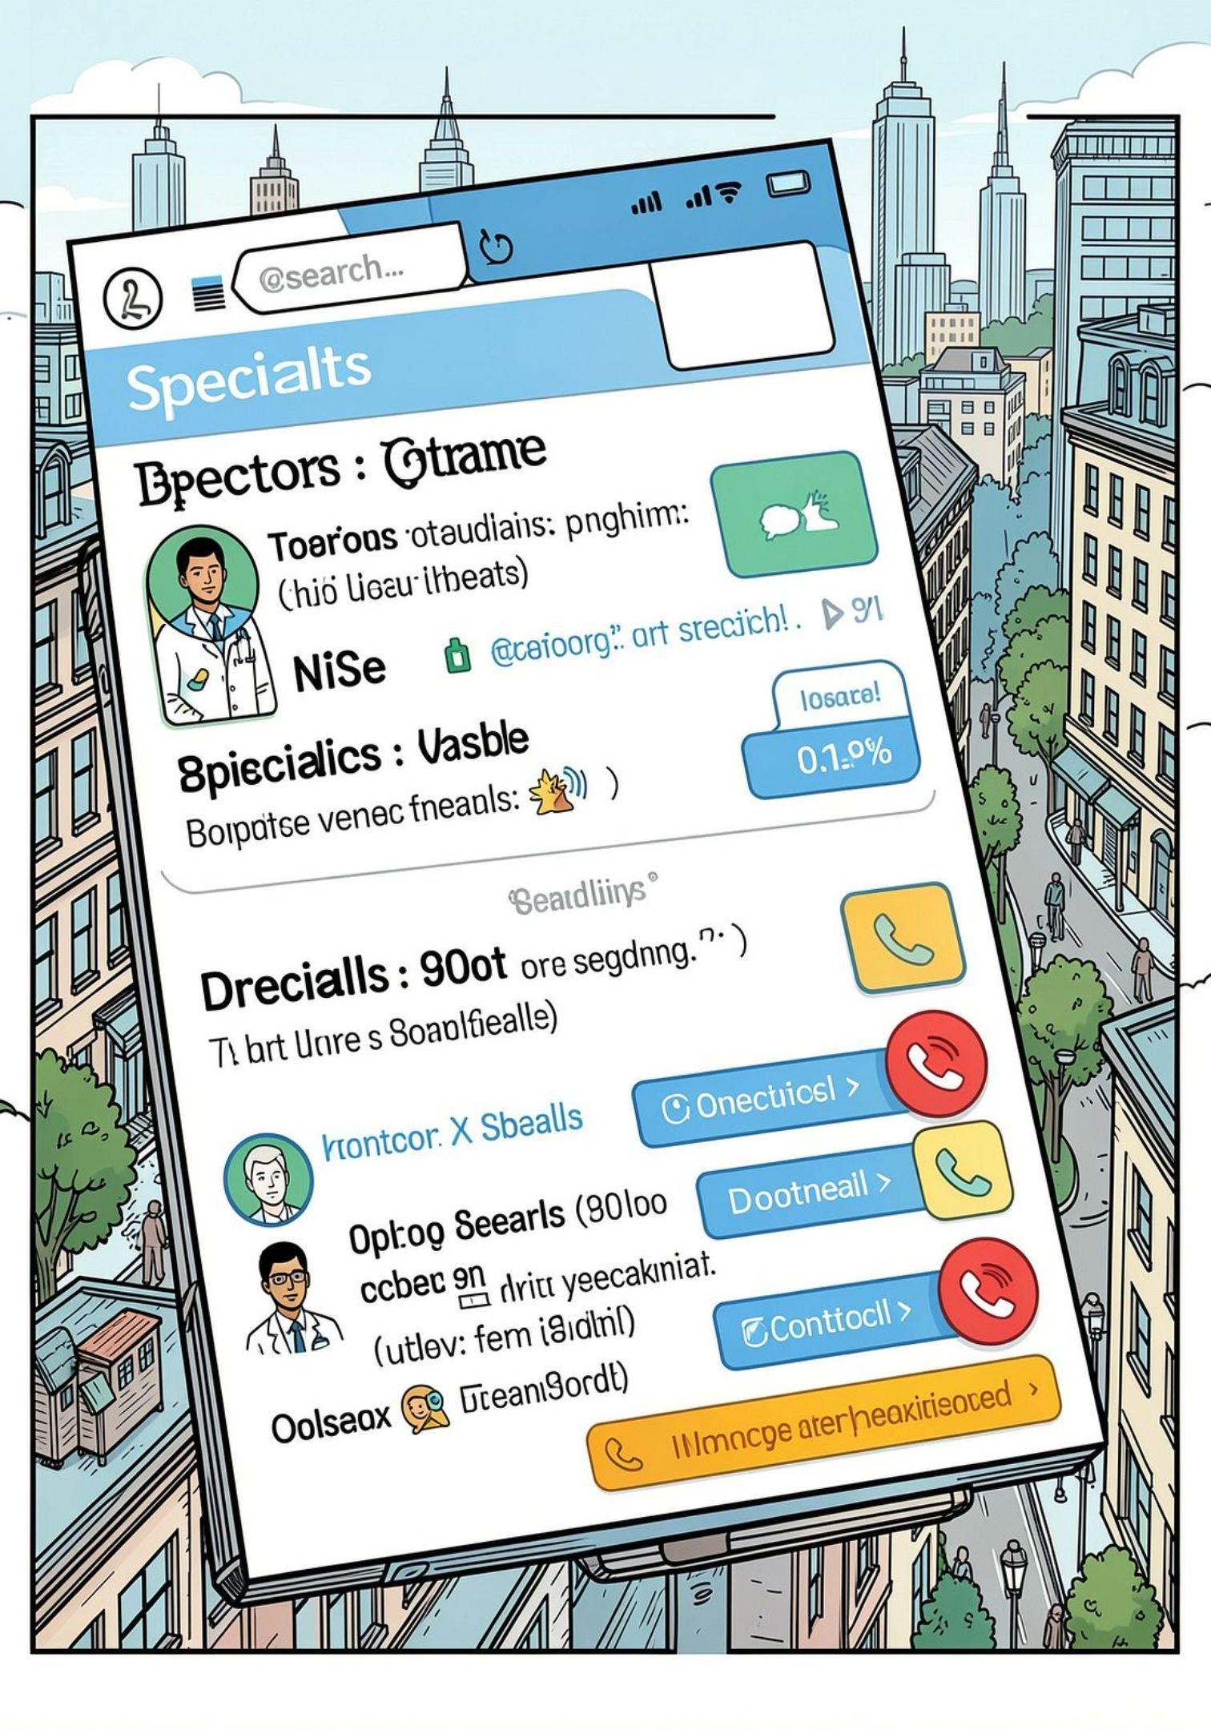



Core feature 4 — Find & contact specialist doctors
City-wide specialist search
Search by specialty, symptoms, or procedure to locate appropriate specialists across the city with availability and proximity indicators.
Direct contact & telehealth
In-app voice and video calls for remote consultations. Click-to-call and secure messaging if the provider allows.
Pre-consultation intake
Collect brief symptom history and attachments (photos, reports) prior to remote or in-person visits to make consultations efficient.

Slide 7
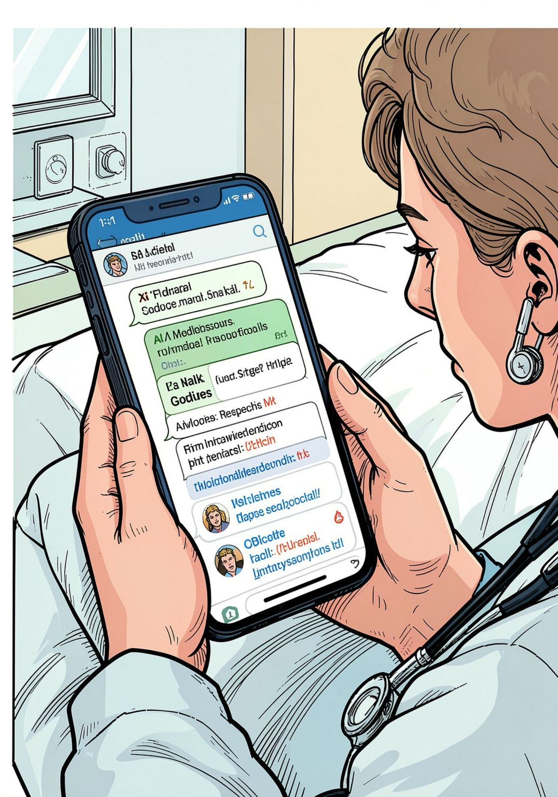

Core feature 5 — Medical AI assistant (chatbot)
The built-in AI assistant provides quick, evidence-based guidance for common symptoms and administrative questions while clarifying limitations: - Symptom triage: Non-urgent guidance, recommended next steps, and red-flag warnings directing users to emergency care when necessary. - Reference-backed answers: Responses include links or citations to trusted resources, guideline summaries, or suggested reading. - Documentation: Ability to attach a short recorded video or photo and receive annotated feedback when clinically safe. - Escalation: Seamless handoff to schedule an appointment or connect to a clinician if needed.
AI must always show disclaimers, sources, and encourage clinical follow-up for diagnostic uncertainty.

Slide 8

Privacy, security, & compliance
HIPAA & data protection
User consent & sharing
Encrypted data-at-rest and in-transit, granular access controls, and audit trails for every record access or appointment action.
Explicit consent flows for record sharing, provider access, and telehealth sessions. Easy revocation and export options.
Clinical safety
Medical AI is constrained to triage and information; logs of AI guidance are saved and surfaced to clinicians during consultations.

Slide 9
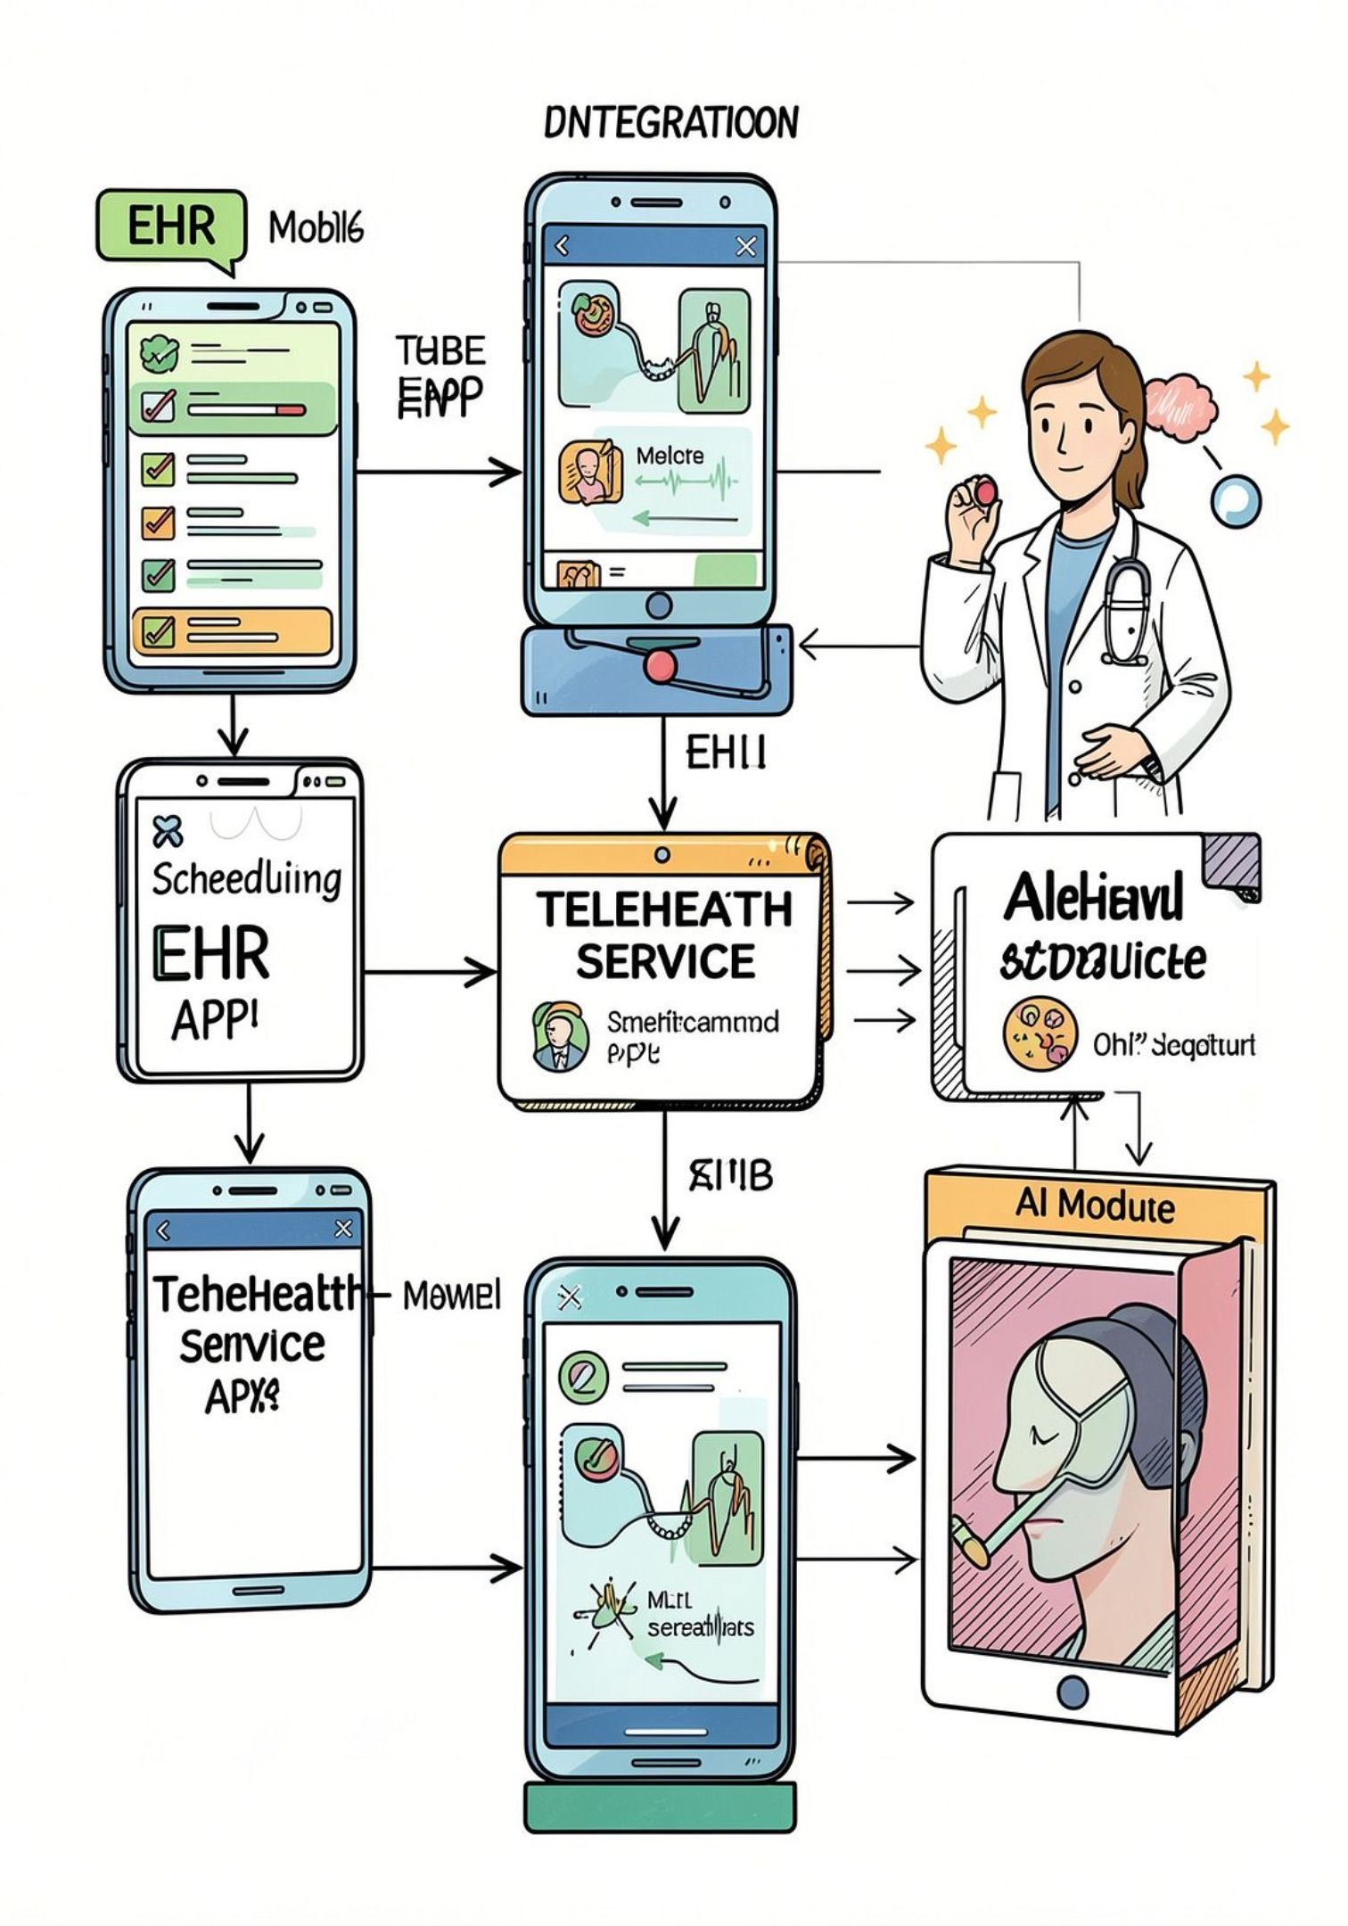
Data model & integrations (high level)
Key data elements and integrations: - Entities: User profile, patient record, provider profile, facility, appointment, messages, AI interaction logs. - Integrations: FHIR-based EHR read/write (where permitted), calendar sync (iCal/Google Calendar), SMS/telephony providers, secure video SDK, and insurer/eligibility APIs. - Operational notes: Idempotent booking flows, optimistic UI updates, conflict resolution for appointment slots, and monitoring for no-show patterns.
Prioritize opt-in EHR connections and staged integration to reduce time-to-market.

Slide 10
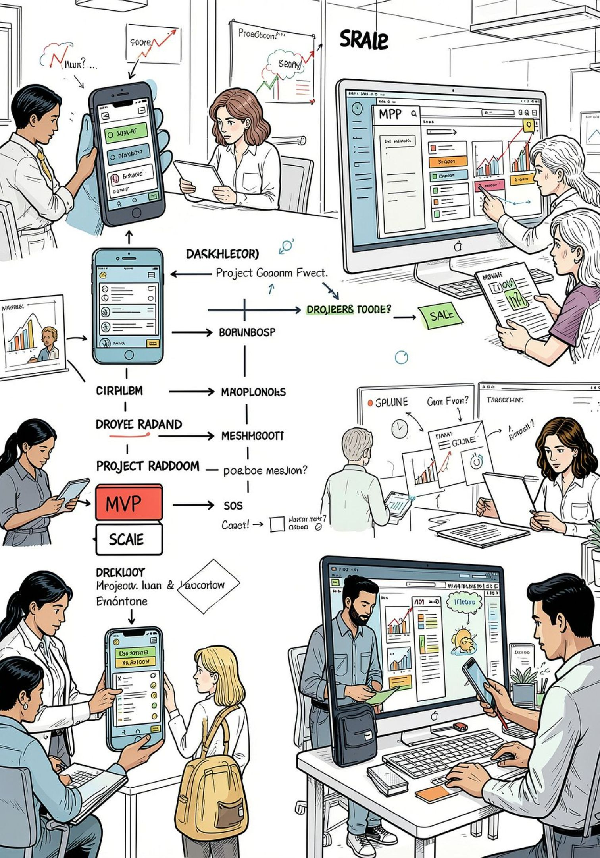
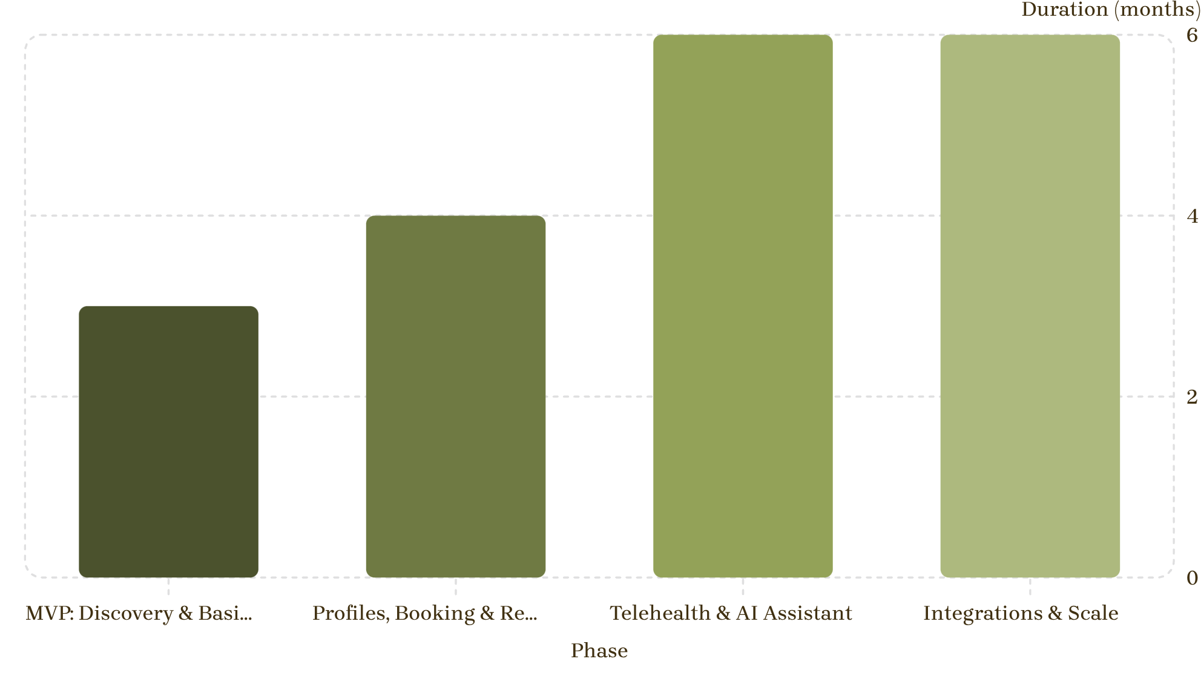

Roadmap & next steps
Immediate recommendations: - Build an MVP focusing on location-based search, verified profiles, and appointment booking. - Pilot telehealth with a small network of clinics while developing the AI assistant in parallel with clinician oversight. - Iteratively add EHR integrations and insurer checks once initial user flows are validated.
Next meeting: define MVP acceptance criteria, security baseline, and a 90-day delivery plan.

