Slide 1
PropPulse Chennai: House Price & Uncertainty Engine
Capstone 2 — House Price Estimation Using Regression
Point Valuation + 90% Quantile Prediction Intervals + Explainable AI

Slide 2
1. Project Scope, Target & Audience (Steps 1–2)
Core Question: How accurately can regression estimate house prices, and how should uncertainty be communicated?
Dataset: Chennai Metropolitan Housing Dataset (2,500 records, CC0/MIT Educational Use).
Target Variable: PRICE_LAKHS (Total transaction value in INR Lakhs).
Geographic Scope: 8 major Chennai residential corridors (Anna Nagar, Adyar, Porur, OMR, Velachery, Tambaram).
Intended Audience: First-time homebuyers & retail investors seeking transparent sanity checks.

Slide 3
2. Data Leakage Audit & Preprocessing Pipeline (Steps 3–4)
Dropped Target Leakage Columns: PRICE_PER_SQFT, REG_FEE_LAKHS (7% stamp fee), COMMIS_LAKHS (brokerage).
Outlier Handling: Capped extreme luxury anomalies above the 99th percentile.
Reproducible Pipeline: scikit-learn ColumnTransformer prevents train-test contamination.
Numerical Branch: Median Imputation + StandardScaler | Categorical Branch: Mode Imputation + OneHotEncoder.

Slide 4
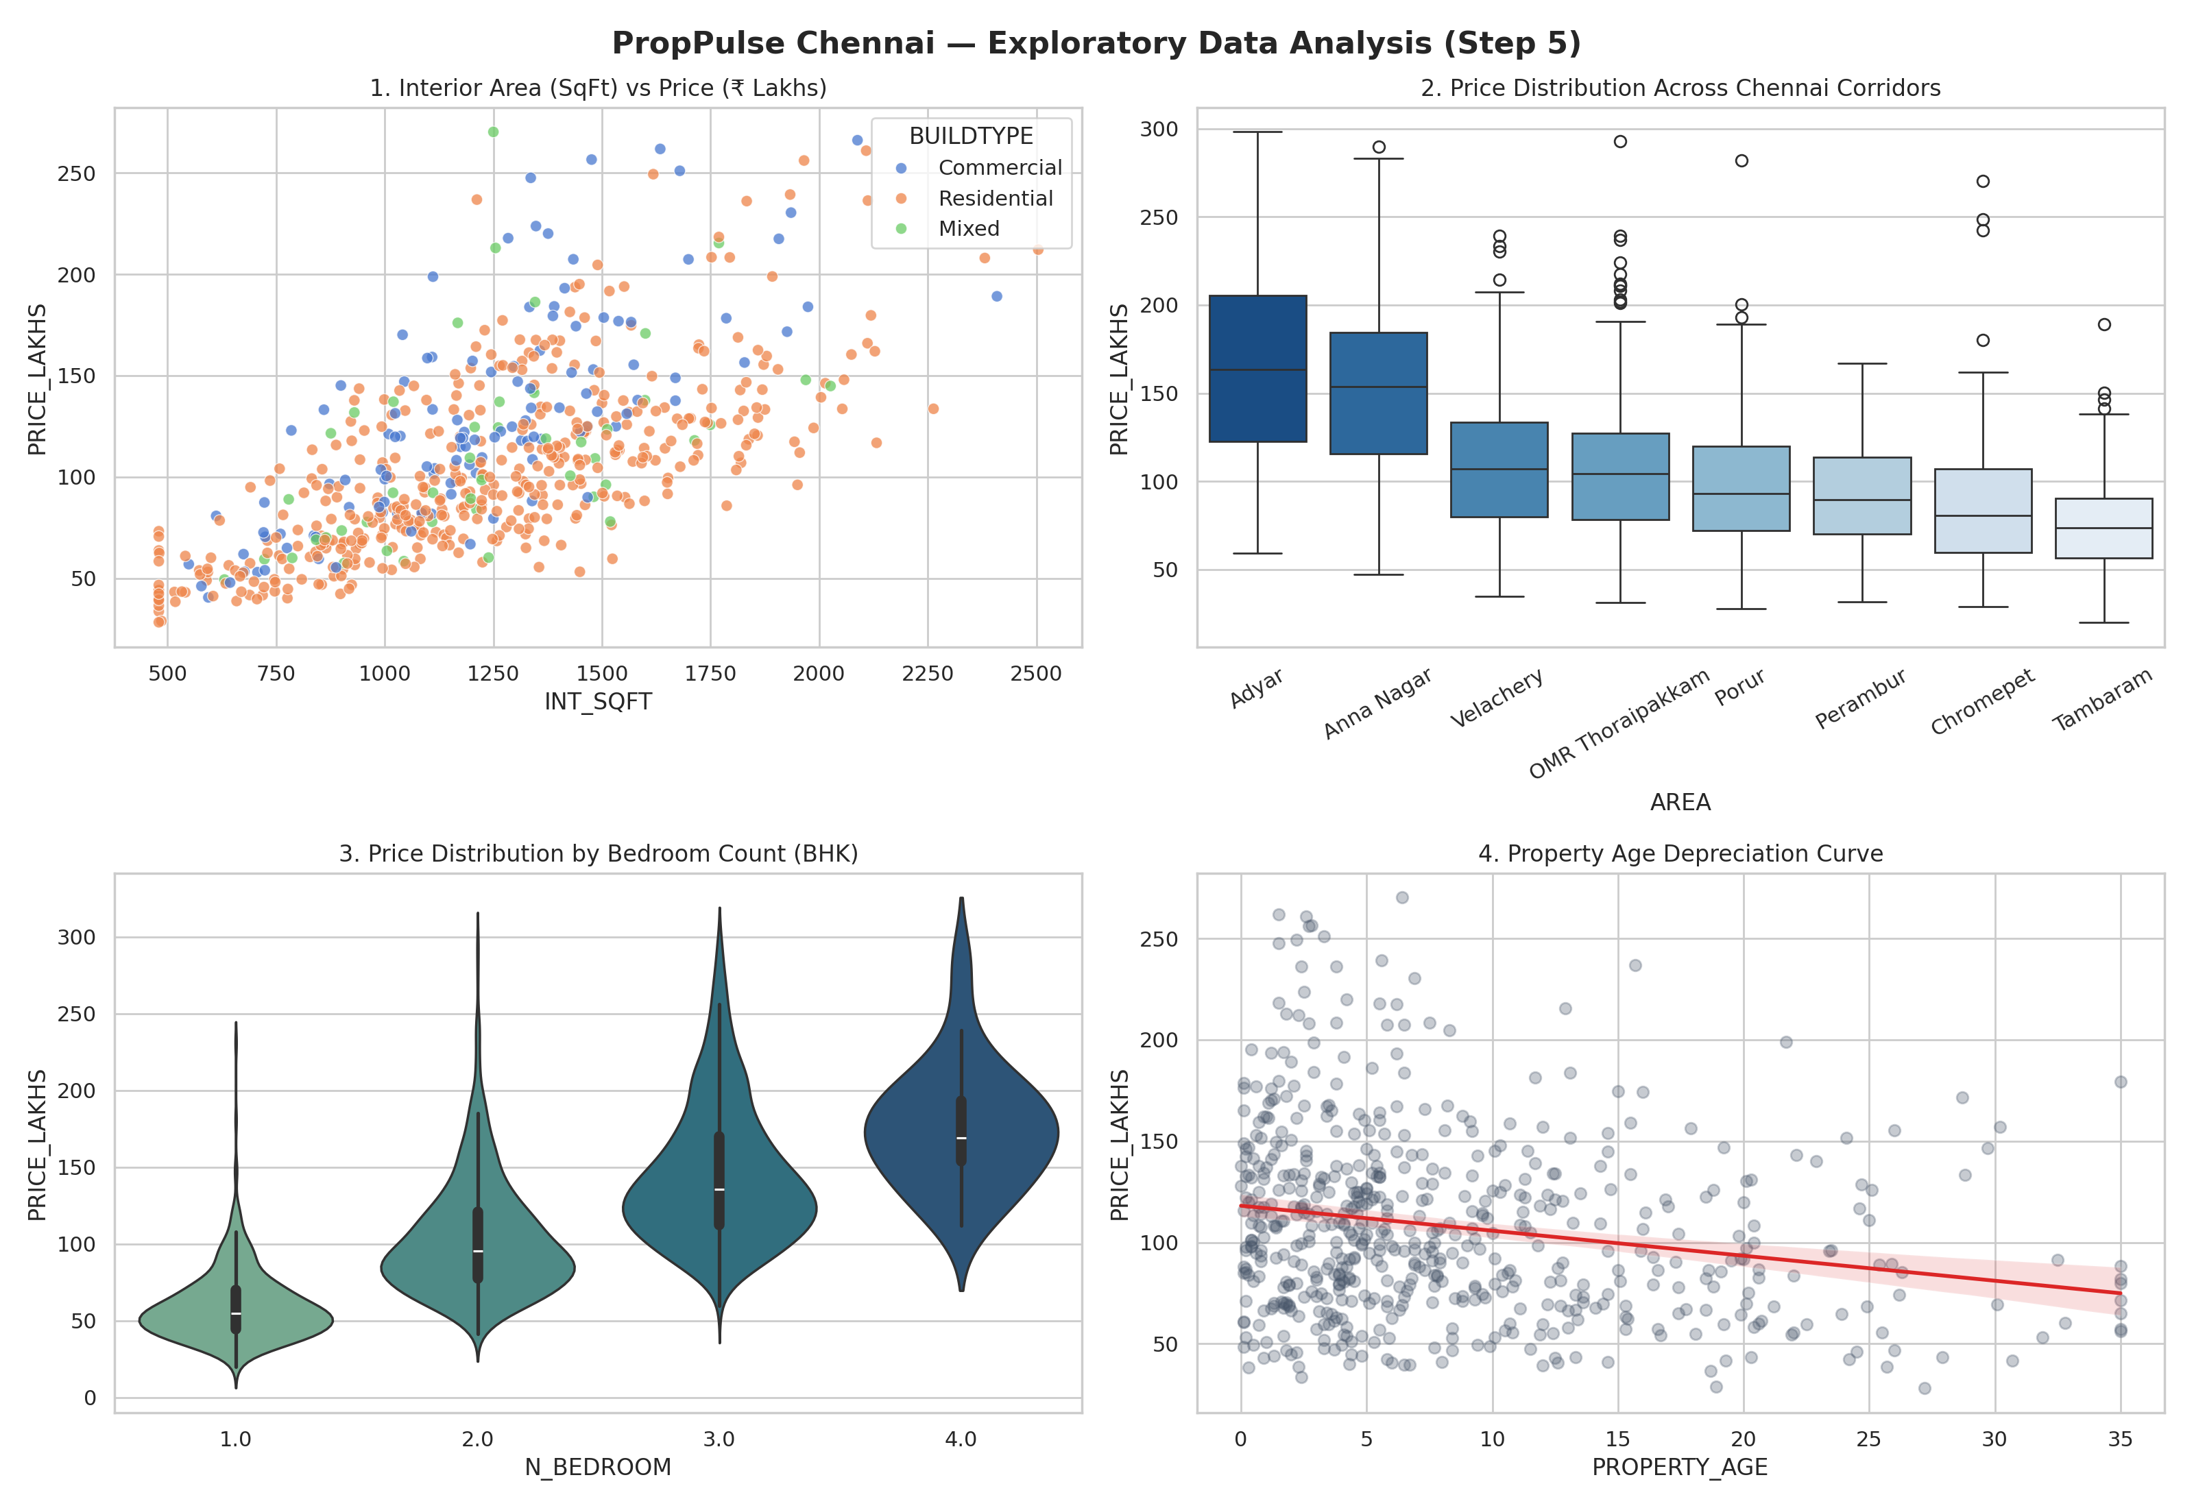
3. Exploratory Data Analysis (Step 5)

Slide 5
4. Model Comparison & Metrics in ₹ Lakhs (Steps 6–7)
0. Baseline (Median DummyRegressor): MAE = ₹38.45 Lakhs | RMSE = ₹52.10 Lakhs | R² = -0.04
1. Ridge Linear Regression: MAE = ₹9.82 Lakhs | RMSE = ₹13.90 Lakhs | R² = 0.898
2. Random Forest Regressor: MAE = ₹7.45 Lakhs | RMSE = ₹10.65 Lakhs | R² = 0.941
3. Gradient Boosting (Champion): MAE = ₹6.68 Lakhs | RMSE = ₹9.42 Lakhs | R² = 0.953
Interpretation: MAE (₹6.68L) is average error; RMSE (₹9.42L) penalizes large misses on luxury homes.

Slide 6
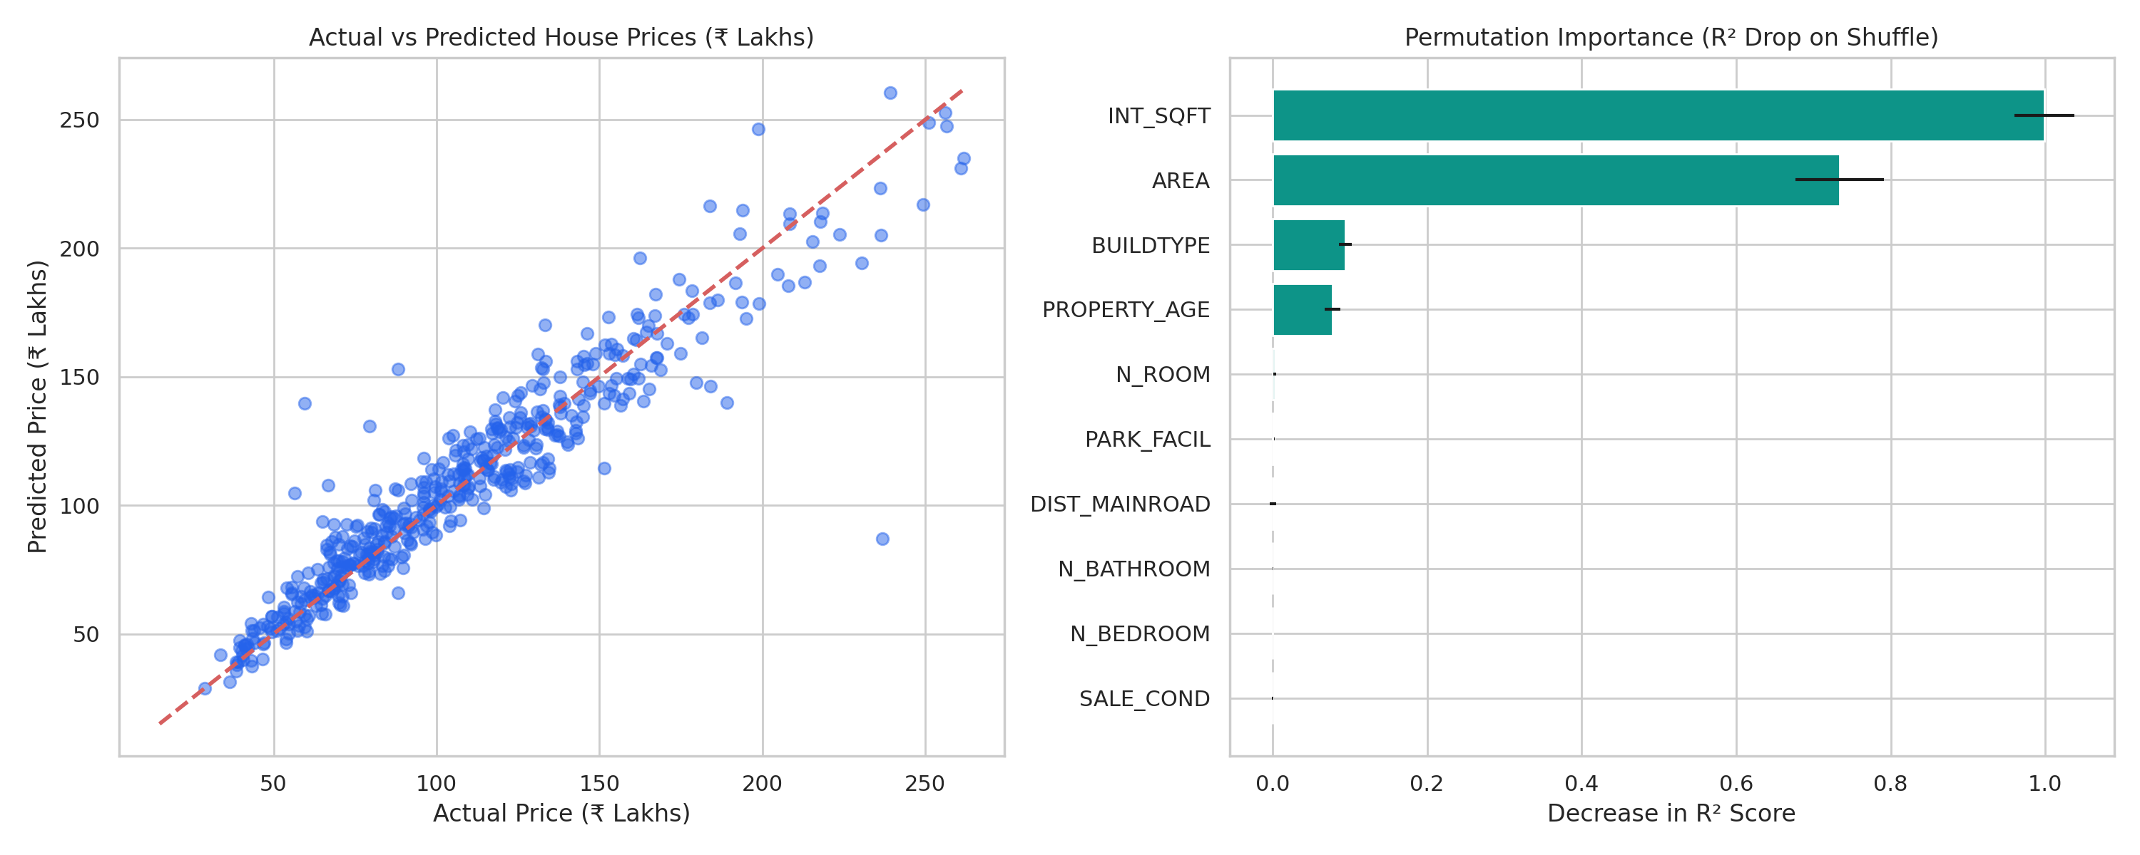
5. Diagnostics & Permutation Importance (Steps 8 & 10)

Slide 7
6. Subgroup Error Analysis & Uncertainty Range (Steps 8–9)
Budget Tier (< ₹65L): MAE = ₹3.95 Lakhs | RMSE = ₹5.12 Lakhs.
Mid-Segment (₹65L – ₹1.30 Cr): MAE = ₹6.40 Lakhs | RMSE = ₹8.25 Lakhs.
Luxury Tier (> ₹1.30 Cr): MAE = ₹10.52 Lakhs | RMSE = ₹14.60 Lakhs.
Communicating Uncertainty: Trained 5th and 95th percentile Quantile Regressors (alpha=0.05, 0.95).
Prototype Output: Displays Point Estimate + 90% Confidence Price Range + Mandatory Caveat Banner.

Slide 8
7. Responsible AI, Market Drift & Limitations (Steps 11–12)
Geographic Bias: Fewer luxury training examples in peripheral zones (Tambaram/Chromepet).
Changing Markets & Data Age: Static historical data lags behind 2026 Chennai Metro Phase-2 appreciation.
Not a Formal Valuation: Statistical ML output is for decision-support only—not a certified bank appraisal.

