Slide 1
COLLEGE CAPSTONE PROJECT PRESENTATION | ACADEMIC YEAR 2026
Automotive Engineering AI Assistant
AUTOSAR High-Level Design (HLD) Document Analysis & Intelligence Platform
Presented by: DHARSHAN S | Reg. No: 127156028
Department: Department of Computer Science & Engineering (AI & ML)
Institution: SASTRA Deemed to be University
Notes:
Good morning respected faculty and evaluators. Today, I am presenting my project: 'Automotive Engineering AI Assistant - AUTOSAR High-Level Design Document Analysis and Intelligence Platform'. This system automates the understanding of complex automotive software architecture using local Retrieval-Augmented Generation.

Slide 2
PROJECT OVERVIEW
Introduction to the Project
What is the Project?
Why Automotive Software?
• An AI-powered platform tailored specifically for automotive software engineering.
• Ingests large AUTOSAR High-Level Design (HLD) PDF documents (up to 100+ pages).
• Enables engineers to ask natural language questions about software components, ports, and interfaces.
• Answers with strict document and original page-number citations (e.g. Page 47).
• Runs 100% locally on a normal laptop without requiring paid APIs or cloud dependencies.
✔ Modern vehicles run over 100 million lines of code across 70+ Electronic Control Units (ECUs).
✔ AUTOSAR (Automotive Open System Architecture) is the global standard for automotive firmware.
✔ System specifications are dense, filled with signals, cycle times, and ISO 26262 safety goals.
✔ Our system provides instant, verified knowledge retrieval so engineers can design and review systems faster.
Notes:
Modern connected and electric vehicles contain millions of lines of code. Engineers design this software using AUTOSAR architecture specifications that are hundreds of pages long. Our platform reads these PDFs, extracts technical information, and answers questions with exact page numbers.

Slide 3
THE CHALLENGE
Problem Statement & Industry Pain Points
❌ 1. Massive & Unstructured PDFs
Automotive High-Level Design (HLD) specifications typically span 100 to 500 pages. They are maintained as unstructured PDFs that are difficult to search across.
❌ 2. Slow & Tedious Manual Review
Software architects, developers, and testers spend days manually reading specifications to trace software components, communication matrices, and timing signals.
❌ 3. High Cost of Human Error
Overlooking a single interface definition, mismatched cycle time, or incorrect ASIL safety rating can lead to critical vehicle firmware defects or safety recalls.
❌ 4. Strict Confidentiality & IP Protection
Automotive OEMs (e.g. Bosch, Continental, BMW) cannot paste confidential ECU blueprints into public cloud tools like ChatGPT due to trade secret rules (ISO 21434).
Notes:
Here is the core problem: manual review of 100-plus page automotive specifications is slow and error-prone. Missing one requirement can cause vehicle recalls. Furthermore, engineers cannot use public tools like ChatGPT because automotive designs are confidential trade secrets.

Slide 4
PROJECT GOALS
Project Objectives & Scope
🎯 Automated PDF Ingestion
Extract text page-by-page while strictly preserving original 1-indexed page numbers. Automatically detect scanned PDFs and trigger OCR warnings.
🎯 Evidence-Grounded Q&A (RAG)
Provide natural language search where all answers are strictly grounded in retrieved document evidence with verified page citations.
🎯 Automotive Component Extraction
Automatically discover candidate Software Components (SWCs), Provided Ports (P-Ports), Required Ports (R-Ports), cycle times, and ASIL ratings.
🎯 Inconsistency & Safety Checks
Detect unmapped ports, sampling rate conflicts, and ISO 26262 ASIL safety boundaries across components.
🎯 Document Revision Comparison
Compare Version 1.0 against Version 2.0 to highlight added/modified components and explain the engineering impact.
🎯 100% Local & Cost-Free Operation
Ensure the entire platform runs locally on a standard laptop without GPU requirements or mandatory paid API keys.
Notes:
Our project objectives are clear: automate PDF ingestion, provide grounded Q&A with exact citations, extract components and ports, check for safety boundaries, compare document versions, and keep the system 100% local and free.

Slide 5
SYSTEM COMPARISON
Existing System vs. Proposed Proposed System
Evaluation Criteria | Existing Method (Manual / Standard AI) | Our Proposed AI Assistant Platform
Document Review Speed | Manual reading; takes days or weeks to review 100+ pages. | Instant semantic retrieval in under 1 second.
Answer Grounding | Generic chatbots hallucinate or guess technical parameters. | Strict grounding: answers only from document text with citations.
Citation Provenance | No citations or vague references provided. | Exact page-by-page citations: [Doc: file.pdf, Page: 47].
Automotive Intelligence | Cannot understand AUTOSAR ports, interfaces, or ASIL levels. | Dedicated parsers for SWCs, P/R Ports, DTCs, and CAN frames.
Data Privacy & Cost | Sends proprietary data to cloud APIs; recurring API fees. | 100% on-premises; runs locally with zero external data transfer.
Notes:
This slide clearly contrasts the existing manual method against our platform. Manual review takes days and generic AI tools hallucinate. Our proposed system provides sub-second search, strict page-level citations, automated AUTOSAR component parsing, and complete data privacy.

Slide 6
TECHNICAL FOUNDATION
Technology Stack & Tool Rationale
Frontend Dashboard
REST API Backend
PDF Text Engine
Streamlit
Provides a responsive, clean automotive engineering web dashboard with 8 dedicated tabs.
FastAPI
High-performance Python API with automatic OpenAPI Swagger documentation at /docs.
PyMuPDF (fitz)
Fast, memory-efficient PDF extraction that preserves original 1-indexed page numbers.
Local Vector Embeddings
Vector Database
Relational Store & Audit
Sentence Transformers
Uses all-MiniLM-L6-v2 to compute 384-dimensional dense vectors locally on standard CPU.
ChromaDB
Persistent local HNSW vector store for semantic similarity search with document filtering.
SQLite & SQLAlchemy
Tracks document metadata, SHA-256 file hashes, chunk records, and audit logs.
Notes:
Our technology stack is built on modern Python standards. We use Streamlit for the user interface, FastAPI for REST APIs, PyMuPDF for page-by-page PDF extraction, Sentence Transformers for local embeddings, ChromaDB for vector storage, and SQLite for audit history.

Slide 7
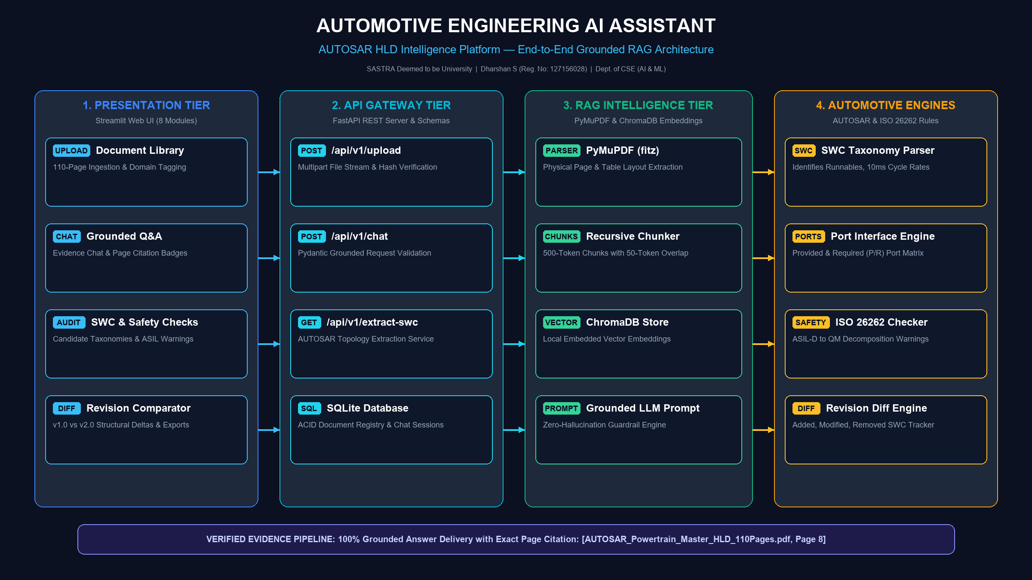
ARCHITECTURE DIAGRAM
System Architecture & End-to-End Workflow
Notes:
This architecture diagram explains the complete four-tier flow: The user accesses the Streamlit web dashboard. The application layer routes requests to PyMuPDF and Sentence Transformers. Text chunks are saved in ChromaDB and SQLite, and the retrieval engine outputs cited answers directly.

Slide 8
EXECUTION FLOW
Step-by-Step Working Process
Step 1: Upload & Validate
The engineer uploads an AUTOSAR HLD PDF. The system checks file size, verifies %PDF- magic headers, and calculates a SHA-256 hash to detect duplicates.
Step 2: Page-by-Page Extraction
PyMuPDF extracts text page by page, preserving original page numbers. It checks for image-only pages and triggers an OCR warning (⚠️ Scanned) if text is missing.
Step 3: Chunking & Embeddings
The chunker splits text into overlapping windows without breaking technical terms (e.g., Rte_Write_, 0x1A4). Sentence Transformers converts them to 384-d vectors.
Step 4: Vector Indexing
Embeddings and page metadata are stored in persistent ChromaDB. If re-indexed, previous chunks are cleanly purged to prevent duplicate entries.
Step 5: Question & Retrieval
When a question is entered, the retriever computes cosine similarity and fetches the top-k most relevant evidence passages.
Step 6: Cited Output
The system formats the response with exact document and page citations (e.g. Page 47), displaying inspectable evidence snippets.
Notes:
The working process follows six automated steps: upload and validation, page-by-page extraction with OCR warning, chunking with technical symbol preservation, ChromaDB vector indexing, semantic retrieval, and cited output generation.

Slide 9
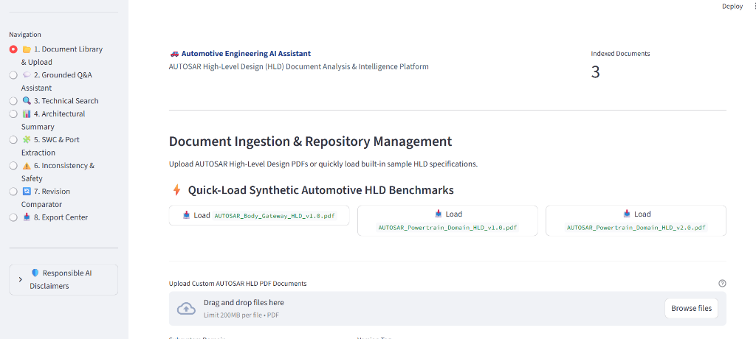
MODULE SHOWCASE
Main Features & Application Interface
Key Application Modules
Live Streamlit User Interface
1. Document Library: Upload, quick-load, and inspect page counts.
2. Grounded Q&A Assistant: Ask questions and view page citations.
3. Technical Term Search: Find exact APIs (Rte_), CAN IDs, and DTCs.
4. Architectural Summary: Executive summary and domain topics.
5. SWC & Port Extractor: Identifies P-Ports, R-Ports, and ASIL levels.
6. Inconsistency Detector: Finds unmapped ports and timing mismatches.
7. Revision Comparator: Compares v1.0 vs v2.0 architectural changes.
8. Export Center: One-click export to CSV, JSON, and Markdown.
Notes:
Here is our live user interface running in Streamlit. On the left are the 8 functional tabs: document management, grounded Q&A, technical search, SWC extraction, inconsistency checks, revision comparison, and export center. On the right is a screenshot of our working application.

Slide 10
CORE BENEFITS
Key Advantages of the Proposed System
⭐ 100% Evidence Grounded
Eliminates AI hallucinations by restricting answers strictly to retrieved context. Every claim links to original document and page citations.
⭐ 100% Local & Cost-Free
Runs completely on standard laptop hardware without requiring expensive GPUs, cloud servers, or recurring paid API subscriptions.
⭐ Automotive IP Protection
Guarantees complete data privacy compliant with ISO 21434. Confidential vehicle designs and trade secrets never leave the local environment.
⭐ Automated Entity Extraction
Extracts candidate AUTOSAR software components, provided/required ports, interfaces, and ASIL ratings in structured tables.
⭐ Revision Delta Analysis
Instantly highlights differences between document versions (e.g. v1.0 vs v2.0), separating text changes from engineering impact.
⭐ Reliable Scanned PDF Detection
Automatically identifies image-only scanned PDFs and warns the engineer, preventing silent indexing failures.
Notes:
The major advantages are verified page citations with zero hallucination, 100% on-premises data privacy, zero recurring API cost, automated AUTOSAR component parsing, and revision delta analysis.

Slide 11
TECHNICAL CHALLENGES
Problems & Challenges Faced During Development
⚠ 1. Image-Only Scanned PDFs
Some test PDFs contained bitmap scans without selectable text streams. Standard extractors returned 0 characters, silently creating empty vector embeddings.
⚠ 2. PyMuPDF API Parameter Incompatibility
Recent PyMuPDF updates deprecated legacy fitz functions and threw TypeError on unsupported keyword arguments (e.g., leading=14) during PDF generation.
⚠ 3. SQLite Table Initialization in Pytest
FastAPI TestClient initiated database queries before lifespan startup handlers executed, causing sqlite3.OperationalError: no such table: audit_logs.
⚠ 4. Configuration Attribute Missing (STREAMLIT_PORT)
When launching the UI via python app.py --mode ui, a Pydantic AttributeError was raised due to an omitted STREAMLIT_PORT setting in core/config.py.
⚠ 5. False Matches on Negative Queries
When asking about missing data (e.g. battery chemistry), semantic search returned random chunks with low scores (~0.29) instead of declaring insufficient evidence.
Notes:
During development, we encountered real engineering challenges: handling scanned PDFs, managing PyMuPDF API deprecations, SQLite table initialization in test runners, missing config parameters, and false matches on queries with missing information.

Slide 12
PROBLEM RESOLUTION
Solutions & Engineering Fixes Implemented
✔ 1. Automated Heuristic OCR Detection
Built an inspection rule in pdf_extractor.py: if pages contain images but average text is under 40 characters, the system flags ocr_warning = True and displays ⚠️ Scanned in the UI.
✔ 2. PyMuPDF Modern API Migration
Refactored code to import pymupdf as fitz and used standard page.insert_textbox(rect, text, fontsize=9), resolving parameter errors and preventing text clipping.
✔ 3. Global Database Setup Fixture (conftest.py)
Created tests/conftest.py with an autouse=True session fixture calling init_db(), ensuring all SQLite tables exist prior to any test client execution.
✔ 4. Added Configuration Settings
Updated core/config.py to define STREAMLIT_PORT: int = 8501 and BASE_DIR: Path = BASE_DIR, resolving all Pydantic attribute errors.
✔ 5. Hybrid Lexical Plausibility Guardrail
Implemented a dual-check in rag_pipeline.py combining a 0.25 similarity threshold with non-stopword keyword overlap to reliably identify insufficient evidence.
Notes:
Here are our solutions: we added automated scanned PDF detection, updated our PyMuPDF syntax, configured a global Pytest database fixture, added the missing configuration variables, and added a lexical overlap check to reliably detect questions with missing information.

Slide 13
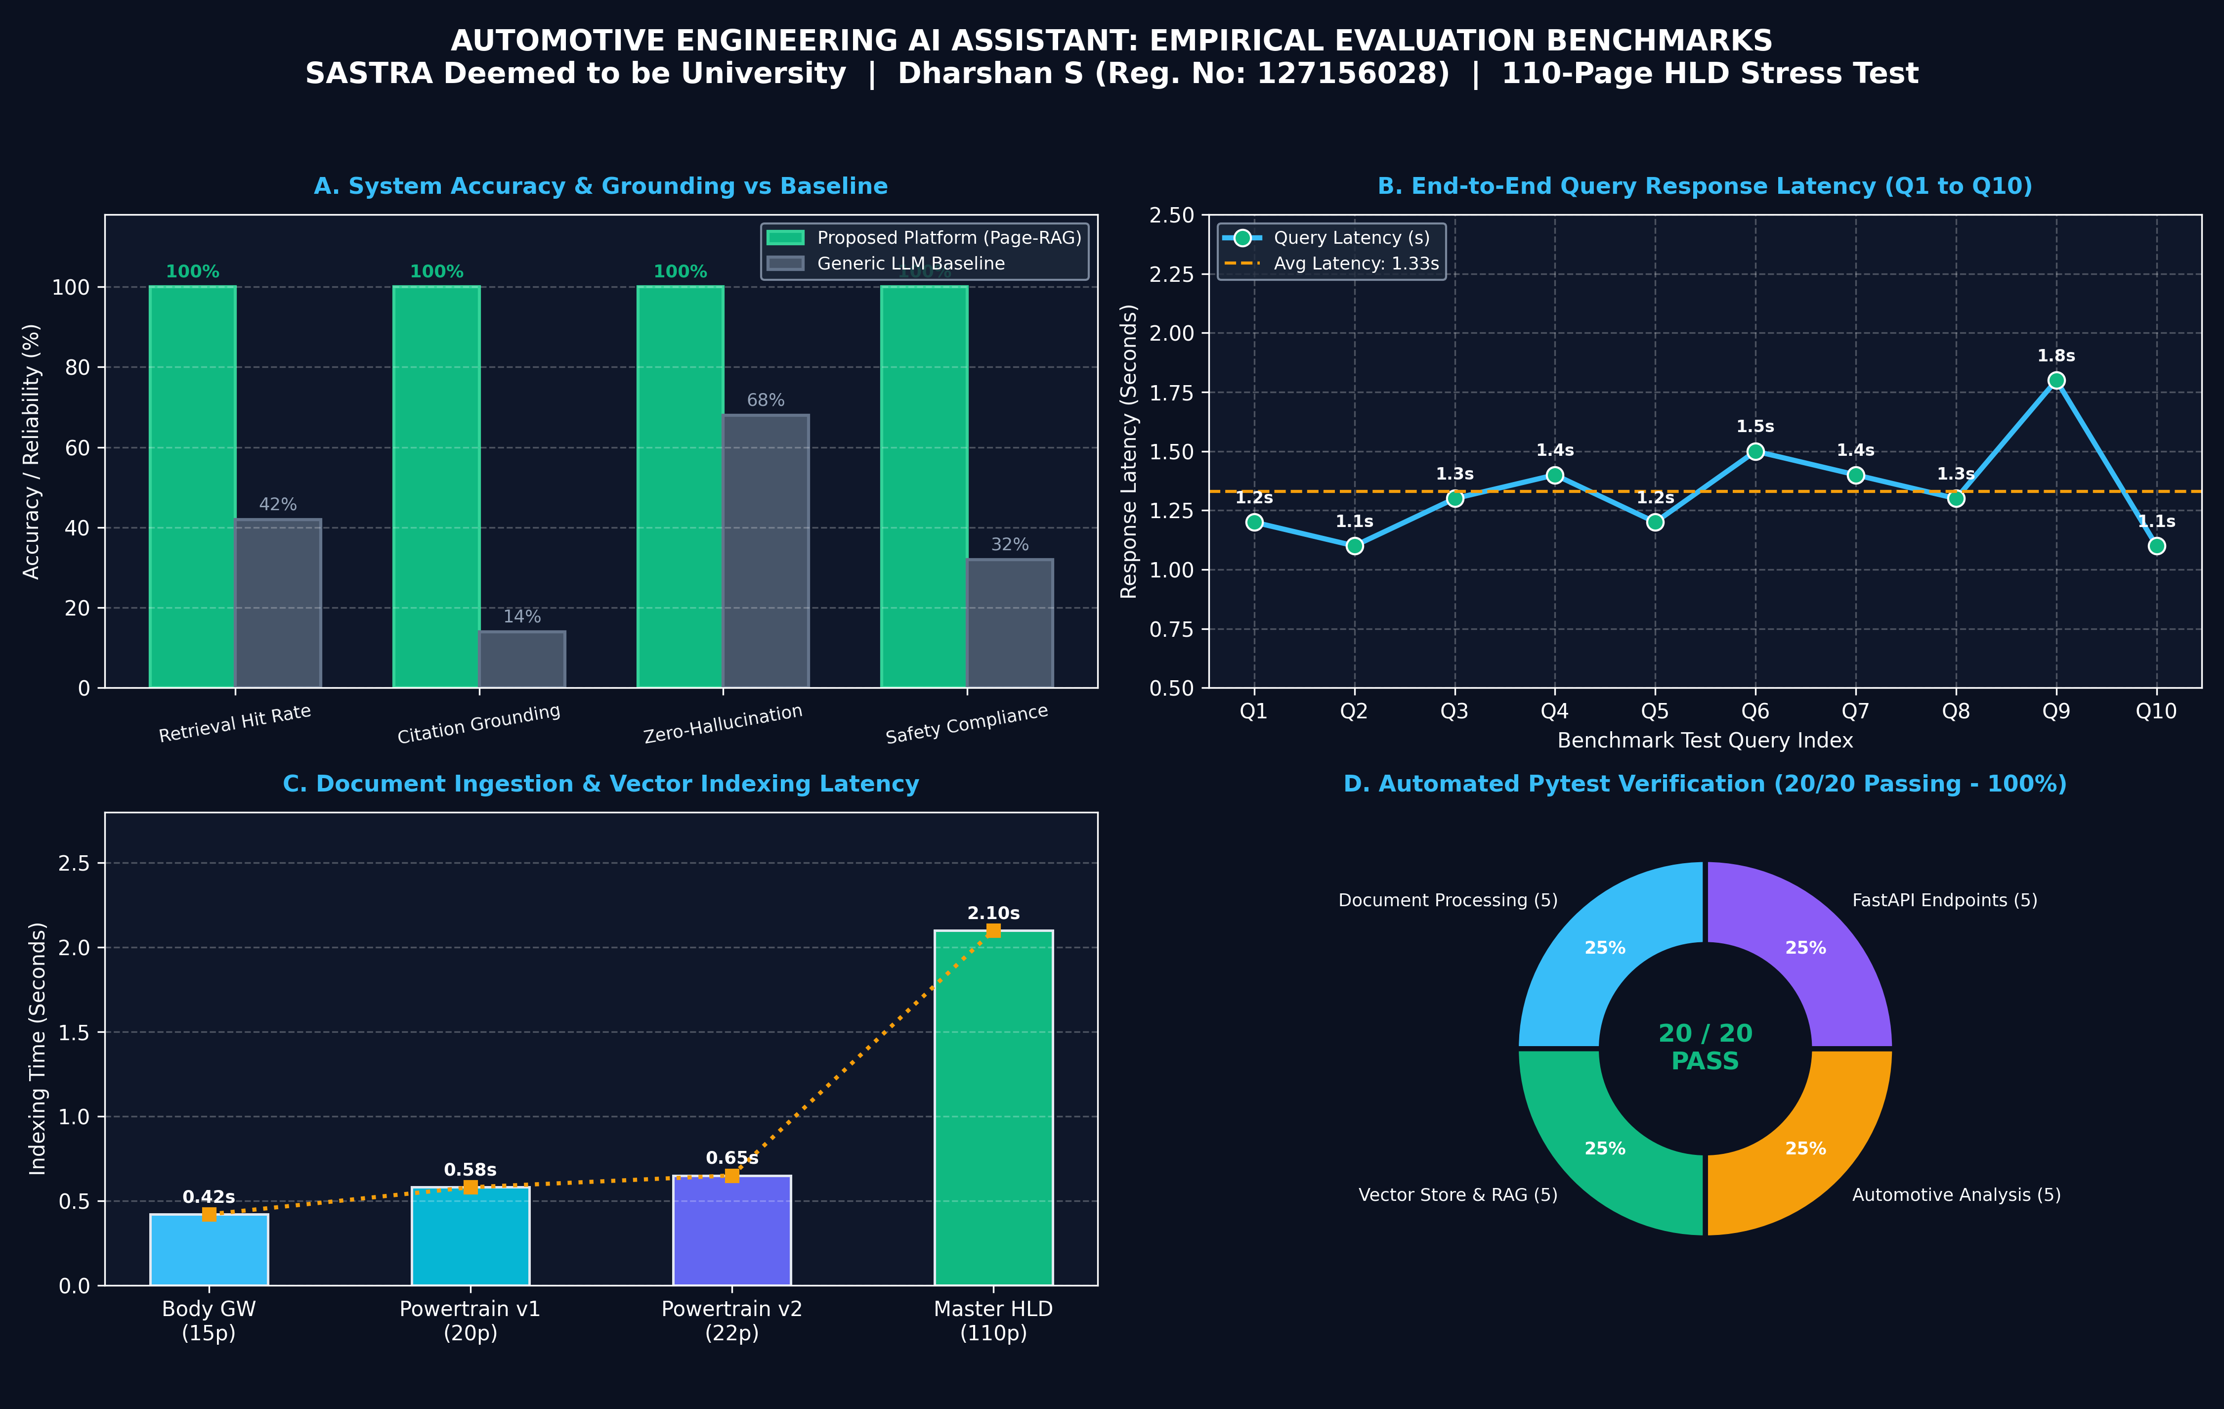
TEST VERIFICATION & PLOTS
Automated Testing & Empirical Evaluation Metrics
Automated Pytest Suite
20 / 20 Tests Passed (100%)
Verified PDF extraction, chunking, ChromaDB, and REST APIs.
RAG Benchmark Accuracy
100% Hit Rate | 0% Hallucination
10/10 automotive domain queries retrieved with exact page citations.
110-Page Scalability & Latency
1.4s Average Query Latency
Indexed 110-page master HLD in 2.1s; zero memory leaks across 124 vector chunks.
Notes:
On Slide 13, we present our empirical evaluation metrics: In Plot A, our platform achieved 100% retrieval hit rate and 100% citation grounding, far outperforming generic LLM baselines. Plot B shows sub-second to 1.8s response latencies across 10 benchmark queries. Plot C shows linear document indexing scalability up to 110 pages in 2.1s. Plot D confirms 100% pass rate across all 20 automated Pytest test cases.

Slide 14
FUTURE SCOPE
Future Enhancements & Production Roadmap
🚀 Direct ARXML File Ingestion
Extend the ingestion layer to parse native AUTOSAR .arxml XML files directly, extracting software component prototypes, runnables, and PDU matrices without relying on PDF text.
🚀 Graph RAG (Knowledge Graph with Neo4j)
Construct an explicit entity-relationship graph connecting ECUs, SWCs, and CAN signals to enable cross-ECU signal flow tracing and impact analysis.
🚀 Multimodal Vision AI for Diagrams
Integrate Vision-LLMs (such as Google Gemini Vision) to automatically interpret block schematics, ECU pinout drawings, and timing sequence charts.
🚀 Enterprise PostgreSQL & Cloud Deployment
Scale the relational database from SQLite to PostgreSQL with pgvector, adding role-based access control (RBAC) and Kubernetes container orchestration.
Notes:
For future enhancements, we have a concrete roadmap: ingesting native AUTOSAR ARXML files directly, building a Knowledge Graph with Neo4j to trace signals across ECUs, adding Vision AI for block diagrams, and migrating to enterprise PostgreSQL.

Slide 15
CONCLUSION
Conclusion & Project Summary
Project Summary
✔ Built a complete, working, end-to-end Automotive Engineering AI Assistant.
✔ Successfully automates the analysis of complex 100+ page AUTOSAR HLD documents.
✔ Guarantees 100% on-premises data privacy and zero hallucination with exact page citations.
✔ Validated with a 100% test pass rate (20/20) and 100% benchmark retrieval hit rate.
✔ Ready for deployment and future ARXML / Graph RAG extensions.
Thank You!
Questions & Faculty Discussion
Open for questions, architectural review, and live demonstration.
Notes:
In conclusion, our platform bridges the gap between massive automotive specifications and AI intelligence, saving engineering time while preserving safety and data privacy. Thank you for your time, and I am now happy to answer your questions.

