Slide 1

For 5th semester engineering students
MLOps &
Model Deployment
Industry perspective + hands-on image model deployment
• What companies expect from AI engineers now
• How ML moves from notebook to production
• Build, serve, containerize and deploy an image classifier
Session format: Part 1 concepts + Part 2 hands-on lab
By Sanjay NT
01

Slide 2
OUTCOME
By the end, you should be able to explain and build
Keep the promise realistic: one deployable mini-system is better than ten half-finished notebooks.
01
Industry view
02
Problem framing
Why AI hiring is moving from experiments to deployed systems.
Turn a business problem into data, model, API and monitoring requirements.
03
Hands-on deployment
04
Career direction
Train an image classifier, expose it through an API and package it.
Build a portfolio that proves engineering ability, not just certificates.
02

Slide 3
OUTCOME
Case Study
Lets analyze a problem.
01
Industry view
02
Problem framing
Why AI hiring is moving from experiments to deployed systems.
Turn a business problem into data, model, API and monitoring requirements.
03
Hands-on deployment
04
Career direction
Train an image classifier, expose it through an API and package it.
Build a portfolio that proves engineering ability, not just certificates.
02

Slide 4
PLAN
Two-part session flow
Designed for students who know basic Python and have started ML/DL.
00–20 min
20–45 min
45–120 min
Industry reality
Example problem
Hands-on lab
AI jobs, role map, expectations
Image inspection from business view
Train → API → Docker → Deploy → Monitor
Best session rule: students should leave with something runnable.
03

Slide 5
INDUSTRY
The market signal: AI is no longer a side project
Companies are under pressure to convert AI into productivity, automation and reliable products.
53%
40%
+55%
+280%
GenAI reached population-level adoption in ~3 years
AI-exposed companies report higher productivity growth
AI skills in job postings grew YoY
Agentic AI skill mentions grew YoY
Industry is shifting from “Can we train a model?” to “Can we run it safely, cheaply and continuously?”
Teaching implication: deployment + monitoring matter early, not after graduation.
Sources: Stanford AI Index 2026; PwC AI Jobs Barometer 2026; Lightcast/Stanford job postings analysis.
04

Slide 6
JOBS
India job reality: opportunity exists, but the bar is rising
The honest message for all: AI is not a shortcut around engineering basics.
June 2026 India signal
AI hiring in IT rose 16% YoY while overall IT hiring fell 3%; AI/ML jobs across 14 sectors rose 25%.
What is growing
What is shrinking
What employers test
AI Engineer, ML Engineer, MLOps, Data Engineer, GenAI apps, automation, analytics
Only-theory ML, copy-paste notebooks, chatbot demos with no evaluation, no deployment
Problem solving, Python, SQL, APIs, Git, cloud basics, model evaluation, reliability mindset
Source: Reuters/Naukri JobSpeak, July 3 2026; LinkedIn Skills on the Rise 2026 India.
05

Slide 7
EXPECTATION
What companies expect from an entry-level AI candidate
Start building these habits now; nobody expects you to know everything yet.
Coding
Data
ML/DL
Deployment
Product sense
Python, Git, debugging, clean functions
EDA, leakage checks, train/val/test split
loss, metrics, augmentation, overfitting
API, Docker, config, logs, health checks
Who uses it? What happens when it fails?
Hiring signal: the strongest candidate show working systems, explain trade-offs and can debug failures live.
06

Slide 8
ROLE MAP
AI jobs are not one job
Pick a lane to start, then grow into adjacent skills.
Data Scientist
ML Engineer
MLOps Engineer
experiments, insights, models
training pipelines, serving, optimization
CI/CD, deployment, monitoring, infra
AI App Engineer
Data Engineer
LLM apps, agents, APIs, workflow automation
data pipelines, quality, warehousing
For this session, the main lane is ML Engineer + MLOps basics.
07

Slide 9
LIFECYCLE
The real AI lifecycle
A model is only one component in the system.
Problem
Data
Train
Evaluate
Package
Deploy
Monitor
Improve
• Training is a phase; deployment is an operating responsibility.
• Data problems create most model failures: label noise, leakage, imbalance and distribution shift.
• Monitoring must cover latency, errors, input drift, model confidence and business impact.
08

Slide 10
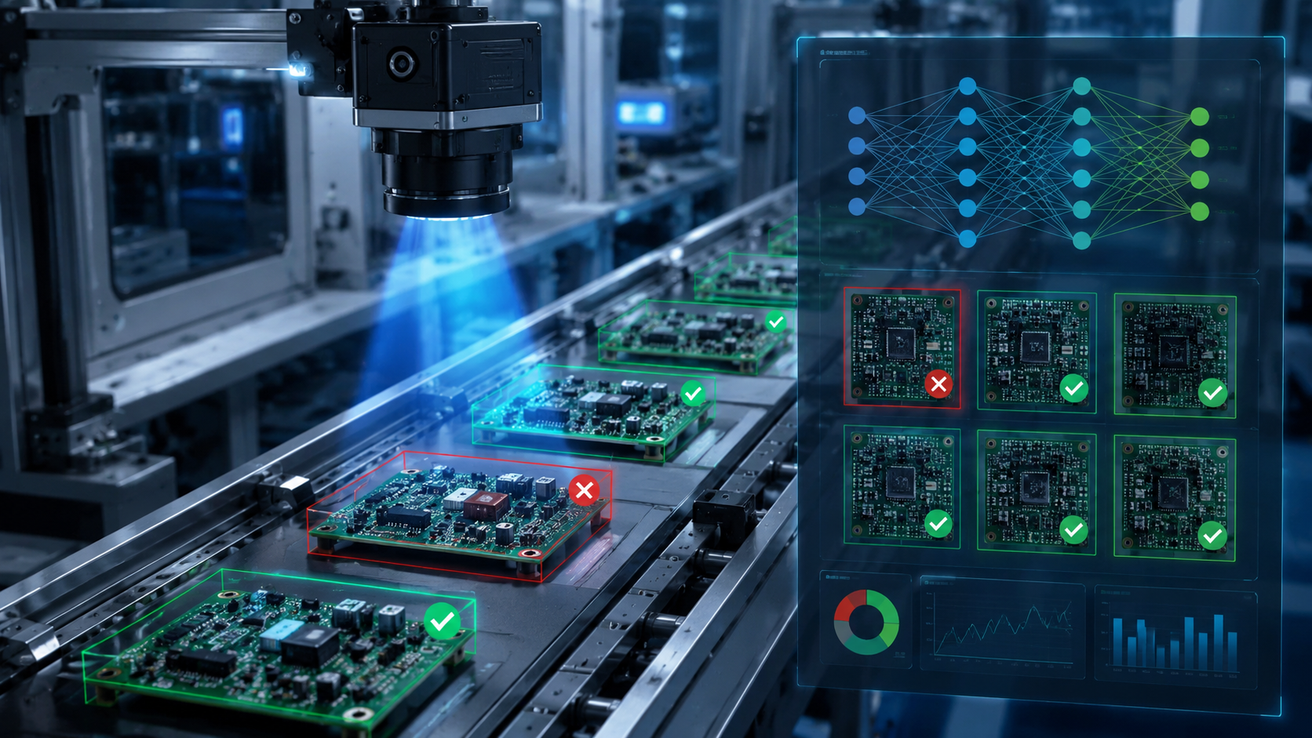
EXAMPLE
Example problem:
Image defect detection
• Input: image from camera / user upload
• Output: OK / Defective + confidence
• Business goal: reduce manual inspection effort
• Risk: false OK can ship a bad product
Teaching choice: use a small dataset and simple CNN/transfer learning so deployment remains the focus.
09

Slide 11
GAP
Why notebook accuracy is not production readiness
This is where many student projects fail.
Notebook demo
Production-ready mini project
• Runs only on my laptop
• No API or repeatable environment
• No input validation
• No versioned data/model
• No error handling/logs
• No monitoring after deployment
• Reproducible training and inference
• API endpoint with health check
• Docker image and config
• Metrics: latency, error rate, confidence
• Basic CI/CD or deployment script
• Rollback and retraining plan
10

Slide 12
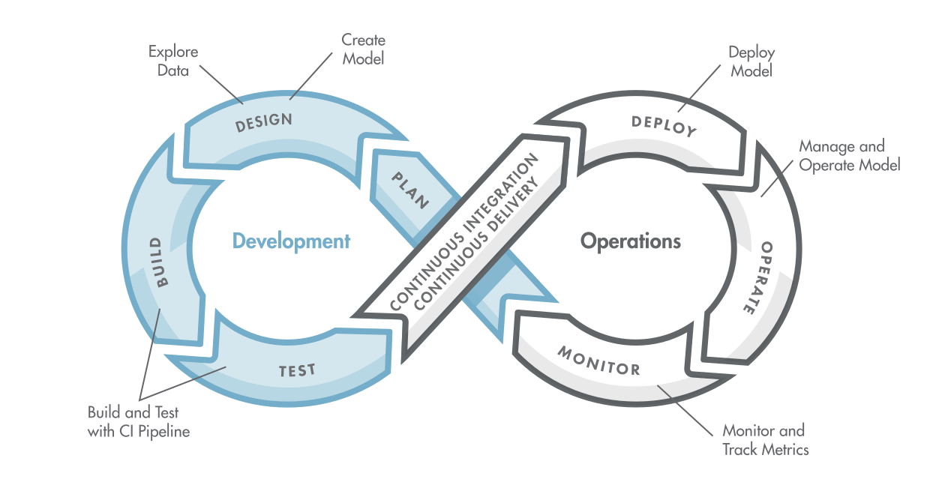

Slide 13
MLOPS
MLOps in one slide
MLOps is not a tool. It is discipline around repeatability, deployment and operations.
Version
Automate
Serve
Observe
Govern
Code, data, model, config
Training, tests, packaging
API/batch/edge endpoint
Logs, metrics, drift, feedback
Security, privacy, rollback
Simple rule: every ML project should be reproducible, testable, deployable and observable.
11

Slide 14
2026 TREND
Recent industry trend: AI skills are moving toward execution
The buzzword is less important than the system you can build.
Foundation
Python, SQL, Git, Linux
ML stack
PyTorch/TensorFlow, sklearn, CV
Deployment
FastAPI, Docker, REST, cloud/K8s
Operations
logging, metrics, monitoring, incidents
Modern AI
LLMOps, agents, RAG, workflow automation
LinkedIn India flags AI & Automation skills such as Prompt Engineering, Workflow Automation, LLMOps, AutoML and APIs as fast-growing.
Sources: LinkedIn Skills on the Rise 2026 India; Lightcast/Stanford AI Index 2026.
12

Slide 15
ROADMAP
A realistic 6-month AI job roadmap
Month 1
Month 2
Month 3
Month 4
Month 5
Month 6
Python + Git + Linux basics
ML fundamentals + metrics
Deep learning + image project
FastAPI + Docker deployment
Monitoring + error handling
Portfolio + mock interviews
13

Slide 16
PORTFOLIO
What a strong student project must prove
A deployed small project beats a large unreadable notebook.
README
problem, dataset, setup, architecture, results
Code quality
config file, functions, type hints, folder structure
Evidence
metrics, screenshots, API sample request/response
Deployment
Dockerfile, run command, health endpoint
Reflection
limitations, failure cases, next improvements
Do not fake complexity. Show clean execution.
14

Slide 17
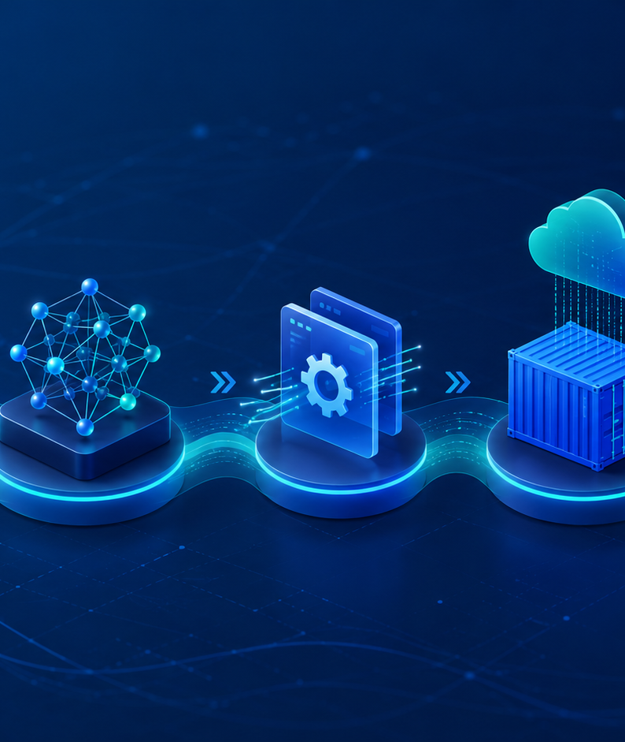
PART 2: HANDS-ON
Build an image model
and deploy it
• Train a simple classifier
• Save model artifact
• Serve inference through FastAPI
• Package in Docker
• Deploy locally or on Kubernetes
• Add basic logs and monitoring checks
15

Slide 18
ARCHITECTURE
Hands-on target architecture
Use this as the mental map while coding.
Dataset
Training script
Model file
FastAPI app
Docker image
Deployment
Monitoring
images + labels
augment + train
model.pt / .h5
/predict + /health
portable runtime
local/K8s/cloud
logs + metrics
• Students should understand inputs, outputs and failure points at every stage.
• You can swap the dataset/model later; the deployment pattern remains similar.
16

Slide 19
STEP 1
Choose a practical image task
Keep training short; spend more time on deployment and debugging.
Dataset options
Model options
Cats vs Dogs, plant disease, waste classification, defect/OK images, custom classroom dataset
Transfer learning with MobileNet/ResNet, or a small CNN for quick demo
Minimum split
Risk checks
Train / validation / test. Do not evaluate on training data.
Class imbalance, bad labels, duplicate images, leakage, poor lighting
17

Slide 20
STEP 2
Training checklist for the live demo
Do not let the hands-on collapse because of missing basics.
✓
Create folders: data/train, data/val, data/test
✓
Load and transform images
✓
Train small model or fine-tune pretrained model
✓
Track loss, accuracy and confusion matrix
✓
Save model + class names
✓
Write one inference test before API
18

Slide 21
EVALUATION
Evaluation: accuracy alone can mislead
Students must learn to ask: what kind of mistake is expensive?
Accuracy
Precision
Recall
Good first metric when classes are balanced
When false positives are costly
When missed defects/diseases are costly
Confusion matrix
Latency
Shows which classes are confused
Production needs speed, not just correctness
Demo line to say: “A model with 95% accuracy can still be useless if the 5% errors are the critical cases.”
19

Slide 22
STEP 3
Serve the model with a small API
This is the step that turns ML into something another application can use.
from fastapi import FastAPI, UploadFile
app = FastAPI()
model = load_model("model.pt")
classes = ["ok", "defect"]
@app.get("/health")
def health():
return {"status": "ok"}
@app.post("/predict")
async def predict(file: UploadFile):
image = preprocess(await file.read())
prob = model_predict(model, image)
return {"class": classes[argmax(prob)],
"confidence": float(max(prob))}
• /health proves the service is alive
• /predict accepts image and returns JSON
• Add validation: file type, size, corrupted image
• Log request id, latency and predicted class
Good API design is part of ML engineering.
20

Slide 23
STEP 4
Package the app with Docker
A Docker image removes “it works only on my laptop” excuses.
• Build: docker build -t image-classifier:1.0 .
• Run: docker run -p 8000:8000 image-classifier:1.0
• Test: curl /health and then upload an image
• Common failure: missing model file, wrong path, heavy dependency image
FROM python:3.11-slim
WORKDIR /app
COPY requirements.txt .
RUN pip install --no-cache-dir -r requirements.txt
COPY . .
EXPOSE 8000
CMD ["uvicorn", "app:app", "--host", "0.0.0.0", "--port", "8000"]
For students: understand the Dockerfile line by line; do not paste it blindly.
21

Slide 24
STEP 5
Deployment choices: choose based on maturity
Do not overcomplicate the first demo. Scale the deployment after the basics work.
Level 1
Level 2
Level 3
Level 4
Local Docker
Cloud VM
Kubernetes
Managed serving
Best for classroom demo and first testing
Simple public endpoint, easier than Kubernetes
Scaling, rollout, health probes, service discovery
KServe, SageMaker, Vertex AI, Azure ML
22

Slide 25
KUBERNETES
Kubernetes deployment: minimum concepts students should know
Kubernetes is powerful, but first learn why each object exists.
Deployment
Runs replicas of the API container
Service
Stable network access inside/outside cluster
Probe
Kubernetes checks health/readiness
Config/Secret
Keeps environment-specific settings outside code
Ingress/Gateway
Routes external traffic to the service
For a first session, explain this visually. YAML can come after they understand the purpose.
23

Slide 26
OPERATIONS
Deployment is not done until you can see failures
This is the industry mindset most students miss.
System
API
Model
Business
CPU, memory, GPU, disk, restarts
requests/sec, latency, 4xx/5xx, timeouts
confidence, class distribution, drift, accuracy feedback
manual review rate, false OK/false defect cost
• Add logs in the API before showing deployment success.
• Track latency and error rate even in a student demo.
• Show at least one failure case and how you debugged it.
24

Slide 27
DEMO SCRIPT
Live demo checklist
Use this sequence to avoid chaos during the hands-on section.
1
Open repo and explain folder structure
5
Upload one image to /predict
2
Run training with a small sample dataset
6
Build Docker image and run container
3
Show saved model artifact and class mapping
7
Show logs and one error case
4
Start FastAPI locally and call /health
8
Optional: deploy to Kubernetes
25

Slide 28
CAREER
Questions students should be ready to answer
These are simple, but weak projects fail here.
Why did you choose this model and metric?
How did you avoid data leakage?
What happens if the image is corrupt or too large?
How do you deploy a new model version safely?
What logs/metrics would you monitor?
How would you improve accuracy without overfitting?
How would you reduce latency or memory usage?
What are the ethical or business risks?
26

Slide 29
ASSIGNMENT
Post-session assignment: build one complete mini-project
Make the rubric concrete so students know what “good” looks like.
Dataset + EDA
10 pts
Training + metrics
20 pts
API inference
20 pts
Docker packaging
15 pts
Deployment proof
15 pts
Monitoring/logs
10 pts
README + demo video
10 pts
Submission should include GitHub repo, screenshot of API response, Docker command and a 2-minute demo.
27

Slide 30
CLOSING
Blunt career advice for AI jobs
Good advice is not always comfortable.
Do not chase only certificates
Do not call every chatbot “AI project”
Certificates help only when backed by code and deployment.
Show evaluation, safety, monitoring and business use.
Learn boring engineering
Build in public
Git, APIs, Docker, SQL and debugging decide whether your ML works outside class.
A clean GitHub repo is your proof before the interview.
28

Slide 31
REFERENCES
Sources used for the industry perspective
Use current signals, but teach durable fundamentals.
• World Economic Forum — Future of Jobs Report 2025
• Stanford HAI — AI Index Report 2026
• PwC — Global AI Jobs Barometer 2026
• Lightcast + Stanford — AI Index 2026 labor-market highlights
• Reuters — India AI hiring outpaces overall IT recruitment, July 3 2026
• LinkedIn — Skills on the Rise 2026: India
Suggested classroom resources: PyTorch/TensorFlow docs, FastAPI docs, Docker docs, Kubernetes docs, MLflow docs.
29

