Slide 1

TIFAC – CORE in CYBER SECURITY
20CYS495 Project Phase 1 Review-2
Group 10
Project Title : APT Profiling and Detection in Critical Infrastructure using Deception Tech
Domain: Threat Intelligence & APT Research
Guide Name: Sreejith K
Sl.No | Student Name | Roll No
1 | Chitla Vyshali | CB.EN.U4CYS22017
2 | Dharshika S | CB.EN.U4CYS22021
3 | Reddicherla Thanuj | CB.EN.U4CYS22056
4 | Mothe Anurag Reddy | CB.EN.U4CYS22069
20CYS 495 B.Tech CYS: 2022 - 2026 Project Presentation
1

Slide 2
TIFAC – CORE in CYBER SECURITY
Problem Statement
Conventional honeypots are insufficient for deceiving sophisticated attackers, while establishing fully interactive deception networks is often too costly and complicated for many organizations. This creates a significant void in cybersecurity.
We are developing an intelligent Security Orchestration Engine to address this challenge.
Here's how it functions:
It detects early signs of an attack, such as a port scan.
It employs a machine learning model to ascertain the attacker's intentions.
It promptly and automatically deploys a customized honeypot specifically designed to engage that particular attacker.
20CYS 495 B.Tech CYS: 2022 - 2026 Project Presentation
2

Slide 3
TIFAC – CORE in CYBER SECURITY
Objectives
Detect Early Attack Signals To capture initial attacker activities such as port scans and reconnaissance attempts.
Classify Attacker Intent To analyze the observed traffic using a lightweight detection method (rule-based or ML) to determine the likely target service (e.g., SSH, web).
Orchestrate Dynamic Honeypots To automatically deploy the most suitable honeypot container in real-time based on the classified intent.
Enable Realistic Engagement To ensure the attacker interacts with convincing honeypots, allowing detailed monitoring of commands, payloads, and techniques.
20CYS 495 B.Tech CYS: 2022 - 2026 Project Presentation
3

Slide 4
TIFAC – CORE in CYBER SECURITY
Objectives - Cont
Centralize Threat Intelligence To forward captured logs into a SIEM (e.g., Splunk) for correlation, visualization, and alerting.
Map to MITRE ATT&CK To profile and classify attacker behavior against the MITRE ATT&CK framework, producing actionable threat intelligence for analysts.
20CYS 495 B.Tech CYS: 2022 - 2026 Project Presentation
4

Slide 5
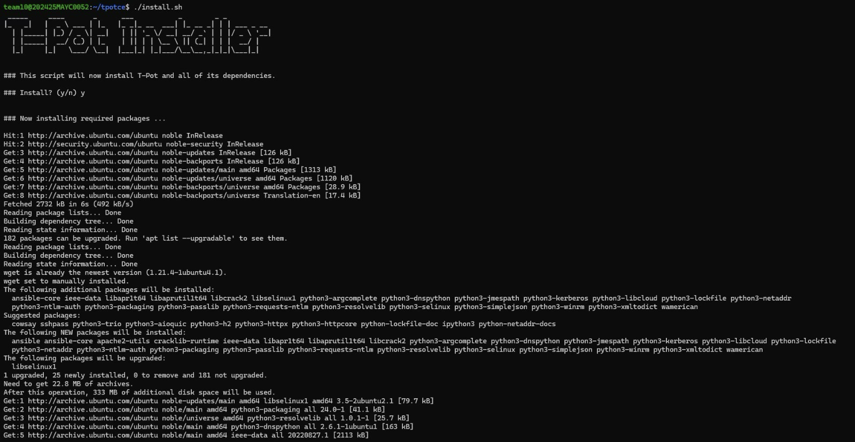
TIFAC – CORE in CYBER SECURITY
The installation of T-Pot, a multi-honeypot framework that brings together several honeypot services into a single environment. During this step, the installation script sets up all the required dependencies such as Ansible and Python libraries, ensuring the system can support and manage honeypots inside Docker containers.
20CYS 495 B.Tech CYS: 2022 - 2026 Project Presentation
5

Slide 6
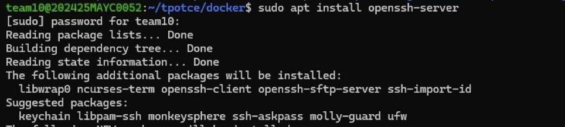
TIFAC – CORE in CYBER SECURITY
we install the OpenSSH Server on the machine. This setup is essential for enabling secure remote access and for simulating SSH services within our environment. Since SSH is one of the most commonly targeted services by attackers through brute-force attempts, including it in our honeypot setup makes the environment more realistic and effective in attracting malicious activity.
20CYS 495 B.Tech CYS: 2022 - 2026 Project Presentation
6

Slide 7
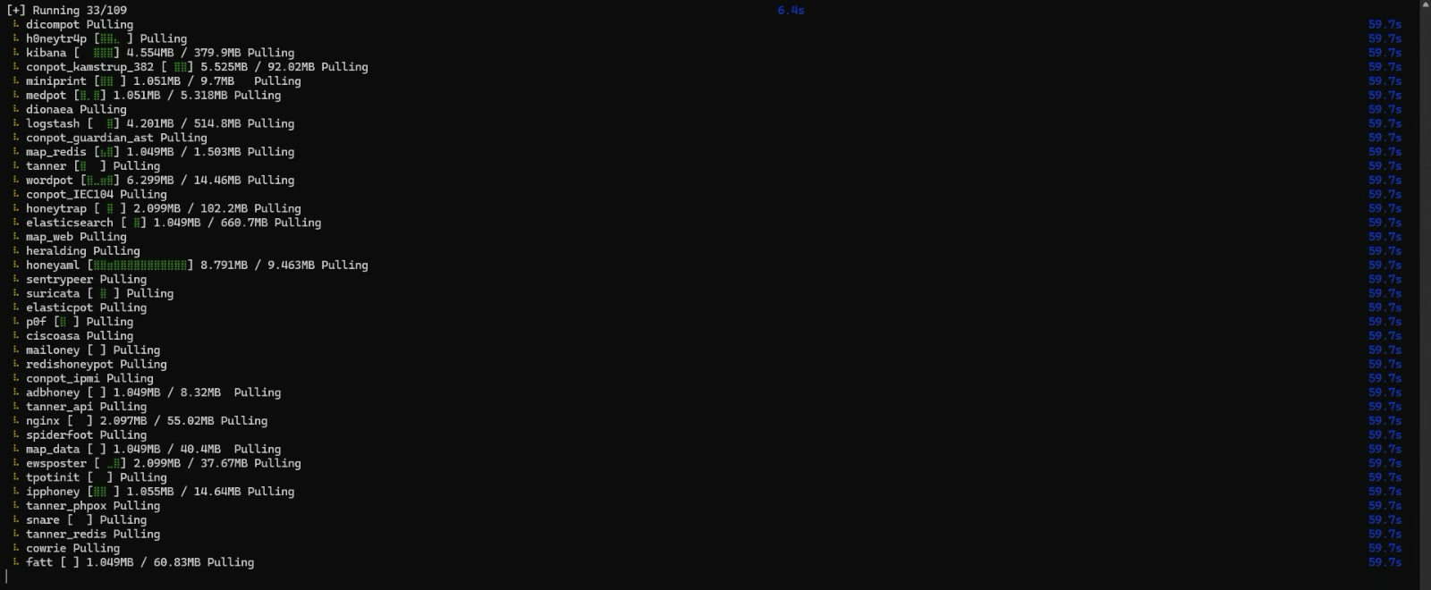
TIFAC – CORE in CYBER SECURITY
Docker pull process where multiple honeypot images such as Cowrie, Dionaea, Conpot, Suricata, and Honeytrap are being downloaded. Each honeypot simulates different services like SSH, web, or industrial control systems. Once pulled, these images can be deployed as containers to create a diverse deception environment for capturing attacker behavior.
20CYS 495 B.Tech CYS: 2022 - 2026 Project Presentation
7

Slide 8
TIFAC – CORE in CYBER SECURITY
Demo of labshock and integrating of splunk
20CYS 495 B.Tech CYS: 2022 - 2026 Project Presentation
8

Slide 9
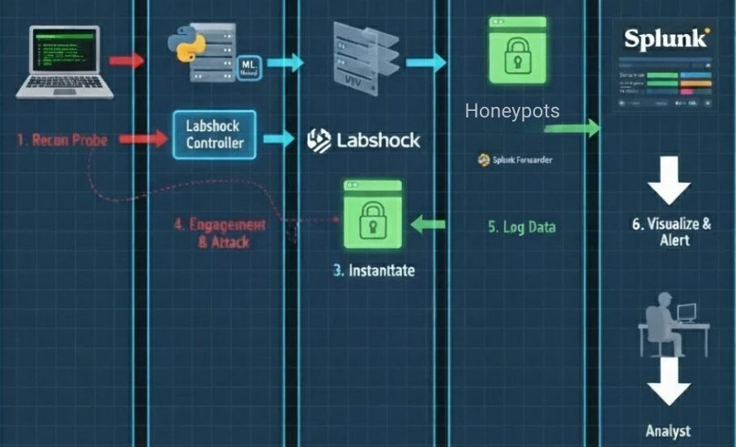
TIFAC – CORE in CYBER SECURITY
Architectural diagram
20CYS 495 B.Tech CYS: 2022 - 2026 Project Presentation
9

