Slide 1

TIFAC – CORE in CYBER SECURITY
20CYS495 Project Phase 1 Final Review
Group 10
Project Title : APT Profiling and Detection in Critical Infrastructure using Deception Technology
Domain: Threat Intelligence & APT Research
Guide Name: Sreejith K
Sl.No | Student Name | Roll No
1 | Chitla Vyshali | CB.EN.U4CYS22017
2 | Dharshika S | CB.EN.U4CYS22021
3 | Reddicherla Thanuj | CB.EN.U4CYS22056
4 | Mothe Anurag Reddy | CB.EN.U4CYS22069
20CYS 495 B.Tech CYS: 2022 - 2026 Project Presentation
1

Slide 2
TIFAC – CORE in CYBER SECURITY
Problem Statement
Conventional honeypots are insufficient for deceiving sophisticated attackers, while establishing fully interactive deception networks is often too costly and complicated for many organizations. This creates a significant void in cybersecurity.
We are developing an intelligent Security Orchestration Engine to address this challenge.
Here's how it functions:
It detects early signs of an attack, such as a port scan.
It employs a machine learning model to ascertain the attacker's intentions.
It promptly and automatically deploys a customized honeypot specifically designed to engage that particular attacker.
20CYS 495 B.Tech CYS: 2022 - 2026 Project Presentation
2

Slide 3
TIFAC – CORE in CYBER SECURITY
Objectives
Detect Early Attack Signals To capture initial attacker activities such as port scans and reconnaissance attempts.
Classify Attacker Intent To analyze the observed traffic using a lightweight detection method (rule-based or ML) to determine the likely target service (e.g., SSH, web).
Orchestrate Dynamic Honeypots To automatically deploy the most suitable honeypot container in real-time based on the classified intent.
Enable Realistic Engagement To ensure the attacker interacts with convincing honeypots, allowing detailed monitoring of commands, payloads, and techniques.
20CYS 495 B.Tech CYS: 2022 - 2026 Project Presentation
3

Slide 4
TIFAC – CORE in CYBER SECURITY
Objectives - Cont
Centralize Threat Intelligence To forward captured logs into a SIEM (e.g., Splunk) for correlation, visualization, and alerting.
Map to MITRE ATT&CK To profile and classify attacker behavior against the MITRE ATT&CK framework, producing actionable threat intelligence for analysts.
20CYS 495 B.Tech CYS: 2022 - 2026 Project Presentation
4

Slide 5
TIFAC – CORE in CYBER SECURITY
Methodologies:
Approach Taken
Honeypot-based Threat Collection (using T-Pot CE)
Penetration Testing Simulation (APT-style attacks launched from Kali Linux)
SIEM-based Detection & Analysis (via Splunk correlation rules)
Threat Intelligence Mapping (to MITRE ATT&CK tactics & techniques)
Tools & Technologies Used:
T-Pot CE – Multi-honeypot framework (Cowrie, Dionaea, Conpot, Medpot, etc.)
Kali Linux – Attack simulation (FTP brute-force, web exploitation, etc.)
Splunk Enterprise – Log aggregation, visualization & rule-based detection
Docker – Containerized honeypot management
Python – Log parsing & JSON-based APT simulation script
MITRE ATT&CK Framework – For APT classification
20CYS 495 B.Tech CYS: 2022 - 2026 Project Presentation
5

Slide 6
Algorithms/Models Used: Rule-based Detection Algorithms in Splunk (mapping log patterns → APT stages)
TIFAC – CORE in CYBER SECURITY
20CYS 495 B.Tech CYS: 2022 - 2026 Project Presentation
6

Slide 7
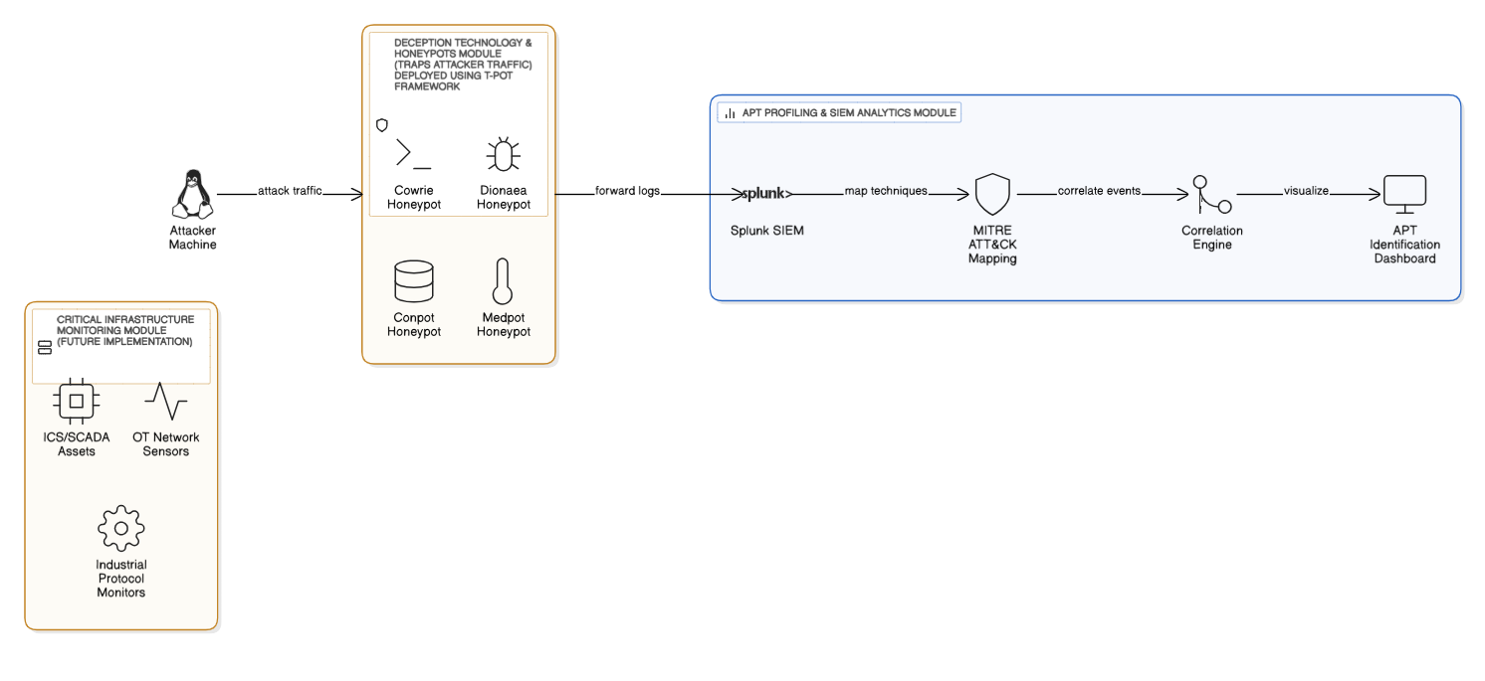
TIFAC – CORE in CYBER SECURITY
System Architecture
20CYS 495 B.Tech CYS: 2022 - 2026 Project Presentation
7

Slide 8
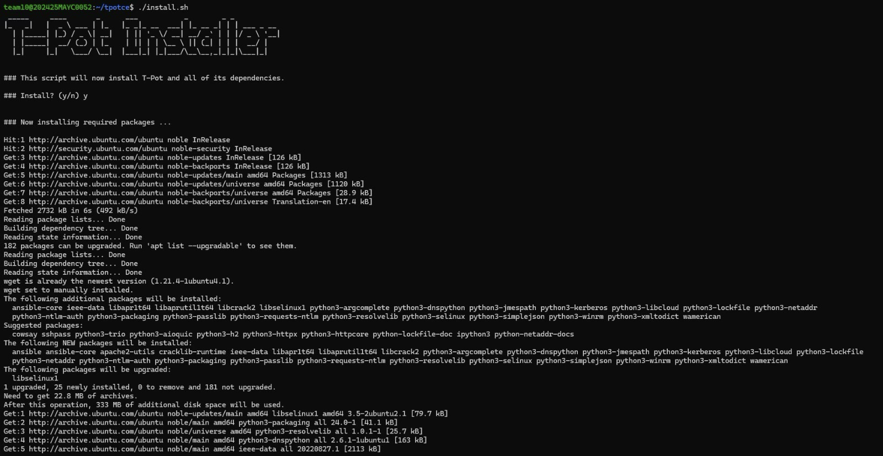
TIFAC – CORE in CYBER SECURITY
Implementation & Results
Deployed T-Pot CE on Ubuntu (via Docker).
The installation of T-Pot, a multi-honeypot framework that brings together several honeypot services into a single environment. During this step, the installation script sets up all the required dependencies such as Python libraries, ensuring the system can support and manage honeypots inside Docker containers.
20CYS 495 B.Tech CYS: 2022 - 2026 Project Presentation
8

Slide 9
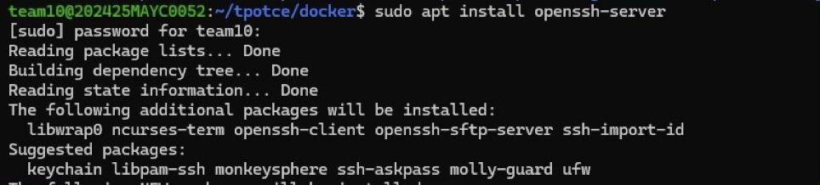
TIFAC – CORE in CYBER SECURITY
we install the OpenSSH Server on the machine. This setup is essential for enabling secure remote access and for simulating SSH services within our environment. Since SSH is one of the most commonly targeted services by attackers through brute-force attempts, including it in our honeypot setup makes the environment more realistic and effective in attracting malicious activity.
20CYS 495 B.Tech CYS: 2022 - 2026 Project Presentation
9

Slide 10
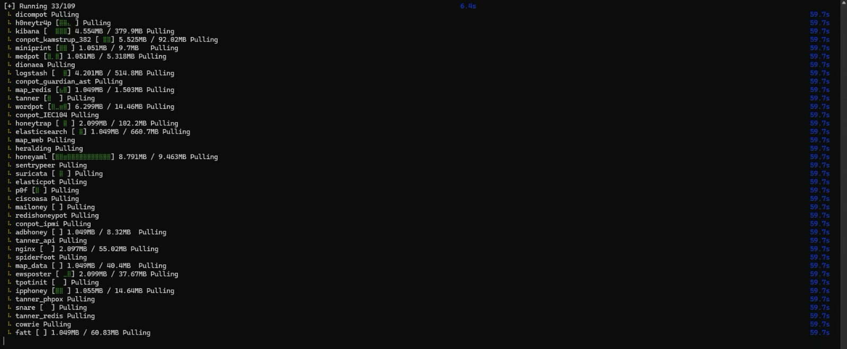
TIFAC – CORE in CYBER SECURITY
Docker pull process where multiple honeypot images such as Cowrie, Dionaea, Conpot, Suricata, and Honeytrap are being downloaded. Each honeypot simulates different services like SSH, web, or industrial control systems. Once pulled, these images can be deployed as containers to create a diverse deception environment for capturing attacker behavior.
20CYS 495 B.Tech CYS: 2022 - 2026 Project Presentation
10

Slide 11
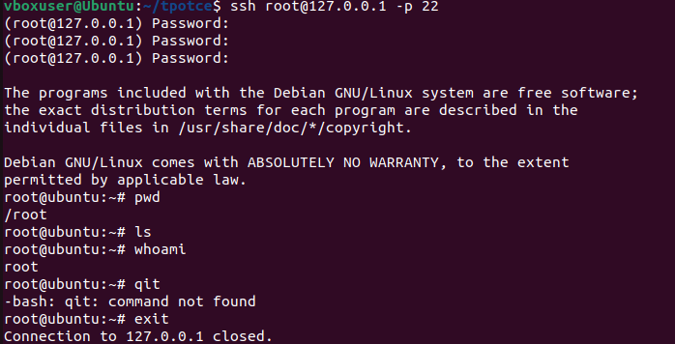
TIFAC – CORE in CYBER SECURITY
Running Cowrie honeypot (for ssh attacks)
The image shows an attacker gaining unauthorized access to the system via SSH after performing a brute-force attack.
After successfully logging in as the root user, the attacker starts initial reconnaissance on the compromised machine.
Commands such as pwd, ls, and whoami are executed to understand the system’s directory structure and confirm the attacker’s privileges.
This activity represents the beginning of the attacker’s post-exploitation phase on the target host.
20CYS 495 B.Tech CYS: 2022 - 2026 Project Presentation
11

Slide 12
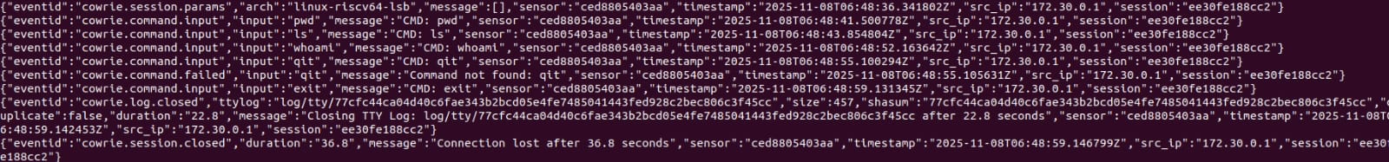
TIFAC – CORE in CYBER SECURITY
Running Cowrie honeypot (for ssh attacks)
The image shows the logs captured by the Cowrie honeypot during the attacker’s SSH session.
Cowrie records every command the attacker enters, including both successful and failed inputs.
The logs include session parameters, timestamps, source IP address, and sensor details.
This information helps analysts understand the attacker’s actions and behavior inside the honeypot environment.
Such logs are crucial for reconstructing the attack flow and identifying patterns or intentions.
20CYS 495 B.Tech CYS: 2022 - 2026 Project Presentation
12

Slide 13
TIFAC – CORE in CYBER SECURITY
Collecting T-POT Logs and Sending Them to Splunk
Collected all logs generated by the T-POT honeypot, especially from the Cowrie service.
Cowrie records attacker behaviour, such as:
Login attempt
Command typed
Attacker IP addresses
Session details
Accessed the location where T-POT stores its logs and opened the main log file: cowrie.json
This file contains raw attacker activity, which must be sent to Splunk for visualization and APT monitoring.
20CYS 495 B.Tech CYS: 2022 - 2026 Project Presentation
13

Slide 14
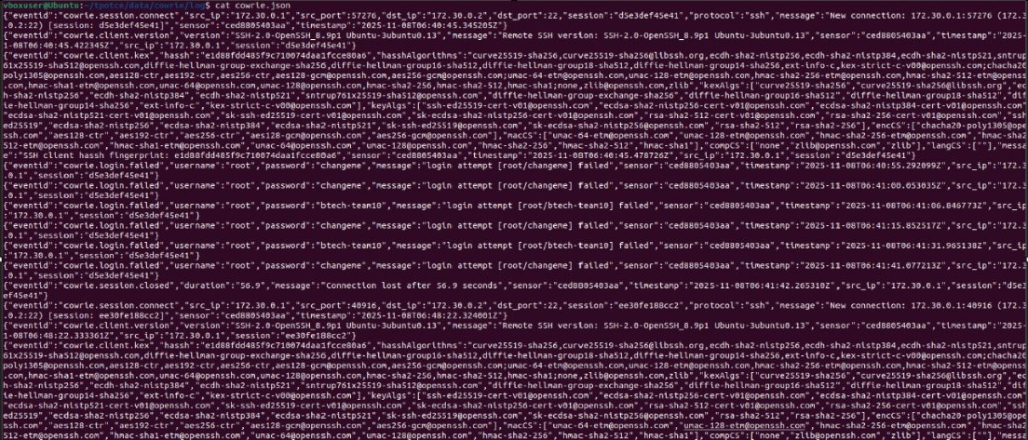
TIFAC – CORE in CYBER SECURITY
20CYS 495 B.Tech CYS: 2022 - 2026 Project Presentation
14

Slide 15
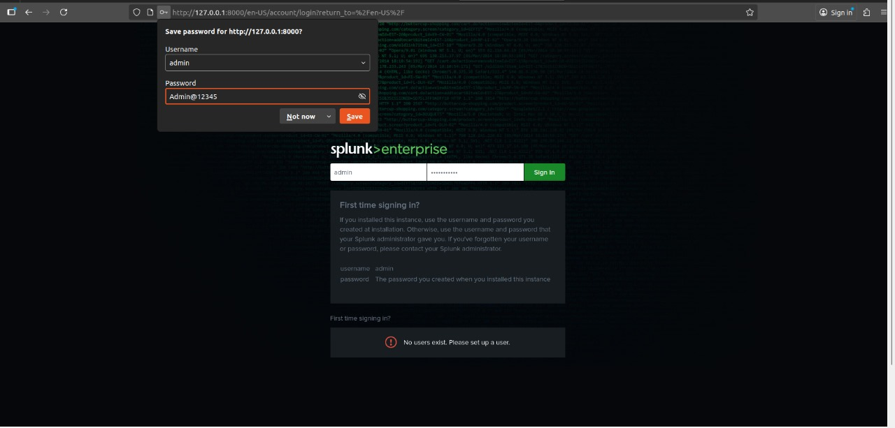
TIFAC – CORE in CYBER SECURITY
Splunk Log Ingestion & APT Activity Analysis:
After collecting the logs from T-POT, the next step is to upload them into Splunk Enterprise for analysis. Then logged into Splunk using the local web interface.
Splunk automatically detected the log format (JSON) and extracted important fields.
20CYS 495 B.Tech CYS: 2022 - 2026 Project Presentation
15

Slide 16
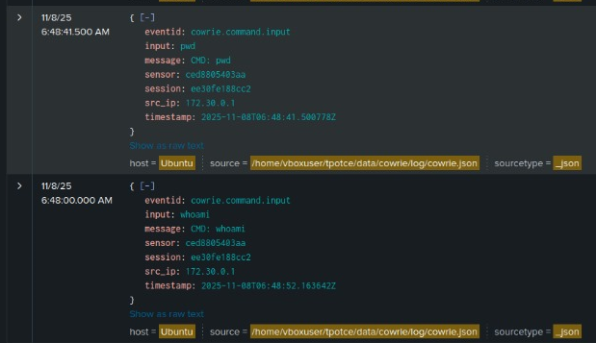
TIFAC – CORE in CYBER SECURITY
Splunk displayed attacker activity clearly, including:
command inputs (pwd, whoami, exit)
multiple failed login attempts
repeated connections from the same IP
These patterns help identify APT-like behaviour, such as repeated intrusion attempts, system exploration, and persistent attacker activity.
20CYS 495 B.Tech CYS: 2022 - 2026 Project Presentation
16

Slide 17
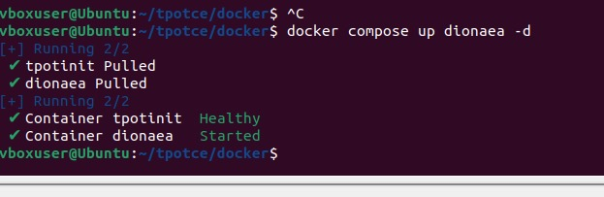
TIFAC – CORE in CYBER SECURITY
Dionaea is a low-interaction malware-capturing honeypot designed to:
Attract attackers
Emulate vulnerable network services
Capture malware payloads
Log exploitation attempts
It is one of the most widely used modules inside
T-Pot, because it focuses specifically on malware collection and exploit detection.
Dionaea imitates vulnerabilities found in real systems, tricking attackers into delivering their malware samples or exploit attempts.
All of these events get forwarded to our Splunk/MITRE dashboard for analysis.
20CYS 495 B.Tech CYS: 2022 - 2026 Project Presentation
17

Slide 18
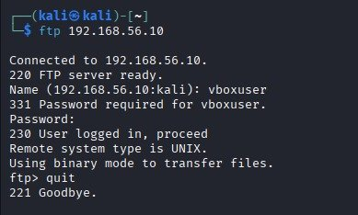
TIFAC – CORE in CYBER SECURITY
Dionaea emulates an FTP (File Transfer Protocol) server. Attackers often target FTP because:
Many systems run old or misconfigured FTP services
FTP may allow anonymous login
Weak credentials (admin/admin, user/password) are common
FTP allows file upload and download — perfect for malware delivery
So Dionaea exposes a fake FTP service to attract these attackers and record everything they do.
Here :
The FTP service is exposed.
Attackers can log in.
Dionaea will record brute force and credential attempts.
20CYS 495 B.Tech CYS: 2022 - 2026 Project Presentation
18

Slide 19
TIFAC – CORE in CYBER SECURITY
mitre_rules.csv
pattern,MITRE_Tactic,Technique_ID,Technique_Name,Likely_APT_Group "\\bnmap\\b|\\bmasscan\\b","Discovery","T1046","Network Service Scanning","Unknown" "\\bwget\\b|\\bcurl\\b","Execution","T1059","Command and Scripting Interpreter","APT29;Lazarus" "\\bnc -e\\b|\\bnetcat\\b|bash -i","Command and Control","T1071.001","Application Layer C2","Unknown" "\\bchmod \\+x\\b|\\bchown\\b","Privilege Escalation","T1222","Modify File/Permissions","Unknown"
"\\badduser\\b|\\buseradd\\b|usermod","Persistence","T1136","Create Account","FIN7" "\\/etc\\/passwd|\\/etc\\/shadow","Discovery","T1083","File and Directory Discovery","Unknown" "\\/wp-login\\.php|wp-login","Initial Access","T1078","Valid Accounts / Brute Force","Unknown" "rm -rf|dd if=","Impact","T1485","Data Destruction","Lazarus" "base64 .* -d|base64 -d|\\bbase64
\\b.*\\|.*bash","Defense Evasion","T1027","Obfuscated Files or Information","Equation Group" "Downloaded file from|dionaea.download|file_hash","Command/Transfer","T1105","Ingress Tool Transfer","APT41" "\\bssh\\b|failed login|invalid password","Initial Access","T1110","Brute Force","APT28;APT33"
20CYS 495 B.Tech CYS: 2022 - 2026 Project Presentation
19

Slide 20
TIFAC – CORE in CYBER SECURITY
The MITRE ATT&CK rule set used in this project focuses only on a selected set of techniques and APT groups because the detections are designed to match the actual behaviour observed in the deployed honeypots.
Honeypots such as Cowrie, Dionaea, and web decoy services generate logs related to activities like brute-force login attempts, file downloads, malware transfer, command execution, privilege escalation, and reconnaissance.
These events correspond to only a subset of MITRE ATT&CK techniques, making it inaccurate and misleading to include the full matrix of 200+ techniques or map them to all known APT groups.
Instead, the rule set concentrates on the techniques that the honeypot can realistically observe and ties them to APT groups known to commonly use those behaviours.
This ensures the classification is evidence-based, accurate, scalable, and defensible, rather than theoretical or overly generalized.
20CYS 495 B.Tech CYS: 2022 - 2026 Project Presentation
20

Slide 21
TIFAC – CORE in CYBER SECURITY
What Attacks does this rules detect
MITRE ATT&CK Tactic | Technique ID | Pattern Detected in Rule | Meaning / Attack Type
Initial Access | T1078 / T1110 | URLs containing /login, /ssh | Brute force or credential attempts against login endpoints (typical for SSH honeypots).
Execution | T1059 / T1105 | Commands with wget, curl, nc, netcat | Remote file downloads or reverse shell commands — attacker trying to pull malicious scripts or open shells.
Persistence | T1136 | adduser, useradd | Attacker trying to create a new local user for persistence.
Privilege Escalation | T1222 | chmod, chown | Permission or ownership modification — possible privilege escalation attempt.
Discovery | T1083 | URLs referencing /etc/passwd, /shadow | File discovery or credential dumping attempts.
Impact | T1485 | rm -rf, dd if= | Destructive behavior like deleting system files or overwriting data.
Command and Control (C2) | T1071 / T1105 | Same as wget, curl | Communication to remote servers to receive further commands.
20CYS 495 B.Tech CYS: 2022 - 2026 Project Presentation
21

Slide 22
TIFAC – CORE in CYBER SECURITY
Algorithm: Honeypot Log Classification Using MITRE ATT&CK Rules
1. START
2. Load MITRE Rule Base
Initialize RuleList as empty list
Open "mitre_rules.csv"
For each row in CSV:
Create Rule with:
pattern ← row["pattern"]
mitre_tactic ← row["MITRE_Tactic"]
technique_id ← row["Technique_ID"]
technique_name ← row["Technique_Name"]
apt_group ← row["Likely_APT_Group"]
Add Rule to RuleList
End For
3. Load Honeypot Log Events
Initialize EventList as empty list
Open honeypot log file or input stream
For each line in the log:
Parse line as JSON → Event
Add Event to EventList
End For
4. Normalize Event Text
Define function ExtractText(Event):
If Event contains "command" and it is not empty:
text ← Event["command"]
Else if Event contains "url" and it is not empty:
text ← Event["url"]
Else:
text ← Event["_raw"]
Convert text to lowercase
Return text
End Function
​
5. Match Event Against MITRE Rules​
Define function ClassifyEvent(Event, RuleList):​
text ← ExtractText(Event)​
For each Rule in RuleList:​
If text matches Rule.pattern using regex:​
Event["MITRE_Tactic"] ← Rule.mitre_tactic​
Event["Technique_ID"] ← Rule.technique_id​
Event["Technique_Name"] ← Rule.technique_name​
Event["Likely_APT_Group"] ← Rule.apt_group​
Event["Matched_Pattern"] ← Rule.pattern​
Return Event // First matched rule is applied​
End For​
// No rule matched​
Event["MITRE_Tactic"] ← "Unclassified"​
Event["Technique_ID"] ← "-"​
Event["Technique_Name"] ← "-"​
Event["Likely_APT_Group"] ← "Unknown"​
Event["Matched_Pattern"] ← "None"​
Return Event​
End Function​
​
6. Process All Events​
Initialize ClassifiedEvents as empty list​
For each Event in EventList:​
ClassifiedEvent ← ClassifyEvent(Event, RuleList)​
Add ClassifiedEvent to ClassifiedEvents​
End For​
​
7. Output Classified Events​
For each ClassifiedEvent in ClassifiedEvents:​
Convert event to JSON or desired output format​
Print or store or send to SIEM (e.g., Splunk)​
End For​
​
20CYS 495 B.Tech CYS: 2022 - 2026 Project Presentation
22

Slide 23
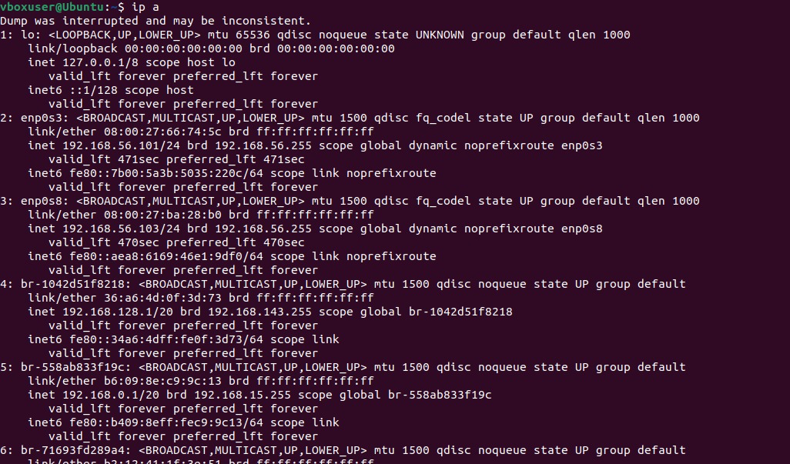
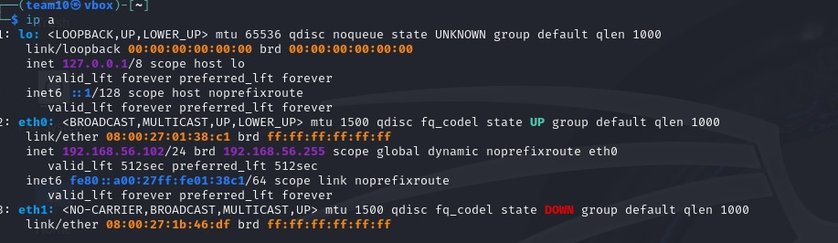
TIFAC – CORE in CYBER SECURITY
Generated APT-style attacks from Kali Linux.
Attack Simulation Setup
To begin our simulation, we set up two virtual machines:
Target VM: This is our T-Pot honeypot server which is listening on IPs 192.168.56.101and 192.168.56.103.
Attacker VM: This is our Kali Linux machine with the IP address 192.168.56.102.
The following attacks will be launched from the Kali machine to the T-Pot server."
20CYS 495 B.Tech CYS: 2022 - 2026 Project Presentation
23

Slide 24
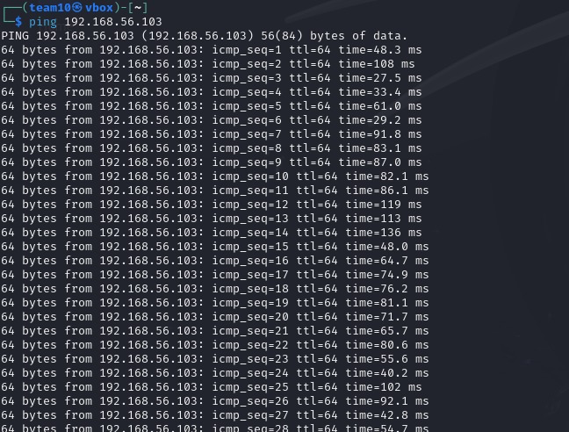
TIFAC – CORE in CYBER SECURITY
Phase 1: Reconnaissance & Scanning
we ran a ping test from our Kali machine to the T-Pot server. The successful replies in the first screenshot confirmed that the honeypot was online and reachable on the network.
This step confirm our target exists and we have a network path to it. If this failed, we'd know a firewall was blocking us or the machine was offline.
20CYS 495 B.Tech CYS: 2022 - 2026 Project Presentation
24

Slide 25
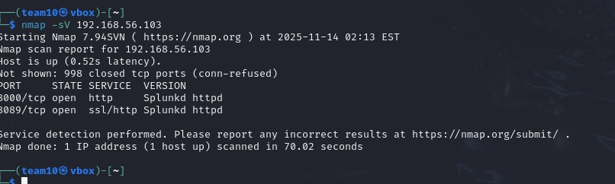
TIFAC – CORE in CYBER SECURITY
After confirming the target was live, we ran an nmap -sV 192.168.56.103 scan. This command scans the target for open ports (-sV also identifies the specific service and version running).
Our Findings
The Nmap scan revealed a very specific attack surface. Instead of finding common ports like SSH (22) or FTP (21), we found:
Port 8000 (Open): Running an HTTP service identified as "Splunkd".
Port 8089 (Open): Running an SSL/HTTP service, also identified as "Splunkd".
20CYS 495 B.Tech CYS: 2022 - 2026 Project Presentation
25

Slide 26
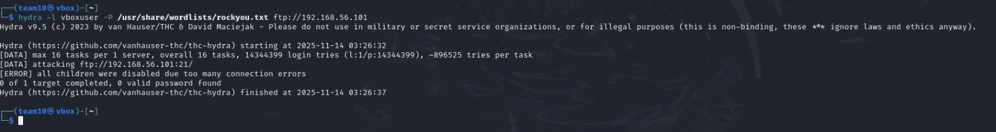
TIFAC – CORE in CYBER SECURITY
Phase 2: Attack Execution & Honeypot Defense
After our reconnaissance, we launched a direct brute-force attack from our Kali machine.
Tool: We used hydra, a very common tool for password cracking.
Target: We attacked the FTP service on the honeypot.
Method: The command attempts to log in as the user vboxuser by trying thousands of different passwords from the famous rockyou.txt wordlist.
The Result: A Successful Defense
20CYS 495 B.Tech CYS: 2022 - 2026 Project Presentation
26

Slide 27
TIFAC – CORE in CYBER SECURITY
Individual Contributions
Team Member | Contribution
Chitla Vyshali | Configured a Kali Linux machine to simulate APT-style attacks against our T-Pot honeypot using tools like Nmap and Hydra.
Dharshika S | Created Splunk SIEM rules and MITRE ATT&CK mapping logic Explored Dionaea Honeypot Established connections between Kali and T-pot and tried attacks.
Reddicherla Thanuj | Configured T-Pot CE, managed Docker environment, integrated honeypots (Cowrie)
Mothe Anurag Reddy | Gathering T-POT logs, forwarding them to Splunk, and created dashboards that highlight APT activity.
20CYS 495 B.Tech CYS: 2022 - 2026 Project Presentation
27

Slide 28
Discussion & Analysis
Strengths:
Real-world APT simulation environment.
Integrated multi-honeypot and SIEM framework.
MITRE ATT&CK-based detection ensures standard mapping.
Modular and scalable (add more honeypots easily).
Limitations/Challenges:
Limited to network-based APT stages.
Requires manual Splunk configuration for new rules.
High resource usage due to multiple containers.
How It Improves Cybersecurity:
Enhances early-stage APT detection.
Reduces incident response time.
Provides security analysts with actionable intelligence.
TIFAC – CORE in CYBER SECURITY
20CYS 495 B.Tech CYS: 2022 - 2026 Project Presentation
28

Slide 29
TIFAC – CORE in CYBER SECURITY
Conclusion & Future Work
Summary of Achievements:
Installed and configured the T-Pot honeypot environment.
Deployed and tested some honeypots such as Cowrie and Dionaea.
Configured log storage for honeypot activity, which will store logs in JSON format.
Forwarded collected honeypot logs to Splunk for visualization and analysis.
Created Splunk SIEM rules and implemented MITRE ATT&CK–based mapping logic for the honeypots tested.
Established attacker–victim connectivity between Kali and T-Pot for controlled testing.
Simulated APT-style attacks using tools like Nmap and Hydra to evaluate honeypot effectiveness.
20CYS 495 B.Tech CYS: 2022 - 2026 Project Presentation
29

Slide 30
TIFAC – CORE in CYBER SECURITY
Future Enhancement:
Integrate the honeypot setup with critical infrastructure environments for more realistic testing.
Deploy and experiment with additional honeypots beyond the ones currently tested.
Enhance and expand the MITRE ATT&CK–based mapping logic to support more honeypots and attack techniques.
20CYS 495 B.Tech CYS: 2022 - 2026 Project Presentation
30

Slide 31
TIFAC – CORE in CYBER SECURITY
Real-world Deployment Possibilities:
Deployment in enterprise SOC environments for proactive threat detection.
Integration with existing SIEM pipelines such as Splunk or ELK for centralized monitoring.
Use in educational cybersecurity labs to support APT awareness and hands-on training.
20CYS 495 B.Tech CYS: 2022 - 2026 Project Presentation
31

Slide 32
TIFAC – CORE in CYBER SECURITY
References
MITRE ATT&CK Framework — https://attack.mitre.org2
Splunk Docs – https://docs.splunk.com
3.T-Pot Community Edition – https://github.com/telekom-security/tpotce
4.Kali Linux Documentation – https://www.kali.org/docs/
5. Bartwal, U., Mukhopadhyay, S., Negi, R., Shukla, S. (2022). Security orches-tration, automation, and response engine for deployment of behavioural honey-pots. 2022 IEEE Conference on Dependable and Secure Computing (DSC), 1–8.https://doi.org/10.1109/dsc54232.2022.9888808
6. P.V. Sai Charan, Mukhopadhyay, S., Manna, S., Rani, N., Vaid, A., HrushikeshChunduri, P. Mohan Anand, Sandeep Kumar Shukla. (2024). ADAPT: Adap-tive Camouflage Based Deception Orchestration For Trapping Advanced PersistentThreats. Digital Threats. https://doi.org/10.1145/3651991
7. Harikrishnan, V. N., Kumar, G. T. (2018). Advanced persistent threat analysis usingSplunk. International Journal of Pure and Applied Mathematics, 118(20), 3761-3768
8. Malik, V., Khanna, A., Sharma, N., Suryaprakash nalluri. (2024). AdvancedPersistent Threats (APTs): Detection Techniques and Mitigation Strategies.https://doi.org/10.21428/e90189c8.91e89a3e
9. Xuan, C. D., Huong, D., Duong, D. (2022). New approach for APT malware de-tection on the workstation based on process profile. Journal of Intelligent FuzzySystems, 43(4), 4815–4834. https://doi.org/10.3233/jifs-212880
20CYS 495 B.Tech CYS: 2022 - 2026 Project Presentation
32

Slide 33
TIFAC – CORE in CYBER SECURITY
Thank You !!
20CYS 495 B.Tech CYS: 2022 - 2026 Project Presentation
33

