Slide 1

TIFAC – CORE in CYBER SECURITY
20CYS495 Project Phase I
Group 10
Project Title : Deception Technology for APT Detection in Critical Infrastructure
Domain: Threat Intelligence & APT Research
Guide Name: Sreejith K
Sl.No | Student Name | Roll No
1 | Chitla Vyshali | CB.EN.U4CYS22017
2 | Dharshika S | CB.EN.U4CYS22021
3 | Reddicherla Thanuj | CB.EN.U4CYS22056
4 | Mothe Anurag Reddy | CB.EN.U4CYS22069

Slide 2
TIFAC – CORE in CYBER SECURITY
Problem Statement
Critical infrastructure environments are prime targets for Advanced Persistent Threats (APTs) that specialize in bypassing traditional, signature-based security controls. The core problem is that once inside a network, these adversaries use stealthy tactics, techniques, and procedures (TTPs) for lateral movement, privilege escalation, and data exfiltration that are nearly indistinguishable from legitimate activity. This leads to a critical detection gap, allowing attackers to operate with prolonged dwell times and significantly increasing the risk of major data breaches and service disruption. As a result, security teams are often overwhelmed by a high volume of low-confidence alerts, which masks genuine threats and impedes effective incident response. This project confronts this challenge by implementing a proactive deception framework engineered to generate high-fidelity, context-rich alerts on malicious activity, providing the clear intelligence required for rapid threat neutralization.
:

Slide 3
TIFAC – CORE in CYBER SECURITY
Motivation and significance of solving this problem
Our motivation is to detect stealthy, long-term APTs that evade standard defenses. We chose a rich deception platform over basic honeypots to emulate realistic credentials, file shares, and AD[Active Directory] objects. This controlled environment safely reveals attacker tactics like lateral movement, privilege escalation, and data exfiltration. Aggregating alerts in Splunk and mapping to MITRE ATT&CK provides real-time visibility, validates coverage, and offers enterprises a practical behavior-based defense model.
The significance of this work lies in delivering a behavior-based defense model that not only advances academic understanding of deception technologies but also provides enterprises with a clear, actionable strategy to strengthen their security posture.

Slide 4
TIFAC – CORE in CYBER SECURITY
We are developing a :
Product: We are developing a new framework/solution. Our project integrates existing technologies (deception platforms, SIEM, red-team tools) to create a novel and comprehensive security capability.
Useful for: Enterprises. The focus on APTs, critical infrastructure, and the complexity of the tools we are using (Splunk, Cobalt Strike) make this solution ideal for large organizations with mature security teams.
Offensive/Defensive Security: Defensive Security. Although we use offensive tools to simulate attacks, our project's primary goal is to build a system that detects and defends against threats. We are implementing an "Active Defense" strategy.
Hardware required / Software only: Hardware required. Our solution requires servers (physical or virtual) to host the deception environment, the Splunk instance, and the various testing tools we will be using.
Linux / Windows / Android: Linux & Windows. Our deception environment will need to include Windows systems to be a realistic target (e.g., for Active Directory decoys). The attack simulation and monitoring tools our team will use are often run from Linux-based systems.

Slide 5
TIFAC – CORE in CYBER SECURITY
Literature Survey
Paper Name | Publication Year | Journal Published | Similarities | Challenges
Advanced Persistent Threat Analysis using Splunk | 2018 | International Journal of Pure and Applied Mathematics | Addressing the challenge of APT detection through a Splunk. | Detection is challenged by stealth, honeypot, and exfiltration.
Advance Persistent Threat Detection Using Long Short Term Memory (LSTM) Neural Networks | 2019 |  | Leverage Splunk SIEM logs to detect stealthy APT activity | Filtering massive, unstructured SIEM logs to pinpoint stealthy APT activity
ADAPT: Adaptive Camouflage-based Deception Orchestration For Trapping Advanced Persistent Threats | 2024 | Journal of ACM | Providing a realistic environment where attackers can execute a complete attack chain | Complex network orchestration and the significant expertise required for implementation and maintenance
Advanced Persistent Threats (APTs): Detection Techniques and Mitigation Strategies | 2024 | International Journal of Global Innovations and Solutions (IJGIS) | APT detection and mitigation require a multi-layered, AI-driven, behavior-focused approach rooted in continuous monitoring, Zero Trust, and lifecycle awareness. | stealthy APT behavior, difficulty in attribution, evolving attack techniques, and the shortage of skilled cybersecurity professionals.

Slide 6
TIFAC – CORE in CYBER SECURITY
Project Objective
Build a deception environment
Set up fake credentials, decoy file shares, bogus Active Directory objects and stand-alone decoy systems.
APT attack simulations
Use red-team tools (Cobalt Strike/Empire/Metasploit) to see how an attacker interacts with your decoys.
Feed all deception logs into Splunk
Forward every triggered event from your fake assets into a central SIEM for full visibility.
Create Splunk dashboards & alerts
– Detect lateral moves using dummy credentials or decoy sessions
– Spot privilege-escalation attempts on fake admin accounts
– Watch for exfiltration via honeyfiles or fake shares
– Flag persistence actions (scheduled tasks, services, registry tweaks)

Slide 7
TIFAC – CORE in CYBER SECURITY
Project Objective
Map detections to MITRE ATT&CK
Tie observed attacker steps back to ATT&CK techniques to check your coverage at each stage.
Measure deception effectiveness
Track metrics like time-to-detect, number of decoys triggered, attacker dwell time, depth of engagement, and false vs. true positives.

Slide 8
TIFAC – CORE in CYBER SECURITY
Research Questions
RQ1: How effective are our decoy assets (fake credentials, file shares, AD objects, standalone systems) at engaging APT tools?
RQ2: Which attacker TTPs interact with the deception environment during Cobalt Strike/Empire/Metasploit simulations?
RQ3: How reliably and with what latency are deception-triggered events forwarded into Splunk?
RQ4: How accurately do custom Splunk dashboards and alerts detect lateral movement, privilege escalation, exfiltration, and persistence?
RQ5: How complete is our coverage of MITRE ATT&CK techniques based on detected deception events?
RQ6: Which metrics most meaningfully assess overall deception effectiveness?

Slide 9
TIFAC – CORE in CYBER SECURITY
Honeypot Vs Deception Tech
Honeypot | Deception Tech
Deploying and maintaining a honeypot is a manually intensive process which can be a long and time-consuming process. It can be costly and complex to deploy | Deploying and maintaining deception tech solutions is quite an automated process and requires comparatively less human effort.
Generally deployed in highly targeted areas of a network where they are most likely to attract cyber attackers like a database of a financial service. | Modern deception solutions can mimic servers, applications, an endpoint device, and IoT devices. They can emulate just about anything.
Offers limited integration capabilities into enterprise security infrastructure as it is deployed as a stand-alone system. | Seamlessly integrates with modern cybersecurity tools such as security information and event management (SIEM) and security information and event management (SOAR).

Slide 10
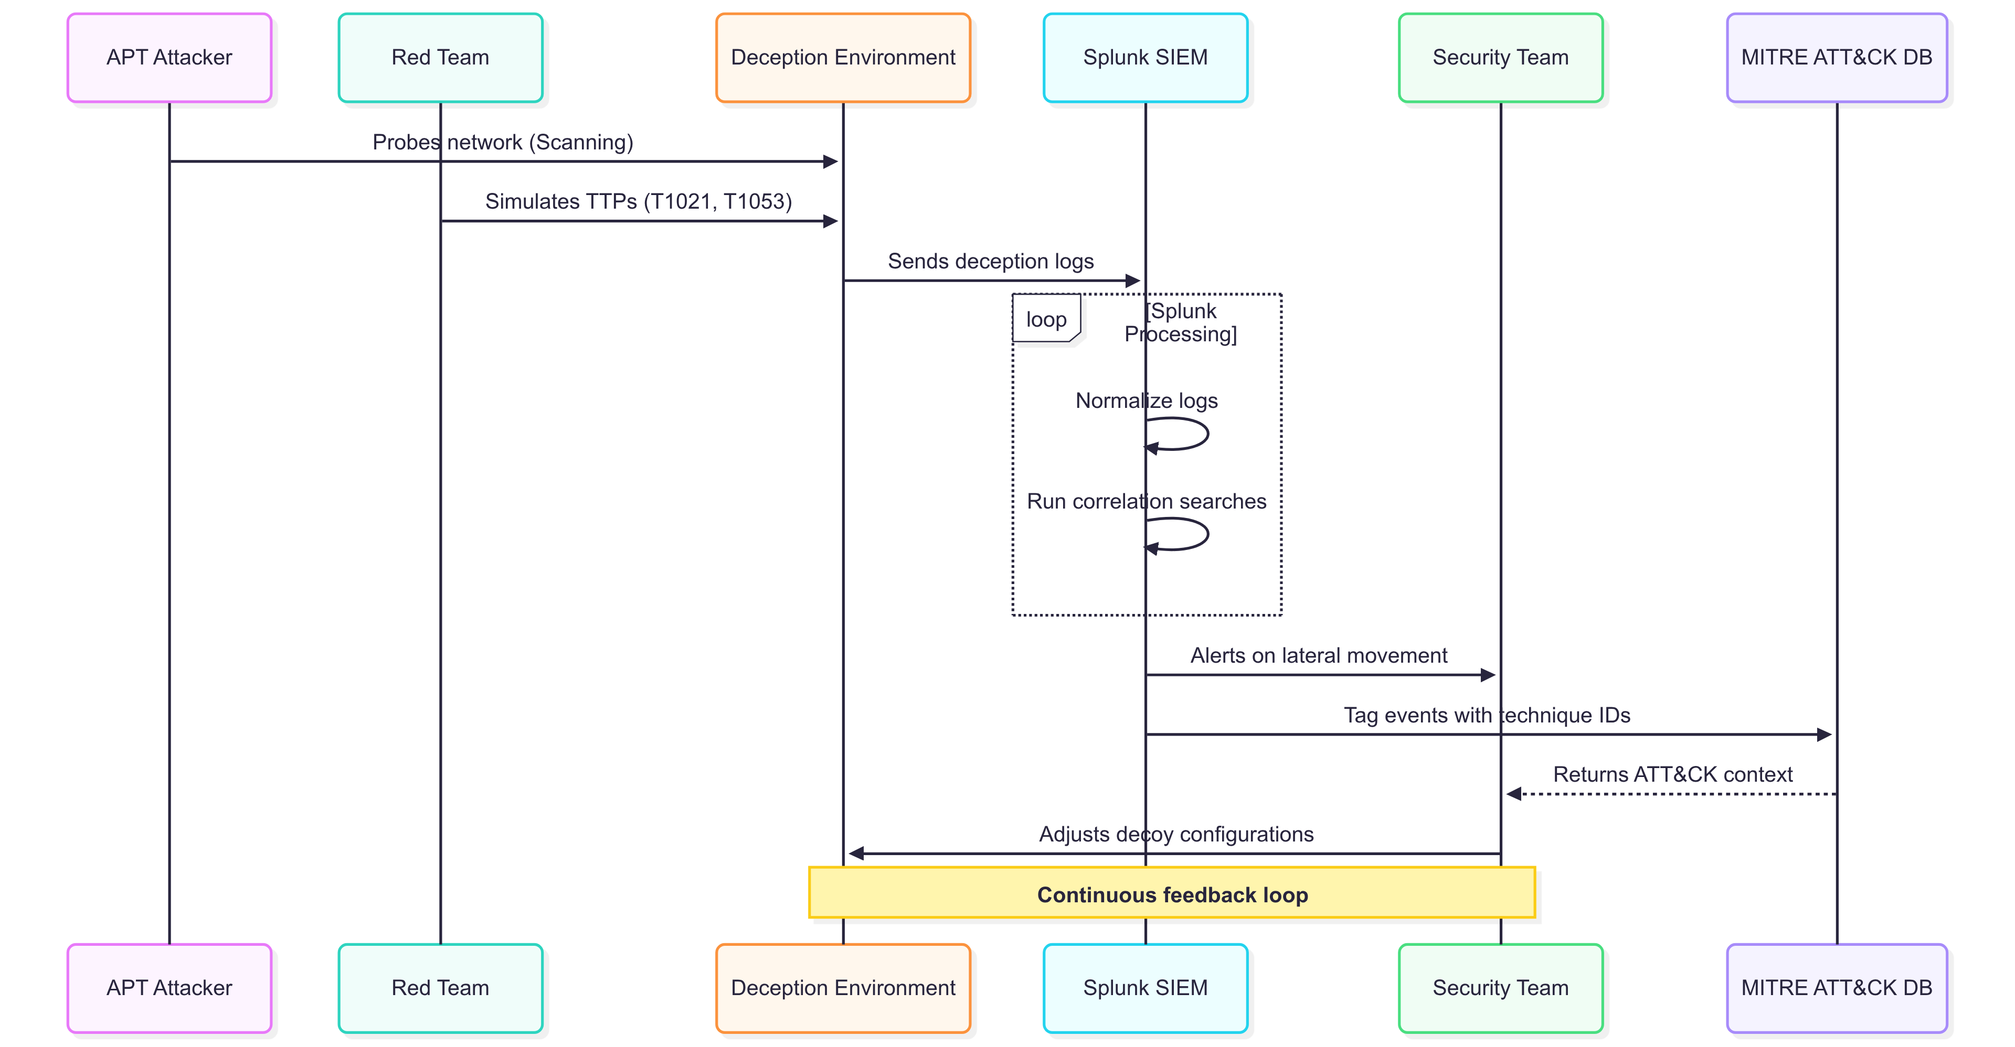
TIFAC – CORE in CYBER SECURITY

Slide 11
TIFAC – CORE in CYBER SECURITY
Tools, Methodologies, and Technologies
Tools:
VMs: (VMware/Hyper-V) Spin up pretend servers.
Active Directory Users & Computers: Create fake user accounts/OUs.
Honeytoken scripts: Plant dummy passwords or shares.
Red-team tools (Cobalt Strike/Metasploit): Simulate attacker moves.
SIEM (Splunk): Capture and review every alert.

Slide 12
TIFAC – CORE in CYBER SECURITY
Methodologies
Craft Deceptive Assets
Deploy decoy servers, accounts and file shares with production-grade names and behaviors to blend into your environment.
Conduct Simulated Intrusions:
Utilize red-team frameworks to mimic real-world adversary actions—credential theft, lateral moves, privilege escalation and persistence—against your traps.
Aggregate & Classify Logs:
Centralize every decoy alert in your SIEM and systematically tag events for expedited investigation.
Engineer Precise Alerts:
Build focused Splunk searches and dashboards to catch lateral movement, exfiltration via honeyfiles, and registry or scheduled-task changes.
Align with MITRE ATT&CK:
Assign each detection its corresponding ATT&CK technique ID and regularly audit a coverage matrix to close visibility gaps.

Slide 13
TIFAC – CORE in CYBER SECURITY
Metrics-Driven Iteration
Regularly review time-to-detect, decoy-trigger counts, attacker dwell time and false/true positives to fine-tune decoys and alerts.
Technologies
Windows Event Forwarding & Sysmon on honeypots to capture process, registry and file-access events
Syslog/Beats to ship Linux honeypot logs into Splunk
PowerShell & Bash Automation for provisioning, rotating honeytokens and updating decoy configurations
Splunk Dashboards, Saved Searches & Alerts to visualize attacker interactions in real time
Summary Indexes & Reports for efficient storage and charting of KPIs without overloading core indexes

Slide 14
Configured VMs
Records of Adversarial interactions
Mapped list of detected events
Detection Framework
Performance Metrices
Report of Splunk Configuration in accordance with the project
TIFAC – CORE in CYBER SECURITY
Deliverables :

Slide 15
TIFAC – CORE in CYBER SECURITY
Comprehensive 8-Month Project Plan (July 2025 to February 2026)
Phase | Timeline | Key Activities | Major Milestone / Deliverable
1. Foundation & Core Setup | July – Aug 2025 | Research and design the lab architecture and deception strategy. Set up the core infrastructure and install all necessary software. | Core infrastructure and software installed and running.
2. Deception Build-Out & Integration | Sept – Oct 2025 | Deploy decoy assets (AD, credentials, shares) and integrate all logs into Splunk. Verify the data pipeline and prepare for the initial project demonstration. | First Project Demo: Successful proof-of-concept of the core detection pipeline.
3. Advanced Simulation & Analytics | Nov – Dec 2025 | Execute APT attack simulations and develop Splunk dashboards. Map detected TTPs to the MITRE ATT&CK framework. | Functional Splunk dashboards and initial MITRE ATT&CK mapping complete.
4. Measurement, Finalization & Delivery | Jan – Feb 2026 | Analyze data to measure effectiveness metrics and conduct final testing. Complete all project documentation and prepare for the final delivery. | Final Delivery: A fully functional lab, comprehensive report, and final presentation.

Slide 16
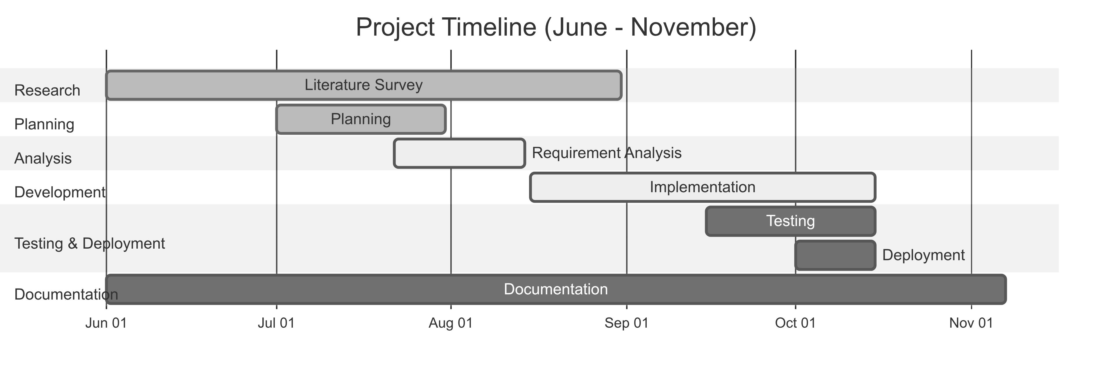
TIFAC – CORE in CYBER SECURITY

Slide 17
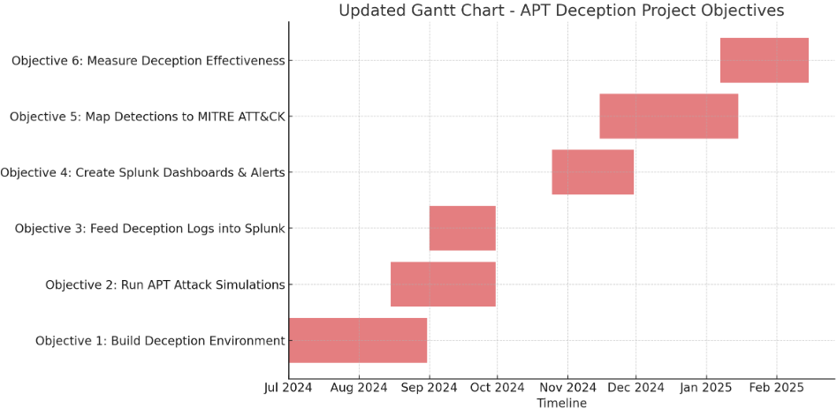
TIFAC – CORE in CYBER SECURITY

Slide 18
TIFAC – CORE in CYBER SECURITY
Individual Work Log
Task | Progress | Name
Literature survey | Completed | Chitla Vyshali
Literature survey | Completed | Dharshika S
Literature survey | Completed | Thanuj R
Literature survey | Completed | M Anurag Reddy

Slide 19
TIFAC – CORE in CYBER SECURITY
Technical Challenges and Mitigation Strategies
Decoy Detection: Sophisticated attackers have in-depth knowledge of deception technologies and can often identify a fake environment
Mitigation: design and deploy a honeynet that replicates the entire operational mode of an organization, not just a single fake machine
False Positives: Alerts from normal scans Mitigation: Refining alert rules and whitelisting legitimate processes," such as automatic OS updates and driver downloads that were triggering spurious notifications

Slide 20
TIFAC – CORE in CYBER SECURITY
Plan for the next 3 weeks
Over the next three weeks, our team will focus on building the foundation for the project. We will begin by researching and selecting the specific technologies and tools for our environment, then set up the necessary virtual machines and network infrastructure. Finally, we will install the core software components like Splunk and our chosen attack simulation tools, ensuring everything is ready for the implementation phase.
Planned tasks
Chitla Vyshali - Research and compare at least two deception technology platforms and recommend one + Literature Survey
Dharshika - Download the Splunk Enterprise trial + Literature Survey
Set up a dedicated VM placeholder for the Splunk installation.
Thanuj R - Define the lab architecture and Research on Metasploitable tools + Literature Survey
M Anurag Reddy - Research and compare at least two deception technology platforms and recommend one + Literature Survey

Slide 21
TIFAC – CORE in CYBER SECURITY
References
Literature Survey :
Harikrishnan, V. N., & Kumar, G. T. (2018). Advanced persistent threat analysis using Splunk. International Journal of Pure and Applied Mathematics, 118(20), 3761-3768.
Putrevu, V. S. C., Mukhopadhyay, S., Manna, S., Rani, N., Vaid, A., Chunduri, H., Putrevu, M. A., & Shukla, S. (2024). ADAPT: Adaptive camouflage based deception orchestration for trapping advanced persistent threats. Digital Threats Research and Practice, 5(3), 1–35. https://doi.org/10.1145/3651991
https://fidelissecurity.com/cybersecurity-101/deception/honeypot-vs-deception/

