Slide 1
Practice Kickoff
December 8th, 2012

Slide 2
Introduction
Why are we here?

Slide 3
Goals
Simulate a kickoff
Practice creativity, brainstorming, and design
Learn what works, and what doesn’t work

Slide 4
Other news
2013 competition
Pasta Feed

Slide 5
Schedule
What are we doing today?

Slide 6
Schedule
12:00
Food, info on 2013 competition and pasta feed
Go over 2009 competition
12:20
Break into smaller teams
Come up with strategies and priorities
12:50
All teams present strategies and priorities
The team comes up with a strategy and priorities we all agree on

Slide 7
Schedule: design
1:20
Break into small teams
Each team brainstorms robot designs
2:00
Each team will present their design
Working together as a club, we will come up with a single robot design
We will try to design as complete of a robot as possible

Slide 8
Schedule
3:00
Look at winning designs from 2009
Compare how we did
3:20
Postmortem
What went right? What went wrong? What can we do differently for the actual kickoff?
3:50
Cleanup

Slide 9
Game Overview
2009 Lunacy

Slide 10
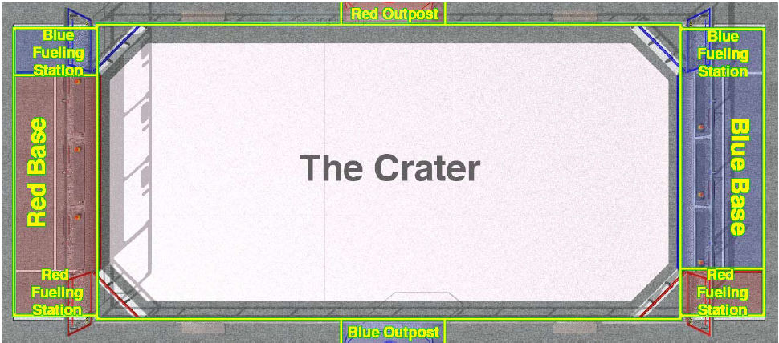
Summary: Field Diagram

Slide 11
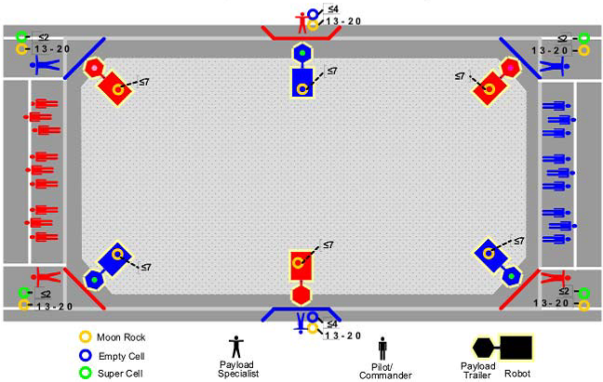
Summary: Field Diagram

Slide 12
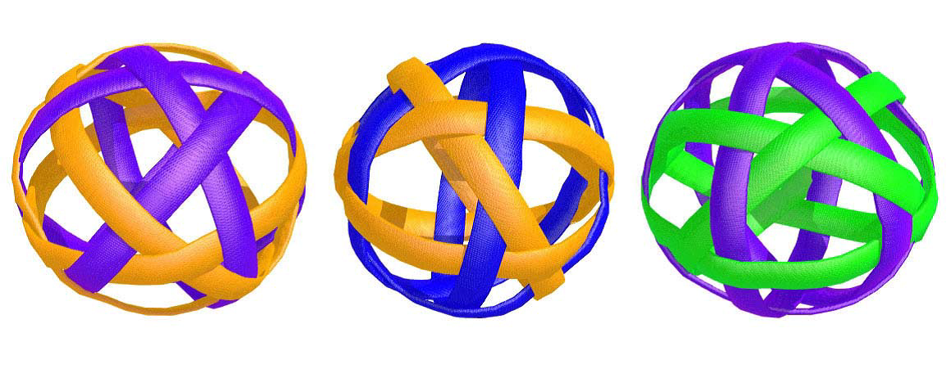
Summary: Earning points
Object | Color | # in arena | Points
Moon Rocks | Orange and purple | 120 | 2
Empty Cells | Orange and blue | Up to 8 (4 per alliance) | 2
Super Cells | Green and purple | Up to 8 (4 per alliance) | 15

Slide 13
Summary: Match format
Timing
15 seconds autonomous
120 seconds teleoperated
You can throw Super Cells only in the last 20 seconds
Ball possession
Robots may be loaded with up to 7 Moon Rocks at the start of the match
Human players are equipped with 20 moon rocks and can try to throw them into the trailers
Super Cells can be “activated” by bringing an Empty Cell from the Outpost to the Fueling Station.

Slide 14
Unusual Rules
All robots MUST use the acrylic, “Rover Wheels” provided in the Kit of Parts.
The Rover Wheels cannot be modified
No other form of traction (arms, treads, other wheels, etc) may be used
You may use as many Rover Wheels as you want
Each trailer is identical, and will be provided to you at the competition
A maximum of four 2-1/2” CIM motors are allowed
No CAN allowed on the Jaguars

Slide 15
Strategy and Priorities
Part 1

Slide 16
Part 1: Strategy and Priorities
Come up with a strategy for the game
Do NOT start designing the robot
Prioritize what is most important
There are many ways to score points or play the game. Which is best? Which should we avoid?
Refer to the rules, draw out ideas, pretend to be a robot
If you can support your strategy using math, ☺

Slide 17
Merging strategies
Part 2

Slide 18
Robot designs
Part 3

Slide 19
Part 3: Robot Design
Come up with a design for the robot
Brainstorm! No idea is too crazy
Draw out and sketch your ideas
Don’t forget the strategies and priorities from the previous part

Slide 20
Combining Designs
Part 4

Slide 21
How did we do?
Comparing our designs to other teams

Slide 22
2009 Winners
Red (100 points)
WildStang (111)
The HOT Team (67)
Spartan Robotics (971)
Blue (68 points)
The ThunderChickens (217)
Truck Town Thunder (68)
Da Bears (247)

Slide 23
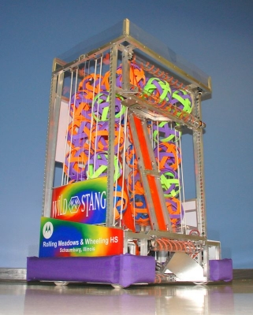
WildStang – Team 111
Swerve drive
Follower wheels and encoders to create a traction control system
Roller at base grabs balls
Moves balls up via elevator to storage at top
Extra space on the side and accessed via lifts
Double rollers at top (fixed shooter) for rapid high volume shooting

Slide 24
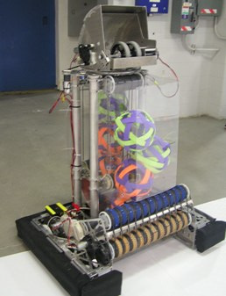
The HOT Team – Team 67
6-wheel skid steer drive
Free-spinning omni-wheels with encoders (regulates drive)
Ball pickup
Large horizontal space
Conveyor belt system
Shooter
180 degree flexibility
Code determines shooting distance

Slide 25
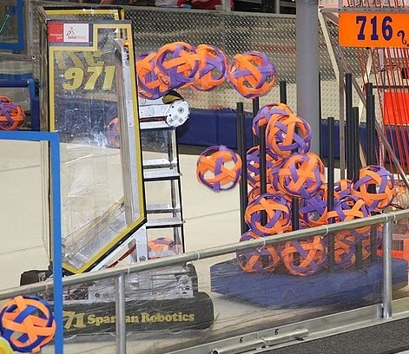
Spartan Robotics – Team 971
Specs from website:
6wd
2 speed
Ground pickup
Large ball storage

Slide 26
How did we do?
What similarities did you see to our final design? What differences?
What strategies were they using during the match? How did the final match go?
Any surprises?
Any comments?

Slide 27
Postmortem
A final review

Slide 28
Final Review
What went right today?
What could be improved?
What should we keep for next time?
What should we change for next time?
Additional comments?

Slide 29
Thank you!
(and clean up)

