Slide 1
Skyline Robotics
Orientation

Slide 2
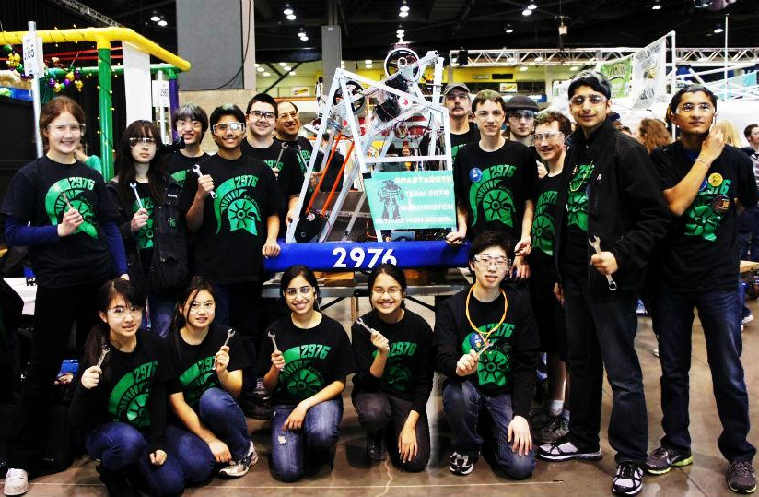
Who are we?
What we do

Slide 3
General info
A robotics team that participates in FIRST Competitions
Mission statement:
The Skyline High School Robotics Team is dedicated to cultivating professional skills. Our mentor guided student run club nurtures and inspires interested young minds in the fields of science, technology, engineering and math (STEM).
We provide students with a unique opportunity to develop self-confidence, creative thinking, leadership, collaboration and teamwork.

Slide 4
Yearly schedule
Fall
Learning (self guided, lectures and field trips)
Practice building
Winter
January kickoff. Competition starts
Build season (6 weeks – very busy)
Spring
Competition
Training and building
Review and plan for the future
Summer
Training and building

Slide 5
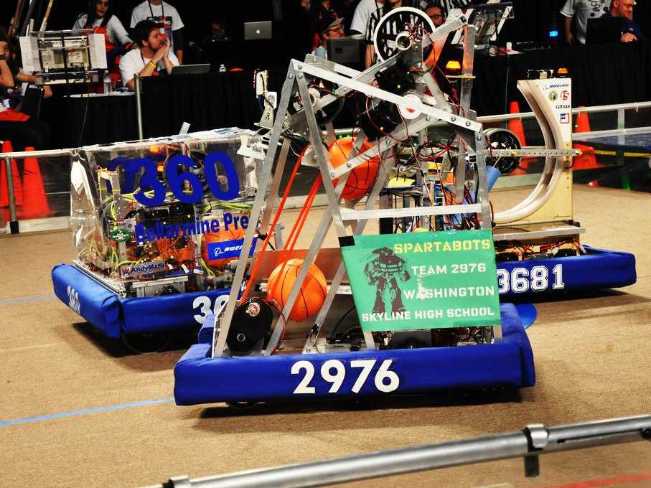
Opportunities
Things you can do at robotics

Slide 6
STEM Fields
Engineering and building
Programming
Electronics and wiring
Design and CAD (computer-aided design)

Slide 7
Robotics club is a business
Fundraising and grants
We need around $14,000 each year to compete
Finance
Bookkeeping and inventory management
Spirit/Outreach
We need support from both the community and the school in order to survive

Slide 8
Other opportunities
Mentors from local companies
Boeing, Microsoft
Real-world experience
Workshops and lectures
Looks great on resumes!
Lots of scholarships (FIRST)

Slide 9
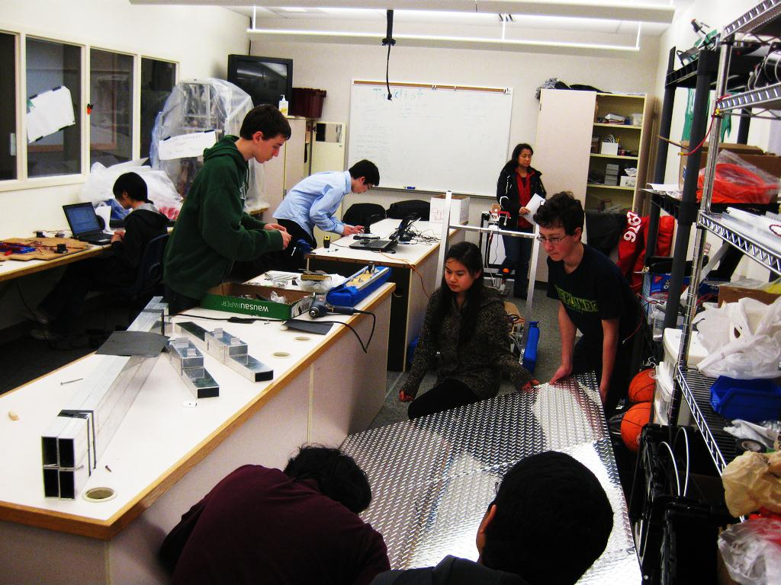
Organization
How our club runs

Slide 10
Club structure
Teams
Build (Structure/Motors/Gears/Pneumatics)
Programming/Electrical
Finance
Fundraising and Grants
Spirit/Outreach
Each team has one lead (elected)

Slide 11
Join Teams
Join teams you’re interested in
You can join more than one team
Mondays:
Programming/Electronics
Tuesdays: (mandatory for officers)
Strategy
Fundraising
Finance
Spirit/Outreach
Wednesdays:
Build

Slide 12
Do Stuff/Points System
We use Trello for project management
Complete tasks on Trello to earn points
Earn additional points for showing up to meetings, etc.
You need 1000 points in order to go to the competition
We’ll be coming up with additional rewards

Slide 13
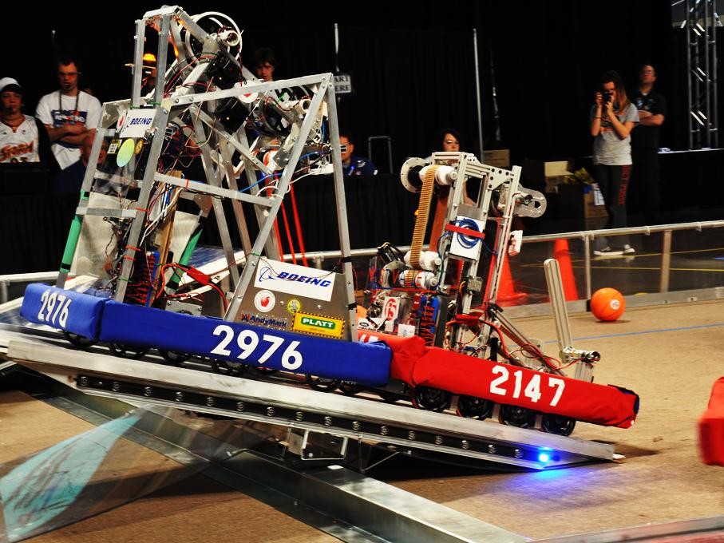
Additional information
Just a few more things you should know

Slide 14
Things we need from you
Club dues: $40 (by mid-October)
Covers cost of t-shirts, etc.
Survey
Media and safety release forms
Join Trello and Google Groups
We’ll send out invites
Optional
Parent driver permission forms

Slide 15
Upcoming events
Saturday
Boeing Family Day
Monday (programming/electronics)
Electronics overview
Tuesday (strategy/officer’s)
Elections
Introduce teams and goals
Wednesday (build)
Safety overview + proper tool usage
Basic building

Slide 16
Upcoming events
Elections this Tuesday
President
Vice President
Finance lead (treasurer)
Spirit/Outreach lead (secretary)
Fundraising lead
Build lead
Programming/Electronics lead

Slide 17
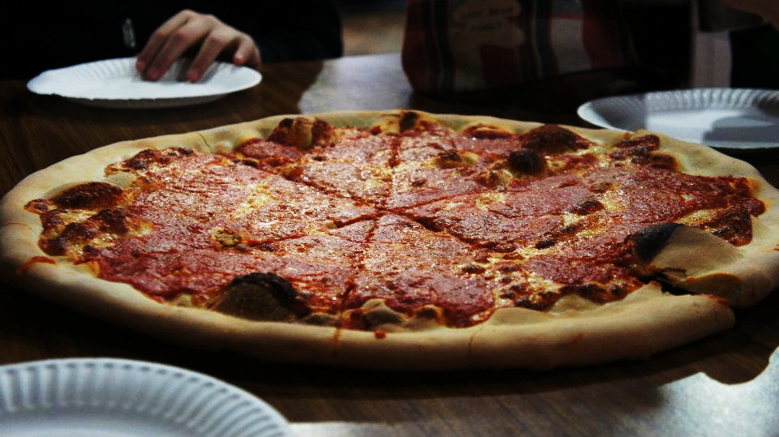
Questions?
Concerns?

