Slide 1
Dharshini S
PDF Chatbot
3/21/2024 Annual Review

Slide 2
DocBot: Your Personalized Document Assistant
3/21/2024 Annual Review

Slide 3


AGENDA
Problem Statement
Project Overview
End Users
Solution and value Proposition
Wow in your solution
Modelling
Result
3/21/2024 Annual Review

Slide 4

PROBLEM STATEMENT
Many individuals and organizations face challenges in efficiently managing and extracting relevant information from large volumes of PDF documents. Manual searching and extraction processes are time-consuming, error-prone, and often inefficient, leading to productivity losses and missed opportunities. There is a clear need for a solution that streamlines the process of accessing, navigating, and extracting information from PDF documents, providing personalized assistance and tailored recommendations to users in order to optimize document management workflows and enhance productivity.
3/21/2024 Annual Review

Slide 5

PROJECT OVERVIEW
Our project introduces a groundbreaking personalized PDF chatbot, integrating LangChain, OpenAI API, chunking algorithms, document search functionalities, OpenAI embeddings, and the PyPDF2 library. Traditional PDF document management is plagued by inefficiencies and time-consuming processes. Our solution addresses these challenges by providing users with an intelligent assistant capable of swiftly navigating, searching, and extracting information from PDFs. Leveraging advanced natural language processing and semantic understanding, the chatbot offers personalized recommendations, content summarization, and data extraction. With applications across industries and user-friendly deployment options, our project aims to revolutionize document management, enhancing productivity and streamlining workflows in the digital era.
3/21/2024 Annual Review

Slide 6

WHO ARE THE END USERS?
The end users of our personalized PDF chatbot span various industries and professions, including but not limited to professionals in corporate settings, researchers, students, and legal professionals. In corporate environments, employees dealing with extensive document repositories benefit from the chatbot's ability to swiftly locate relevant information, streamline document review processes, and extract data efficiently. Researchers and students find value in the chatbot's capability to expedite academic research by providing quick access to pertinent information within research papers and documents. Legal professionals leverage the chatbot's features to streamline document analysis, review legal documents, and extract key insights from case files. With its versatility and user-friendly interface, our chatbot caters to a diverse range of end users, empowering them to enhance productivity and streamline document management workflows.
3/21/2024 Annual Review

Slide 7

YOUR SOLUTION AND ITS VALUE PROPOSITION
Our solution, the personalized PDF chatbot, represents a cutting-edge advancement in document management technology. By integrating sophisticated linguistic processing techniques, natural language understanding, and document management functionalities, we've created a transformative tool that offers unparalleled value to users. The chatbot's key features include intelligent search capabilities, personalized recommendations, content summarization, and data extraction, all powered by advanced algorithms and AI models. Our solution streamlines document management workflows, saving users valuable time and effort in navigating, searching, and extracting information from PDF documents. Whether it's professionals in corporate environments, researchers, students, or legal professionals, our chatbot caters to a diverse range of users, providing them with a seamless and intuitive experience. With its ability to enhance productivity, streamline workflows, and deliver actionable insights, our solution redefines the way individuals and organizations interact with PDF documents, ultimately driving efficiency and innovation in the digital age.
3/21/2024 Annual Review

Slide 8

THE WOW IN YOUR SOLUTION
One unique feature of our project is its seamless integration of LangChain's linguistic processing capabilities with OpenAI API's natural language understanding, enabling the chatbot to offer personalized recommendations and insights tailored to each user's preferences and interactions. This personalized approach enhances user experience, making document navigation and information extraction more intuitive and efficient. Additionally, our chatbot's ability to analyze and summarize PDF documents using chunking algorithms and OpenAI embeddings sets it apart, providing users with concise summaries and actionable insights, thus revolutionizing the way individuals and organizations interact with PDF documents.
3/21/2024 Annual Review
8

Slide 9
MODELLING
We adopted a streamlined approach utilizing a Python-based framework along with a well-defined methodology and specific Python libraries. Our framework emphasizes modularity and scalability, ensuring seamless integration of various components. Methodologically, we followed an agile development approach, allowing for iterative improvements and rapid adaptation to evolving requirements. The Python libraries utilized in our project include LangChain for linguistic processing, OpenAI for advanced natural language understanding, PyPDF2 for PDF parsing, and faiss-cpu for efficient similarity search. These libraries collectively provided the necessary tools and functionalities to implement our solution effectively, enabling us to deliver a robust and feature-rich application for text processing and document management.
3/21/2024 Annual Review
9

Slide 10
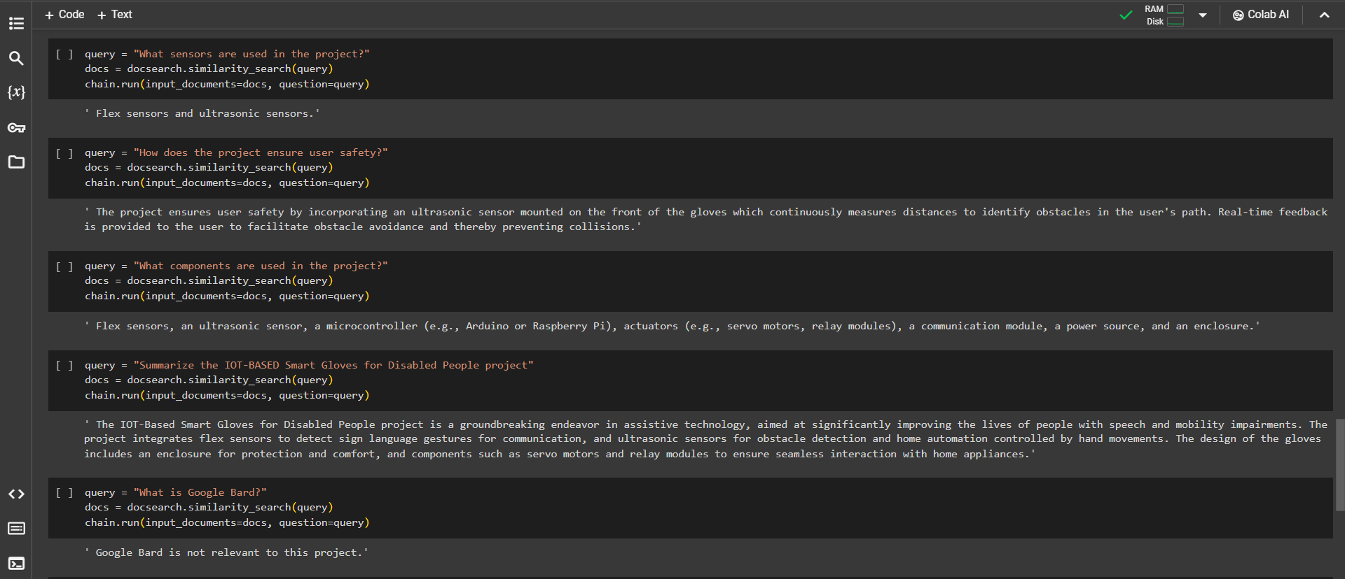
RESULTS
Demo Link
3/21/2024 Annual Review
10

