Slide 1
HOTEL RESERVATION SYSTEM
Submitted By:
Dharshini Govindarajan
Dipanjan Haldar
Mahesh Kumar
Sanhita Murthy

Slide 2
INDEX
Introduction
Requirement
Actors
Design
Implementation
Functionality
Future Enhancements
Conclusion

Slide 3
Introduction
Purpose is to automate the cumbersome process of making a hotel reservation as well as the process of updating the hotel database with the available rooms and facilities

Slide 4
Requirement
Hotel Reservation System (HRS) is a platform that allows users, system administrators to access the HRS to perform different functionalities.
SYSTEM ADMIN :
Allows the system administrator to add/delete a room to the available list of rooms, query information regarding the guests and keep track of the employees in the Hotel
USER :
Allows the user to search/book a room, place food order and pay the settlements for his stay

Slide 5
Actors
CUSTOMER/USER
Can create an account using a login & password on the HRS
Can search for rooms available from – to date in the HRS
Can book a room or cancel a booking
Can order food
Can make payment for the duration of the stay as well the pending balances

Slide 6
Actors
SYSTEM ADMIN
Can add/delete a room to/from the existing room list
Check in and check out the guests
Approve a booking for any customer
Create/Deleted menu items for the food an beverages department
Can view the list of Customers currently in house
Can update bills/payment dues for any customer

Slide 7
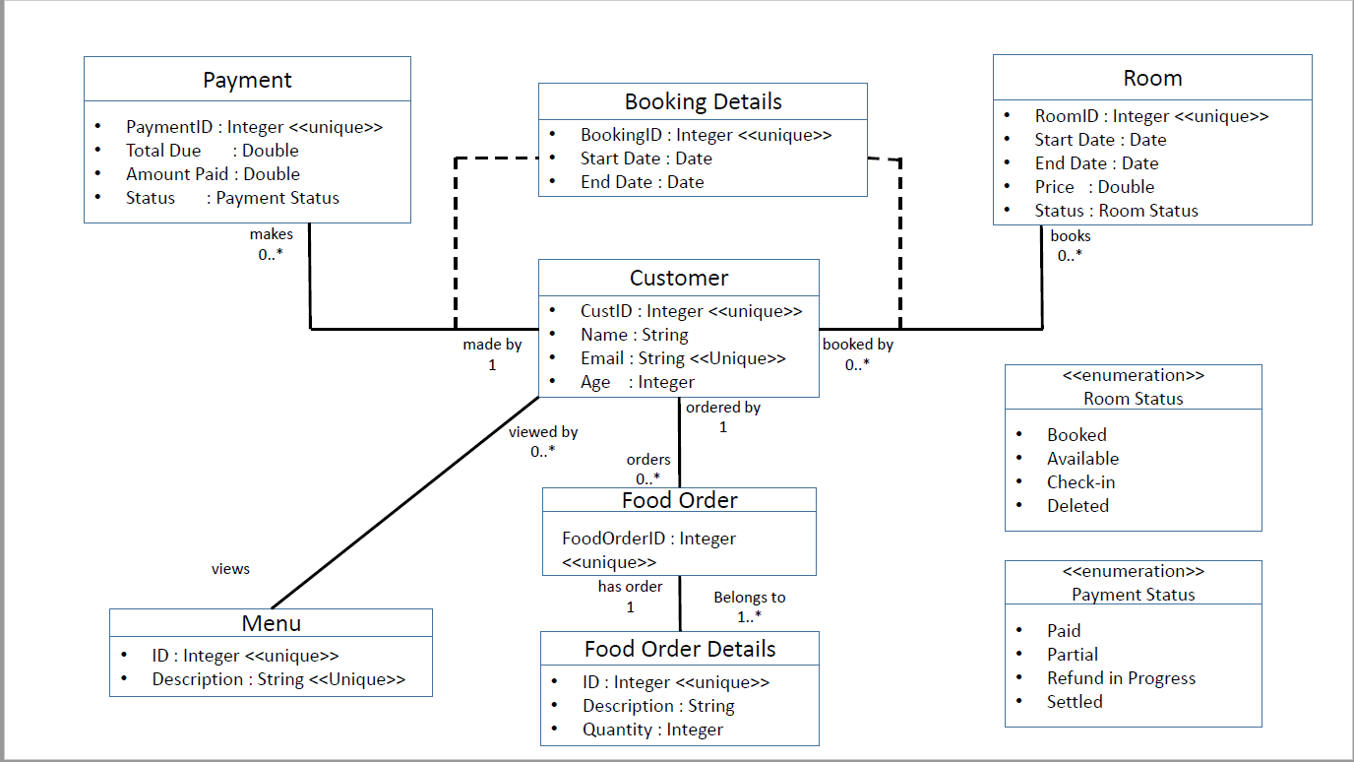
Design

Slide 8
Implementation
For the implementation of HRS following technologies are used:
Programming Language : Java
Database : MySQL
IDE : Eclipse Neon

Slide 9
DEMO

Slide 10
Future Goals
Adding functionality for customer feedback
Creating Email alerts for customers regarding offers available
Creating a web interface for the HRS

Slide 11
References
www.tutorialspoint.com
http://www.ccs.neu.edu/home/kenb/db/topics.html
http://www.ccs.neu.edu/home/kenb/
https://piazza.com/northeastern/spring2017/cs520001/resources
http://stackoverflow.com/

Slide 12
Conclusion
We have achieved our required goal set of building up a basic Hotel Reservation System. It caters to the needs of the Customers and administrators and makes the experience of booking a room or managing a hotel effortless.

Slide 13
Questions

