Slide 1
Digital portfolio
STUDENT NAME: Dharshini.B
REGISTER NO AND NMID: 36324u09017 and D30D664876E24989B8E41E63B80A054
DEPARTMENT: BCA
COLLEGE/UNIVERSITY: Sree abiraami arts and science college for women / Thiruvalluvar university

Slide 2
Project title
Interactive digital
Portfolio using front
End developed

Slide 3
Agenda
1. Problem statement
2. Project overview
3. End users
4. Tools and Technique
5. Portfolio design and layout
6. Features and functionality
7. Result and Screenshot
8. Conclusion

Slide 4
Project Statement
In today’s competitive digital world development, individuals struggle to effectively showcase their skill, achievements, and creative work using traditional resumes or printed portfolios. There is a growing need for dynamic and accessible digital portfolios that better represent a person’s abilities, especially in professional and academic environments

Slide 5
Project Overview
the project focuses on creating a personal digital portfolio website that highlights an individuals: personal information Academic qualifications skills and technical expertise projects and achievements Contact details This portfolio can be used for job interviews, internships, higher studies application, and professional networking.

Slide 6
Who are the End Users?
Students & Job Seekers Use digital portfolios to showcase skills, academic projects, certifications, and work experience for admissions, internships, and job opportunities.
Professionals & Creatives Utilize portfolios to present creative work, build personal brands, attract clients, and enhance professional visibility in their industry.

Slide 7
Tools and Techniques
Frontent: HTML, CSS, Javascript Editor: VS Code Frameworks (optional): Boothstrap, Tailwind CSS Version Control: Git, GitHub Hosting: GitHub Pages / Netlify

Slide 8
Portfolio design and layout
portfolio will consist of the following section: 1. The Home/introduction – Brief intro with photo and tagline. 2. About Me – Education, Background, and interests. 3. Skills – Programming languages, tools, frameworks. 4. Project – Academic and personal projects with links/screenshots. 5. Achievements – Certifications, awards, internships. 6. Contact – Email, LinkedIn, GitHub

Slide 9
Features and Functionality 1. Responsive UI (works on mobile & desktop). 2. Navigation bar for smooth section transitions. 3. Interactive skills display (progress bars / icons). 4. Image gallery for projects. 5. Contact form or direct links. 6. Light / Dark mode (optional).

Slide 10
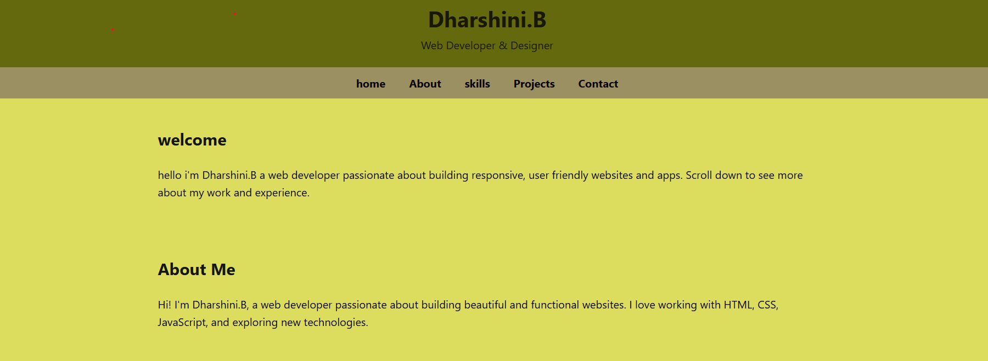
Results and Screenshots

Slide 11
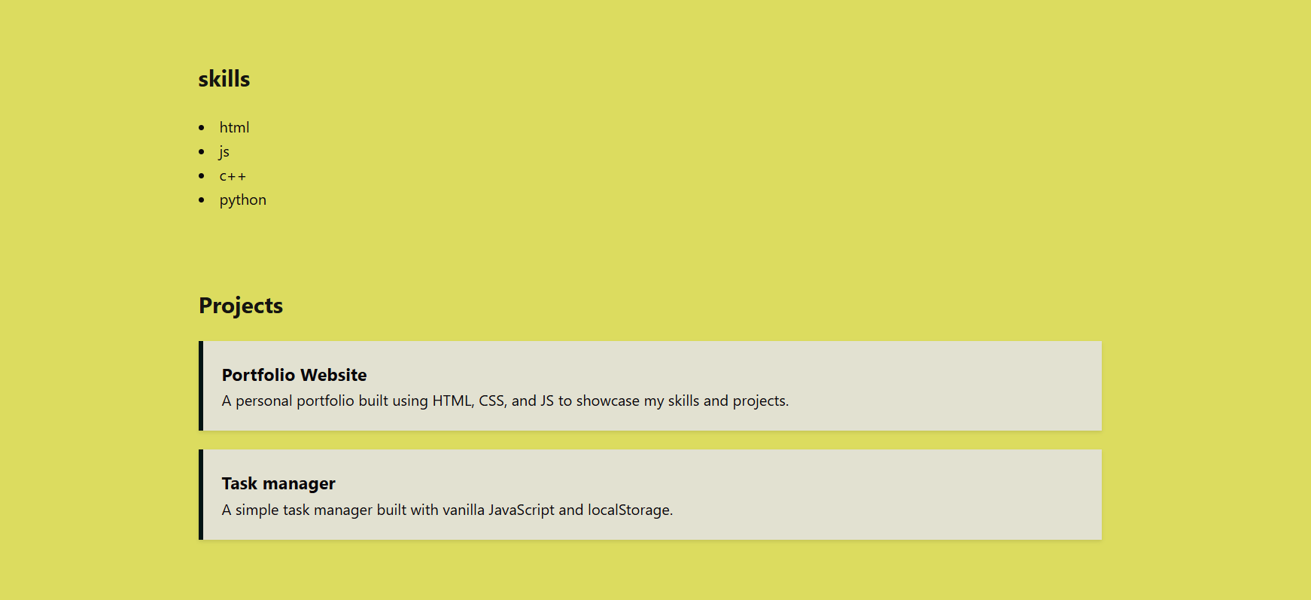

Slide 12


Slide 13
Thank You

