Slide 1

LINUX INFRASTRUCTURE PROJECT
ZERO-TRUST
Enterprise Storage Vault
with Automated Ransomware Defense
and Disaster Rollback
Web application and Linux command demonstration
DHARSHINI K / KANI V / HEMANATH K / IBADUL AZAM
LINUX SYSTEM ADMINISTRATION / E1ITA307
01
Notes:
Dharshini: Good morning, ma’am. We will demonstrate our Linux storage vault through a web interface and explain the Bash commands behind it.

Slide 2
TEAM
Team and presentation roles
DHARSHINI K
2411021060912
Overview and architecture
KANI V
2411021061023
Access and file operations
HEMANATH K
2411021060862
Detection and automation
IBADUL AZAM
2411021060840
Recovery and validation
Supervisor: Prof. Kusuma J
LINUX SYSTEM ADMINISTRATION / E1ITA307
02
Notes:
Dharshini: Introduce each member and the presentation split. Supervisor Prof. Kusuma J. Alliance University, Bengaluru.

Slide 3
OVERVIEW
Problem and project scope
Authorized work
The student reads and updates the assignment.
Restricted access
Outsiders cannot read the vault or its protected backup.
Verified recovery
A clean copy restores the sample files after an incident.
LINUX SYSTEM ADMINISTRATION / E1ITA307
03
Notes:
Dharshini: A student needs to edit an assignment. Outsiders must be denied access. The clean backup should remain protected. We demonstrate detection through a canary file, not universal ransomware detection.

Slide 4
WEB INTERFACE
Four separate application views
Overview
Vault access, backup presence and timer status
Student workspace
View files, save a sentence and verify its modification time
Defense & recovery
Permission tests, canary checks and confirmed recovery
Activity & logs
New events in IST and clearly labelled legacy records
LINUX SYSTEM ADMINISTRATION / E1ITA307
04
Notes:
Dharshini: The latest frontend shows one selected page at a time. Overview contains state cards. Workspace manages files and timestamps. Security runs Bash operations. Activity displays newest events first. Source: web/index.html and web/app.js.

Slide 5
ARCHITECTURE
Browser, adapter and Bash engine
01
Browser interface
HTML / CSS / JavaScript
02
Local HTTP adapter
Python validates the request and selects a fixed action
03
Bash security engine
Linux permissions, hashes, backup and recovery
LINUX SYSTEM ADMINISTRATION / E1ITA307
05
Notes:
Dharshini: HTML, CSS and JavaScript form the frontend. Python standard-library HTTP connects the browser to fixed Bash operations. Bash performs the security tasks. The web layer extends the original Bash-only submission. Source: server.py, run.sh and src/ztvault.sh.

Slide 6
COMMANDS / STARTUP
Starting and locating the application
pwd / ls
Show the current directory and its contents.
cd Zero_Trust_Vault_Web_v2
Enter the extracted application folder.
sudo bash run.sh
Start the local web server with administrator privileges.
LINUX SYSTEM ADMINISTRATION / E1ITA307
06
Notes:
Dharshini: Run in Ubuntu. Open http://localhost:8765 in Windows. Keep Ubuntu open. sudo elevates privileges, bash runs the launcher. Use the full extracted folder path if needed.

Slide 7
COMMANDS / IDENTITIES
Linux accounts and groups
groupadd ztv_access
Create the group allowed to use the working vault.
useradd -M -g ztv_access -s /usr/sbin/nologin ztv_writer
Create the student account without a home or interactive login.
id ztv_writer
Show the user ID and group membership.
LINUX SYSTEM ADMINISTRATION / E1ITA307
07
Notes:
Kani: These are setup commands executed by the installer as root. Do not rerun useradd on an existing account. ztv_outsider is a separate account excluded from the access group. Source: scripts/setup.sh.

Slide 8
COMMANDS / PERMISSIONS
Ownership and access permissions
chown root:ztv_access /srv/ztvault/data
Set root as owner and ztv_access as the group.
chmod 2770 /srv/ztvault/data
Allow owner and group access. New items inherit the group.
chmod 0700 /srv/ztvault/data
During containment, restrict directory access to root.
LINUX SYSTEM ADMINISTRATION / E1ITA307
08
Notes:
Kani: Read=4, write=2, execute=1. Directory execute means traverse. The leading 2 is setgid. Sample files use 0660. Permissions do not prevent root access or revoke already-open file handles. Source: setup.sh and ztvault.sh.

Slide 9
VIVA / CHMOD
Permission numbers explained
4
2
1
Read
Write
Execute / traverse
2770 directory: owner 7, group 7, others 0, setgid 2
0660 file: owner and group can read and write
LINUX SYSTEM ADMINISTRATION / E1ITA307
09
Notes:
Kani: Explain the sum. Seven is read plus write plus execute. Six is read plus write. Zero grants no permission. The groups of digits refer to owner, group and others.

Slide 10
COMMANDS / ACCESS TESTS
Testing the real user permissions
runuser -u ztv_writer -- cat /srv/ztvault/data/assignment.txt
Read the assignment using the student’s actual permissions.
runuser -u ztv_outsider -- cat /srv/ztvault/data/assignment.txt
An outsider read attempt should produce Permission denied.
runuser -u ztv_writer -- ls /var/lib/ztvault/backups
The student must not list the protected backup folder.
LINUX SYSTEM ADMINISTRATION / E1ITA307
10
Notes:
Kani: The application starts as administrator, then uses runuser for each student/outsider test. A permission-denied output is expected for the last two checks. Source: test_permissions function.

Slide 11
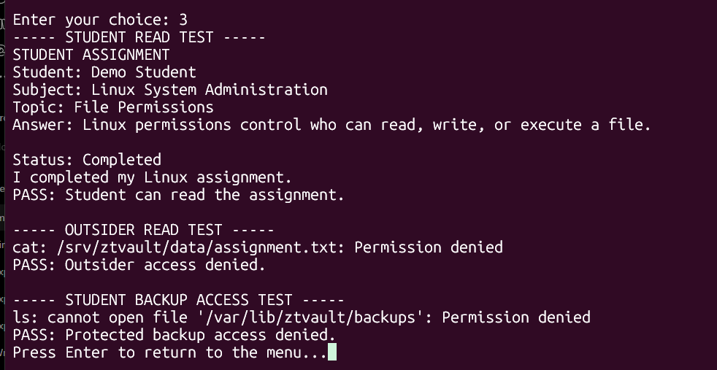
EVIDENCE
Recorded Linux permission evidence
Student reads
Outsider denied
Backup restricted
LINUX SYSTEM ADMINISTRATION / E1ITA307
11
Notes:
Kani: This is the earlier terminal demonstration, showing real student reading, outsider denial and backup restriction. It is evidence from the recorded terminal run, not a new browser screenshot. Source: screenshot 133549.

Slide 12
COMMANDS / FILES
Saving and verifying the assignment
printf '%s\n' "$note"
Write the entered sentence as text, without interpreting it as a command.
runuser -u ztv_writer -- tee -a "$VAULT/assignment.txt"
Append the sentence with student permissions.
stat -c '%y' /srv/ztvault/data/assignment.txt
Inspect the actual last-modified time of the file.
LINUX SYSTEM ADMINISTRATION / E1ITA307
12
Notes:
Kani: The Bash pipeline sends printf output into tee -a. The web layer reads the file back after saving and checks for the sentence. stat does not generate a new modification time. It reads filesystem metadata. Source: update_assignment, metadata and app.js.

Slide 13
TIMESTAMPS
Event time and file modification time
06:42:59 UTC
12:12:59 IST
IST is UTC plus 5 hours 30 minutes
date -u +%Y-%m-%dT%H:%M:%SZ
The log retrieval time can be later than the event time.
LINUX SYSTEM ADMINISTRATION / E1ITA307
13
Notes:
Kani: New events use ISO UTC with Z. Browser formatting uses Asia/Kolkata. The save receipt uses the file modification time, not the refresh time. Old log lines do not contain a timezone and are preserved with a legacy label.

Slide 14
COMMANDS / BACKUP
Clean backup and integrity checks
tar -czf "$work/clean-backup.tar.gz" assignment.txt marks.txt canary.txt
Create a compressed archive containing the three sample files.
sha256sum clean-backup.tar.gz > clean-backup.sha256
Record the archive fingerprint in a checksum file.
sha256sum --check clean-backup.sha256
Compare the archive with its recorded fingerprint.
LINUX SYSTEM ADMINISTRATION / E1ITA307
14
Notes:
Hemanath: The first command runs inside the vault. Archive hash commands run inside the archive directory. c=create, z=gzip, f=archive filename. The application creates one clean backup and later verifies it rather than overwriting it. Source: create_backup.

Slide 15
COMMANDS / DEFENSE
Canary detection and containment
sha256sum canary.txt
Compute the fingerprint of the trap file.
sha256sum --check --status "$CANARY"
Check the trusted baseline quietly and use its exit status.
chmod 0700 "$VAULT"
Restrict student access after a failed canary check.
LINUX SYSTEM ADMINISTRATION / E1ITA307
15
Notes:
Hemanath: CANARY points to /var/lib/ztvault/baselines/canary.sha256. Check runs from the vault directory. A missing or invalid canary also triggers containment. Hashing detects changes, it does not encrypt data. Source: monitor function.

Slide 16
COMMANDS / AUTOMATION
Automatic monitoring with systemd
systemctl daemon-reload
Reload unit definitions after creating the service and timer.
systemctl enable --now ztvault-monitor.timer
Enable the timer for future startup and start it now.
systemctl status ztvault-monitor.timer --no-pager
Inspect timer activity and its next trigger.
LINUX SYSTEM ADMINISTRATION / E1ITA307
16
Notes:
Hemanath: The timer checks approximately every ten seconds while Ubuntu runs. Version 2 installs /usr/local/lib/ztvault-web/monitor.sh so automatic events record UTC. This schedules checking, not backup creation. Source: enable_monitoring.

Slide 17
COMMANDS / OBSERVABILITY
Logs and operation locking
journalctl -u ztvault-monitor.service -n 20 --no-pager
Show the monitoring service’s most recent twenty log entries.
tail -n 25 /var/log/ztvault/events.log
Read the latest application events.
flock -w 15 9
Wait up to fifteen seconds for the shared operation lock.
LINUX SYSTEM ADMINISTRATION / E1ITA307
17
Notes:
Hemanath: Use sudo for protected logs. File descriptor 9 opens /var/lib/ztvault/operation.lock. Web operations wait for the lock. The monitor uses flock -n 9 and skips a busy check. flock is an advisory coordination lock, not access control.

Slide 18
LIVE DEMO
Safe incident demonstration
01 Confirm DEMO
Only harmless sample canary text changes.
02 Detect the change
The monitor compares the saved fingerprint.
03 Block student writing
The vault becomes LOCKED and records an alert.
LINUX SYSTEM ADMINISTRATION / E1ITA307
18
Notes:
Hemanath: In Security, first verify the clean backup and enable monitoring. Click Simulate incident and type DEMO. Wait approximately fifteen seconds or click Check now. Then test write blocking and inspect Activity. No malware executes.

Slide 19
COMMANDS / RECOVERY
Verified disaster rollback
mktemp -d "$BASE/recovery/restore-XXXXXX"
Create a unique staging directory for recovered files.
tar -xzf "$BACKUP" -C "$stage" --no-same-owner --no-same-permissions
Extract the backup into staging before replacing active files.
sha256sum --check "$MANIFEST"
Verify the recovered original files against the trusted manifest.
LINUX SYSTEM ADMINISTRATION / E1ITA307
19
Notes:
Ibadul Azam: The administrator must type RESTORE. After verification, mv preserves the previous vault and install copies verified files with controlled ownership and permissions. Recovery returns to the clean backup point, so newer edits disappear from the active files. Source: recover_files.

Slide 20
COMMANDS / STORAGE
Controlled installation and recovery paths
install -d -o root -g ztv_access -m 0700 "$VAULT"
Create the working directory with explicit ownership and permissions.
install -o root -g ztv_access -m 0660 "$stage/$name" "$VAULT/$name"
Copy each restored sample with its intended access settings.
mv "$VAULT" "$old/data"
Preserve the previous working directory before installing recovered files.
LINUX SYSTEM ADMINISTRATION / E1ITA307
20
Notes:
Ibadul Azam: These are internal excerpts, not standalone commands to paste without variables. BASE=/var/lib/ztvault, VAULT=/srv/ztvault/data. stage, old and name are local recovery variables. The project uses ext4 and does not configure LVM.

Slide 21
SCRIPT EXPLANATION
Bash control flow and error handling
read / case / while
Accept input, select an operation and repeat the terminal menu.
if / functions
Check conditions and group commands by responsibility.
set -Eeuo pipefail
Detect command, unset-variable and pipeline failures.
trap / exit status
Report operation errors and control cleanup or stopping.
LINUX SYSTEM ADMINISTRATION / E1ITA307
21
Notes:
Ibadul Azam: The original terminal menu uses read, case and while. The web dispatcher selects fixed operations. if validates conditions. Functions organize tasks. The server rejects unknown actions and invalid confirmations. Source: ztvault.sh and server.py.

Slide 22
TESTING
Validation and security boundaries
Recorded terminal evidence
Student access, outsider denial, detection and recovery.
Web checks completed
Save/read-back logic, timestamps, API input and route logic.
Target Ubuntu verification
Live permissions, systemd scheduling and complete browser demo.
LINUX SYSTEM ADMINISTRATION / E1ITA307
22
Notes:
Ibadul Azam: Earlier terminal screenshots cover Linux permission and recovery behavior. Web version checks cover actual file append with account switching emulated, time metadata and API validation. Full new privileged integration and visual browser QA remain to be performed on the target laptop. Do not claim all end-to-end checks passed.

Slide 23
SCOPE
Current limits and future extensions
CURRENT SCOPE
FUTURE EXTENSIONS
Canary-based detection
Local single-version backup
Manual recovery confirmation
Local administrator web interface
Broader file-integrity policies
Off-device backup versions
User authentication and roles
Administrator notifications
LINUX SYSTEM ADMINISTRATION / E1ITA307
23
Notes:
Ibadul Azam: The canary can miss changes elsewhere. Local single-version backup cannot recover from loss of the disk. The HTTP server is a loopback administrator demo without multi-user login. Future extensions are not implemented.

Slide 24
CONCLUSION
Demonstration and command recap
Overview → Workspace → Security → Activity
Save a sentence. Verify access. Check the backup.
Enable monitoring. Confirm DEMO. Test blocking.
Confirm RESTORE. Inspect the event history.
chmod sha256sum tar systemctl flock
LINUX SYSTEM ADMINISTRATION / E1ITA307
24
Notes:
Ibadul Azam: Demonstrate the application in this order. Finish by saying chmod controls access, sha256sum detects changes, tar handles backups, systemctl manages monitoring and flock coordinates operations. Thank you, ma’am.

