Slide 1
Digital Portfolio
STUDENT NAME: DHARSHINI K
REGISTER NO AND NMID: 6016A42F0C0381CB61E43F0FA1B742C4
DEPARTMENT: BSC.COMPUTER SCIENCE
COLLEGE: ARCOT SRI MAHALAKSHMI WOMEN’S COLLEGE.
UNIVERSITY: THIRUVALLUVAR UNIVERSITY

Slide 2
PROJECT TITLE
MY DIGITAL PORTFOLIO

Slide 3


AGENDA
Problem Statement
Project Overview
End Users
Tools and Technologies
Portfolio design and Layout
Features and Functionality
Results and Screenshots
Conclusion
Github Link
3/21/2024 Annual Review

Slide 4

PROBLEM STATEMENT
In today’s competitive professional environment, having a traditional resume alone is not enough to showcase one’s skills, projects, and achievements effectively. Recruiters and companies increasingly look for interactive and accessible ways to evaluate candidates beyond paper-based resumes. A static document often fails to highlight practical skills, certifications, and project work in a visually appealing and structured format.
Therefore, there is a need for a personal digital portfolio website that provides an organized, professional, and accessible platform to present one’s academic background, technical skills, projects, certifications, and contact details. Such a portfolio allows individuals to showcase their journey, achievements, and abilities in a way that is both engaging and easy to access by potential employers or collaborators.

Slide 5

PROJECT OVERVIEW
This digital portfolio was created as my very first web development project. It is designed to showcase my skills, achievements, and learning journey in the field of computer science.
The portfolio includes sections such as About Me, Projects, Certificates, and Contact, providing a structured and professional way to present my back ground.
The goal of this project was to:
Learn and practice HTML, CSS, and JavaScript. Build a responsive and user-friendly interface.
Organize personal details, academic achievements, and certifications in one place.
Create a foundation for future projects and continuous improvements.
This project reflects my interest in web development and serves as a starting point for developing more advanced application.

Slide 6

WHO ARE THE END USERS?
the main end users are:
Recruiters & Hiring Managers They use the portfolio to quickly understand your skills, projects, and certifications beyond a traditional resume .Helps them evaluate your technical ability (since you built the site yourself).
Academic Evaluators / Faculty Professors or mentors may review the portfolio as part of coursework, project evaluation, or internships .They focus on how you present your knowledge, skills, and achievements
Peers & Collaborators Fellow students, teammates, or project partners who may want to collaborate with you on coding projects or research. They can access your contact details and view your work.
Professional Network (LinkedIn, Tech Communities)Professionals in your field who come across your portfolio link on platforms like LinkedIn, GitHub, or CodePen. They see your portfolio as a demonstration of your initiative and creativity.

Slide 7

TOOLS AND TECHNIQUES
Tools and Techniques
HTML – For structuring the content of the portfolio.
CSS – For styling, layout design, and creating a clean, responsive interface.
JavaScript – For adding interactivity and enhancing user experience.
CodePen – As the development and testing platform to build and preview the project.
Responsive Design Techniques – To ensure the portfolio works on desktop, tablet, and mobile devices.
Version Control (basic saving on CodePen) – To manage and update different versions of the project.

Slide 8
POTFOLIO DESIGN AND LAYOUT
Header Section Displays the portfolio title and user’s name. Contains a navigation bar with links to sections: About, Projects, Certificates, Contact. Ensures quick access to all major parts of the portfolio.
2. About Me SectionPositioned at the top for easy visibility. Provides a brief introduction about academic background, career goals, and interests. Written in a professional but simple tone to create a personal connection.
3. Projects Section Showcases completed projects .Currently includes “Portfolio Website – It’s My First Project”. Designed to expand later as new projects are completed.
4. Certificates Section Displays a list of certifications achieved. Each certificate has a clickable “View Certificate” link for verification. Organized in a bullet-point format for clarity and easy readability.
5. Contact Section Includes a contact form with fields for Name, Email, and Message. Allows visitors to connect for collaboration, job opportunities, or networking. Positioned at the bottom as a call-to-action (CTA).
6. Footer Section Contains copyright information (© 2025 Dharshini).Provides a professional finishing touch to the portfolio .
8

Slide 9
FEATURES AND FUNCTIONALITY
Features and Functionality
Responsive Design – Works smoothly on desktop, tablet, and mobile devices.
Navigation Menu – Easy access to About, Projects, Certificates, and Contact sections.
About Me Section – Provides a clear introduction and background information.
Projects Section – Highlights completed work with descriptions.
Certificates Section – Displays achievements with links to view certificates.
Contact Section – Allows visitors to connect easily.
Clean & Simple Layout – Focused on readability and user experience.

Slide 10
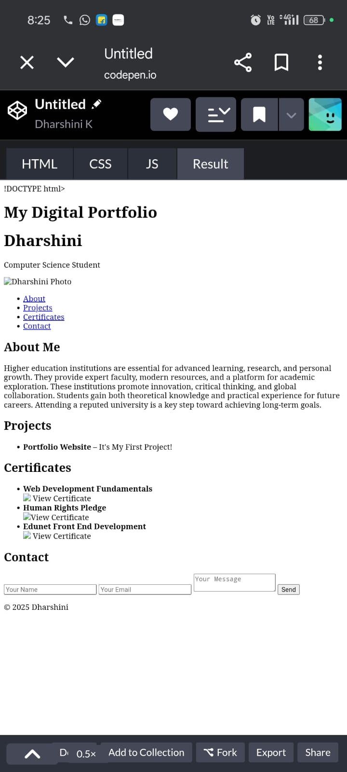
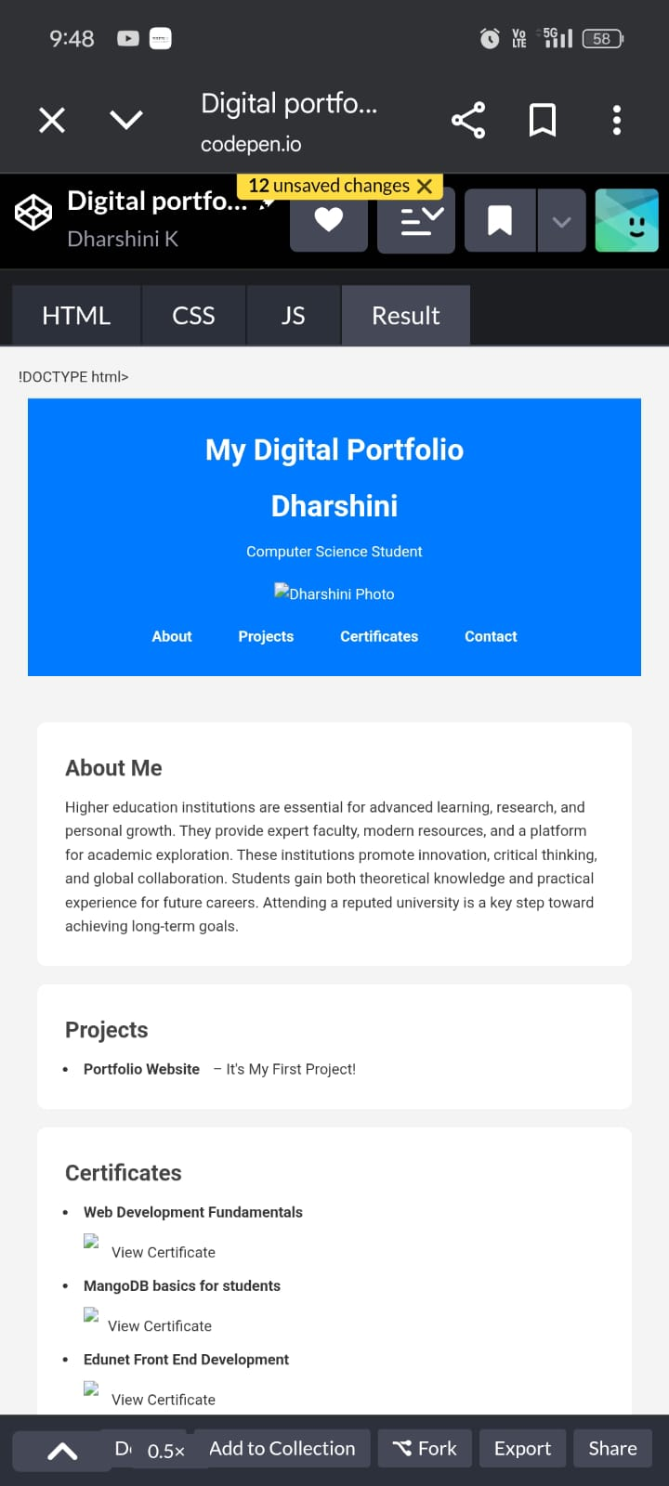

RESULTS AND SCREENSHOTS
3/21/2024 Annual Review
10

Slide 11
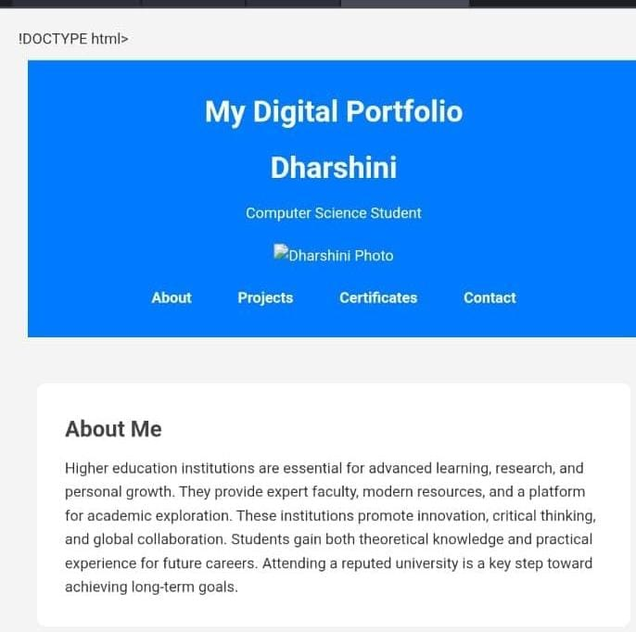
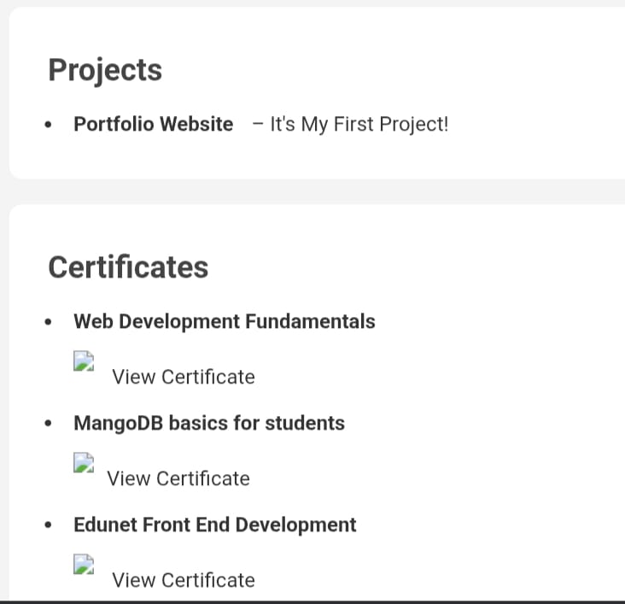
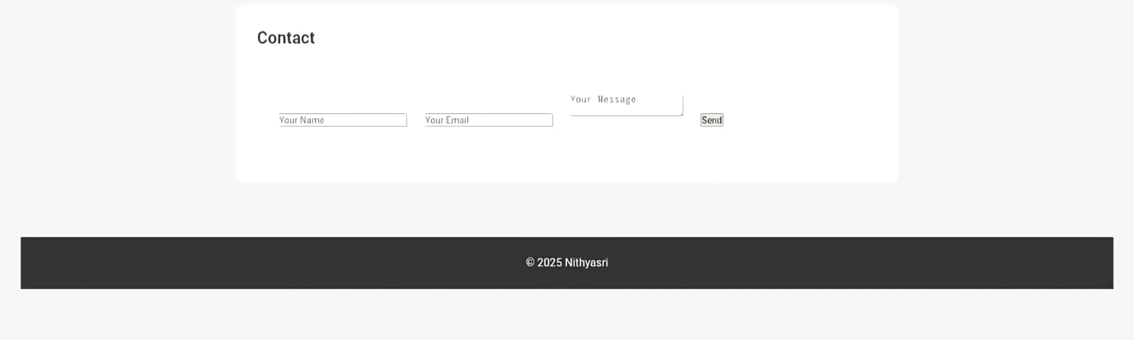

Slide 12
CONCLUSION
This digital portfolio represents my first step into web development and showcases my skills, projects, and achievements in a structured way.
It serves as both a learning project and a professional platform to present myself to recruiters, mentors, and collaborators.
Through this work, I have gained hands-on experience with HTML, CSS, and responsive design while building a foundation for future projects. This portfolio will continue to grow and improve as I learn new technologies and expand my expertise.
12

Slide 13
9.GitHub Link
https://github.com/dharshinik192006/TNSDC-FWD-DP1.git

