Slide 1
VitaTwin AI
Predict. Simulate. Prevent.
An AI-powered healthcare Digital Twin proof-of-concept for early
glycemic-risk awareness in Type 2 Diabetes
Happiest Health Digital Twin Challenge 2026
Team: A Girl :) | SRM Madurai College for Engineering and Technology

Slide 2
THE PROBLEM
Healthcare today reacts after the event has already happened
DATA
EVENT
REACTION
A patient's medical record and
wearable data exist —
but sit unused between visits.
A glucose excursion, or other
adverse event, occurs
unpredicted.
Clinical response happens
only after the fact —
the costliest point to intervene.
Type 2 Diabetes is one of India's most prevalent chronic, lifestyle-linked conditions — and glycemic instability is a leading driver of avoidable complications.
VitaTwin AI — Predict. Simulate. Prevent.
2

Slide 3
OUR APPROACH
From reacting to a single event, to living alongside a twin
DATA
DIGITAL TWIN
PREDICTION
SIMULATION
EARLY AWARENESS
Traditional healthcare: DATA → EVENT → REACTION
VitaTwin AI creates a living computational representation of a patient — combining what we already know with what is happening right now — so the AI can estimate what could happen next, and clinicians can explore hypothetical futures before deciding.
VitaTwin AI — Predict. Simulate. Prevent.
3

Slide 4
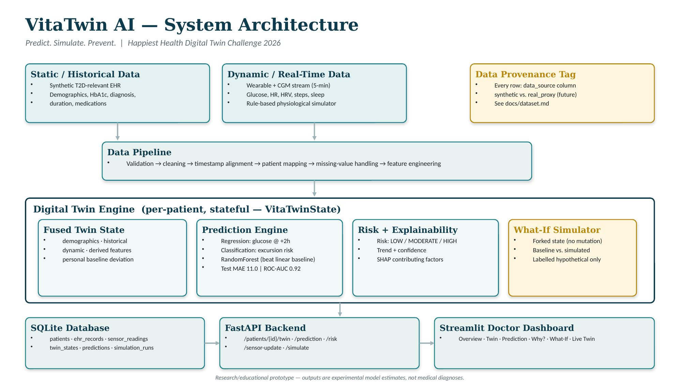
SYSTEM DESIGN
Architecture
VitaTwin AI — Predict. Simulate. Prevent.
4

Slide 5
DATA STRATEGY
Synthetic, disclosed, and schema-compatible with real data
Static / Historical
Dynamic / Real-Time
Synthetic T2D-relevant patient population
Age 35-72, BMI 23-39, HbA1c 5.8-9.8%
Diagnosis, duration, medication profile
5-minute glucose / HR / HRV / steps / sleep
Rule-based physiological simulator
Meal + activity + circadian response modeling
Why synthetic, and why that's the right call
Real CGM+wearable datasets (OhioT1DM, D1NAMO) are Type 1 diabetes research cohorts — there is no strong open dataset combining T2D-specific EHR with continuous wearable+CGM data. Rather than hide this mismatch, every row carries a data_source tag, and the dynamic-stream schema is built to be drop-in compatible with real datasets via a documented loader stub — so real data replaces the simulator later without touching downstream code.
VitaTwin AI — Predict. Simulate. Prevent.
5

Slide 6
CORE INNOVATION
An explicit Digital Twin state — not just a model
VitaTwinState: a real, persisted per-patient object — demographics, historical record, dynamic signals, derived features, prediction, and explanation — not a label a model spits out
Update loop: new sensor data → validation → timestamp alignment → twin update → feature engineering → prediction → risk → explanation → dashboard refresh
Personal baseline: risk is judged against each patient's own recent glucose baseline, not only a population average — "current state is 19.7% above this patient's baseline"
What-If simulation runs on a forked copy of the state — it never mutates the real, persisted twin
VitaTwin AI — Predict. Simulate. Prevent.
6

Slide 7
MACHINE LEARNING
Baselines first, temporal validation, no leakage
Dual Prediction Target
Models — Trained & Evaluated
Validation Discipline
Regression: glucose value
~2 hours ahead
Classification: probability of a
hyperglycemic excursion
(>180 mg/dL) within 2 hours
Regression: Ridge vs. Random Forest
-> Random Forest won (val MAE
10.7 vs. 15.9)
Classification: LogReg vs. RF
-> Random Forest won (val ROC-AUC
0.92 vs. 0.85)
Real, run, test-set results -- see
docs/model.md
Per-patient chronological
70/15/15 split (train/val/test)
No shuffling -- adjacent 5-min
readings are correlated, so a
random split would leak
Test MAE: 11.0 mg/dL
Test ROC-AUC: 0.92
VitaTwin AI — Predict. Simulate. Prevent.
7

Slide 8
TRUST & TRANSPARENCY
The clinician never sees a bare risk score
Risk: HIGH
How
SHAP (TreeExplainer) on the selected
tree-based model gives signed,
per-prediction feature contributions.
We show direction and rank of the
top 4-5 factors — never a raw SHAP
plot dumped on a clinician, and never
a causal claim the evidence doesn't
support (e.g. we do not say low sleep
"caused" the glucose spike).
↑ glucose trend (rising 3 of last 4 readings)
↓ recent activity vs. patient baseline
↓ sleep duration last night
↑ 22% deviation from personal glucose baseline
VitaTwin AI — Predict. Simulate. Prevent.
8

Slide 9
KEY DIFFERENTIATOR — REAL OUTPUT, NOT A MOCKUP
What-If Simulator: baseline vs. simulated scenario
Baseline — Patient VT001, actual state
Simulated — +activity, +sleep, -glucose
Predicted glucose (+2h): 186 mg/dL
Excursion probability: 81%
Risk category: HIGH
Predicted glucose (+2h): 179 mg/dL
Excursion probability: 70%
Risk category: HIGH (reduced, not flipped)
Honest finding, stated plainly
Even with a combined activity+sleep+glucose intervention, risk stayed HIGH -- this baseline model is (correctly) dominated by current glucose over short-horizon lifestyle levers. Documented as a limitation and a concrete next step (richer meal/medication features), not hidden. Every number above came from actually running src/simulation/whatif.py.
VitaTwin AI — Predict. Simulate. Prevent.
9

Slide 10
DEMONSTRATION
Live Twin: a real, working replay engine
Built and working: a “Live Twin” tab replays each patient's real last 24 hours, 5 minutes at a time, with Play / Pause / Reset / Scrub and adjustable speed (1x / 4x / 12x)
Each step re-runs the ACTUAL trained model live: Digital Twin updates → prediction recomputes → risk re-assesses → the same risk ring/SHAP panels used everywhere else update in real time
Verified end-to-end: in one real patient's 24h window, risk genuinely moves LOW → MODERATE → HIGH → MODERATE → LOW as the day progresses — not scripted, just what the model actually outputs at each real historical point
Jury demo flow: select patient → open Live Twin → press Play → watch risk rise and fall live → pause on a HIGH moment → open “Why this prediction?” → open What-If Simulator
VitaTwin AI — Predict. Simulate. Prevent.
10

Slide 11
STATUS
Progress & Roadmap
Complete — real, tested code
Remaining
✓ Phase 0 — Feasibility report
✓ Phase 1 — Synthetic data generator (11/11 tests)
✓ Phase 2 — Preprocessing & fusion pipeline
✓ Phase 3 — Digital Twin engine (fork/update/snapshot)
✓ Phase 4-5 — Trained models, real test metrics
✓ Phase 6 — SHAP explainability
✓ Phase 7 — What-If simulator + recommendations
✓ Phase 8 — FastAPI backend (12 endpoints)
✓ Phase 9 — Two dashboards: Streamlit + custom web UI
✓ Phase 10 — Live Twin replay (real, working, tested)
✓ Phase 11 — Full test suite: 66/66 passing
✓ Phase 12 — Documentation (7 docs, all real)
○ Phase 13 — Record the actual demo video
○ (script ready in docs/demo_script.md,
○ every number verified against the
○ live running system)
○ Team name + college name
○ (placeholders in README/deck/LICENSE)
VitaTwin AI — Predict. Simulate. Prevent.
11

Slide 12
Safety, honestly stated
VitaTwin AI is a research and educational prototype. Predictions are experimental model outputs and are not medical diagnoses or treatment recommendations. All data is synthetic or disclosed as a physiological proxy — no real patient data is used.
Team
A Girl :) — SRM Madurai College for Engineering and Technology
Team Leader: Dharshini M
VitaTwin AI — Predict. Simulate. Prevent.

