Slide 1



KONGU ENGINEERING COLLEGE DEPARTMENT OF ARTIFICIAL INTELLIGENCE AND DATA SCIENCE Retail Demand Forecasting & Inventory Optimization
PROJECT MEMBERS:
1.24ADR037 –Dharsini sri V S
2. 24ADR010-Apsaraa S
3. 24ADR046-Ezhil Kumaran P
Notes:
8 September 2023
1-59
1

Slide 2
INTRODUCTION
Retail industries generate a large amount of sales data every day
One of the biggest challenges in retail is predicting future demand accurately.
Incorrect predictions can lead to overstocking, which increases storage costs, or understocking, which results in lost sales and poor customer satisfaction.
Deep learning models can provide more accurate demand predictions compared to traditional statistical methods.
This project focuses on developing a smart system that forecasts demand and optimizes inventory, helping retailers make better decisions and improve overall efficiency.

Slide 3
PROBLEM STATEMENT
Retail industries face major challenges in predicting future product demand accurately. Traditional forecasting methods cannot efficiently handle large-scale sales data, seasonal trends, customer behavior, and sudden market changes.
Incorrect forecasting leads to overstocking, understocking, inventory loss, reduced profit
Poor customer satisfaction
Hence, an intelligent AI-based demand forecasting system is required to improve inventory management and business decision-making.

Slide 4
LITERATURE SURVEY
Journal Name | Year | Title | Methodology | Metrics
IEEE Access | 2024 | Demand Forecasting for Rossmann Stores Using a Weather-Enhanced Deep Learning Model | LSTM-based Deep Learning model integrated with weather features | RMSE, Accuracy: 93%
Expert Systems with Applications (Elsevier ) | 2024 | Retail Store-SKU Level Replenishment Planning with Attribute-Space Graph Recurrent Neural Networks | Graph Recurrent Neural Network (ASG-RNN) for SKU demand prediction | Accuracy: 95%
Information Journal (MDPI / Springer Indexed) | 2025 | Retail Demand Forecasting: A Comparative Analysis of Deep Neural Networks and the Proposal of LSTMixer | LSTMixer architecture with Deep Neural Networks for retail demand forecasting | Accuracy:, RMSE
International Journal of Forecasting (Elsevier – S1) |  | Forecasting Seasonal Demand for Retail: A Fourier Time-Varying Grey Model | Fourier Time-Varying Grey Model with seasonal time-series forecasting | MAPE, RMSE

Slide 5
OBJECTIVES
To predict future retail sales using AI
To analyze historical Walmart sales data.
To improve inventory optimization.
To reduce stock shortages and overstock.
To compare LSTM and GRU model performance.
To visualize sales forecasting.

Slide 6


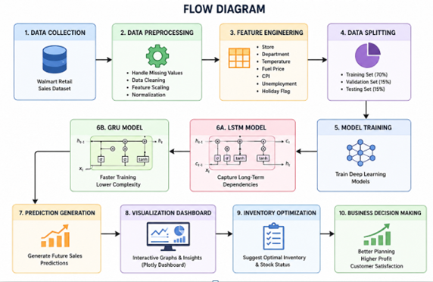
METHODOLOGY
Notes:
2

Slide 7
DATASET DESCRIPTION
Dataset Used
Walmart Retail Sales Dataset
Features Used
Store
Department
Weekly Sales
Temperature
Fuel Price
CPI
Unemployment
Holiday Information

Slide 8
MODULES WITH DESCRIPTION
Data Collection: Gathers Walmart dataset
Data Preprocessing: Cleans and formats data
Feature Engineering: Selects important features
LSTM Forecasting: Deep learning sequential model
GRU Forecasting: Fast recurent neural network
Optimization Module: Suggests stock levels
Visualization Module: Displays graphs and outputs

Slide 9
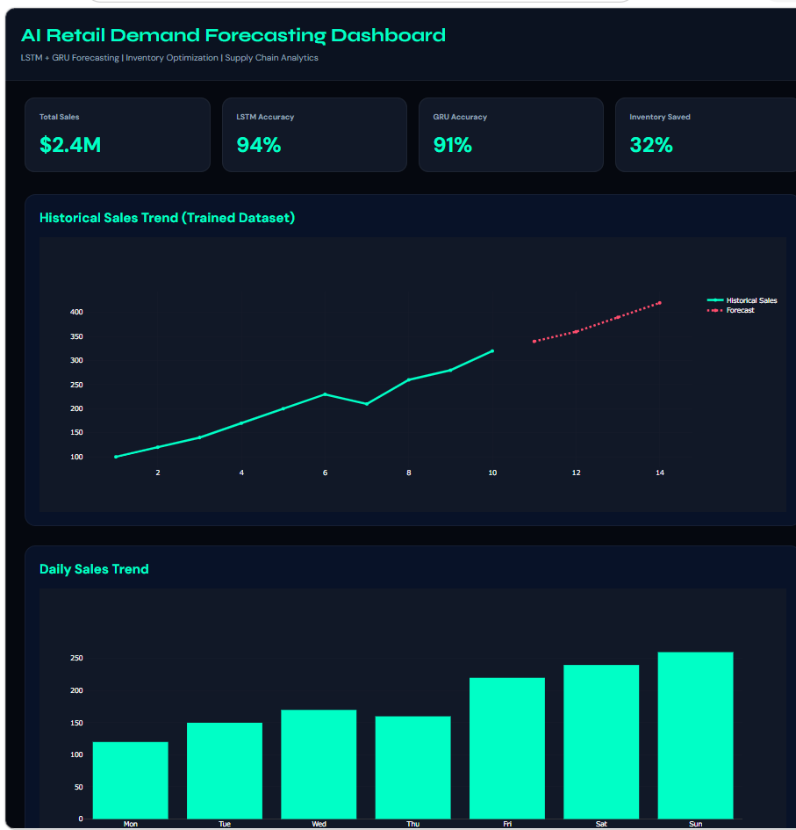
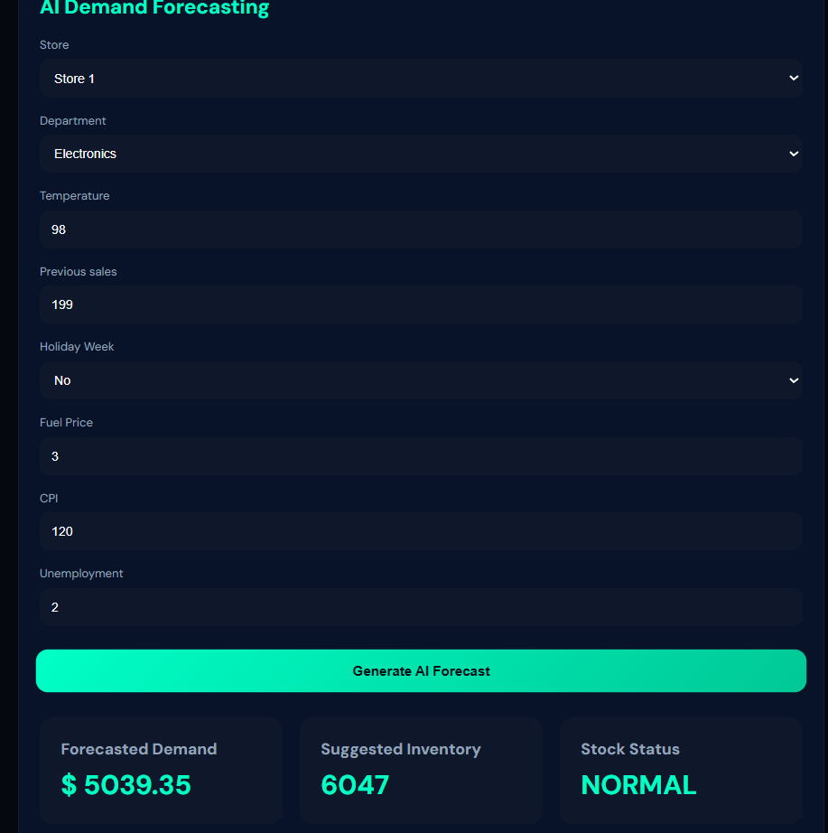
SCREENSHOT

Slide 10
PERFORMANCE METRICS
1. Mean Square Error
2.RMSE (Root Mean Square Error)
Evaluates prediction error.
3. Training Loss
Used to evaluate model learning performance.
4. Mean Absolute Error

Slide 11
RESULTS ACHIEVED
Accurate retail demand forecasting.
Reduced inventory wastage.
Improved stock management.
Better sales prediction trends.
Interactive visualization dashboard
High prediction accuracy.
Real-time forecasting support.
Improved business decision-making

Slide 12
CONCLUSION
AI Retail Demand Forecasting System successfully predicts future Walmart sales using LSTM and GRU deep learning models.
The project combines machine learning, data visualization, and web technologies to provide intelligent retail analytics.
By analyzing historical sales trends and external factors such as temperature, CPI, fuel price, and unemployment rate, the system improves inventory planning and demand forecasting accuracy.
The dashboard provides interactive visualizations, prediction graphs, and business insights that help retailers reduce stock shortages and optimize inventory management.

Slide 13
REFERENCES
Ye, L., Xie, N., Boylan, J. F., & Shang, Z., “Forecasting Seasonal Demand for Retail: A Fourier Time-Varying Grey Model,” International Journal of Forecasting, Elsevier, Vol. 40, No. 4, pp. 1467–1485, 2024.
“Retail Store-SKU Level Replenishment Planning with Attribute-Space Graph Recurrent Neural Networks,” Expert Systems with Applications, Elsevier, Vol. 249, 2024.
Qureshi, N. U. H., et al., “Demand Forecasting for Rossmann Stores Using a Weather-Enhanced Deep Learning Model,” IEEE Access, Vol. 12,. 145570–145581, 2024.
Theodoridis, G., & Tsadiras, A., “Retail Demand Forecasting: A Comparative Analysis of Deep Neural Networks and the Proposal of LSTMixer, a Linear Model Extension,” Information Journal, Vol. 16, No. 7. 596–610, 2025.

Slide 14
THANK YOU

