Slide 1
AZ-104T00A Module 08: Azure Virtual Machines

Slide 2
Module Overview
Lesson 01: Virtual Machine Planning
Lesson 02: Creating Virtual Machines
Lesson 03: Virtual Machine Availability
Lesson 04: Virtual Machine Extensions
Lesson 05: Module 08 Lab and Review​
Notes:
Module overview

Slide 3
Lesson 01: Virtual Machine Planning

Slide 4
Virtual Machine Planning Overview
IaaS Cloud Services
Planning Checklist
Location and Pricing
Virtual Machine Sizing
Virtual Machine Disks
Storage Options
Supported Operating Systems
Virtual Machine Connections
Notes:
Lesson overview

Slide 5
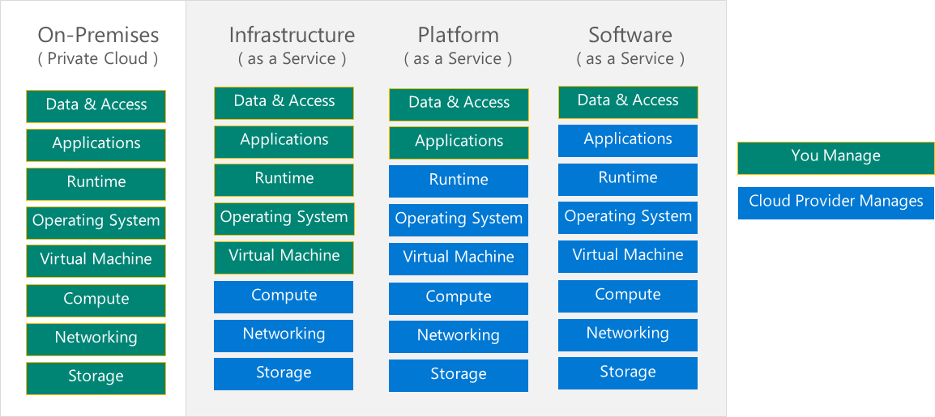
IaaS Cloud Services
Test and development, website hosting, storage, backup, recovery, high-performance computing, big data analysis, and extended data center
Notes:
Infrastructure as a Service - https://azure.microsoft.com/en-us/overview/what-is-iaas/

Slide 6
Planning Checklist
Start with the network
Name the VM
Decide the location for the VM
Determine the size of the VM
Understand the pricing model
Consider storage for the VM
Select an operating system

Slide 7

Location and Pricing
Location
Each region has different hardware and service capabilities
Locate virtual machines as close as possible to your users
Locate virtual machines to ensure compliance and legal obligations
Pricing
Compute costs
Storage costs (consumption-based and reserved instances)
55+ Azure regions
Available in 140 countries

Slide 8
Virtual Machine Sizing
VM Type | Sizes | Purpose
General Purpose | B, Dsv3, Dv3, Dasv4, Dav4, DSv2, Dv2, Av2, DC | Balanced CPU-to-memory ratio. Ideal for testing and development, small to medium databases, and low to medium traffic web servers.
Compute Optimized | Fsv2 | High CPU-to-memory ratio. Good for medium traffic web servers, network appliances, batch processes, and application servers.
Memory Optimized | Esv3, Ev3, Easv4, Eav4, Mv2, M, DSv2, Dv2 | High memory-to-CPU ratio. Great for relational database servers, medium to large caches, and in-memory analytics.
Storage Optimized | Lsv2 | High disk throughput and IO ideal for Big Data, SQL, NoSQL databases, data warehousing and large transactional databases.
GPU | NC, NCv2, NCv3, ND, NDv2 (Preview), NV, NVv3, NVv4 (Preview) | Specialized virtual machines targeted for heavy graphic rendering and video editing, as well as model training and inferencing (ND) with deep learning. Available with single or multiple GPUs.
High Performance Compute | HB, HC, H | Our fastest and most powerful CPU virtual machines with optional high-throughput network interfaces (RDMA).
Notes:
✔️ Be cautious when resizing production VMs - they will be rebooted automatically which can cause a temporary outage and change some configuration settings such as the IP address.
Sizes for Windows virtual machines in Azure - https://docs.microsoft.com/en-us/azure/virtual-machines/windows/sizes?toc=%2Fazure%2Fvirtual-machines%2Fwindows%2Ftoc.json#size-tables
Sizes for Linux virtual machines in Azure - https://docs.microsoft.com/en-us/azure/virtual-machines/linux/sizes?toc=%2fazure%2fvirtual-machines%2flinux%2ftoc.json

Slide 9
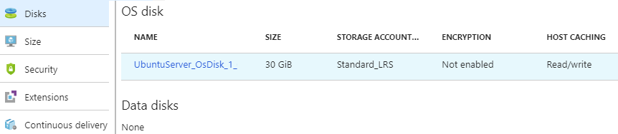
Virtual Machine Disks
Operating System Disks are SATA drives, labeled as C:
Temporary Disks provides short term storage
Data Disks are SCSI drives and depend on your virtual machine type
Notes:
✔️ Don’t store data on the temporary disk. It provides temporary storage for applications and processes and is intended to only store data such as page or swap files.

Slide 10
Storage Options
Premium storage offers high-performance, low-latency SSD disk support
Use premium storage for virtual machines with input/output (I/O)-intensive workloads
Two types of disks: Unmanaged and Managed
Unmanaged disks require you to manage the storage accounts and VHDs
Managed disks are maintained by Azure (recommended)

Slide 11
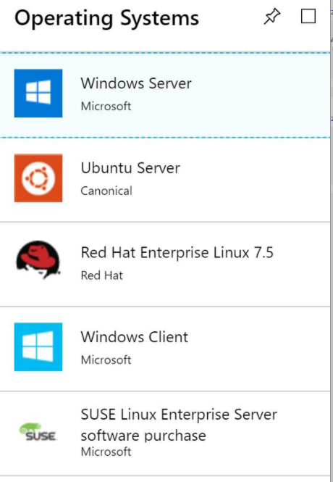
Supported Operating Systems
Windows Server includes many common products, requires a license, doesn’t support OS upgrades
Linux distributions are supported, upgrade of the OS is supported
Notes:
Microsoft server software support for Microsoft Azure virtual machines - https://support.microsoft.com/en-us/help/2721672/microsoft-server-software-support-for-microsoft-azure-virtual-machines
Linux on distributions endorsed by Azure - https://docs.microsoft.com/en-us/azure/virtual-machines/linux/endorsed-distros#supported-distributions–versions.

Slide 12




Virtual Machine Connections
Remote Desktop Protocol for Windows-based virtual machines
Secure Shell Protocol for Linux based virtual machines
Bastion Subnet for RDP/SSH through the Portal over SSL
Bastion Subnet
SSL
Private IP
Remote protocol
SSL
RDP
SSH
VM Subnet
< VNet >

Slide 13
Lesson 02: Creating Virtual Machines

Slide 14
Creating Virtual Machines Overview
Creating Virtual Machines in the Portal
Windows Virtual Machines
Windows VM Connections
Demonstration – Creating a VM in the Portal
Linux Virtual Machines
Linux VM Connections
Demonstration – Connect to Linux Virtual Machines
Notes:
Lesson overview

Slide 15
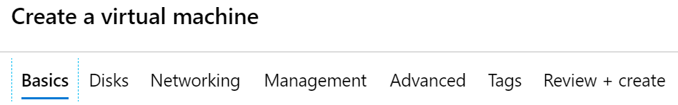
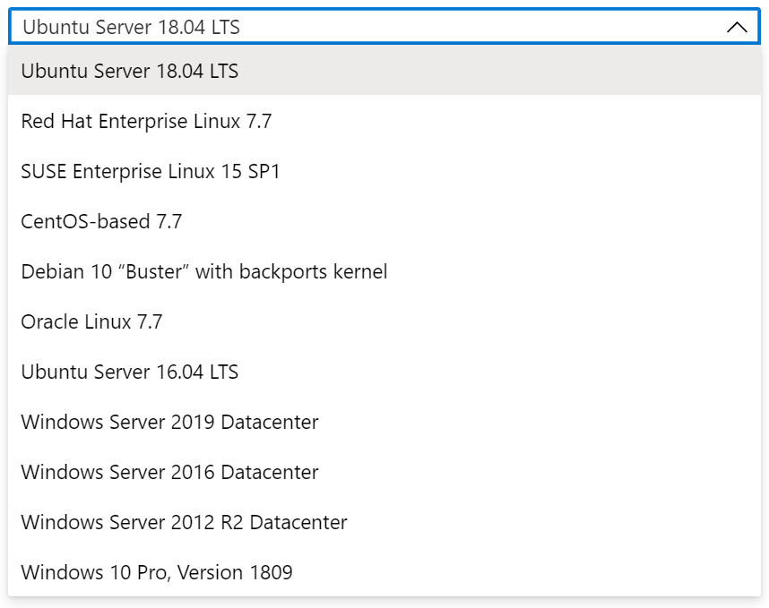
Creating Virtual Machines in the Portal
Basic (required) - Project details, Administrator account, Inbound port rules
Disks - OS disk type, data disks
Networking - Virtual networks, load balancing
Management - Monitoring, Auto-shutdown, Backup
Guest config - Add additional configuration, agents, scripts or applications

Slide 16
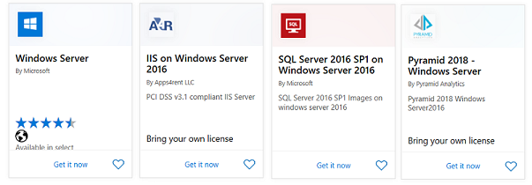
Windows Virtual Machines
Unique hybrid capabilities
Advanced multi-layer security
Faster innovation for applications
Unprecedented hyper-converged infrastructure
Notes:
Windows Virtual Machines Documentation - https://docs.microsoft.com/en-us/azure/virtual-machines/windows/

Slide 17
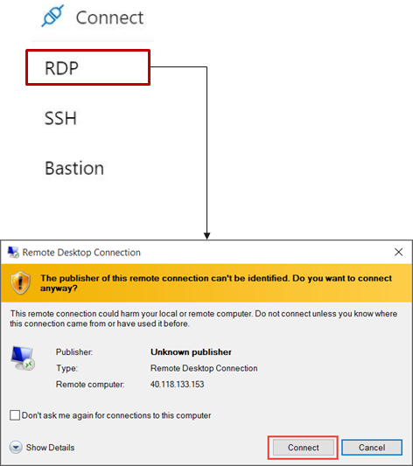
Windows VM Connections
Remote Desktop Protocol (RDP) creates a GUI session and accepts inbound traffic on TCP port 3389
WinRM creates a command-line session so can run scripts

Slide 18
Demonstration – Creating a VM in the Portal
Create the virtual machine
Connect to the virtual machine
Install the Web Server role
View the IIS welcome page
Notes:
✔ Always consider having students walk-through the demonstrations themselves. Also, consider the overlap with the formal labs and your best use of time.

Slide 19
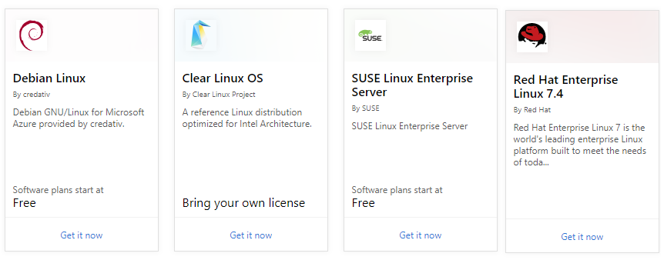
Linux Virtual Machines
Hundreds of community-built images in the Azure Marketplace
Linux has the same deployment options as for Windows VMs
Manage Linux VMs with many popular open-source DevOps tools
Notes:
Linux virtual machines (Documentation) - https://docs.microsoft.com/en-us/azure/virtual-machines/linux/

Slide 20
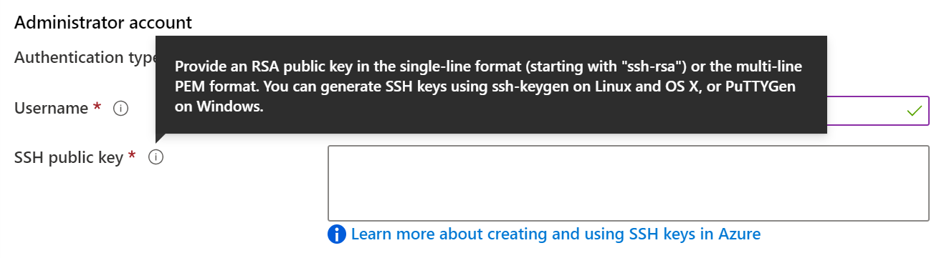
Linux VM Connections
Authenticate with a SSH public key or password
SSH is an encrypted connection protocol that allows secure logins over unsecured connections
There are public and private keys
Notes:
✔️ Azure currently requires at least a 2048-bit key length and the SSH-RSA format for public and private keys.

Slide 21
Demonstration – Connect to Linux VMs
Create the SSH keys
Create the Linux machine and assign the public SSH key
Access the server using SSH
Notes:
✔ Always consider having students walk-through the demonstrations themselves. Also, consider the overlap with the formal labs and your best use of time.

Slide 22
Lesson 03: Virtual Machine Availability

Slide 23
Virtual Machine Availability Overview
Maintenance and Downtime
Availability Sets
Update and Fault Domains
Availability Zones
Scaling Concepts
Scale Sets
Implementing Scale Sets
Autoscale
Implementing Autoscale
Notes:
Lesson overview

Slide 24
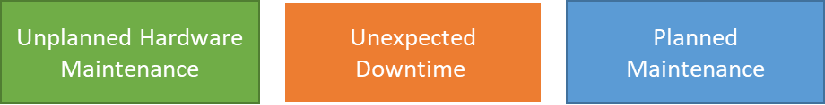
Maintenance vs. Downtime
When the platform predicts a failure, it will issue an unplanned hardware maintenance event. Action: Live migration.
Unexpected Downtime is when a virtual machine fails unexpectedly. Action: Automatically migrate (heal).
Planned Maintenance events are periodic updates made to the Azure platform. Action: No action.
Notes:
✔️ To reduce the impact of downtime due to one or more of these events, we recommend placing multiple virtual machines into an availability set (next topic).

Slide 25
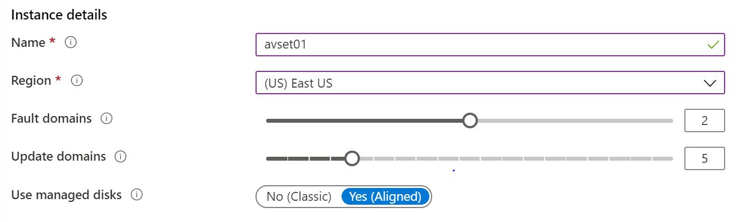
Availability Sets
Two or more instances in two or more availability Sets = 99.95% SLA
Configure multiple virtual machines in an Availability Set
Configure each application tier into separate Availability Sets
Combine a Load Balancer with Availability Sets
Use managed disks with the virtual machines
Notes:
✔️ You can create a virtual machine and an availability set at the same time. A VM can only be added to an availability set when it is created. To change the availability set, you need to delete and then recreate the virtual machine.

Slide 26
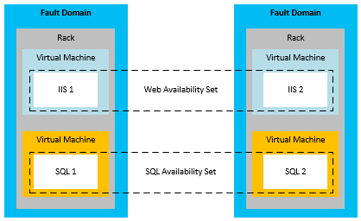
Update and Fault Domains
Update domains allows Azure to perform incremental or rolling upgrades across a deployment. During planned maintenance, only one update domain is rebooted at a time.
Fault Domains are a group of virtual machines that share a common set of hardware, switches, that share a single point of failure. VMs in an availability set are placed in at least two fault domains.
Notes:
✔️ Placing your virtual machines into an availability set does not protect your application from operating system or application-specific failures, it does limit the impact of potential physical hardware failures, network outages, or power interruptions. Can you see why this important and how this is implemented?

Slide 27
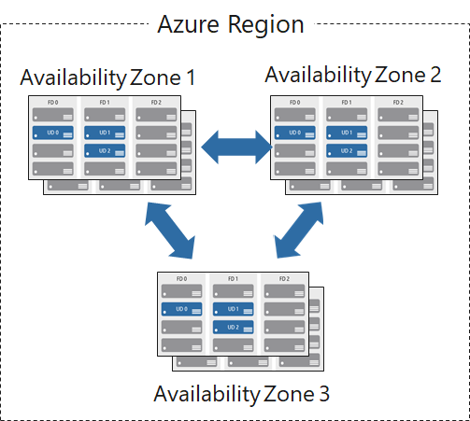
Availability Zones
Unique physical locations in a region
Includes datacenters with independent power, cooling, and networking
Protects from datacenter failures
Combines update and fault domains
Provides 99.99% SLA​

Slide 28
Scaling Concepts
Vertical scaling (scale up and scale down) is the process of increasing or decreasing power to a single instance of a workload; usually manual​
Horizontal scaling (scale out and scale in) is the process of increasing or decreasing power to a single instance of a workload; frequently automated​
Vertical scaling
Horizontal scaling

Slide 29
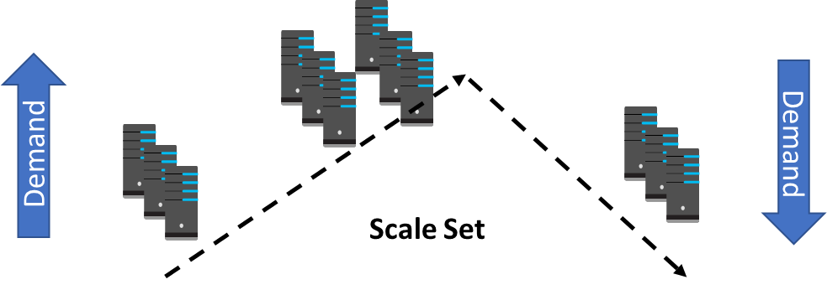
Scale Sets
Scale sets deploy a set of identical VMs
No pre-provisioning of VMs is required
As demand goes up VMs are added
As demand goes down VM are removed
The process can be manual, automated, or a combination of both

Slide 30
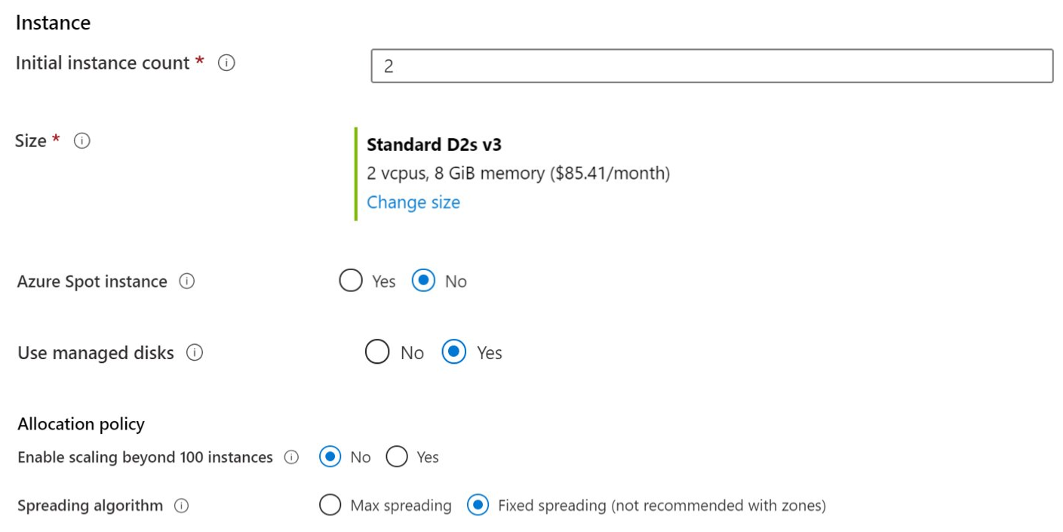
Implementing Scale Sets
Instance count. Number of VMs in the scale set (0 to 1000)
Instance size. The size of each virtual machine in the scale set
Azure Spot Instance. Unused capacity at a discounted rate
Use managed disks
Enable scaling beyond 100 instances

Slide 31
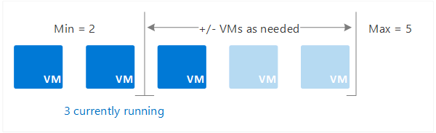
Autoscale
Define rules to automatically adjust capacity
Scale out (increase) the number of VMs in the set
Scale in (reduce) the number of VMs in the set
Schedule events to increase or decrease at a fixed time
Reduces monitoring and optimizes performance
Notes:
✔️ Autoscale minimizes the number of unnecessary VM instances that run your application when demand is low, while customers continue to receive an acceptable level of performance as demand grows and additional VM instances are automatically added.

Slide 32
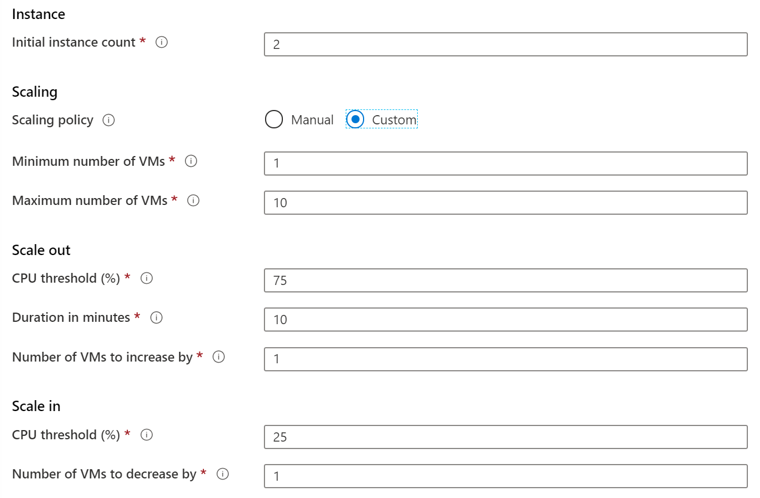
Implementing Autoscale
Define a minimum, maximum, and default number of VM instances
Create more advanced scale sets with scale out and scale in parameters
Notes:
Best Practices for Autoscale - https://docs.microsoft.com/en-us/azure/monitoring-and-diagnostics/insights-autoscale-best-practices

Slide 33
Lesson 04: Virtual Machine Extensions

Slide 34
Virtual Machine Extensions Overview
Virtual Machine Extensions
Custom Script Extensions
Desired State Configuration
Demonstration – Custom Script Extension
Notes:
Lesson overview

Slide 35
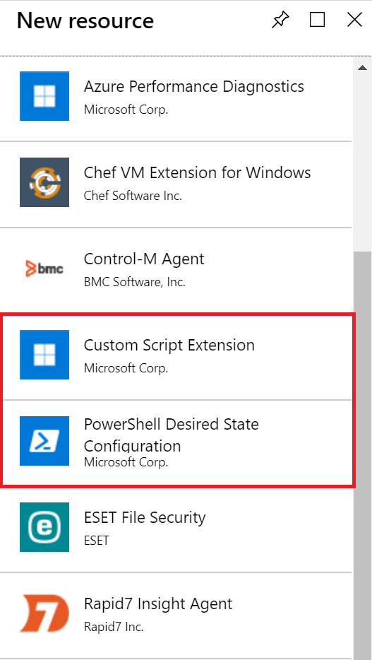
Virtual Machine Extensions
Extensions are small applications that provide post-deployment VM configuration and automation tasks
Managed with Azure CLI, PowerShell, Azure Resource Manager templates, and the Azure portal
Bundled with a new VM deployment or run against any existing system
Different for Windows and Linux machines
Notes:
Virtual machine extensions and features for Windows - https://docs.microsoft.com/en-us/azure/virtual-machines/extensions/features-windows?toc=%2Fazure%2Fvirtual-machines%2Fwindows%2Ftoc.json
Virtual machine extensions and features for Linux - https://docs.microsoft.com/en-us/azure/virtual-machines/extensions/features-linux

Slide 36
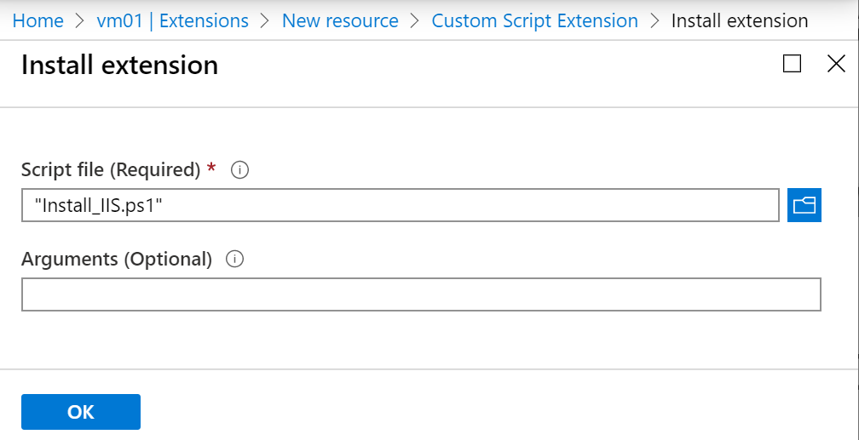
Custom Script Extensions
Extension scripts can be simple or complex
Extensions have 90 minutes to run
Double check dependencies to ensure availability
Account for any errors that might occur
Protect/encrypt sensitive information
✔️ For PowerShell use the Set-AzVmCustomScriptExtension command
Notes:
✔ Can you think of any custom script extensions that you might want to create?

Slide 37
Desired State Configuration
Configuration block(s) have a name
Node blocks define the computers or VMs that you are configuring
Resource block(s) configure the resource and its properties
There are many built-in configuration resources
configuration IISInstall
{
Node “localhost”
{
WindowsFeature IIS
{
Ensure = “Present”
Name = “Web-Server”
}
}
}

Slide 38
Demonstration – Custom Script Extension
Verify the Web Server feature is available on a virtual machine
Create a PowerShell script file to install the Web Server
Configure an Extension in the Portal to run the script
Verify the Web Server feature was installed
Notes:
✔ Always consider having students walk-through the demonstrations themselves. Also, consider the overlap with the formal labs and your best use of time.

Slide 39
Lesson 05: Module 08 Labs and Review

Slide 40
Lab 08 - Manage Virtual Machines
Lab scenario
You are tasked with identifying different options for deploying and configuring Azure virtual machines.
Objectives
Task 1: Deploy zone-resilient virtual machines in the Azure portal and with templates.
Task 2: Configure Azure virtual machines by using virtual machine extensions.
Task 3: Scale compute and storage for Azure virtual machines.
Task 4: Deploy zone-resilient scale sets by using the Azure portal.
Task 5: Configure Azure virtual machine scale sets by using extensions.
Task 6: Scale compute and storage for Azure virtual machine scale sets.

Slide 41
Module 08 Review
Module Review Questions
Microsoft Learn Modules (docs.microsoft.com/Learn)
Build a scalable application with virtual machine scale sets
Deploy Azure virtual machines from VHD templates
Choose the right disk storage for your virtual machine workload
Add and size disks in Azure virtual machines
Protect your virtual machine settings with Azure Automation State Configuration
Notes:
https://docs.microsoft.com/en-us/learn/modules

