Slide 1

Brrrgrrr: A Customizable Burger Ordering Platform
Brrrgrrr is a web application built using the MERN stack (MongoDB, Express.js, React.js, and Node.js) that allows users to create and order customized burgers. Users have complete control over their burger, selecting ingredients and adjusting quantities to suit their preferences. The platform dynamically calculates the total bill based on the chosen ingredients and their quantities. Additionally, users can access a detailed order history and a dedicated page showcasing nutritional information and pricing for all available ingredients.

Slide 2
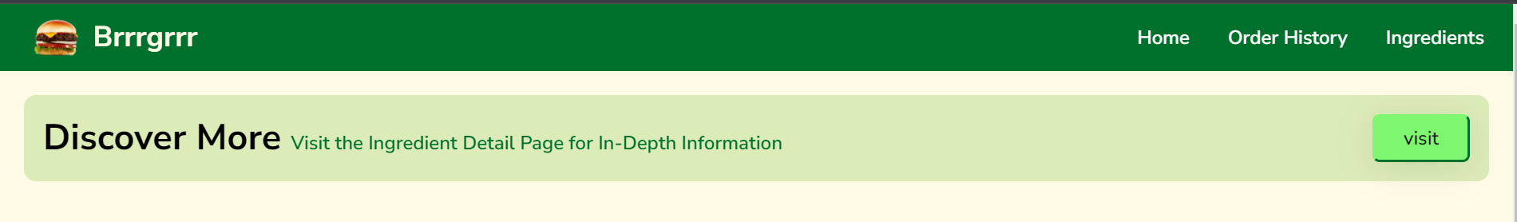
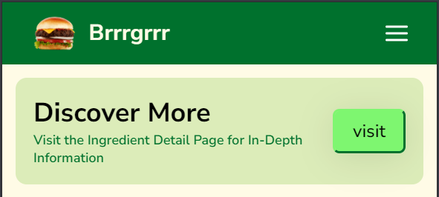
Header (Desktop) :
Header (Mobile) :

Slide 3
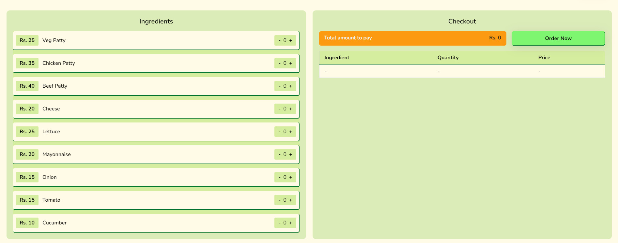
Home Page (Desktop) :

Slide 4
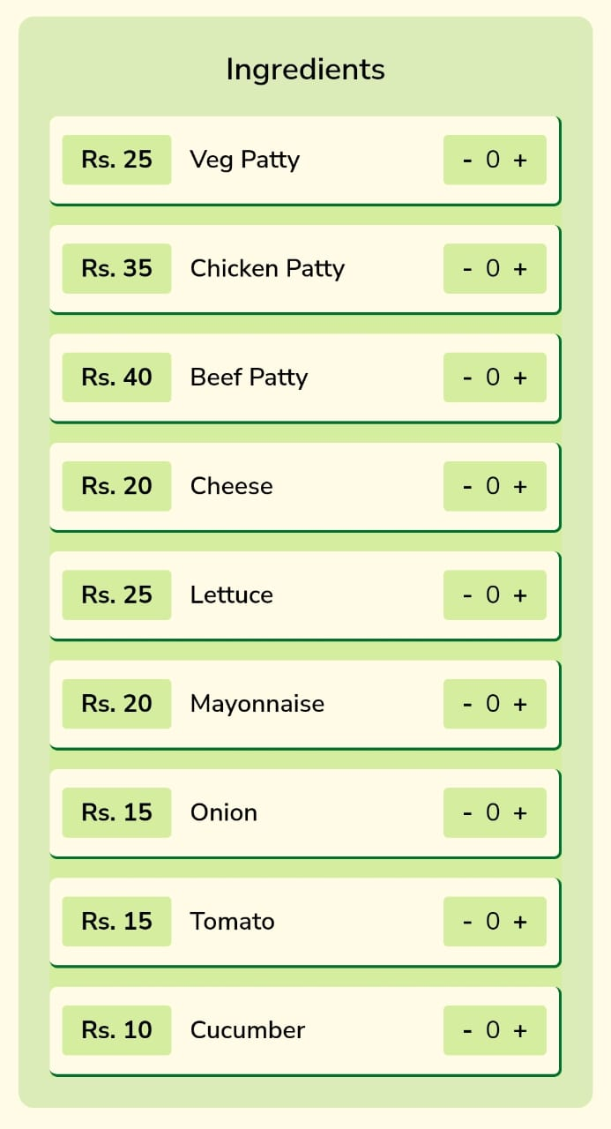
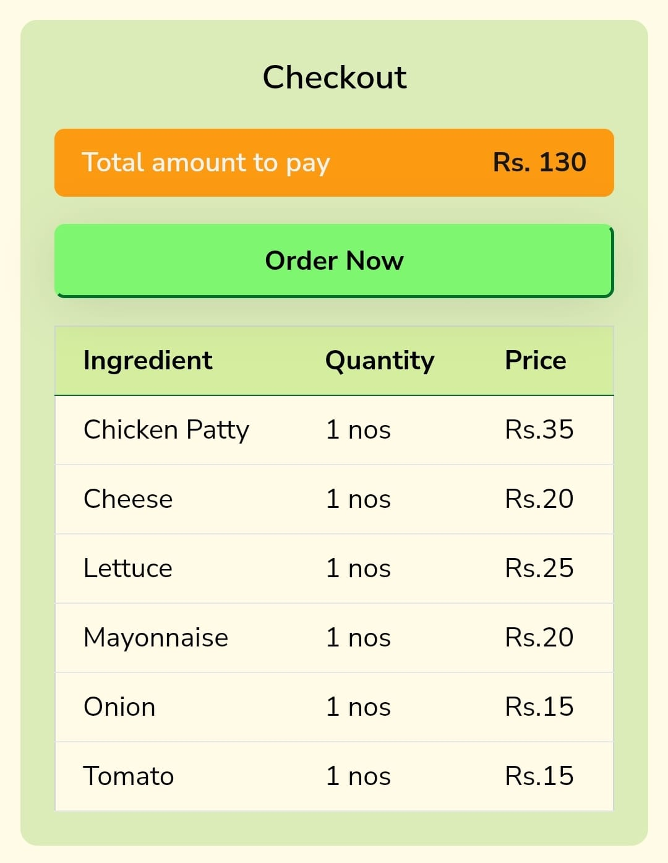
Home Page (Mobile) :

Slide 5
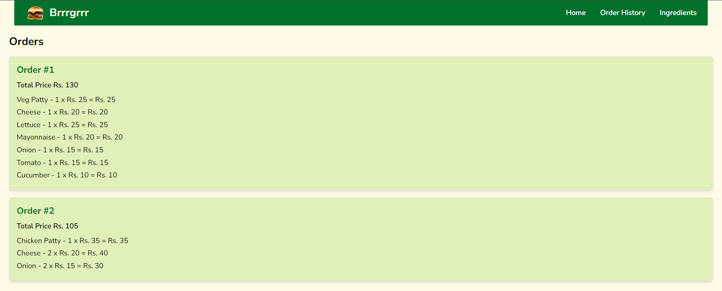
Order History (Desktop) :

Slide 6
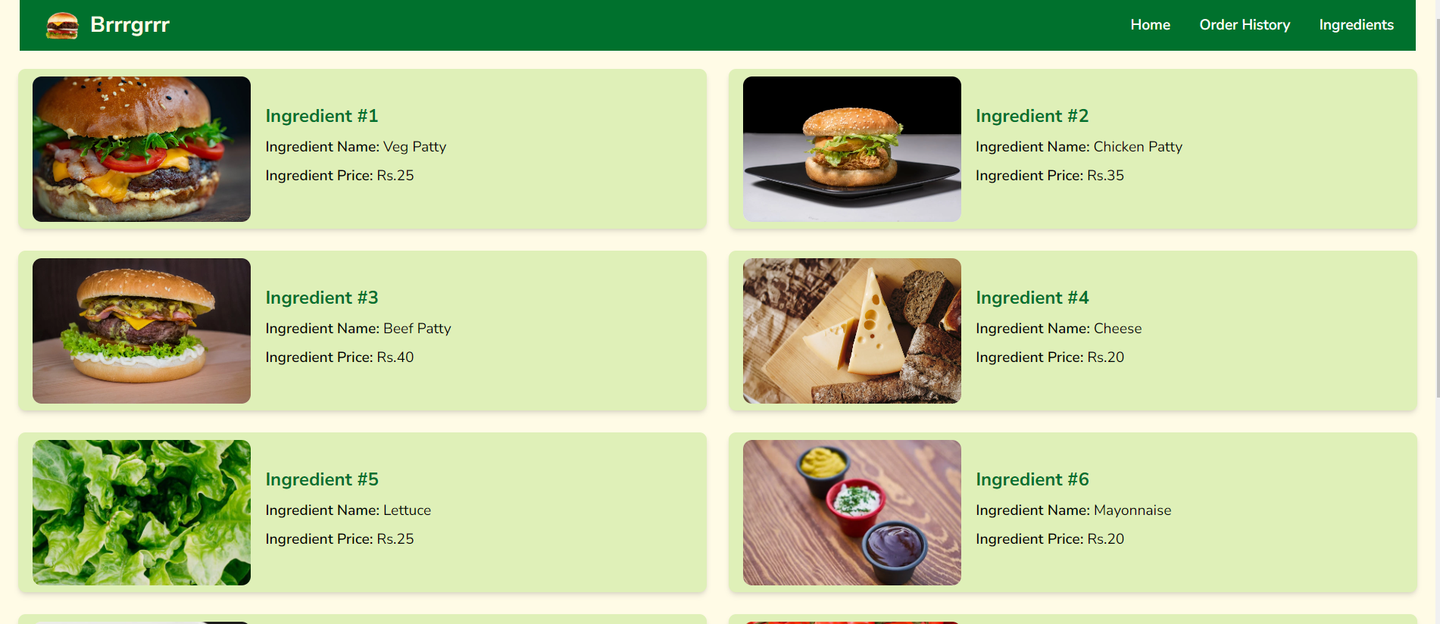
Ingredients (Desktop) :

Slide 7
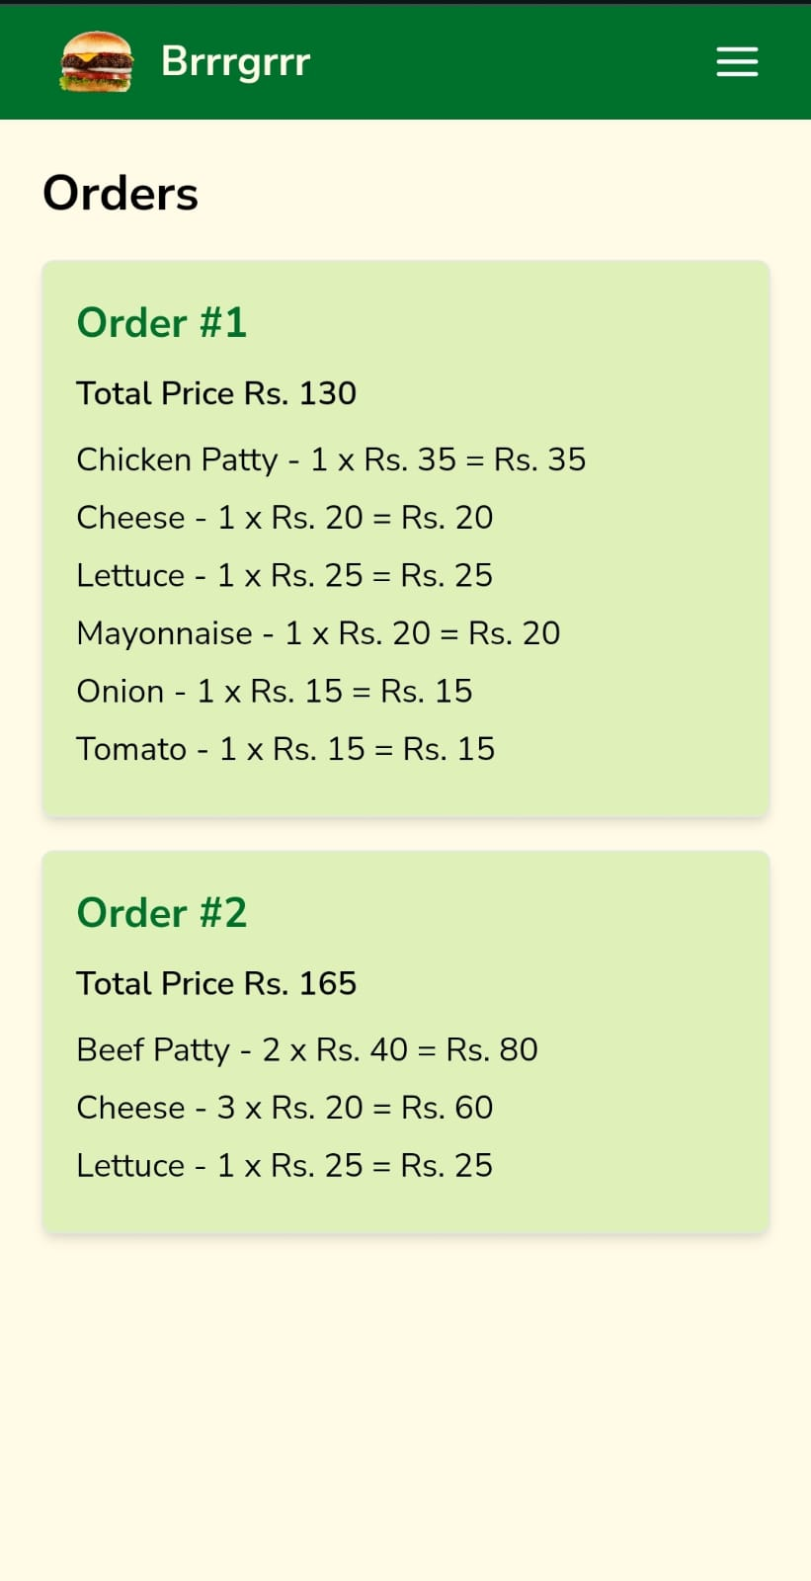
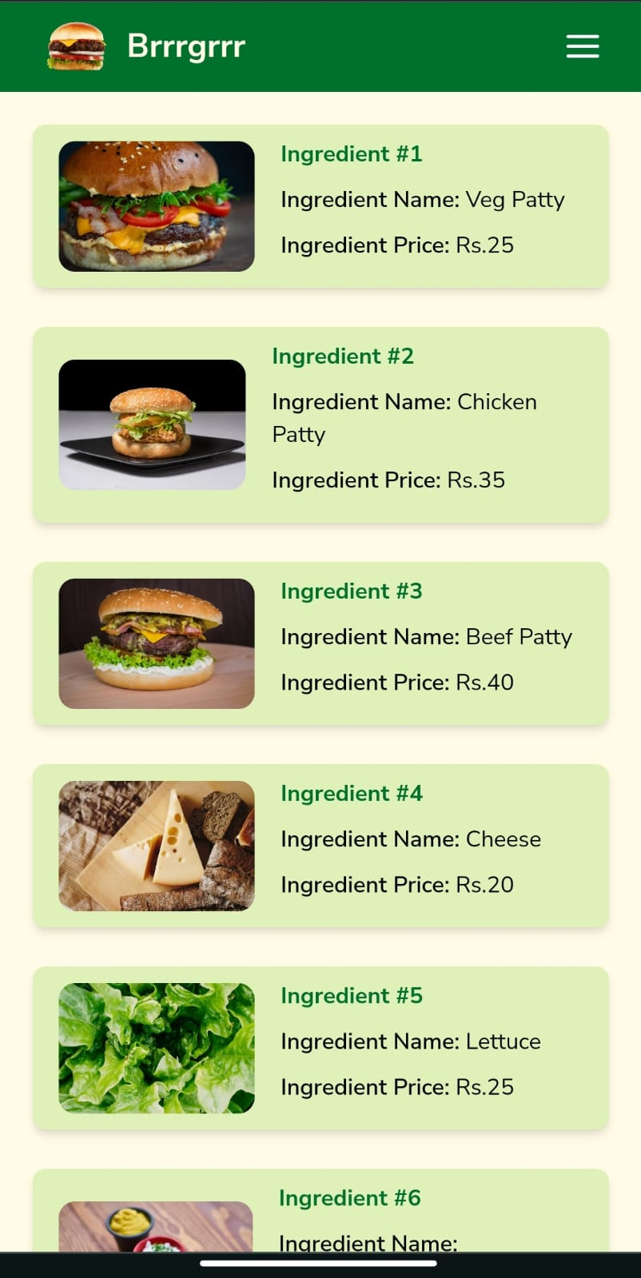
Order History (Mobile) :
Ingredients (Mobile) :

