Slide 1


Understanding Keyloggers
Keyloggers are a serious threat to your privacy and security. This presentation explains what they are, how they work, and what you can do to protect yourself.
by DHARUN KUMAR V

Slide 2


What is a Keylogger?
A keylogger is a type of software or hardware that records your keystrokes. These programs are designed to secretly capture everything you type, including passwords, credit card numbers, and personal information.
Purpose of Keyloggers
Keyloggers are often used by hackers to steal your identity, access your bank accounts, or commit other crimes.
Consequences of Keyloggers
The consequences of being infected by a keylogger can be severe, including financial loss, identity theft, and even legal repercussions.

Slide 3
Types of Keyloggers
Keyloggers can be classified into two main categories: software keyloggers and hardware keyloggers.
Software Keyloggers
Hardware Keyloggers
These keyloggers are installed on your device. They are designed to secretly record your keystrokes and send the data to the hacker.
These keyloggers are physical devices that are attached to your keyboard. They capture everything you type without being noticed.

Slide 4





How Keyloggers Work
Keyloggers work by secretly capturing and recording your keystrokes, often without your knowledge.
Installation
The keylogger is installed on your device or attached to your keyboard.
Recording
The keylogger silently records all the keystrokes you make.
Transmission
The recorded data is sent to the hacker, either through the internet or other means.

Slide 5

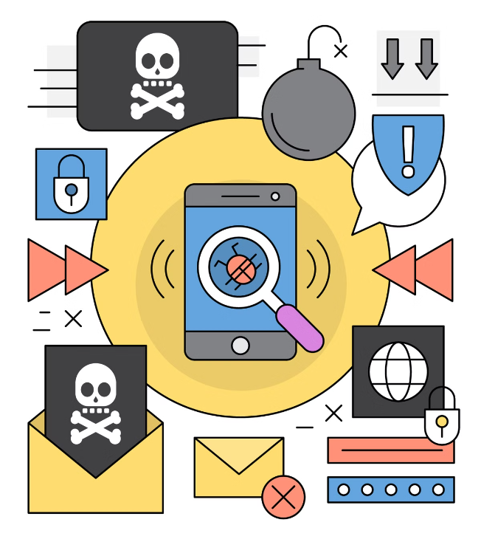
How Keyloggers Are Installed
Keyloggers can be installed on your device in a variety of ways, often using deceptive techniques.
1
Phishing Emails
Hackers send fake emails that trick you into downloading and installing the keylogger.
2
Malware
Viruses or malware can install keyloggers on your device without your knowledge.
3
Physical Access
A hacker can physically attach a hardware keylogger to your keyboard if they have access to your device.

Slide 6
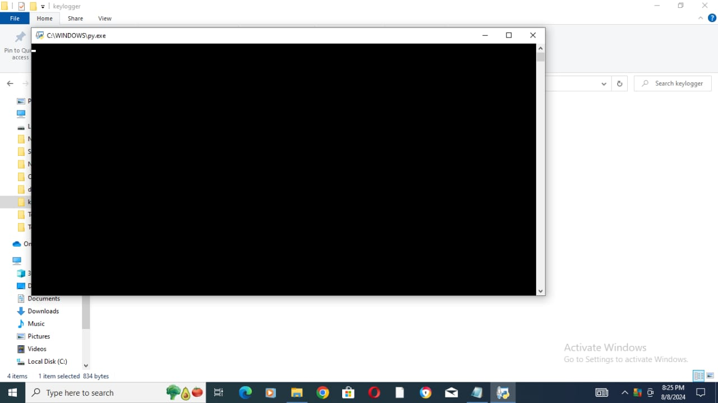

Slide 7
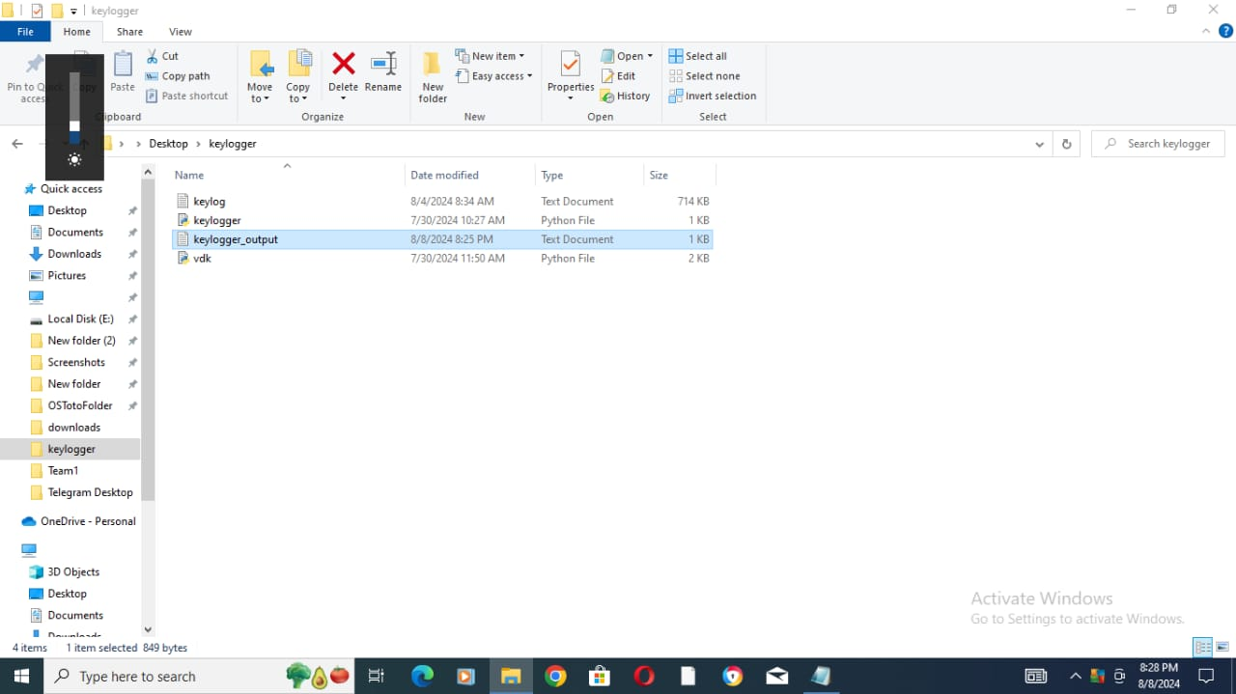

Slide 8
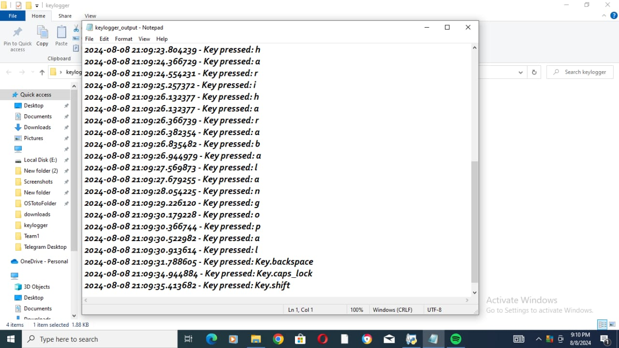

Slide 9

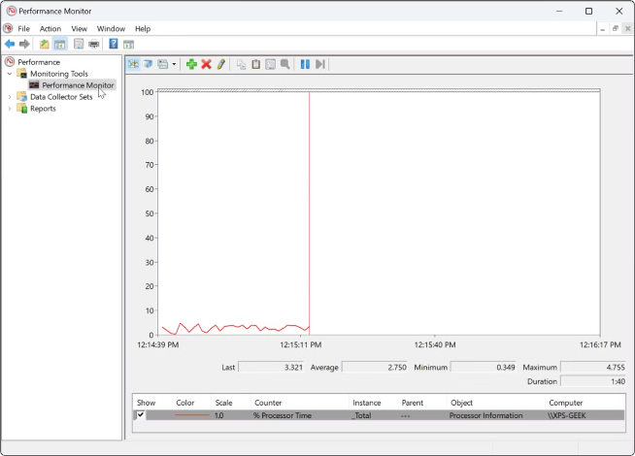
Signs of a Keylogger on Your Device
While keyloggers often operate in the background, there are certain signs that might indicate the presence of a keylogger.
Slower Performance
Your device may run slower than usual, lagging, and freezing.
Unusual Activity
Programs may open or close by themselves, and you may see strange activity on your screen.
Increased Data Usage
You may experience unexpected data usage if a software keylogger is sending information to the hacker.

Slide 10





How to Protect Yourself
There are several steps you can take to protect yourself from keyloggers.
Antivirus Software
Physical Security
Suspicious Links
Regular Scans
Keep your antivirus software updated and perform regular scans to detect and remove keyloggers.
Keep your devices secure to prevent anyone from attaching a hardware keylogger to your keyboard.
Avoid clicking on suspicious links or downloading attachments from unknown emails.
Perform regular security scans on your device to detect any potential threats.

Slide 11



