Slide 1


M.Tech/MCA Program
Advanced Industry Integrated Programs
Jointly offered by University and LTIMindTree
Review II
Project Title
AEGIE : A Research Framework for Adaptive Agentic AI Based Voice Interview Evaluation
Team Member
DHASLIM N (251011007)
T9951
Knowledge partner | Implementation partner

Slide 2
AEGIE : A Research Framework for Adaptive Agentic AI Based Voice Interview Evaluation
Introduction
AEGIE is an AI-based voice interview evaluation system.
It records the candidate's spoken answers during an interview.
NVIDIA Parakeet converts the recorded speech into text.
MiniLM and AI agents analyse the answer and generate measurable evidence.

Slide 3
AEGIE : A Research Framework for Adaptive Agentic AI Based Voice Interview Evaluation
Objective
Conduct a real-time voice-based technical interview.
Measure speaking features such as WPM, fillers and pauses.
Analyse answer meaning using semantic and concept similarity.
Adapt the next question difficulty based on previous-answer evidence.

Slide 4
AEGIE : A Research Framework for Adaptive Agentic AI Based Voice Interview Evaluation
Module name
Interview Module: Records candidate voice and manages questions.
Transcription Module: Converts speech into text using Parakeet.
Evaluation Module: Calculates speech and semantic evidence.
Agentic Module: Handles adaptation, feedback and result generation.

Slide 5
AEGIE : A Research Framework for Adaptive Agentic AI Based Voice Interview Evaluation
Methodology/Modeling Plan
Capture the candidate's answer through the microphone.
Convert voice into a transcript using Parakeet STT.
Generate semantic embeddings and similarities using MiniLM.
Combine the evidence for adaptive questioning and feedback.

Slide 6
AEGIE : A Research Framework for Adaptive Agentic AI Based Voice Interview Evaluation
Data preprocessing & EDA
Clean and organize the interview question and reference-answer data.
Store questions according to Easy, Medium and Hard difficulty.
Process transcripts into sentences for semantic comparison.
Store evaluation features for later analysis and model calibration.

Slide 7
AEGIE : A Research Framework for Adaptive Agentic AI Based Voice Interview Evaluation
Approach/Algorithms/Tools
Flask: Web application and interview interface.
NVIDIA Parakeet: Speech-to-text transcription.
MiniLM: Whole-answer, sentence and concept semantic similarity.
Python + Agent Workflow: Evaluation, adaptation and feedback processing.

Slide 8
AEGIE : A Research Framework for Adaptive Agentic AI Based Voice Interview Evaluation
Project plan/milestones progress
Voice recording and Parakeet transcription completed.
Speech-feature and MiniLM evaluation completed.
Rule-based adaptive questioning and feedback implemented.
Next stage is human annotation, calibration and validation.

Slide 9
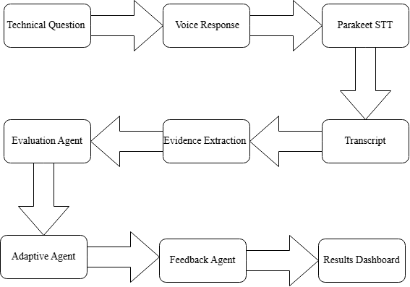
AEGIE : A Research Framework for Adaptive Agentic AI Based Voice Interview Evaluation
Pipeline structure

Slide 10
M.Tech/MCA Program
Advanced Industry Integrated Programs
Jointly offered by University and LTIMindTree
Review II
Project Title
ServiceSense AI – Customer Complaint Classification & Resolution Intelligence
Team Member
DHASLIM N (251011007)
T9951
Knowledge partner | Implementation partner

Slide 11
Service Sense AI – Customer Complaint Classification & Resolution Intelligence
Introduction
ServiceSense AI is a customer complaint classification and resolution support system.
It understands customer complaints written in text form.
It predicts the complaint category and customer intent.
It also retrieves similar past complaints and suggests suitable resolutions.

Slide 12
Service Sense AI – Customer Complaint Classification & Resolution Intelligence
Objective
Automatically identify the customer complaint intent.
Reduce manual work for customer-support teams.
Provide relevant resolution support using similar past complaints.
Send weak or unsupported complaints for manual review.

Slide 13
Service Sense AI – Customer Complaint Classification & Resolution Intelligence
Module name
Complaint Input Module – accepts customer complaint text.
ML Classification Module – predicts the customer intent.
RAG Retrieval Module – finds similar previous complaints.
Hybrid Decision Module – selects ML, RAG, or Manual Review.

Slide 14
Service Sense AI – Customer Complaint Classification & Resolution Intelligence
Methodology/Modeling Plan
Convert complaint text into numerical features using TF-IDF.
Train Logistic Regression and Random Forest models.
Use FAISS to retrieve similar complaint records.
Combine ML and RAG results using a confidence-based Hybrid Decision.

Slide 15
Service Sense AI – Customer Complaint Classification & Resolution Intelligence
Data preprocessing & EDA
Load the customer-support dataset using Pandas.
Select complaint, category, intent, and response columns.
Clean missing or unnecessary text values.
Study the distribution of categories and intent classes.

Slide 16
Service Sense AI – Customer Complaint Classification & Resolution Intelligence
Approach/Algorithms/Tools
TF-IDF – converts complaint text into numerical features.
Logistic Regression – main model for intent classification.
FAISS – retrieves similar complaints for RAG support.
Flask + Docker – used to build and deploy the demo application.

Slide 17
Service Sense AI – Customer Complaint Classification & Resolution Intelligence
Project plan/milestones progress
Dataset preparation and preprocessing completed.
ML model training and comparison completed.
FAISS RAG and Hybrid Decision completed.
Flask UI and Docker deployment completed.

Slide 18
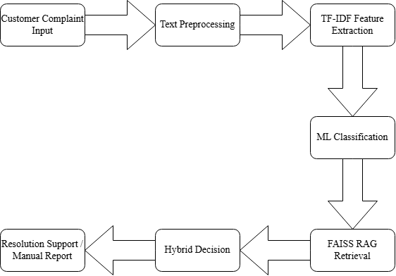
Service Sense AI – Customer Complaint Classification & Resolution Intelligence
Pipeline structure

