Slide 1


M.Tech/MCA Program
Advanced Industry Integrated Programs
Jointly offered by University and LTIMindTree
Review III
Project Title
AEGIE : A Research Framework for Adaptive Agentic AI Based Voice Interview Evaluation
Team Member
DHASLIM N (251011007)
T9951
Knowledge partner | Implementation partner

Slide 2
AEGIE : A Research Framework for Adaptive Agentic AI Based Voice Interview Evaluation
Introduction
AEGIE is a voice-based AI system for technical interview evaluation.
NVIDIA Parakeet converts the candidate’s spoken answer into text.
MiniLM checks the answer at whole-answer, sentence, and concept levels.
Agentic AI is used to evaluate the response, select the next question, and show feedback.

Slide 3
AEGIE : A Research Framework for Adaptive Agentic AI Based Voice Interview Evaluation
Objective
Convert the candidate’s voice response into text automatically.
Measure delivery features such as speaking rate, fillers, and pauses.
Compare the answer with expected technical content using MiniLM.
Adapt the next question difficulty and provide clear feedback.

Slide 4
AEGIE : A Research Framework for Adaptive Agentic AI Based Voice Interview Evaluation
Module name
Speech Processing Module – records voice and converts speech into text using NVIDIA Parakeet.
Semantic Analysis Module – compares the response with reference content using MiniLM.
Adaptive Agent Module – selects the next question difficulty from the current evidence.
Feedback Module – displays semantic evidence, speech measures, and the final prototype level.

Slide 5
AEGIE : A Research Framework for Adaptive Agentic AI Based Voice Interview Evaluation
Problem Statement
Traditional technical interviews depend heavily on manual evaluation by interviewers.
Different interviewers may judge the same answer in different ways.
Existing systems often focus on only speech features or only answer content.
AEGIE combines voice analysis, semantic evidence, adaptive questioning, and feedback in one system.

Slide 6
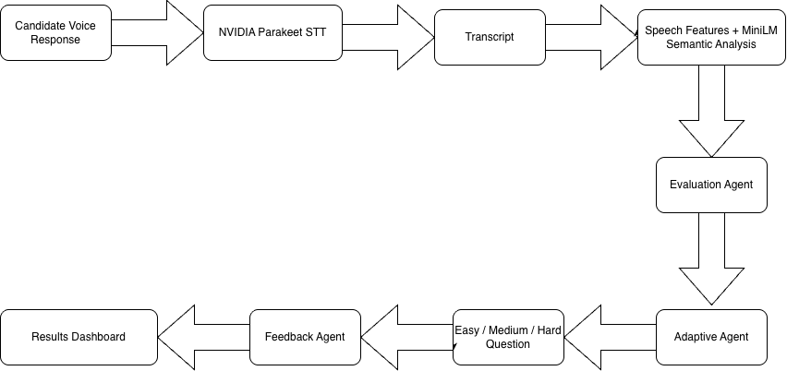
AEGIE : A Research Framework for Adaptive Agentic AI Based Voice Interview Evaluation
Methodology

Slide 7
AEGIE : A Research Framework for Adaptive Agentic AI Based Voice Interview Evaluation
Approach/Algorithms/Tools
NVIDIA Parakeet is used for speech-to-text transcription.
MiniLM is used for semantic similarity and concept matching.
Rule-based Agentic AI controls Easy, Medium, and Hard question adaptation.
Python, Flask, and MLflow are used for application development and experiment tracking.

Slide 8
AEGIE : A Research Framework for Adaptive Agentic AI Based Voice Interview Evaluation
Findings and Results
The five-question prototype completed the full voice-to-feedback workflow successfully.
Average speaking rate was 117.33 WPM, with 1 filler and 10 pauses recorded.
Mean whole-answer similarity was 0.6522 and mean concept similarity was 0.4994.
The final prototype evidence score was 0.5605, which falls in the Intermediate range.

Slide 9
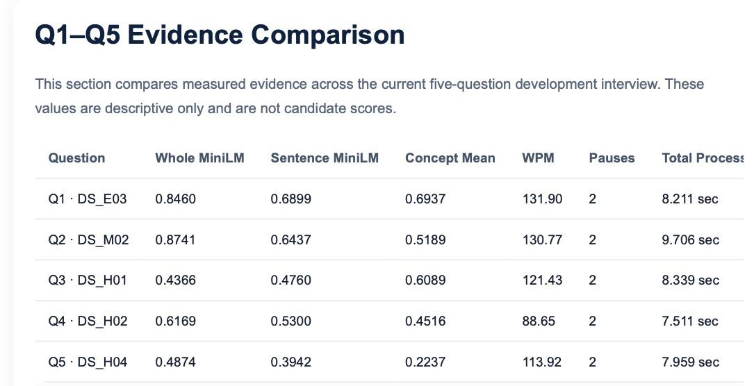
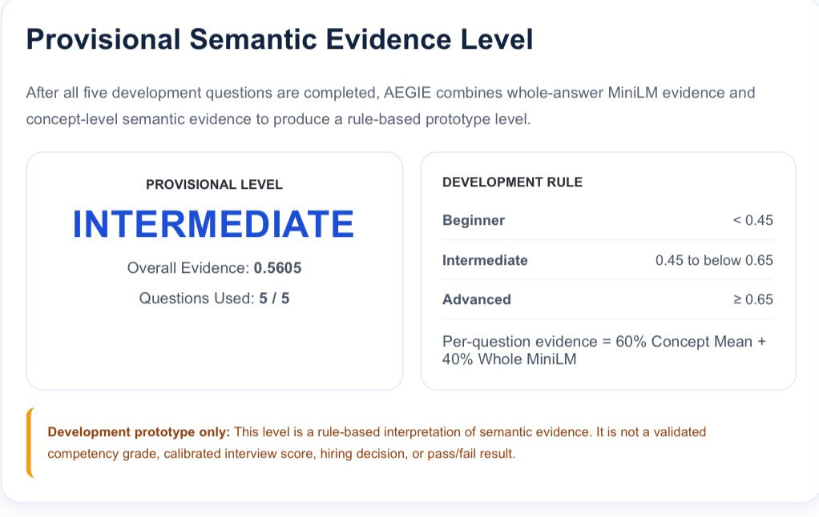

Slide 10
AEGIE : A Research Framework for Adaptive Agentic AI Based Voice Interview Evaluation
Conclusion
AEGIE successfully combines voice processing, semantic analysis, adaptive questioning, and feedback in one workflow.
NVIDIA Parakeet and MiniLM provide speech transcription and semantic evidence for each response.
The prototype can adapt question difficulty using the evidence generated from the current answer.
Future work will use real participant data and expert evaluation to improve calibration and validation.

Slide 11
AEGIE : A Research Framework for Adaptive Agentic AI Based Voice Interview Evaluation
Acknowledgement
I thank my project guide for continuous guidance and technical support.
I thank the faculty members of Rajalakshmi Engineering College for their suggestions.
I thank the industry mentor from L&T EduTech for valuable project inputs.
I also thank my department and institution for providing the required support and facilities.

Slide 12
AEGIE : A Research Framework for Adaptive Agentic AI Based Voice Interview Evaluation
Reference
Reimers and I. Gurevych, “Sentence-BERT: Sentence Embeddings Using Siamese BERT-Networks,” 2019.
W. Wang et al., “MiniLM: Deep Self-Attention Distillation for Task-Agnostic Compression of Pre-Trained Transformers,” 2020.
I. Naim et al., “Automated Analysis and Prediction of Job Interview Performance,” IEEE Trans. Affect. Comput., 2018.
H.-Y. Suen et al., “Intelligent Video Interview Agent Used to Predict Communication Skill and Perceived Personality Traits,” 2020.

Slide 13
M.Tech/MCA Program
Advanced Industry Integrated Programs
Jointly offered by University and LTIMindTree
Review III
Project Title
ServiceSense AI – Customer Complaint Classification & Resolution Intelligence
Team Member
DHASLIM N (251011007)
T9951
Knowledge partner | Implementation partner

Slide 14
Service Sense AI – Customer Complaint Classification & Resolution Intelligence
Introduction
ServiceSense AI is designed to automate and improve customer complaint resolution.
It combines semantic classification with hybrid retrieval to understand customer issues.
An uncertainty-aware mechanism identifies ambiguous complaints and requests clarification.
LangGraph enables multi-turn interaction, satisfaction checking, re-resolution, and escalation.

Slide 15
ServiceSense AI – Customer Complaint Classification & Resolution Intelligence
Objective
Classify customer complaints accurately using semantic embeddings and machine learning.
Retrieve relevant support responses using BM25 and MiniLM-FAISS hybrid retrieval.
Detect uncertain cases and decide whether to resolve, clarify, or escalate the complaint.
Provide multi-turn resolution with satisfaction checking and human escalation when required.

Slide 16
ServiceSense AI – Customer Complaint Classification & Resolution Intelligence
Module name
Classification Module: MiniLM embeddings and Logistic Regression identify customer intent.
Retrieval Module: BM25 and FAISS retrieve relevant customer-support information.
Decision Module: RRF, Cross-Encoder, and uncertainty logic select reliable results.
Agent Module: LangGraph manages clarification, resolution, follow-up, and escalation.

Slide 17
ServiceSense AI – Customer Complaint Classification & Resolution Intelligence
Problem Statement
Traditional complaint classification systems mainly provide single-turn predictions or responses.
Ambiguous customer complaints can result in incorrect intent prediction and unsuitable resolutions.
Single retrieval methods may fail to capture both keyword relevance and semantic similarity.
A stateful system is required to clarify uncertainty and continue until resolution or escalation.

Slide 18
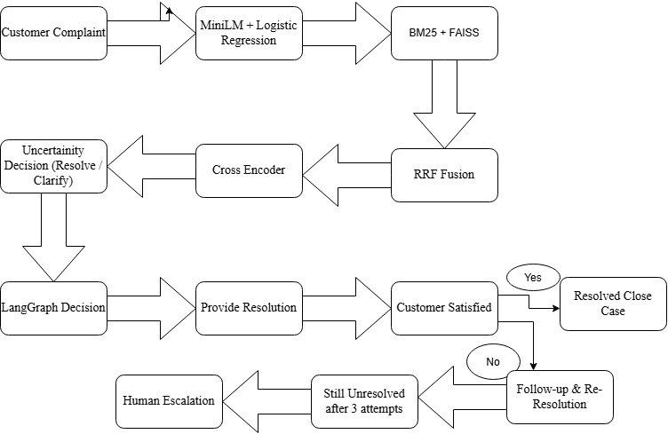
ServiceSense AI – Customer Complaint Classification & Resolution Intelligence
Methodology

Slide 19
ServiceSense AI – Customer Complaint Classification & Resolution Intelligence
Approach/Algorithms/Tools
Classification: MiniLM embeddings with Logistic Regression for intent prediction and confidence estimation.
Retrieval: BM25 + MiniLM-FAISS with Reciprocal Rank Fusion for hybrid information retrieval.
Decision & Agent: Cross-Encoder, uncertainty logic, and LangGraph for stateful multi-turn resolution.
Development & Deployment: Python, Flask, Scikit-learn, Sentence Transformers, MLflow, and Docker.

Slide 20
ServiceSense AI – Customer Complaint Classification & Resolution Intelligence
Findings and Results
Semantic intent classification achieved 99.40% accuracy on the controlled test split.
Leakage-free retrieval achieved 99.00% Recall@1 and 99.33% Recall@3 and Recall@5.
The hybrid retrieval pipeline obtained an MRR of 0.9911 on 300 held-out queries.
The agentic workflow passed 7/7 predefined tests, covering clarification through escalation.

Slide 21
Metric | Result
Classification Accuracy | 99.40%
Recall@1 | 99.00%
Recall@5 | 99.33%
Agentic Workflow Test Pass Rate | 100% (7/7 tests)

Slide 22
ServiceSense AI – Customer Complaint Classification & Resolution Intelligence
Conclusion
ServiceSense AI extends complaint classification into a stateful multi-turn resolution framework.
Hybrid retrieval combines keyword and semantic information for more relevant support retrieval.
Uncertainty handling reduces the risk of immediately answering ambiguous customer complaints.
LangGraph enables clarification, satisfaction checking, re-resolution, and human escalation.

Slide 23
ServiceSense AI – Customer Complaint Classification & Resolution Intelligence
Acknowledgement
I sincerely thank my project guide for continuous guidance and valuable suggestions.
I thank the faculty members for their support throughout the project development.
I acknowledge L&T EduTech and LTIMindtree for providing the industry-integrated learning opportunity.
I also thank everyone who supported the successful development and evaluation of this project.

Slide 24
ServiceSense AI – Customer Complaint Classification & Resolution Intelligence
Reference
Reimers, N. & Gurevych, I. — Sentence-BERT: Sentence Embeddings using Siamese BERT-Networks.
Johnson, J. et al. — Billion-scale Similarity Search with GPUs (FAISS).
Cormack, G. et al. — Reciprocal Rank Fusion Outperforms Condorcet and Individual Rank Learning Methods.
Robertson, S. & Zaragoza, H. — The Probabilistic Relevance Framework: BM25 and Beyond.

