Slide 1


M.Tech/MCA Program
Advanced Industry Integrated Programs
Jointly offered by University and LTIMindTree
Review III
Project Title
AEGIE : A Research Framework for Adaptive Agentic AI Based Voice Interview Evaluation
Team Member
DHASLIM N (251011007)
T9951
Knowledge partner | Implementation partner

Slide 2
AEGIE : A Research Framework for Adaptive Agentic AI Based Voice Interview Evaluation
Introduction
AEGIE is a voice-based AI system for technical interview evaluation.
NVIDIA Parakeet converts the candidate’s spoken answer into text.
MiniLM checks the answer at whole-answer, sentence, and concept levels.
Agentic AI is used to evaluate the response, select the next question, and show feedback.

Slide 3
AEGIE : A Research Framework for Adaptive Agentic AI Based Voice Interview Evaluation
Objective
Convert the candidate’s voice response into text automatically.
Measure delivery features such as speaking rate, fillers, and pauses.
Compare the answer with expected technical content using MiniLM.
Adapt the next question difficulty and provide clear feedback.

Slide 4
AEGIE : A Research Framework for Adaptive Agentic AI Based Voice Interview Evaluation
Module name
Speech Processing Module – records voice and converts speech into text using NVIDIA Parakeet.
Semantic Analysis Module – compares the response with reference content using MiniLM.
Adaptive Agent Module – selects the next question difficulty from the current evidence.
Feedback Module – displays semantic evidence, speech measures, and the final prototype level.

Slide 5
AEGIE : A Research Framework for Adaptive Agentic AI Based Voice Interview Evaluation
Problem Statement
Traditional technical interviews depend heavily on manual evaluation by interviewers.
Different interviewers may judge the same answer in different ways.
Existing systems often focus on only speech features or only answer content.
AEGIE combines voice analysis, semantic evidence, adaptive questioning, and feedback in one system.

Slide 6
AEGIE : A Research Framework for Adaptive Agentic AI Based Voice Interview Evaluation
Methodology
Record the candidate’s spoken response through the interview interface.
Convert speech to text and extract WPM, filler words, and pauses.
Use MiniLM to measure whole-answer, sentence-level, and concept-level similarity.
Use the evidence to select the next question difficulty and display the final feedback.

Slide 7
AEGIE : A Research Framework for Adaptive Agentic AI Based Voice Interview Evaluation
Approach/Algorithms/Tools
NVIDIA Parakeet is used for speech-to-text transcription.
MiniLM is used for semantic similarity and concept matching.
Rule-based Agentic AI controls Easy, Medium, and Hard question adaptation.
Python, Flask, and MLflow are used for application development and experiment tracking.

Slide 8
AEGIE : A Research Framework for Adaptive Agentic AI Based Voice Interview Evaluation
Findings and Results
The five-question prototype completed the full voice-to-feedback workflow successfully.
Average speaking rate was 117.33 WPM, with 1 filler and 10 pauses recorded.
Mean whole-answer similarity was 0.6522 and mean concept similarity was 0.4994.
The final prototype evidence score was 0.5605, which falls in the Intermediate range.

Slide 9
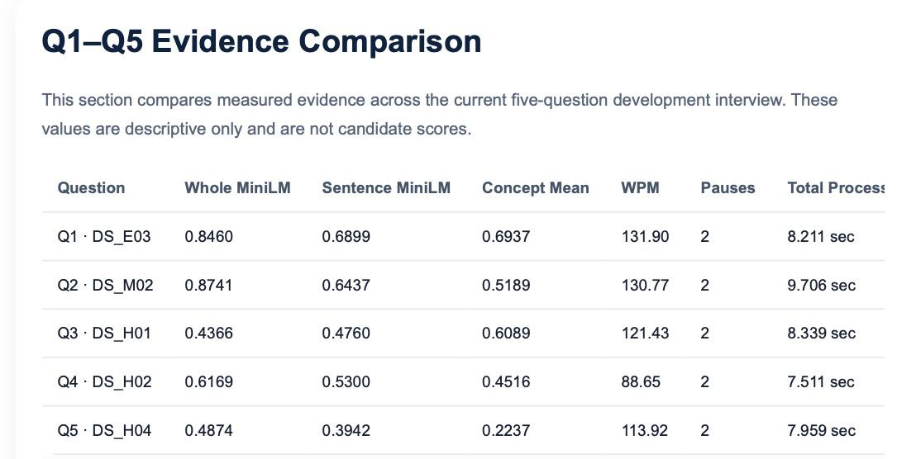
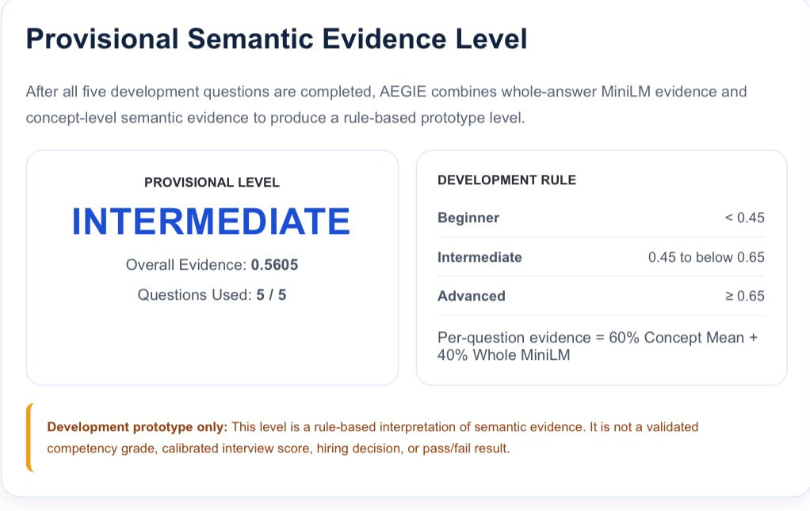

Slide 10
AEGIE : A Research Framework for Adaptive Agentic AI Based Voice Interview Evaluation
Conclusion
AEGIE successfully combines voice processing, semantic analysis, adaptive questioning, and feedback in one workflow.
NVIDIA Parakeet and MiniLM provide speech transcription and semantic evidence for each response.
The prototype can adapt question difficulty using the evidence generated from the current answer.
Future work will use real participant data and expert evaluation to improve calibration and validation.

Slide 11
AEGIE : A Research Framework for Adaptive Agentic AI Based Voice Interview Evaluation
Acknowledgement
I thank my project guide for continuous guidance and technical support.
I thank the faculty members of Rajalakshmi Engineering College for their suggestions.
I thank the industry mentor from L&T EduTech for valuable project inputs.
I also thank my department and institution for providing the required support and facilities.

Slide 12
AEGIE : A Research Framework for Adaptive Agentic AI Based Voice Interview Evaluation
Reference
Reimers and I. Gurevych, “Sentence-BERT: Sentence Embeddings Using Siamese BERT-Networks,” 2019.
W. Wang et al., “MiniLM: Deep Self-Attention Distillation for Task-Agnostic Compression of Pre-Trained Transformers,” 2020.
I. Naim et al., “Automated Analysis and Prediction of Job Interview Performance,” IEEE Trans. Affect. Comput., 2018.
H.-Y. Suen et al., “Intelligent Video Interview Agent Used to Predict Communication Skill and Perceived Personality Traits,” 2020.

