Slide 1
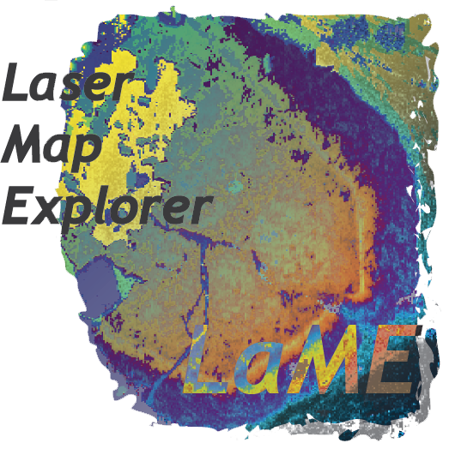
Laser Map Explorer (LaME)
Derrick Hasterok, Shavin Kaluthantri, Maggie Li, Stijn Glorie, Martin Hand, Alex De Vries Van Leeuwen

Slide 2
LaME
Analyze map-form geochemical data
Rapidly transform and classify data

Slide 3
Features
LA-ICP-MS data, XRF
Maps
Standard geochemical plots
Unsupervised machine learning (PCA, Clustering)
Profiling
Note taking (makes supplements a breeze)
Workflow design

Slide 4
New Features (XRF)

Slide 5
Workflow Design Tool

Slide 6
Web-based Documentation

