Slide 1
AGILE SOFTWARE DEVELOPMENT
Dhatchitha Prakash

Slide 2
01
INTRODUCTION
What is Agile?

Slide 3
What is Agile?
Agile Software Development is a flexible, iterative, and customer-centric approach to building software. It emphasizes collaboration, adaptability, and continuous improvement, enabling teams to respond quickly to changing requirements. Rooted in the Agile Manifesto, it values individuals and interactions, working software, customer collaboration, and responding to change over rigid processes.

Slide 4
02
WHY AGILE IS USED?

Slide 5
01
Delivers value early in the project.
02
Focuses on important work, avoiding waste.
03
Adapts quickly to changes.
04
Encourages teamwork across different roles.
05
Provides regular updates for transparency.

Slide 6
03
FOUR CORE VALUES OF AGILE

Slide 7
Individuals & Interactions over Processes & Tools.
Working Software over Comprehensive Documentation.
Customer Collaboration over Contract Negotiation.
Responding to Change over Following a Plan.

Slide 8
04
12 PRINCIPLES OF AGILE

Slide 9
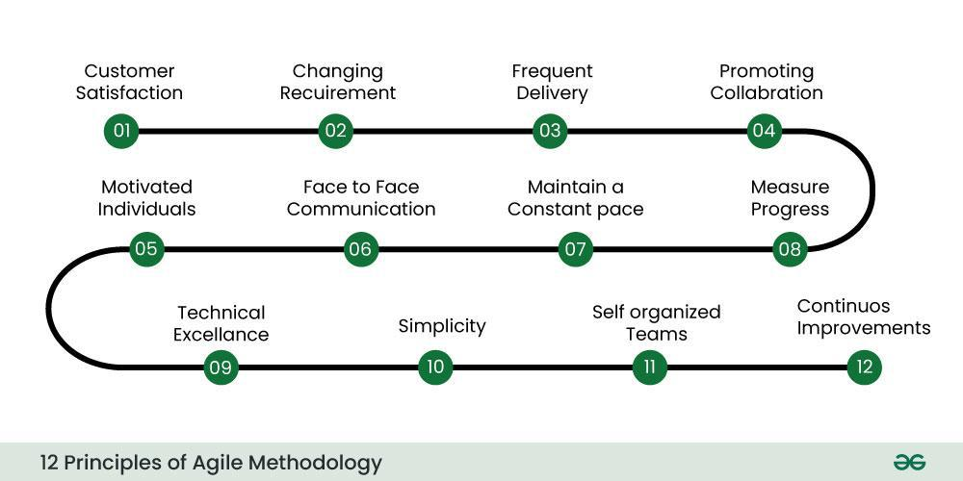
12 Principles of agile

Slide 10
05
AGILE SOFTWARE DEVELOPMENT PROCESS

Slide 11
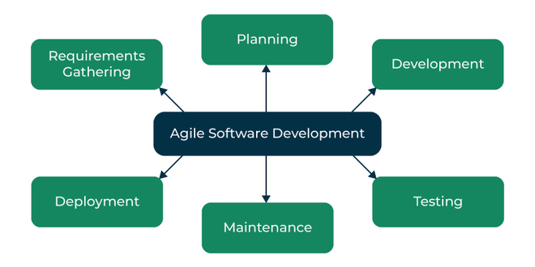

Slide 12
06
AGILE SOFTWARE DEVELOPMENT CYCLE

Slide 13
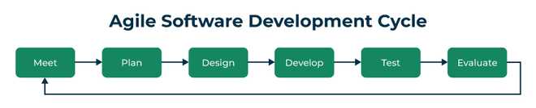
Concept – Identify project goals and feasibility.
Inception – Plan resources, team, and initial requirements.
Iteration/Construction – Develop and test the product in cycles.
Release – Final testing, deployment, and user training.
Production – Maintain and support the live system.
Retirement – Phase out and replace or upgrade the system.

Slide 14
07
ADVANTAGES OF AGILE

Slide 15
Advantages of Agile
Faster software deployment
Encourages collaboration & technical excellence
Better adaptability to change
Higher customer satisfaction
Immediate feedback & improvement

Slide 16
08
CONCLUSION

Slide 17
Conclusion
Agile methodology promotes flexibility, collaboration, and continuous improvement, making it ideal for fast-paced and evolving projects.
By focusing on iterative development, customer satisfaction, and adaptive planning, Agile ensures efficiency and high-quality outcomes in software
development.

Slide 18
Thank You!
Do you have any questions?

